Slide 1


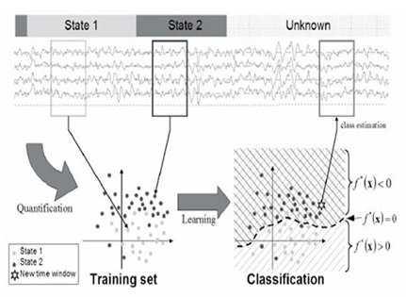
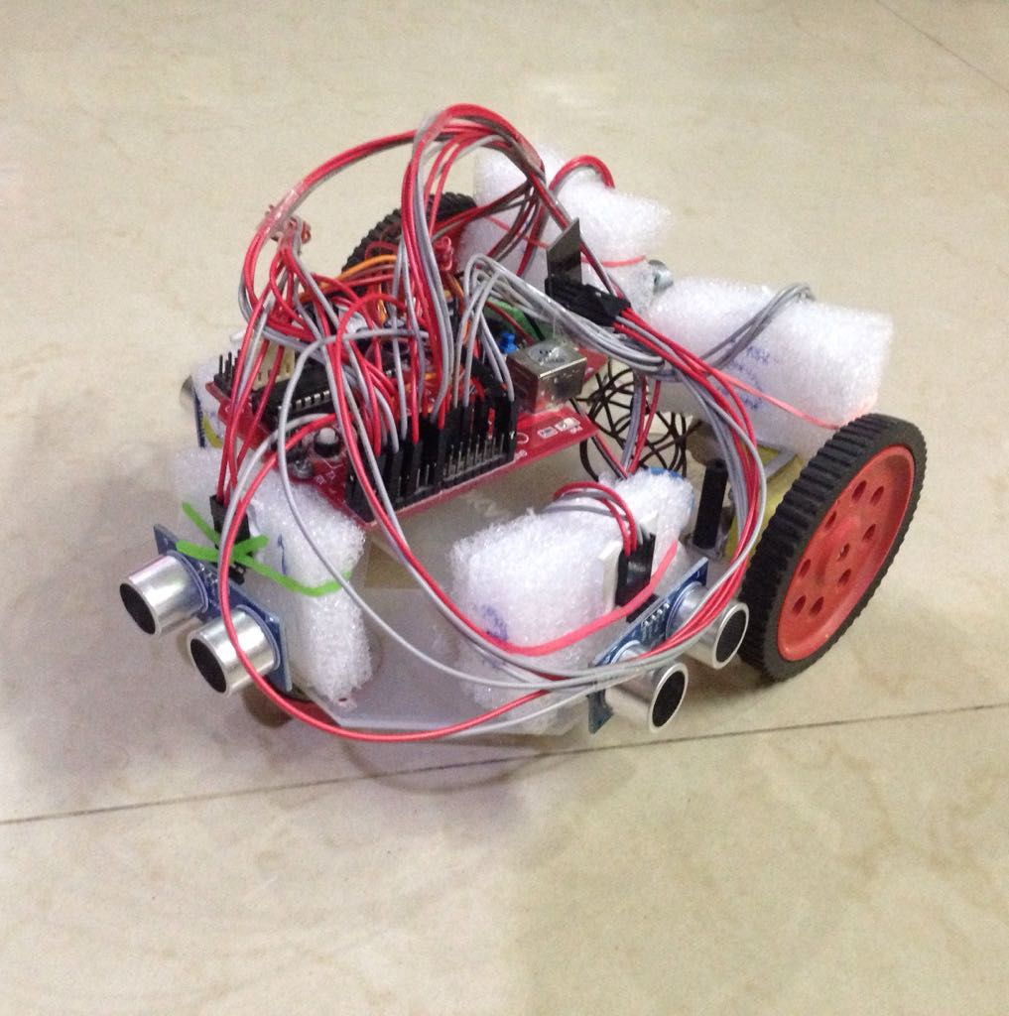
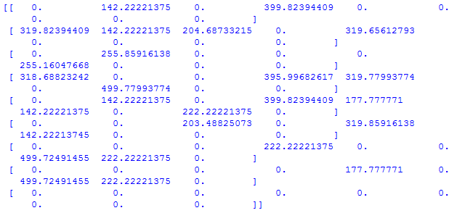
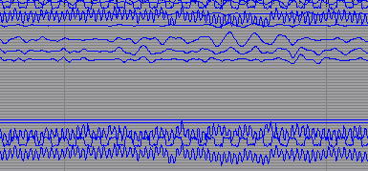
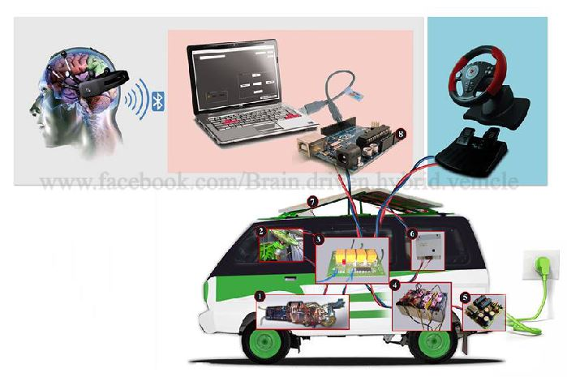
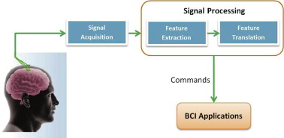
G H Patel College of Engineering & Technology
Brain Computer Interfaced Autonomous Driving
Introduction
Self-Driving Cars! No steering wheel, no manual control, no troubles. Just like a human, these autonomous cars uses sensor obtained data to understand the situations around them, and a brain that receives, processes on information gathered from ultrasound or LIDAR.
Reinforcement learning algorithms have been applied in robotics to learn how to solve tasks based on reward signals obtained during task execution. In that, the basic mechanism involves providing a reward signal, reinforcement signal to the robot according to the actions performed.
But Wait. More than just that, Imagine what the outlook would be like if the human brain itself coordinates with that brain thing of the self-driving car.
With the inclusion of that, more than just being safe and reliable, for user acceptance, such vehicles will also provide a rich user experience. Here, learning using Brain Computer Interface (BCI) overpowers tedious and error-prone manual tuning of human dependent parameters. Brain Computer Interface approach allows the user to just think about the desired style of driving, and the car will.
Results
The results focus directly on the classification between the positive and negative emotion from EEG signal. This is because this information is very valuable for a reinforcement learning task, since the rewards could be set according to the that.
We use Support Vector Machine for the classification of the EEG signal. The results for each participant (P1 and P2) are shown in tables I and II. Each column represents the real class, whereas each row show the actual classification percentages for each class.
Table I
Emotion Recognition Performance, P1
Table II
Emotion Recognition Performance, P2
We trained the car for every possible permutation of obstacles which could hinder the car in its way to reaching the destination using Q-learning. Trained data is uploaded to a local server which can easily be accessible by the Wi-Fi module – ESP8266 embedded on the Arduino based car.
As a result, the car will find the optimal path to the destination using the matrices generated as a result of training using Q-Leaning and can be controlled by the human brain, especially useful in the emergency situations.
 | Positive | Negative
Positive | 77.4% | 22.6%
Negative | 24.7% | 75.3%
 | Positive | Negative
Positive | 62.5% | 37.5%
Negative | 23.3% | 76.7%
Materials and methods
Q-learning, a model-free reinforcement learning technique. Specifically, to find an optimal policy in selecting an action for any given (finite) Markov decision process (MDP), Q-learning can be used. It works by learning an action-value function that ultimately gives the expected utility of taking a given action in a given state and following that favorable policy afterward.
Arduino Powered Car, autonomous vehicle with an assortment of electronic sensors and components like Wi-Fi module and Servo Motors, which pulls together the knowledge it had learned and synthesized from many sources along the way.
Non-invasive BCI are based on electroencephalogram (EEG) signals. Electrodes placed on the client’s head helps recording the EEG. This technology is not invasive and only records the electrical activity of the brain without getting along with it. This is to be used to override the decisions made by the Q-learning.
Conclusions and Future work
We have used Q-learning for the training of car and stored the live feedback of particular action to improve the performance.
‘Think and Drive’ mode where emotions like ‘excited’, ‘normal’, ‘fear’, ‘sadness’ are captured using the EEG headset, and forwarded through a computer to the vehicle’s steering mechanism.
In conclusion, there are many strong socio-economic motivators for the adoption of autonomous vehicles. Human safety, infrastructure efficiency, quality of life and a ready customer base are just a few of the key factors that will help make self-driving cars a reality.
There are plenty of opportunities for future work.
First, we need to better characterize the components of the brain activity associated to the proposed protocol.
Despite we have thought of presenting a proof-of-concept experiment with two participants, a component characterization will require to conduct further experiments with a larger number of participants to verify the classification of the recorded brain activity.
Second, the results suggest that it is possible to obtain information about the correct execution of the task that goes beyond simple error vs. non error classification. This information would be extremely useful to perform reinforcement learning in more realistic and complex robot scenarios.
Flow Chart
References
Iturrate, L. Montesano and J. Minguez, “Robot Reinforcement Learning using EEG-based reward signals”, 2010
Volodymyr Mnih, Koray Kavukcuoglu, David Silver, Alex Graves, Ioannis Antonoglou, Daan Wierstra and Martin Riedmiller, “Playing Atari with Deep Reinforcement Learning”, 2013
Volodymyr Mnih, Koray Kavukcuoglu, David Silver, Alex Graves, Adrià Puigdomènech Badia, Mehdi Mirza, Tim Harley and Timothy P. Lillicrap, “Asynchronous Methods for Deep Reinforcement Learning”, 2016
Shrinand Thakkar Virali Thakkar Prof. Hetal Gaudani (130110107059) (130110107060) (Project Guide)
Computer Engineering Department

