Slide 1
Brain Computer Interfaced Autonomous Driving

Slide 2
Contents
Idea
Basic Flowchart
Q-Learning
EEG Signal Classification
Conclusion
Future Work

Slide 3
Idea
Just like a human, autonomous cars uses sensor obtained data to understand the situations around them, and a brain that receives, processes on information gathered.
Each autonomous vehicle is outfitted with advanced tools to collect information, including long-range radar, LIDAR, cameras, short/medium-range radar, and ultrasound.

Slide 4
Idea
Imagine what the outlook would be like if the human brain itself accompanies that brain thing of the self-driving car.
Driving choices range from highly accelerated sporty driving to average paced comfortable one. Alongside this, a large number of parameters such as distances to other cars, speed during lane changes, characterize the style of a human driver.

Slide 5
Idea
Here, learning using Brain Computer Interface (BCI) overpowers tedious and error-prone manual tuning of these human dependent parameters.
Brain Computer Interface approach allows the user to just think about the desired style of driving, and the car will.

Slide 6
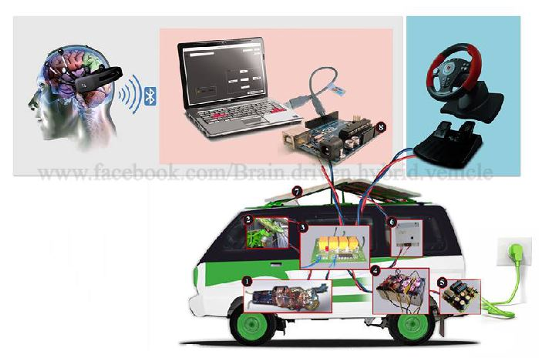
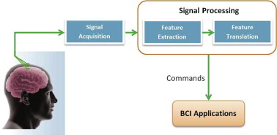
Basic Flowchart

Slide 7
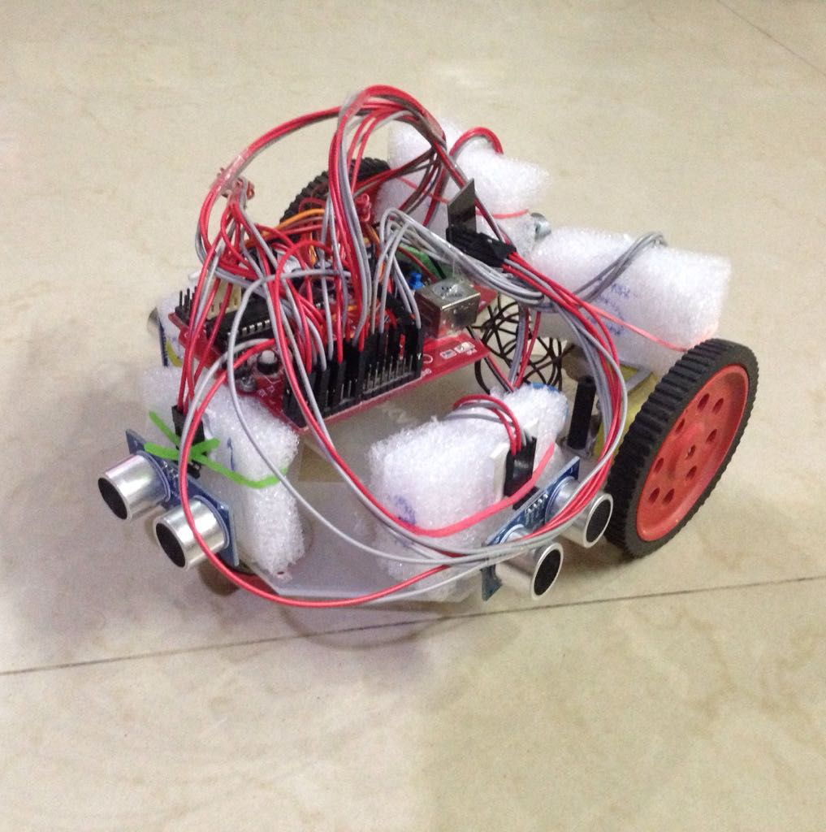
Arduino Powered Car
It will work as an autonomous vehicle with an assortment of electronic sensors (HC-SR04) and components like Wi-Fi module (ESP8266) and Servo Motors, which pulls together the knowledge it had learned and synthesized from many sources along the way.

Slide 8
The Q-learning Algorithm
Q-learning is basically a model-free reinforcement learning technique.
It works by learning an action-value function that ultimately gives the expected utility of taking a given action in a given state and following that favourable policy afterward.

Slide 9
The Q-learning Algorithm
Initial reward array
rewards[] = { 0.0018, 0.0017, 0.0019, 0.0011, 0.0013, 0.0012};
Distance Vector
arr_x[7] = {fr_s, fm_s, fl_s, 1, 0, 0};
To predict reward
total+= (arr_x[i] * rewards[i]);

Slide 10
float Receive_Reward(float fr, float fl, float fm, boolean wentForward){
if(fr < 12.0 && fl < 12.0 && fm < 12.0){
reward = reward - 3.0;
}else if(fr < 6.0 || fl < 6.0 || fm < 6.0){
reward = reward - 2.0;
}
if(wentForward){
reward = reward + 1.0;
}
else{
reward = reward + 0.65;
}
return reward;
}

Slide 11
Actual Q Step
void Update_rewards(float y_actual, float y_pred, float arr_x[])
{
for(int i = 0; i < N; i++){
float pDelta = (y_pred - y_actual) * arr_x[i];
weights[i] = weights[i] - (learn_rate * pDelta);
}
}

Slide 12
The Q-learning Algorithm
We first trained the car for few possible permutation of obstacles which could hinder the car in its way to reach the destination using Q-learning.
Trained data is uploaded on a local server which is easily accessible by the Wi-Fi module embedded on the Arduino based car.

Slide 13
EEG Signal Classification

Slide 14
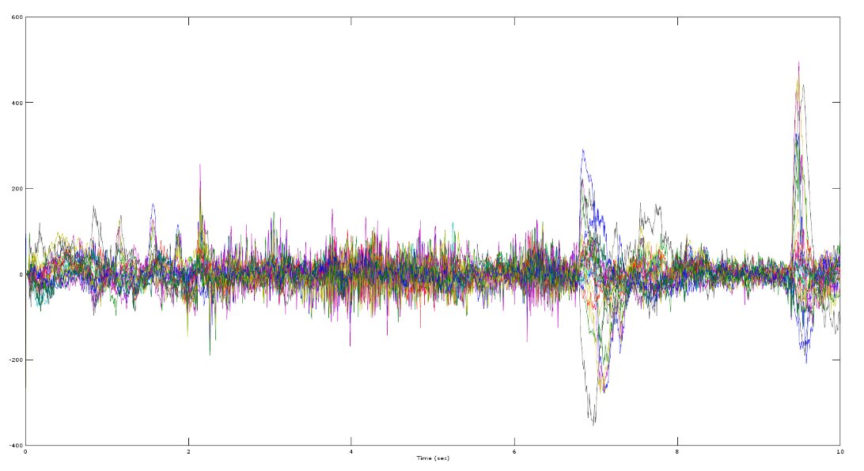
Electroencephalography (EEG)
Measure spatial distribution of voltage fields and variation over time.
EEG measures voltage fluctuations resulting from ionic current within the neurons of the brain.
Using electrodes it’s possible to measure our brain electrical activities.

Slide 15
DEAP Dataset
The electroencephalogram (EEG) and peripheral physiological signals of 32 participants were recorded as each watched 40 one-minute long excerpts of music videos.
Participants rated each video in terms of the levels of arousal, valence, like/dislike, dominance and familiarity.

Slide 16
Preprocessing
The data was downsampled to 128Hz.
EOG artefacts were removed.
A bandpass frequency filter from 8.0-30.0Hz was applied.
The data was averaged to the common reference.
The data was segmented into 60 second trials and a 3 second pre-trial baseline removed.

Slide 17
Feature Extraction
The maximum value
The minimum value.
The difference of the mean value of the baseline from the mean value of the raw signal (filtered signal).

Slide 18
Feature Extraction
Standard deviation.
The mean of the absolute values of the first difference of the signal.
The mean of the absolute values of the second difference of the signal.

Slide 19
Formatting
The numerical values we got from the calculations are formatted in Attribute Related File- Format (ARFF) which is the acceptable file format for the input in WEKA.
The value we input in file makes the Instances of ARFF with the class values declared at the end of each instance.

Slide 20
Classification
The classification was carried out with the use of support vector machine as the selected technique when 2 emotional states were used to classification.
Classification result of 74% when the binary emotional states were used for the classification.

Slide 21
Conclusion
We have used Q-Learning for the training of car and stored the live feedback of particular action to improve the performance.
‘Think and Drive’ mode where emotions like ‘excited’, ‘normal’, ‘fear’, ‘sadness’ could be captured using the EEG headset, and forwarded through a computer to the vehicle’s steering mechanism.

Slide 22
Conclusion
In conclusion, there are many strong socio-economic motivators for the adoption of autonomous vehicles.
Human safety, infrastructure efficiency, quality of life and a ready customer base are just a few of the key factors that will help make these kind of self-driving cars a reality.

Slide 23
Future Work
We need to better characterize the components of the brain activity associated to the proposed protocol.
Despite we have thought of a experimenting it with two participants, a component characterization will require to conduct further experiments with a larger number of participants to verify the classification of the recorded brain activity.

Slide 24
Thank You

