Slide 1
ZDC autoresearch, Phase 5: Λ → nπ⁰ on MSF events
Find more Λ → nπ⁰ in EICrecon on meson-structure events without a dirtier Λ sample
Started 2026-11-08 · one slide per try · rebuilt from the run's result files

Slide 2
Phase 5 tries — Λ found on the search halves, step by step
try | change | 9x275 | 9x130 | score | purity | z | verdict
Y1 | B0 ECal clusters split at local maxima | 943 → 944 | 66 → 71 | 1009 → 1015 | 19.8 → 19.0 % | +1.2 | INCONCLUSIVE
Y2 | the Λ vertex with each daughter's lever arm | 943 → 953 | 66 → 83 | 1009 → 1036 | 19.8 → 20.4 % | +4.2 | ACCEPTED
Y4 | B0 splitting retried on top of Y2 | 953 → 975 | 83 → 123 | 1036 → 1098 | 20.4 → 20.0 % | +7.0 | ACCEPTED
Y5 | the ZDC pairing with a photon in B0 | 975 → 1164 | 123 → 147 | 1098 → 1311 | 20.0 → 23.8 % | +13.3 | ACCEPTED
Y6 | sharper energy sharing between split B0 clusters | 1164 → 1209 | 147 → 182 | 1311 → 1391 | 23.8 → 24.7 % | +8.1 | ACCEPTED
Y7 | the B0 photon energy law fitted on a B0 photon gun | 1209 → 1238 | 182 → 190 | 1391 → 1428 | 24.7 → 25.1 % | +3.7 | ACCEPTED
Y8 | B0 split sharing narrowed again, 0.5 → 0.3 crystal | 1238 → 1252 | 190 → 194 | 1428 → 1446 | 25.1 → 25.3 % | +3.4 | ACCEPTED
Y9 | the ZDC pairing with both photons in B0 | 1252 → 1267 | 194 → 219 | 1446 → 1486 | 25.3 → 26.7 % | +5.2 | ACCEPTED
Y10 | the Λ-mass term of the final choice, 112 → 40 MeV | 1267 → 1267 | 219 → 219 | 1486 → 1486 | 26.7 → 26.7 % | +0.0 | REJECTED (no effect)
Score 1009 → 1486 (+47 %), purity 19.8 → 26.7 %; each row is paired against the best of its time.
2

Slide 3
Phase 5 tries in Phase 4's columns — S4a_tm per thrown Λ → nπ⁰ on the D4 gun
S4a_tm per thrown Λ → nπ⁰ | mean 100–275 GeV | at 275 GeV | MSF found, 9x275 / 9x130 | verdict
R1 (PR 3064), start of Phase 4 | 0.404 % | 0.832 % | —
X9, end of Phase 4 = start of Phase 5 | 7.436 % | 14.101 % | 943 / 66
Y1: B0 ECal clusters split at local maxima | 7.436 % | 14.101 % | 944 / 71 | INCONCLUSIVE
Y2: the Λ vertex with each daughter's lever arm | 7.439 % | 14.117 % | 953 / 83 | ACCEPTED
Y4: B0 splitting retried on top of Y2 | 7.439 % | 14.117 % | 975 / 123 | ACCEPTED
Y5: the ZDC pairing with a photon in B0 | 7.439 % | 14.117 % | 1164 / 147 | ACCEPTED
Y6: sharper energy sharing between split B0 clusters | 7.439 % | 14.117 % | 1209 / 182 | ACCEPTED
Y7: the B0 photon energy law fitted on a B0 photon gun | 7.439 % | 14.117 % | 1238 / 190 | ACCEPTED
Y8: B0 split sharing narrowed again, 0.5 → 0.3 crystal | 7.439 % | 14.117 % | 1252 / 194 | ACCEPTED
Y9: the ZDC pairing with both photons in B0 | 7.439 % | 14.117 % | 1267 / 219 | ACCEPTED
Y10: the Λ-mass term of the final choice, 112 → 40 MeV | 7.439 % | 14.117 % | 1267 / 219 | REJECTED (no effect)
ceiling (perfect separation, P1b resolution) | 14.1 % | 27.8 % | reachable 43.6 % / 8.0 % of expected
3
Notes:
D4 columns from headline.csv (441): CP5_1_Y6_D4, CP5_2_Y9_D4 at the checkpoints, D4P5_<try> for the other tries (Phase 4's slim template, reconstructed at the Phase 5 close). MSF columns: the try's N_found on the search halves (463). Phase 5 selected on MSF; D4 was reported, never selected on.

Slide 4
Phase 5 score — yield and purity per beam energy
N_expected = 0.358 × generated Λ (one Λ per event)
N_found = events whose true Λ → n pi0 is rebuilt:
candidate within ±30 MeV of m_Λ, and
n, γ, γ clusters ≥ 80 % from the true
neutron and the two true photons
N_window = events with any candidate in the window
yield = N_found / N_expected
purity = N_found / N_window
X9 on D6c (40 000 events per beam) | 9x275 | 9x130
N_found / N_expected | 1840 / 14320 | 129 / 14320
yield | 12.85 ± 0.28 % | 0.90 ± 0.08 %
reachable (n in ZDC, both γ read) | 43.6 % | 8.0 %
N_found / N_window | 1840 / 8749 | 129 / 1408
purity | 21.03 ± 0.44 % | 9.16 ± 0.77 %
Selector (463): keep a change when
• the score N_found(9x275) + N_found(9x130) on the search halves D6s rises: on identical Λ, b found only by the current best, c only by the change, z = (c − b) / √(b + c) ≥ 3
• and the pooled purity does not fall by more than 2σ: z_P = (P_new − P_best) / √(σ_new² + σ_best²) ≥ −2
• D6h (files 41–80) is held out: every 5 tries the current best must reproduce its gain there at > 2σ
• fair play F1–F3 of Phase 4 (460) on the MSF outputs; a FAIL voids the try
Yield is pushed up; purity is a floor. A change that only cleans the sample is reported, not kept.
4

Slide 5
Where Λ → nπ⁰ land and what X9 finds in each regime
regime (share of N_expected; X9 found in it) | 9x275 | 9x130
all three in the ZDC | 27.9 %; 1472 found (36.8 %) | 1.3 %; 62 found (34.3 %)
n ZDC, γ B0 + γ ZDC | 11.0 %; 366 found (23.3 %) | 2.1 %; 66 found (22.0 %)
n ZDC, γ γ in B0 | 4.0 %; 1 found (0.2 %) | 3.5 %; 1 found (0.2 %)
n ZDC, a γ in EEMC-P / LFHCAL | 0.7 %; 0 found (0.0 %) | 1.2 %; 0 found (0.0 %)
n ZDC, a γ lost | 25.6 %; 0 found (0.0 %) | 10.1 %; 0 found (0.0 %)
n in B0 | 6.6 %; 1 found (0.1 %) | 30.0 %; 0 found (0.0 %)
n lost or elsewhere | 1.1 %; 0 found (0.0 %) | 23.3 %; 0 found (0.0 %)
Λ interacts in material / does not decay | 17.2 % / 6.4 % | 27.2 % / 0.2 %
At 9x275 the software can still win in the first four rows; at 9x130 the neutron misses the ZDC for 53 %.
5

Slide 6
Y1 — B0 ECal clusters split at local maxima
Change
search half | best | this try
9x275 N_found | 943 | 944
9x275 purity | 21.5 % | 20.6 %
9x130 N_found | 66 | 71
9x130 purity | 9.4 % | 9.5 %
• B0 island clustering keeps one cluster per island today (splitCluster false)
• with both photons in B0 (4.0 % of expected at 9x275) the pair is merged for 93 % of the Λ
• split at every hit above 30 MeV that exceeds its 8 neighbours
• shared hits weighted by exp(−d / 1 crystal) × peak energy (stock: η-φ distance, scale 1)
• three parameters on the X9 install; no code change
Prediction (written before launch)
paired: b 9, c 15, z +1.22; purity z_P -1.01
• N_found on the search halves: 9x275 ≈ 920 → 960, 9x130 ≈ 65 → 95; purity flat or down < 1 point
INCONCLUSIVE
fair play PASS
6
Notes:
Row Y1_b0_split against MSF5_X9; selector space/perf/msf-select-Y1_b0_split-vs-MSF5_X9-D6s.json (463); fair play space/perf/fair-play-Y1_b0_split-msf.json (460).

Slide 7
Y2 — the Λ vertex with each daughter's lever arm
Change
search half | best | this try
9x275 N_found | 943 | 953
9x275 purity | 21.5 % | 21.7 %
9x130 N_found | 66 | 83
9x130 purity | 9.4 % | 11.9 %
• the Λ line through the IP had slope Σ pᵢxᵢ / Σ pᵢzᵢ: right when n, γ, γ hit one depth
• a B0 photon (z ≈ 7 m) beside ZDC daughters (z ≈ 35 m) was weighted down by ~7/35
• now, for a vertex at depth z: s⊥ = Σ wᵢxᵢ⊥ / (P + z Σ wᵢ), wᵢ = pᵢ / (zᵢ − z), at every bisection step
• the depth search ends short of the nearest impact point (it ran on to the ZDC)
• 33 lines in LambdaReconstruction.cc; all-ZDC events keep the stock result
Prediction (written before launch)
paired: b 7, c 34, z +4.22; purity z_P +0.71
• 9x275 920 → ~990, 9x130 ~65 → ~80; all-ZDC unchanged within ±10; purity up slightly
ACCEPTED
fair play PASS
7
Notes:
Row Y2_vertex_lever_arm against MSF5_X9; selector space/perf/msf-select-Y2_vertex_lever_arm-vs-MSF5_X9-D6s.json (463); fair play space/perf/fair-play-Y2_vertex_lever_arm-msf.json (460).

Slide 8
Y4 — B0 splitting retried on top of Y2
Change
search half | best | this try
9x275 N_found | 953 | 975
9x275 purity | 21.7 % | 20.8 %
9x130 N_found | 83 | 123
9x130 purity | 11.9 % | 15.3 %
• Y1 resolved both B0 photons for ~50 more Λ (9x275) and ~65 (9x130), but their mass failed
• Y2 made the γγ-in-B0 regime count: 0 → 5 found at 9x275, 1 → 15 at 9x130
• Y1's three B0 island parameters on the Y2 install
Prediction (written before launch)
• γγ in B0 found 5 → ~20 and 15 → ~35; N_found 953 → ~968, 83 → ~103; purity flat
paired: b 8, c 70, z +7.02; purity z_P -0.50
ACCEPTED
fair play PASS
8
Notes:
Row Y4_b0_split_on_y2 against Y2_vertex_lever_arm; selector space/perf/msf-select-Y4_b0_split_on_y2-vs-Y2_vertex_lever_arm-D6s.json (463); fair play space/perf/fair-play-Y4_b0_split_on_y2-msf.json (460).

Slide 9
Y5 — the ZDC pairing with a photon in B0
Change
search half | best | this try
9x275 N_found | 975 | 1164
9x275 purity | 20.8 % | 24.6 %
9x130 N_found | 123 | 147
9x130 purity | 15.3 % | 19.1 %
• the ZDC pairing assumed both photons in the ZDC: with one photon in B0 it still wrote two ZDC photons
• now each tagged ZDC cluster with each B0 photon candidate is a hypothesis too (Y2's vertex)
• a winning mixed hypothesis writes one ZDC photon; the rest of the ZDC is the neutron
• LambdaReconstruction pairs that photon with the B0 photon
• switch lambdaPairingMixed, off by default; off reproduces Y4 exactly
Prediction (written before launch)
paired: b 22, c 235, z +13.29; purity z_P +4.84
• emulated mixed regime 195 → 383 (9x275), 32 → 55 (9x130); N_found 975 → ~1150, 123 → ~145; purity up
ACCEPTED
fair play PASS
9
Notes:
Row Y5_mixed_pairing against Y4_b0_split_on_y2; selector space/perf/msf-select-Y5_mixed_pairing-vs-Y4_b0_split_on_y2-D6s.json (463); fair play space/perf/fair-play-Y5_mixed_pairing-msf.json (460).

Slide 10
Y5 and Y9 — photon hypotheses in the ZDC pairing
ZDC pair (X2–X9)
γ, γ = two tagged ZDC clusters
n = every other ZDC cluster
ZDC Hcal clusters
tagged by depth, length, width
lowest score
π⁰ and Λ masses,
decay depth, photon depth
Λ reconstruction
ZDC and B0 photons,
one candidate per event
ZDC + B0 (Y5)
γ = one tagged ZDC cluster, γ = a B0 photon
n = every other ZDC cluster
vertex with each lever arm (Y2)
B0 ECal clusters
≤ 4 leading, ≥ 1 GeV
B0 + B0 (Y9)
γ, γ = two B0 photons; n = the whole ZDC
Why
• with one photon in B0 the old pairing still wrote two ZDC photons: the true one with a neutron fragment, or two fragments
• their energy left the neutron, and the true triplet could not form: another triplet chosen (186) or the ZDC photon missing (144) of 803
• emulation: Y5 383 instead of 195 in γ B0 + γ ZDC (474); Y9 +49 net with both photons in B0 (475)
10
Notes:
Y5 patch space/notes/patches/Y5_mixed_pairing.patch; emulation scripts/473 and 474; switch lambdaPairingMixed.

Slide 11
Y6 — sharper energy sharing between split B0 clusters
Change
search half | best | this try
9x275 N_found | 1164 | 1209
9x275 purity | 24.6 % | 25.0 %
9x130 N_found | 147 | 182
9x130 purity | 19.1 % | 23.5 %
• with both photons in B0, Y5 still misses a photon for 198 of 264 Λ (9x275) and 151 of 264 (9x130)
• the photon's best B0 cluster is shared below purity 0.8 (~50 %) or merged with the other photon (~45 %)
• split hits are shared by exp(−d / s) × peak energy; s = 1.0 → 0.5 crystal
• one parameter on the Y5 install
Prediction (written before launch)
paired: b 9, c 89, z +8.08; purity z_P +1.17
• γγ-in-B0 found 33 → ~50 (9x275), 57 → ~80 (9x130); N_found 1164 → ~1180, 147 → ~170; purity flat
ACCEPTED
fair play PASS
11
Notes:
Row Y6_b0_profile against Y5_mixed_pairing; selector space/perf/msf-select-Y6_b0_profile-vs-Y5_mixed_pairing-D6s.json (463); fair play space/perf/fair-play-Y6_b0_profile-msf.json (460).

Slide 12
Y7 — the B0 photon energy law fitted on a B0 photon gun
Change
search half | best | this try
9x275 N_found | 1209 | 1238
9x275 purity | 25.0 % | 25.2 %
9x130 N_found | 182 | 190
9x130 purity | 23.5 % | 23.9 %
• stock law 0.99·E^1.14 reads gun photons 11–48 % high at 5–40 GeV
• refit on D2b_photon_B0 (2–40 GeV, 7–20 mrad) with Y6's B0 clustering: 1.0888·E^1.0058
• every gun energy within 0.2 % of true; one parameter on Y6
Prediction (written before launch)
• γγ in B0 up, γ B0 + γ ZDC down (the stock overestimate cancelled the ZDC photon's 0.78); net small, sign uncertain
paired: b 31, c 68, z +3.72; purity z_P +0.38
ACCEPTED
fair play PASS
12
Notes:
Row Y7_b0_photon_law against Y6_b0_profile; selector space/perf/msf-select-Y7_b0_photon_law-vs-Y6_b0_profile-D6s.json (463); fair play space/perf/fair-play-Y7_b0_photon_law-msf.json (460).

Slide 13
Y8 — B0 split sharing narrowed again, 0.5 → 0.3 crystal
Change
search half | best | this try
9x275 N_found | 1238 | 1252
9x275 purity | 25.2 % | 25.4 %
9x130 N_found | 190 | 194
9x130 purity | 23.9 % | 24.3 %
• Y6 (1.0 → 0.5 crystal) gained +80, z +8.1
• both photons in B0 is still the regime with the most B0 losses: 87 and 97 of 264 found
• one parameter on Y7
Prediction (written before launch)
• N_found 1238 → ~1250, 190 → ~200; the gain may stop or turn (tail energy to the wrong maximum)
paired: b 5, c 23, z +3.40; purity z_P +0.28
ACCEPTED
fair play PASS
13
Notes:
Row Y8_b0_profile_03 against Y7_b0_photon_law; selector space/perf/msf-select-Y8_b0_profile_03-vs-Y7_b0_photon_law-D6s.json (463); fair play space/perf/fair-play-Y8_b0_profile_03-msf.json (460).

Slide 14
Y9 — the ZDC pairing with both photons in B0
Change
search half | best | this try
9x275 N_found | 1252 | 1267
9x275 purity | 25.4 % | 26.4 %
9x130 N_found | 194 | 219
9x130 purity | 24.3 % | 28.7 %
• with both photons in B0 another triplet wins for 46 (9x275) and 53 (9x130) of 264 Λ
• Y5's pairing still writes ZDC fragments as photons there and takes their energy from the neutron
• third hypothesis: every pair of B0 photon candidates, the whole ZDC as the neutron
• if it wins, no ZDC photon is written; switch lambdaPairingExternalPair, off reproduces Y8
Prediction (written before launch)
• emulated net +21 / +28 in γγ-in-B0, −4 / −3 in γ B0 + γ ZDC; N_found 1252 → ~1268, 194 → ~219
paired: b 10, c 50, z +5.16; purity z_P +1.76
ACCEPTED
fair play PASS
14
Notes:
Row Y9_external_pair against Y8_b0_profile_03; selector space/perf/msf-select-Y9_external_pair-vs-Y8_b0_profile_03-D6s.json (463); fair play space/perf/fair-play-Y9_external_pair-msf.json (460).

Slide 15
Y10 — the Λ-mass term of the final choice, 112 → 40 MeV
Change
search half | best | this try
9x275 N_found | 1267 | 1267
9x275 purity | 26.4 % | 26.4 %
9x130 N_found | 219 | 219
9x130 purity | 28.7 % | 28.6 %
• LambdaReconstruction ranks triplets across ZDC, B0 and EEMC-P by π⁰ and Λ mass χ²
• its Λ term had the width 0.1 m_Λ = 112 MeV; now 40 MeV, as the ZDC pairing
• after Y5 and Y9 another triplet wins for only 22 Λ on both search halves
Prediction (written before launch)
• N_found 1267 → ~1272, 219 → ~222; N_window up, purity down < 1 point
paired: b 0, c 0, z +0.00; purity z_P -0.02
REJECTED
fair play PASS
15
Notes:
Row Y10_lambda_mass_rank against Y9_external_pair; selector space/perf/msf-select-Y10_lambda_mass_rank-vs-Y9_external_pair-D6s.json (463); fair play space/perf/fair-play-Y10_lambda_mass_rank-msf.json (460).

Slide 16
Checkpoint 1 — held-out MSF files and the D4 gun, X9 → Y6
N_found (yield) | X9, search | Y6, search | X9, held out | Y6, held out | reachable
9x275 | 943 (13.17 %) | 1209 (16.89 %) | 897 (12.53 %) | 1151 (16.08 %) | 43.6 %
9x130 | 66 (0.92 %) | 182 (2.54 %) | 63 (0.88 %) | 165 (2.30 %) | 8.0 %
purity, held out (pooled) |  |  | 19.0 % | 23.8 %
held out: REPRODUCES
b 30, c 386, z +17.45; purity z_P +6.06
D4 Λ gun, S4a_tm per thrown Λ → nπ⁰ (reported, never selected on)
• X9 (end of Phase 4): 7.44 % mean, 14.10 % at 275 GeV; Y6: 7.44 % mean, 14.12 % at 275 GeV (ceilings 14.1 % / 27.8 %)
The search halves gained 38 %, the held-out halves 37 %: the accepted steps are no overfit.
16

Slide 17
Checkpoint 2 — held-out MSF files and the D4 gun, Y6 → Y9
N_found (yield) | Y6, search | Y9, search | Y6, held out | Y9, held out | reachable
9x275 | 1209 (16.89 %) | 1267 (17.70 %) | 1151 (16.08 %) | 1206 (16.84 %) | 43.6 %
9x130 | 182 (2.54 %) | 219 (3.06 %) | 165 (2.30 %) | 205 (2.86 %) | 8.0 %
purity, held out (pooled) |  |  | 23.8 % | 25.8 %
held out: REPRODUCES
b 28, c 123, z +7.73; purity z_P +2.48
D4 Λ gun, S4a_tm per thrown Λ → nπ⁰ (reported, never selected on)
• X9 (end of Phase 4): 7.44 % mean, 14.10 % at 275 GeV; Y9: 7.44 % mean, 14.12 % at 275 GeV (ceilings 14.1 % / 27.8 %)
Y7–Y9 measured again on files nothing was tuned on.
17

Slide 18
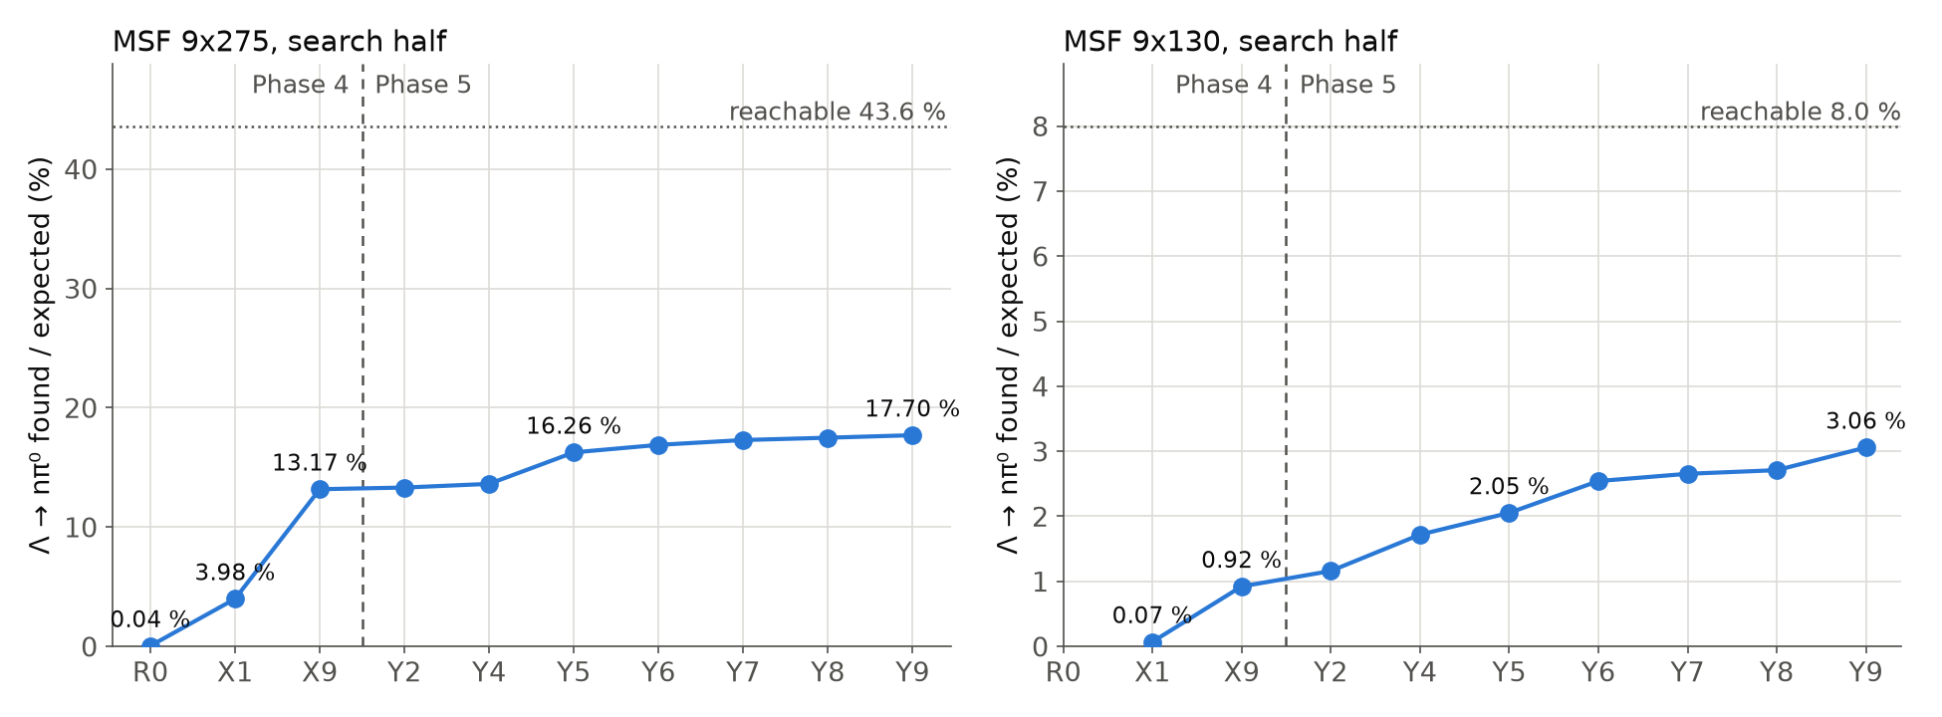
Phase 4 and Phase 5 on the MSF score — yield step by step
Λ → nπ⁰ found per expected on the MSF search halves (210). R0 the pin; X1, X9 Phase 4 rows (tuned on the D4 gun); Y2–Y9 the accepted Phase 5 tries (tuned on MSF). R0 was not run at 9x130.
Phase 4 took MSF 9x275 from 0.04 % to 13.2 % without seeing MSF; Phase 5 added 4.5 points there and tripled 9x130.
18

Slide 19
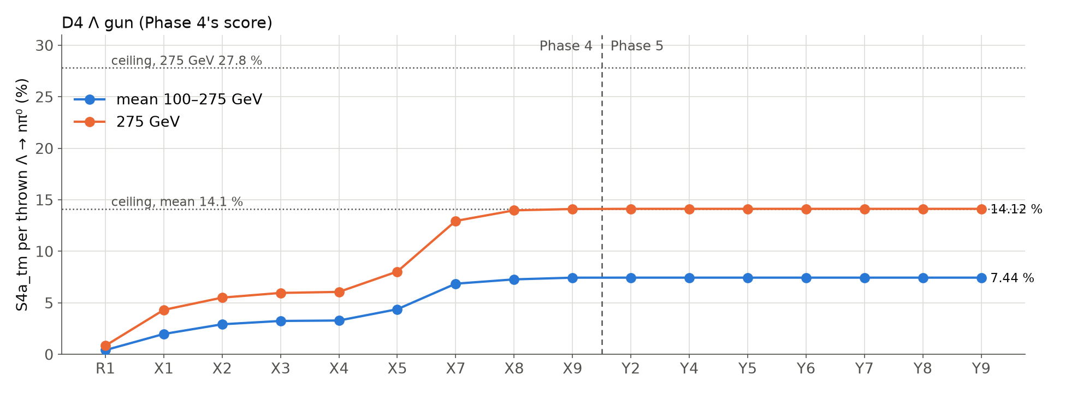
Phase 4 and Phase 5 on the D4 gun score — S4a_tm step by step
S4a_tm per thrown Λ → nπ⁰ on the D4 Λ gun (headline.csv): Phase 4 tries R1 → X9, then every accepted Phase 5 try (D4P5_*, CP5_1_Y6_D4, CP5_2_Y9_D4).
Phase 5 leaves the gun where Phase 4 left it: its gains are in B0 regimes the gun barely reaches.
19

Slide 20
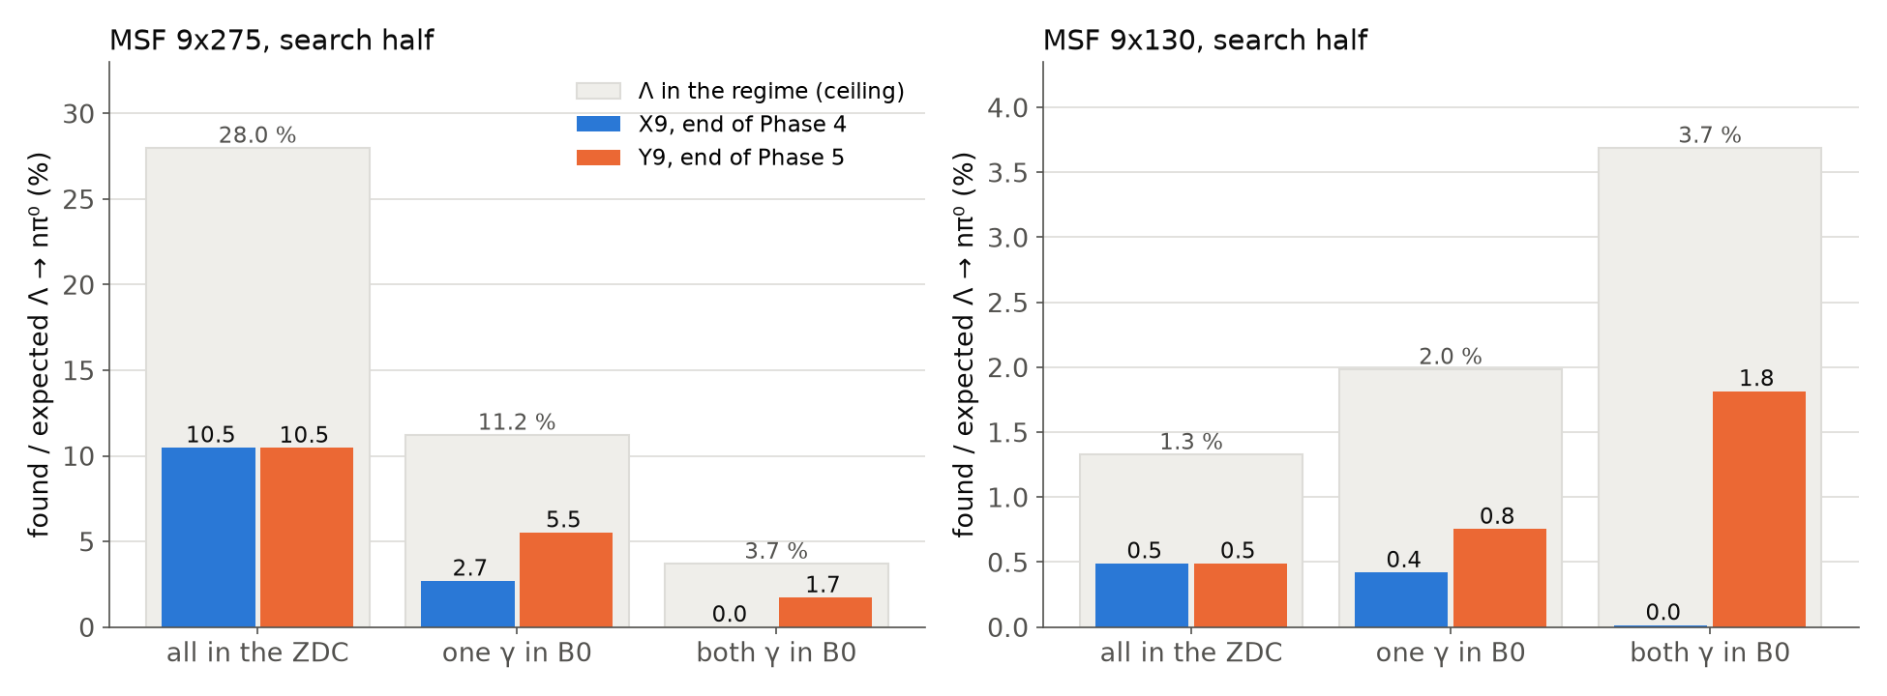
Phase 5's gain by regime — X9 and Y9 on MSF
Found per expected Λ → nπ⁰ in each regime (210 groups, search halves); grey: the regime's share of expected, the most any reconstruction could find there.
All-ZDC unchanged; one photon in B0 doubled; both photons in B0 from zero to 1.7 % (9x275) and 1.8 % (9x130).
20

Slide 21
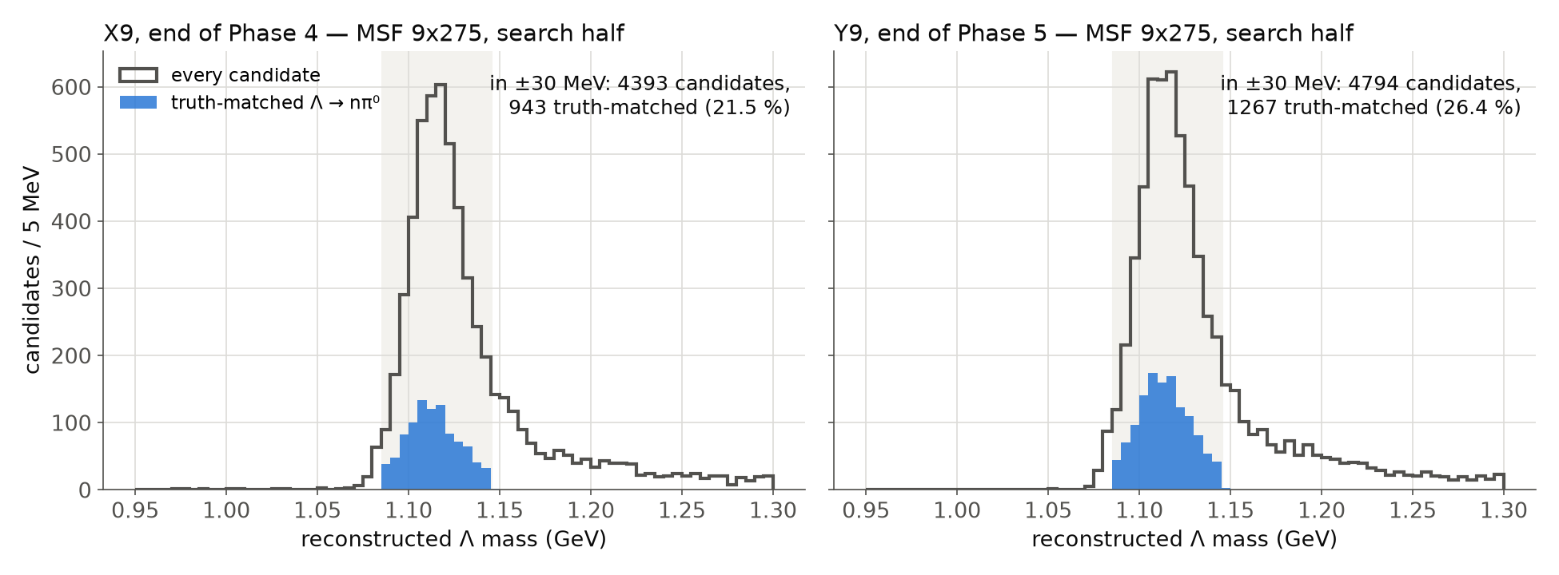
Λ mass on MSF 9x275 — every candidate and the truth-matched ones, X9 and Y9
ReconstructedLambdas mass, at most one candidate per event (F3a), MSF 9x275 search half; shaded: the ±30 MeV scoring window; blue: candidates 210 truth-matches to the true n, γ, γ.
The wrong candidates peak at m_Λ too (both pairings rank by Λ mass): purity needs other variables — a phase of its own.
21

Slide 22
Phase 4 and Phase 5 side by side
 | Phase 4 — the Λ bar fight | Phase 5 — Λ → nπ⁰ on MSF events
data it tuned on | D4 Λ gun (8 momenta × 2000) | MSF 2026-11 search halves (2 × 20 000 events)
score | S4a_tm per thrown Λ → nπ⁰ (D4) | N_found on MSF, purity as a floor
held out | D4h (fresh seeds) | D6h (MSF files 41–80)
tries | 9: 8 accepted, 1 rejected | 9: 7 accepted, 1 inconclusive, 1 rejected
D4 S4a_tm, mean / 275 GeV | 0.404 % / 0.832 % → 7.436 % / 14.101 % | X9 → Y9: 7.439 % / 14.117 % (reported, not selected on)
MSF 9x275 found / expected (search) | R0 0.04 % → X1 4.0 % → X9 13.2 % | X9 13.2 % → Y9 17.7 % (held out 12.5 % → 16.8 %)
MSF 9x130 found / expected (search) | X9 0.92 % | X9 0.92 % → Y9 3.06 % (held out 0.88 % → 2.86 %)
purity in the window, 9x275 / 9x130 | X9 21 % / 9 % | Y9 26 % / 29 %
what changed | ZDC clustering, photon tag, Λ pairing | vertex lever arm, pairing with B0 photons, B0 splitting and law
Next: Phase 6, the crystal-seeded ZDC photon finder (prepared, loop v6)
• the all-ZDC regime loses a photon for 1125 of 2003 Λ (9x275 half); a scope study decides first (stop below +50 emulated)
22

