Slide 1
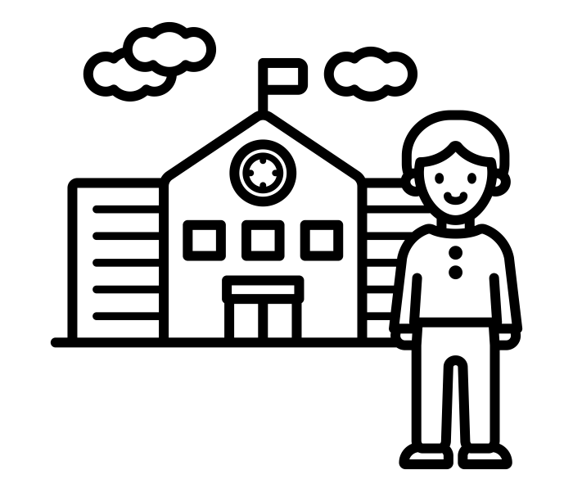
What If I Don’t Like Any of The Choices?
The Limits of Preference Elicitation for Participatory Algorithm Design
Samantha Robertson, Niloufar Salehi

Slide 2
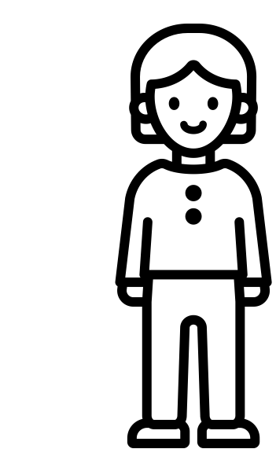
Needs
Values
Goals
1. Option A
2. Option B
3. Option C

Slide 3
Preferences ≠ Participation

Slide 4

An example...
Students
Preferences over schools
Matching
algorithm
Best possible assignments for students subject to school priorities
Priorities over students
In SFUSD: sibling, preK/TK, CTIP1, attendance area
Schools
Notes:
Background on student assignment and SFUSD in particular

Slide 5
An example...
Students
Preferences over schools
Matching
algorithm
Best possible assignments for students subject to school priorities
Priorities over students
In SFUSD: sibling, preK/TK, CTIP1, attendance area
Schools
Notes:
Background on student assignment and SFUSD in particular

Slide 6
An example...
Students
Preferences over schools
Matching
algorithm
Best possible assignments for students subject to school priorities
Priorities over students
In SFUSD: sibling, preK/TK, CTIP1, attendance area
Schools
Notes:
Background on student assignment and SFUSD in particular

Slide 7
An example...
Students
Preferences over schools
Matching
algorithm
Best possible assignments for students subject to school priorities
Priorities over students
In SFUSD: sibling, preK/TK, CTIP1, attendance area
Schools
Notes:
Background on student assignment and SFUSD in particular

Slide 8
An example...
Students
Preferences over schools
Matching
algorithm
Best possible assignments for students subject to school priorities
Priorities over students
In SFUSD: sibling, preK/TK, CTIP1, attendance area
Schools
Notes:
Background on student assignment and SFUSD in particular

Slide 9
Three assumptions
Preferences are inherent and fixed
Preferences fully encapsulate relevant values, needs, and goals
Some aggregation of these preferences is socially optimal

Slide 10
What do I prefer?
1. Preferences are inherent and fixed
1. School A
2. School B
3. School C
4. School D
5. ???
6.
7.
...

Slide 11
1. Preferences are inherent and fixed
Students
Inherent, fixed
Preferences over schools
Time consuming, situated
Matching
algorithm
Best possible assignments for students subject to school priorities
Priorities over students
In SFUSD: sibling, preK/TK, CTIP1, attendance area
Schools

Slide 12
What if I don’t like any of the choices?
2. Preferences fully encapsulate relevant values, needs, and goals
1. …?

Slide 13
2. Preferences fully encapsulate relevant values, needs, and goals
Students
“All choice”
Preferences over schools
Limited options, unequal access
Matching
algorithm
Best possible assignments for students subject to school priorities
Priorities over students
Added advantage to underserved students
What about alternatives to choice?
In SFUSD: sibling, preK/TK, CTIP1, attendance area
Schools
Cannot address access and participation barriers

Slide 14
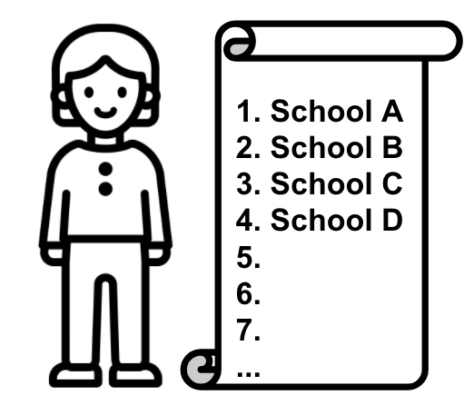
What do we prefer?
3. Some aggregation of these preferences is socially optimal

Slide 15
3. Some aggregation of these preferences is socially optimal
Students
Preferences over schools
Efficiency is optimal
Matching
algorithm
Best possible assignments for students subject to school priorities
Priorities over students
Outcomes constrained by preference patterns
In SFUSD: sibling, preK/TK, CTIP1, attendance area
Schools

Slide 16
Expanding participation beyond preferences
Alternative formats
What formats would work well?
More opportunities
When is participation appropriate?
Discourse and deliberation
How can we build accessible tools and infrastructure to involve stakeholders in the design and governance of algorithmic systems?

Slide 17
Takeaways
Preferences are an intuitive way to incorporate participation
Ask people what they want → Give as many people as possible what they want
But, the story is more complicated than that…
How do we ask people what they want? Who responds?
What are the alternatives they can choose from? Who benefits? What’s missing?
How do we decide who gets what they most want? How does that drive change?

Slide 18

Thank you!
samantha_robertson@berkeley.edu
@samanthaa_rr

