Slide 1

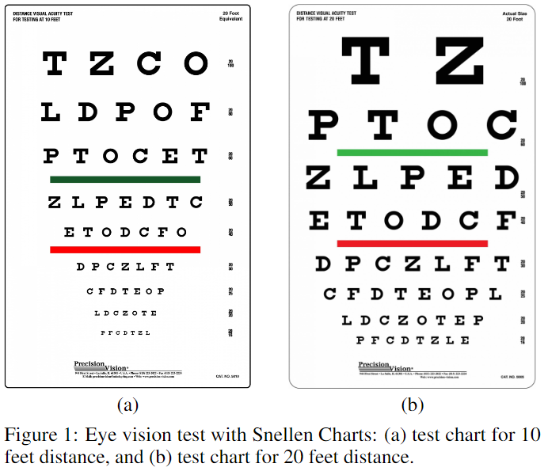
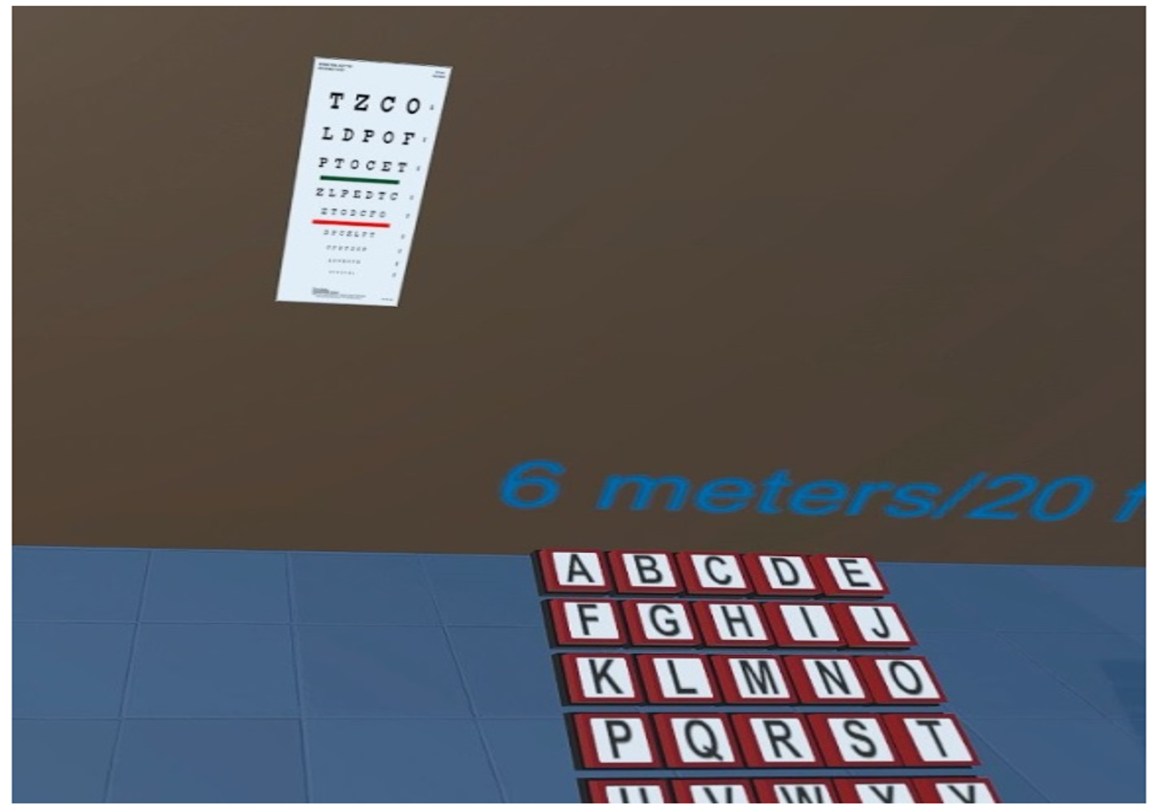
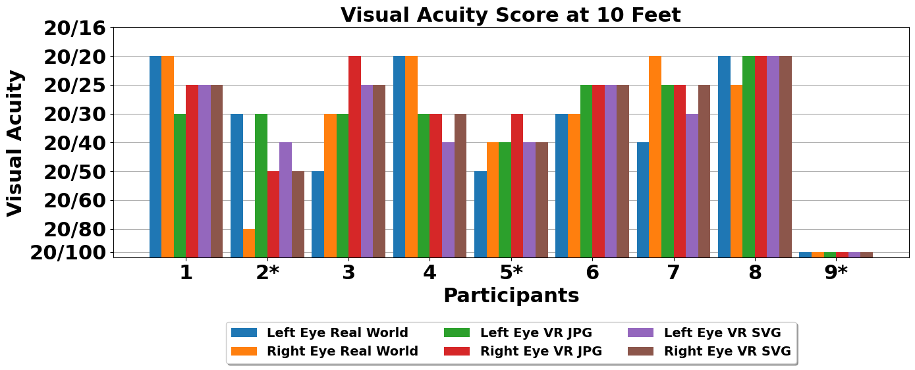
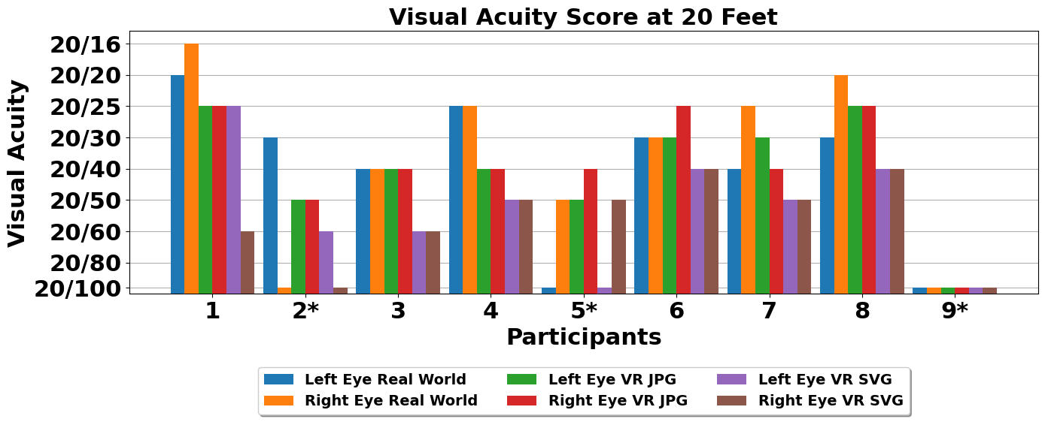
Effectiveness of Visual Acuity Test in VR vs the Real World
Sarker M. Asish
Florida Polytechnic University
Roberto E. Salazar
University of Louisiana at Lafayette
Arun K. Kulshreshth
University of Louisiana at Lafayette
ABSTRACT: Virtual Reality (VR) devices have opened a new dimension of merging technology and healthcare in an immersive and exciting way to test eye vision. Visual acuity is a person's capacity to perceive small details. An optometrist or ophthalmologist determines a visual acuity score following a vision examination. In this work, we explored how recent VR devices could be utilized to conduct visual acuity tests. We used two Snellen charts to examine eye vision in VR, similar to testing in a doctor's chamber. We found that VR could be utilized to conduct preliminary eye vision tests.
Individual Eye Scores at 10 feet Distance
METHODOLOGY
We created a VR environment for testing visual acuity and compared it with the real-world vision test.
Two charts: one for 10 feet distance, and the other for 20 feet distance from the participant.
Three conditions for each chart :
Real-World: a real chart displayed in a room with natural lighting conditions.
JPG Image in VR: chart displayed in the VR scene in JPG format.
SVG Image in VR: chart displayed in the VR scene as SVG format.
Nine participants (seven males and two females, age range: 20 to 31) attended our pilot trial using Meta Quest Pro VR headset.
Most participants had similar scores in VR conditions and the real-world.
Individual Eye Scores at 20 feet Distance
CONCLUSION AND FUTURE WORK
VR-based visual acuity tests are a viable option as a preliminary test before visiting an eye doctor.
In the future, we will integrate eye tracking and investigate the pattern of low-vision people's gaze behavior for early detection of vision problems.
ID: 1048

