Slide 1
Electronics
Rob Spanton

Slide 2


Slide 3
Switch off
your robots!

Slide 4
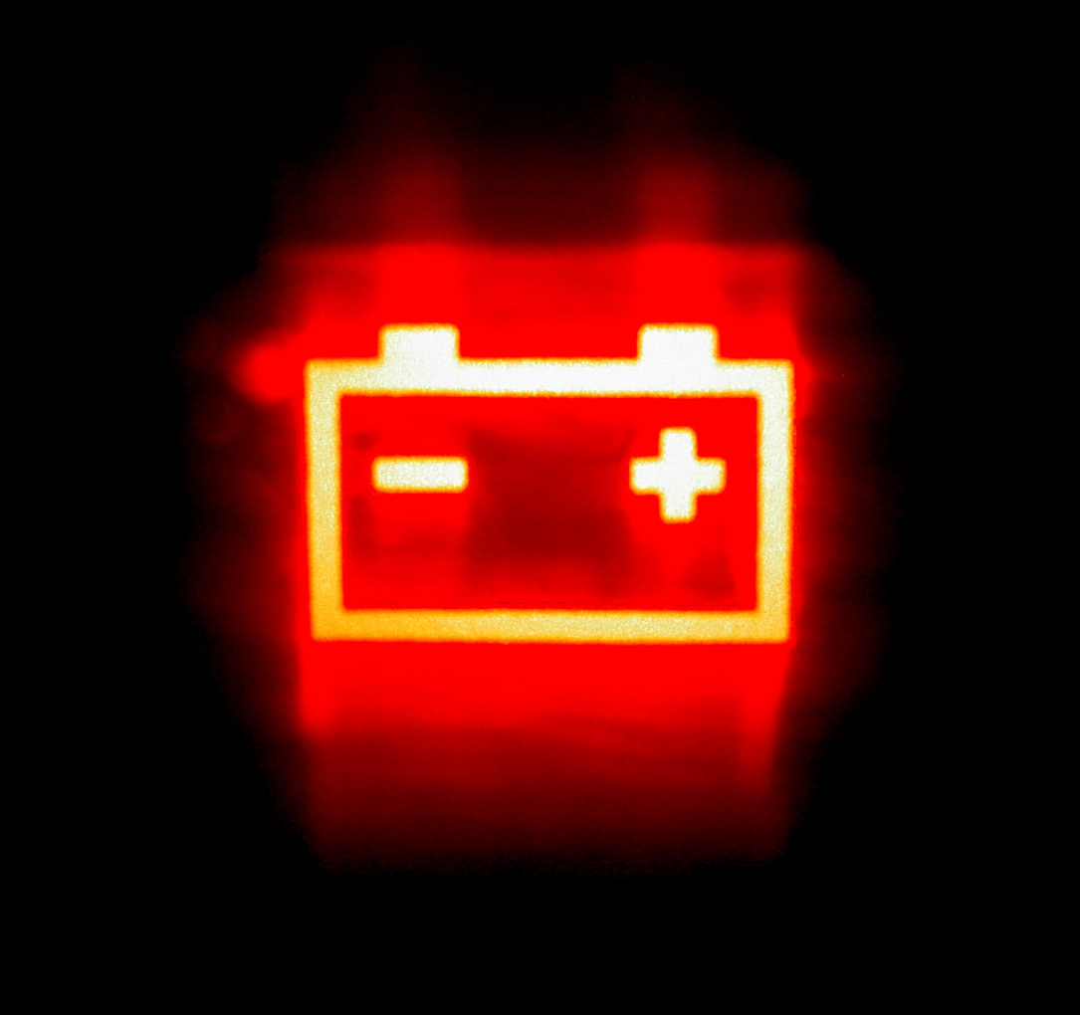

Slide 5
Kit
Power board
Motor board (x 2)
JointIO board
Servo board
Vision system

Slide 6
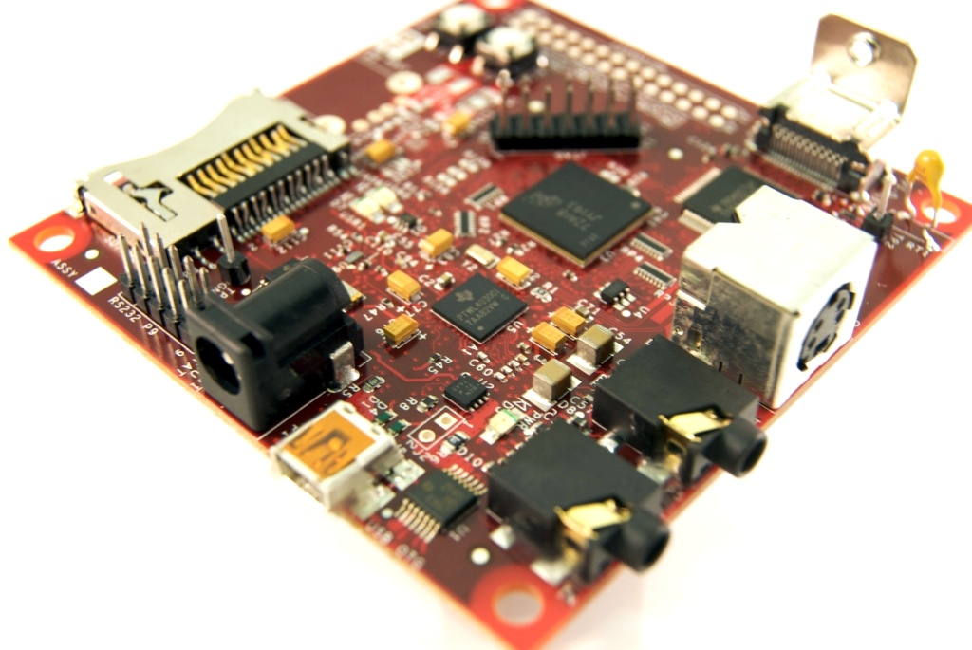

Slide 7
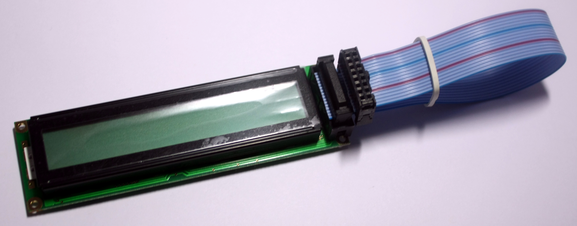

Slide 9
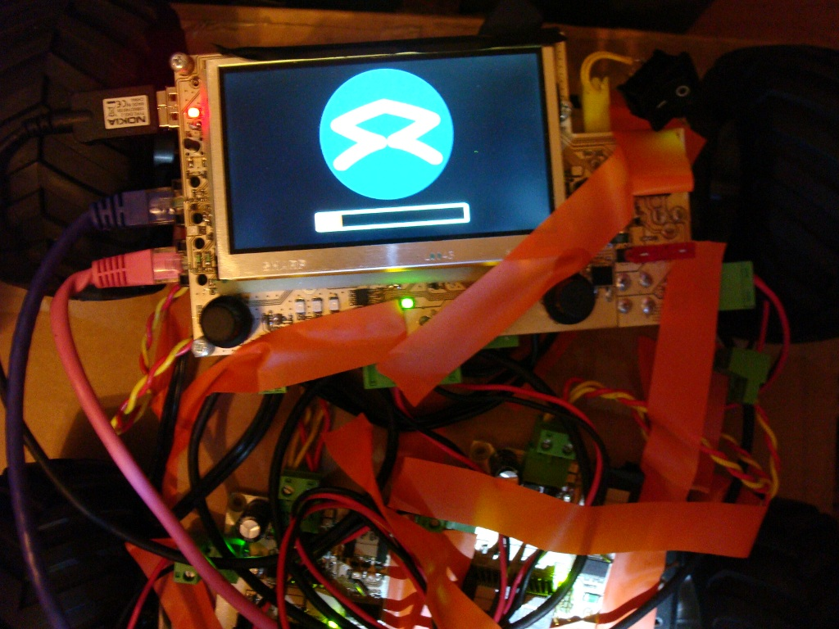

Slide 10
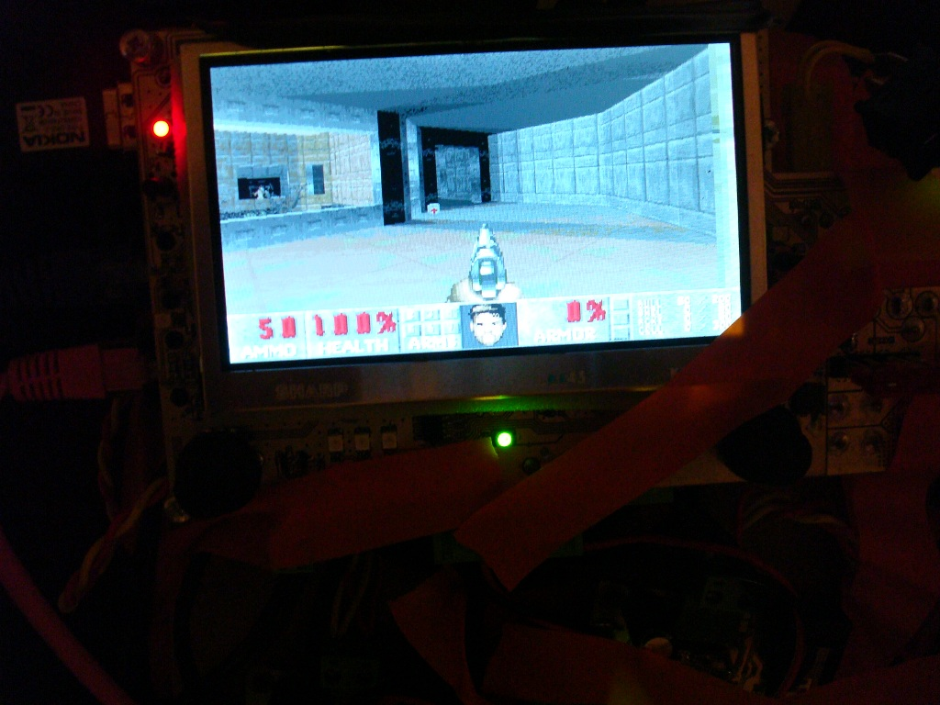

Slide 11
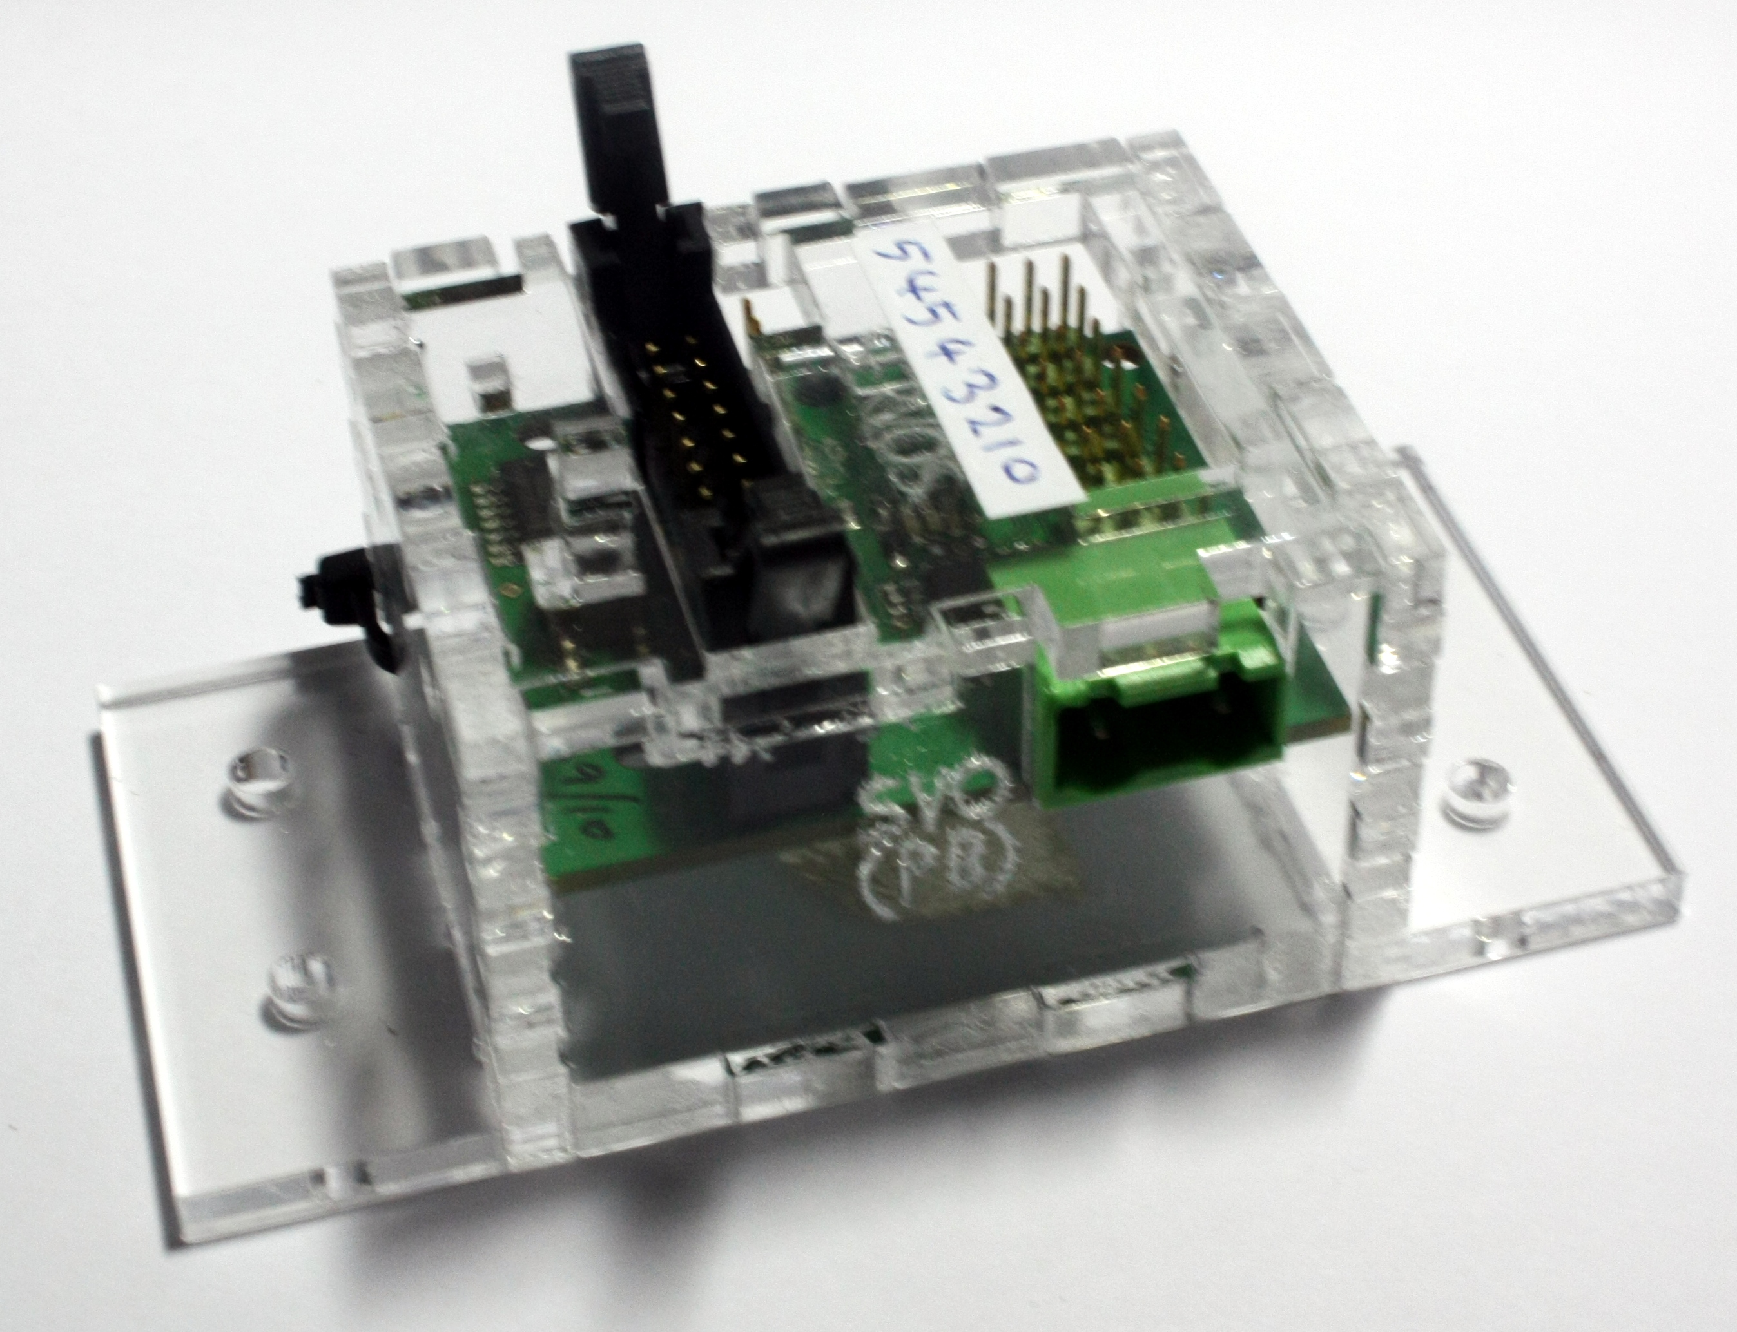
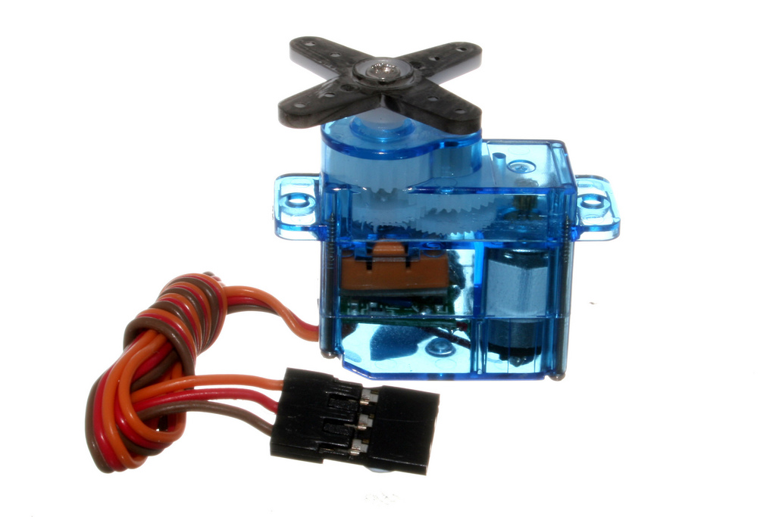
PWM Board
Controls servos

Slide 12
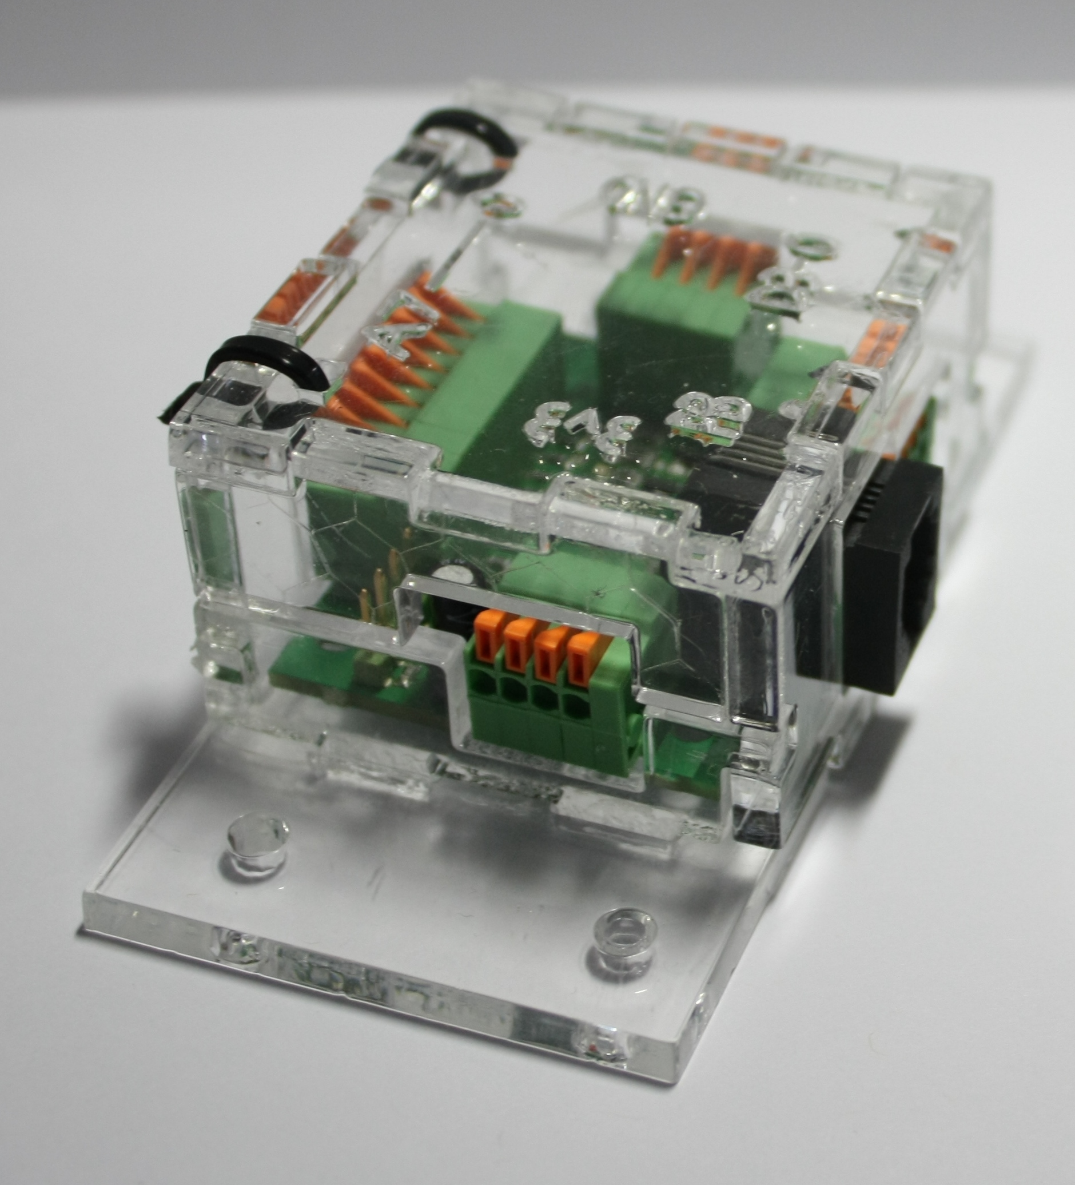
JointIO Board
Digital inputs
Analogue inputs
Digital outputs

Slide 13
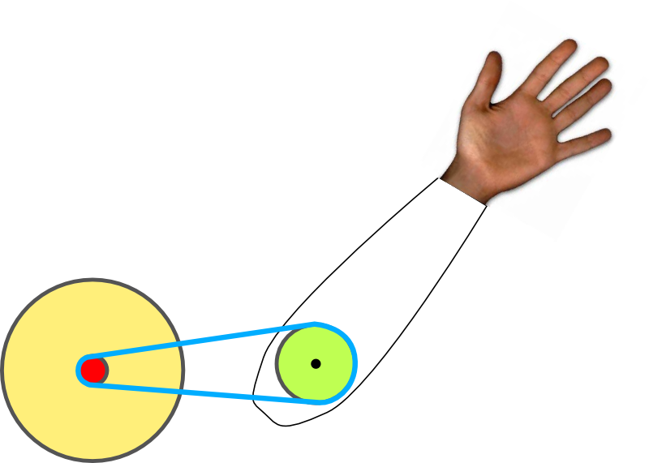
JointIO Example

Slide 14
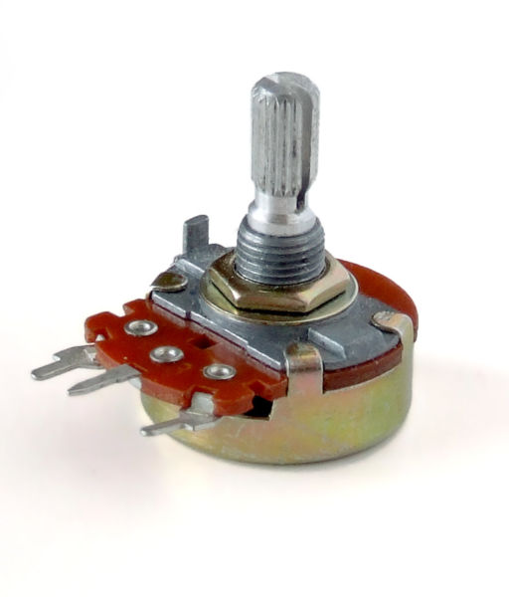

Slide 15
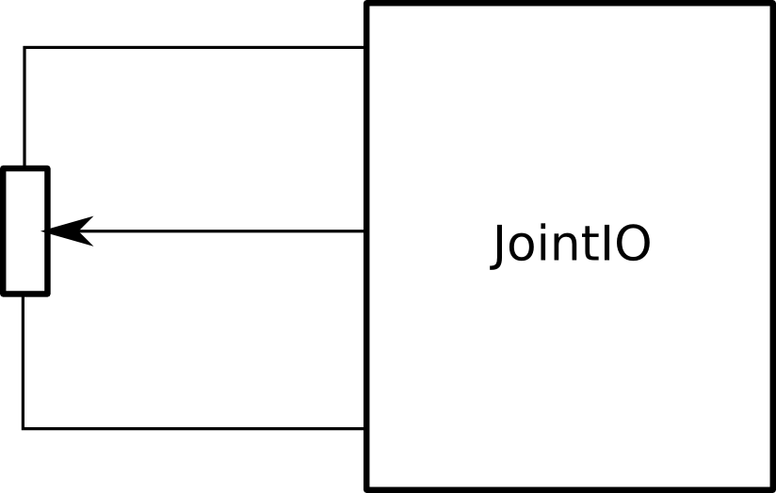

Slide 16
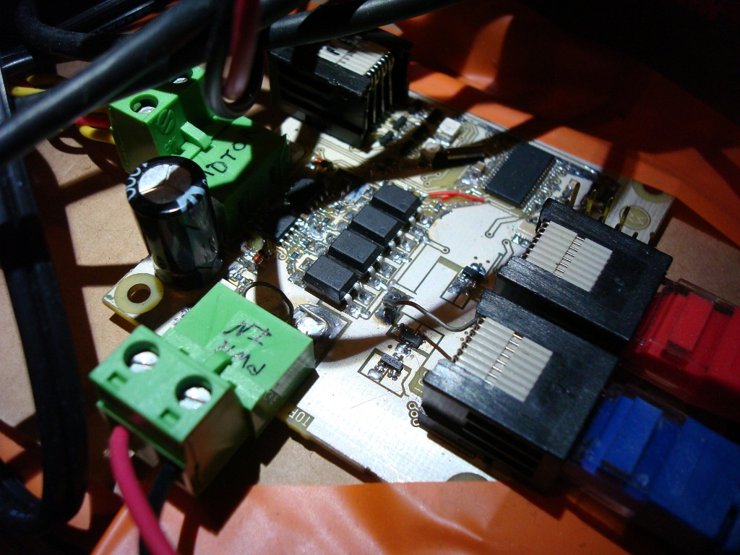

Slide 17
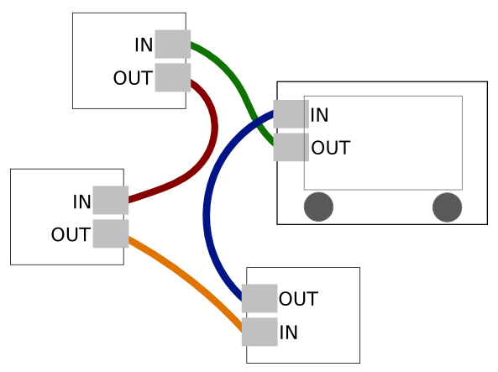

Slide 18
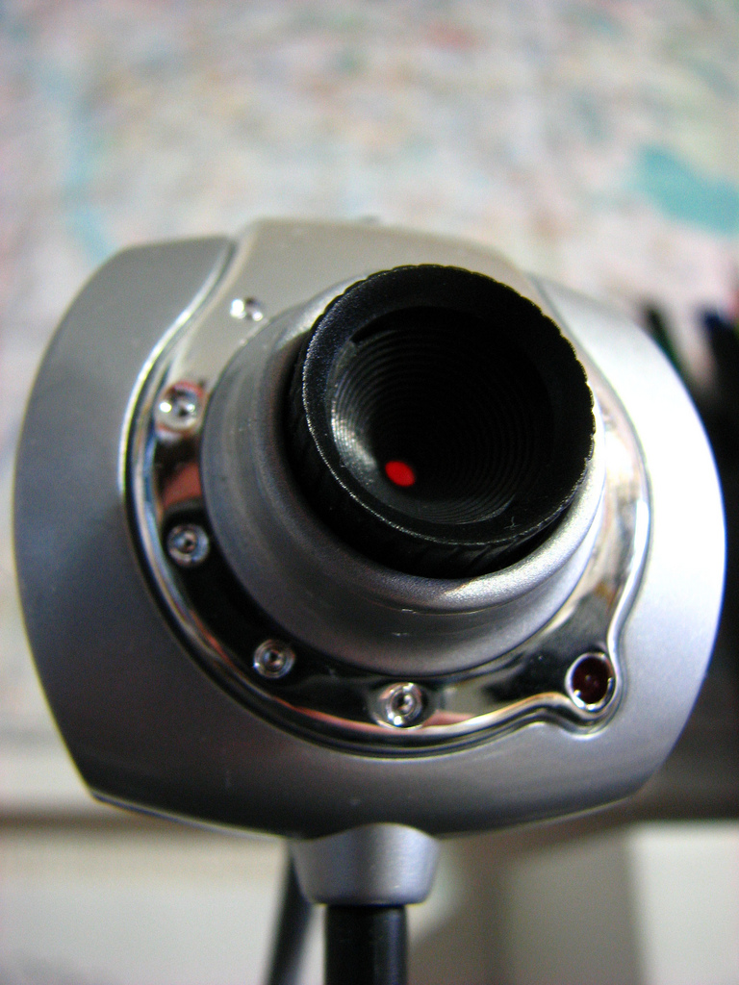
Vision

Slide 19
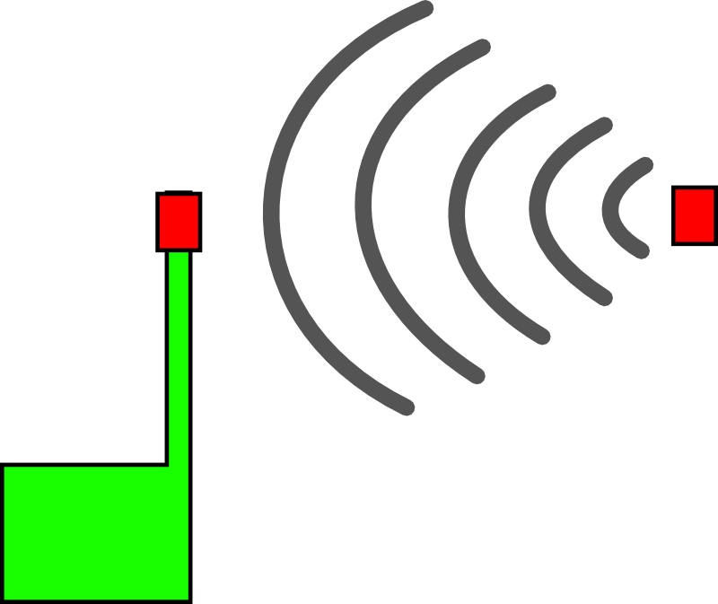
IR

Slide 20



Suppliers

Slide 21
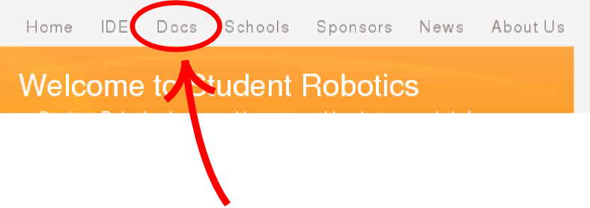
Documentation
www.studentrobotics.org

Slide 22
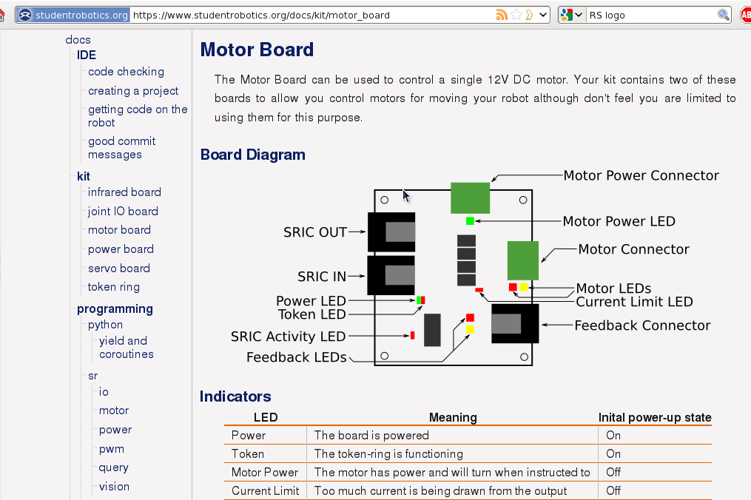

Slide 23
Hack

Slide 24
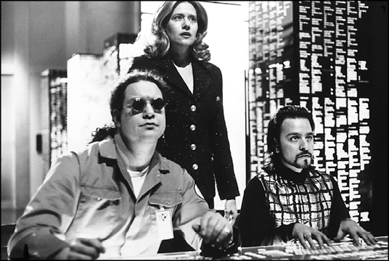

Slide 25
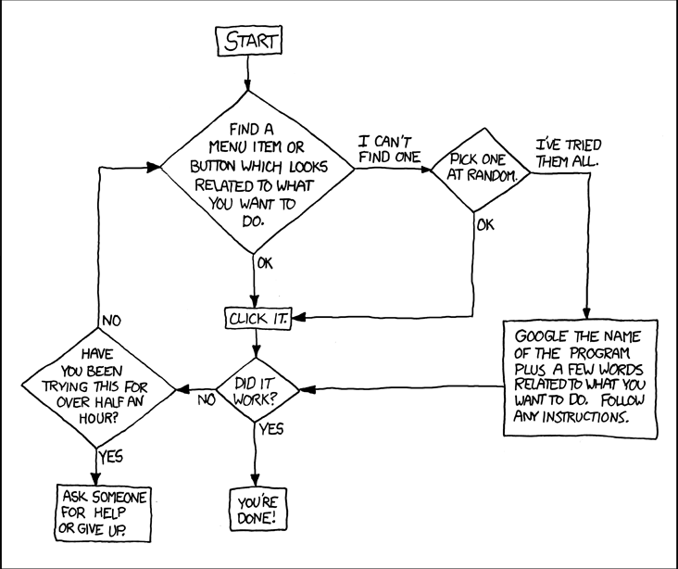

Slide 26
The Three Laws of
Student Robotics

Slide 27
The Three Laws of
Student Robotics
A robot must keep its batteries charged at all times.

Slide 29
The Three Laws of
Student Robotics
A robot must keep its batteries charged at all times.
A robot must be turned off whilst undergoing surgery.

Slide 30


Slide 31
The Three Laws of
Student Robotics
A robot must keep its batteries charged at all times.
A robot must be turned off whilst undergoing surgery.
A robot must keep its batteries charged at all times.

Slide 32
Finally
When's the electronics kit arriving?

