Slide 1

Student Robotics

Slide 2
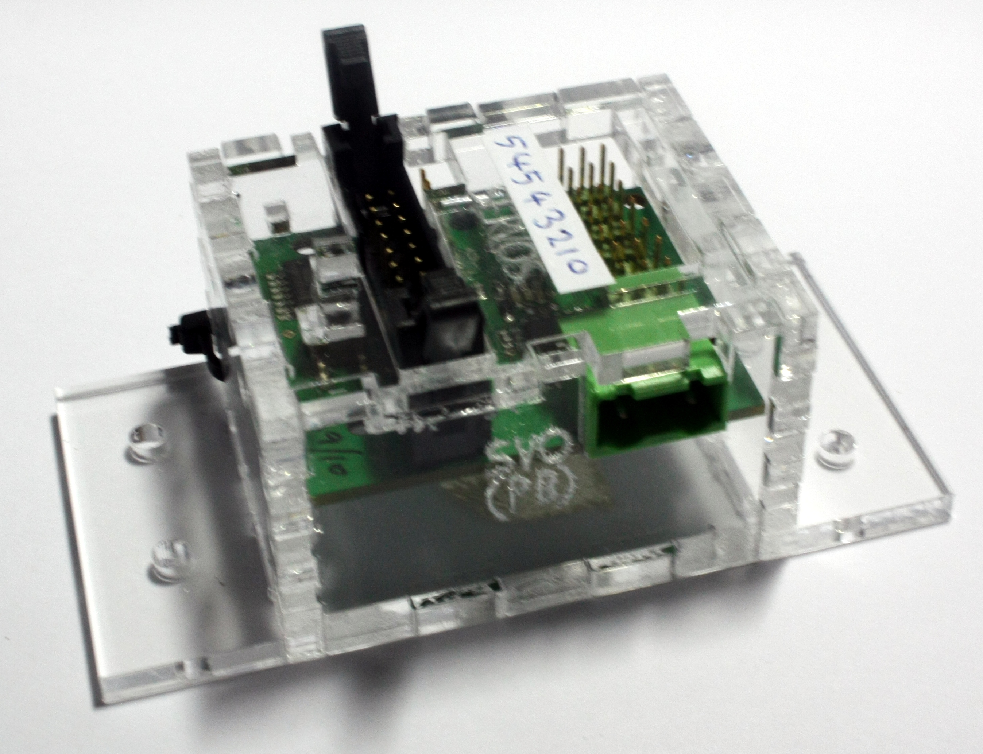
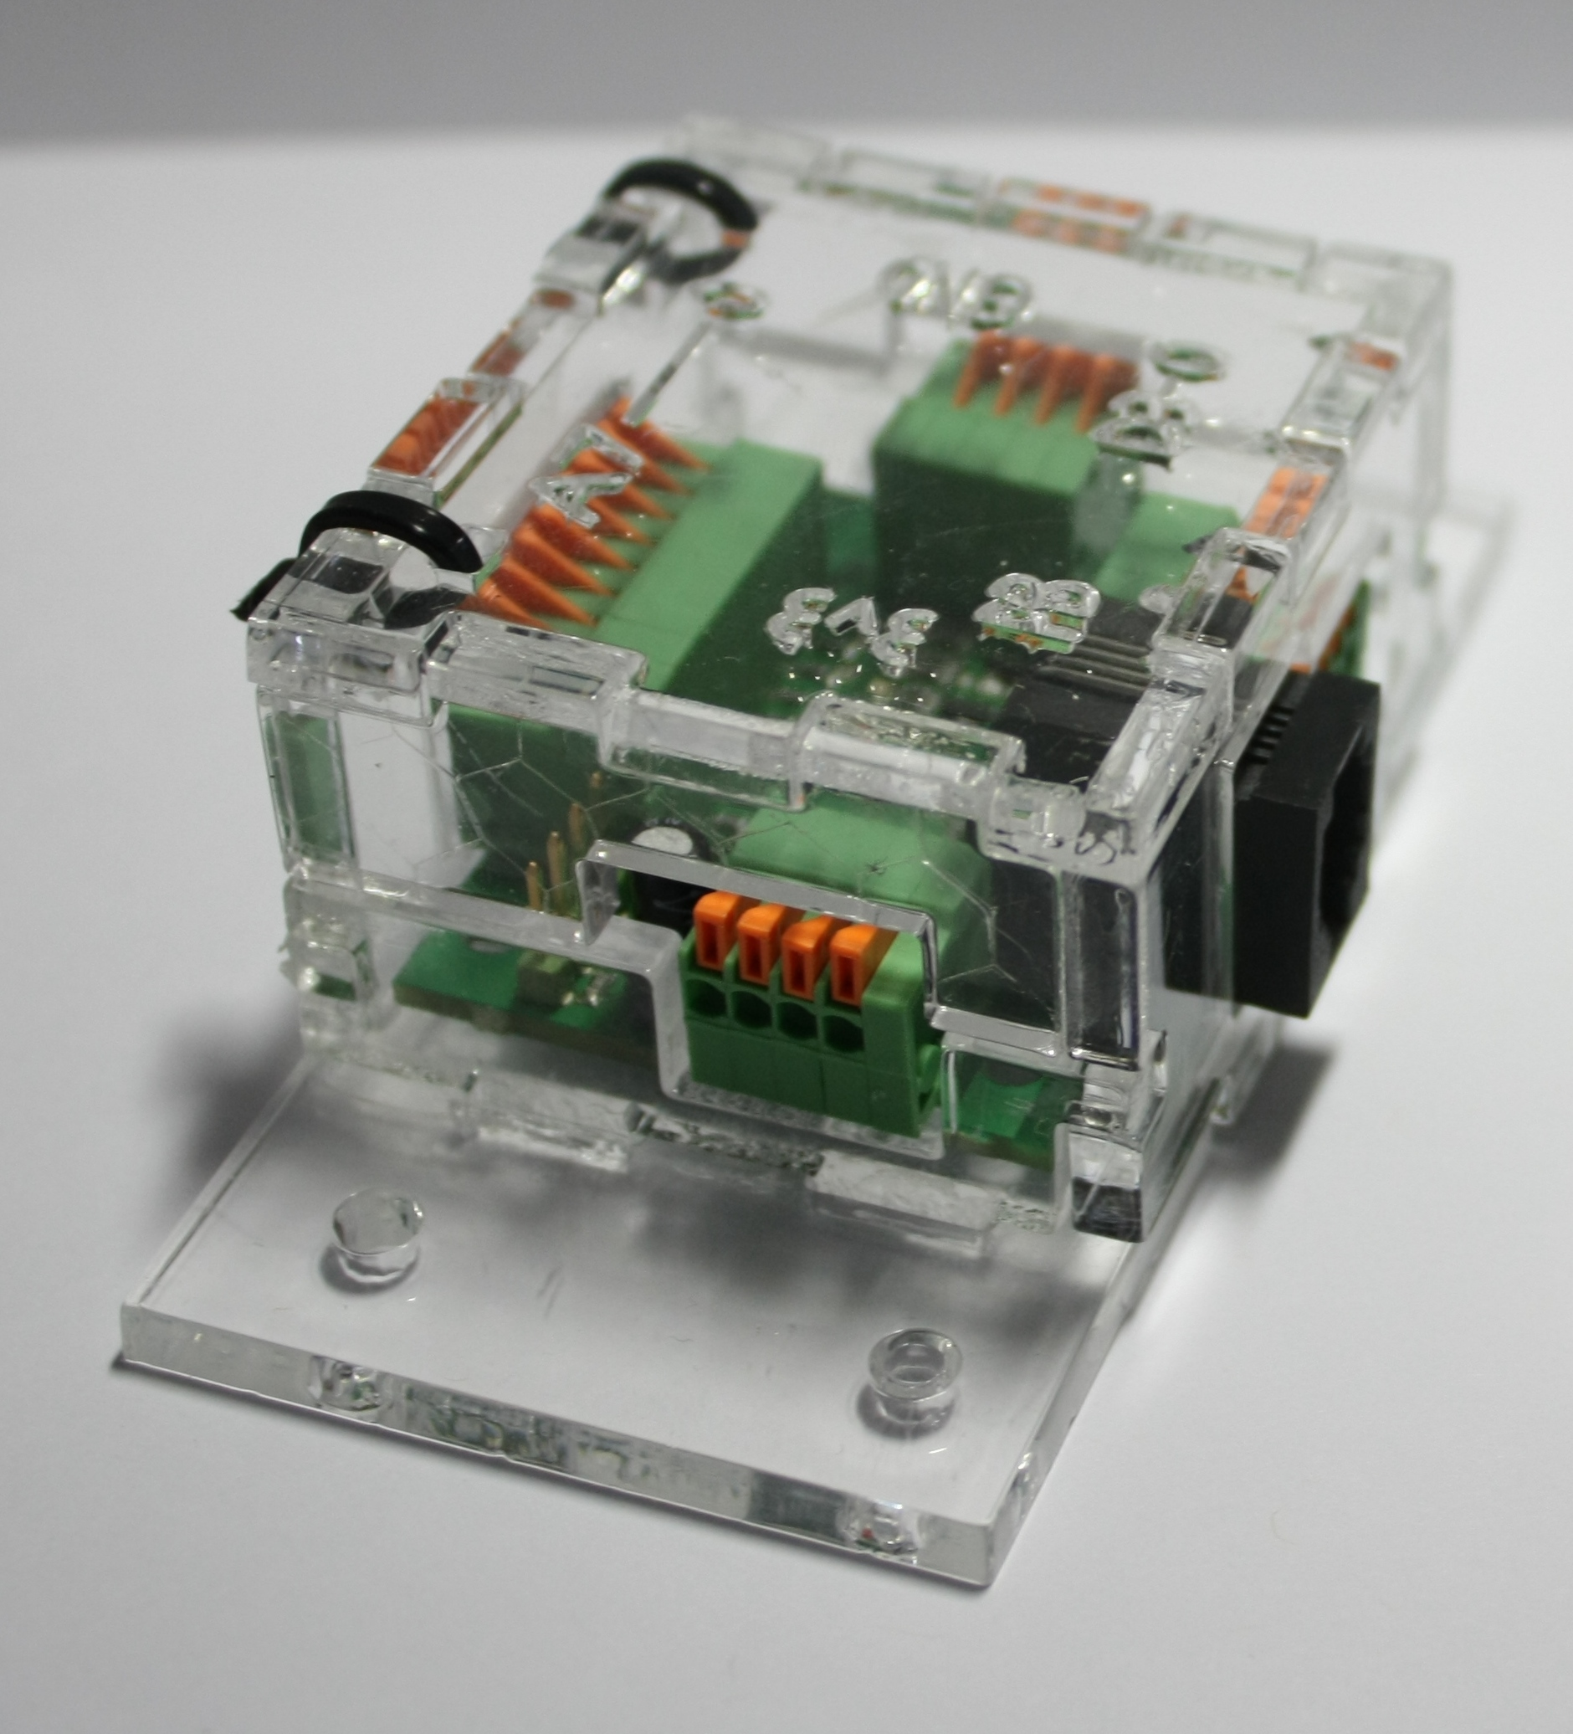
Electronics

Slide 3
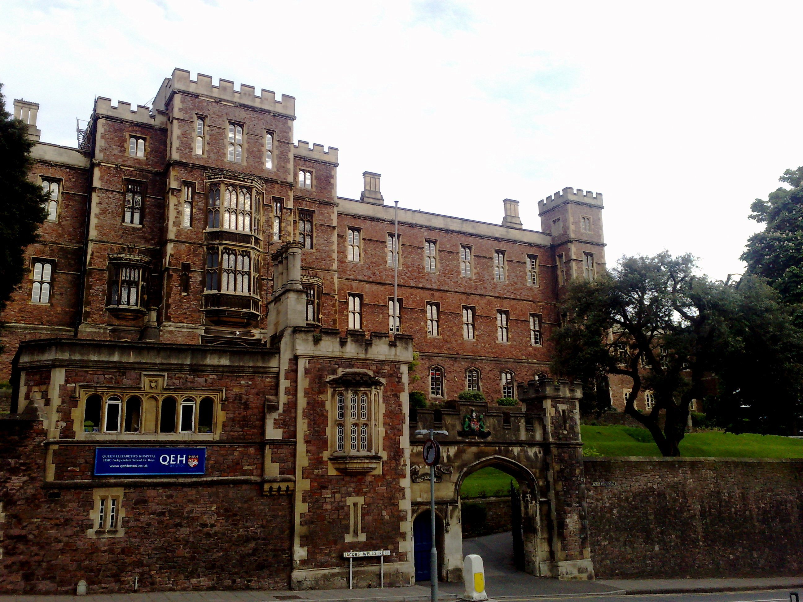
Schools

Slide 4
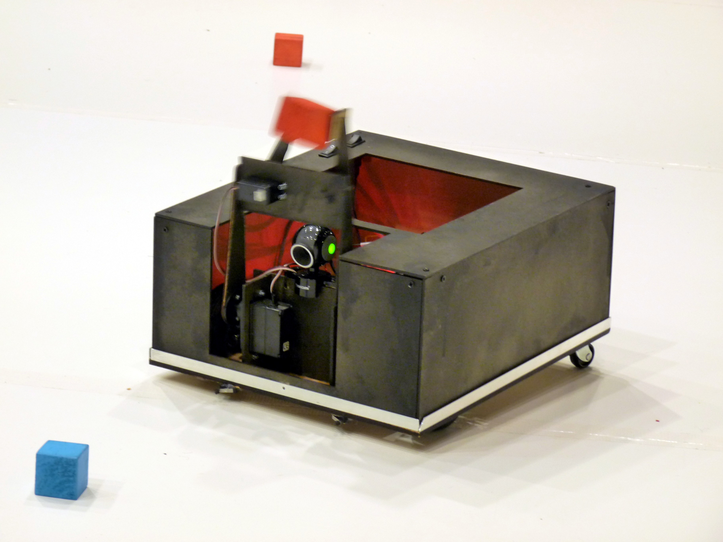
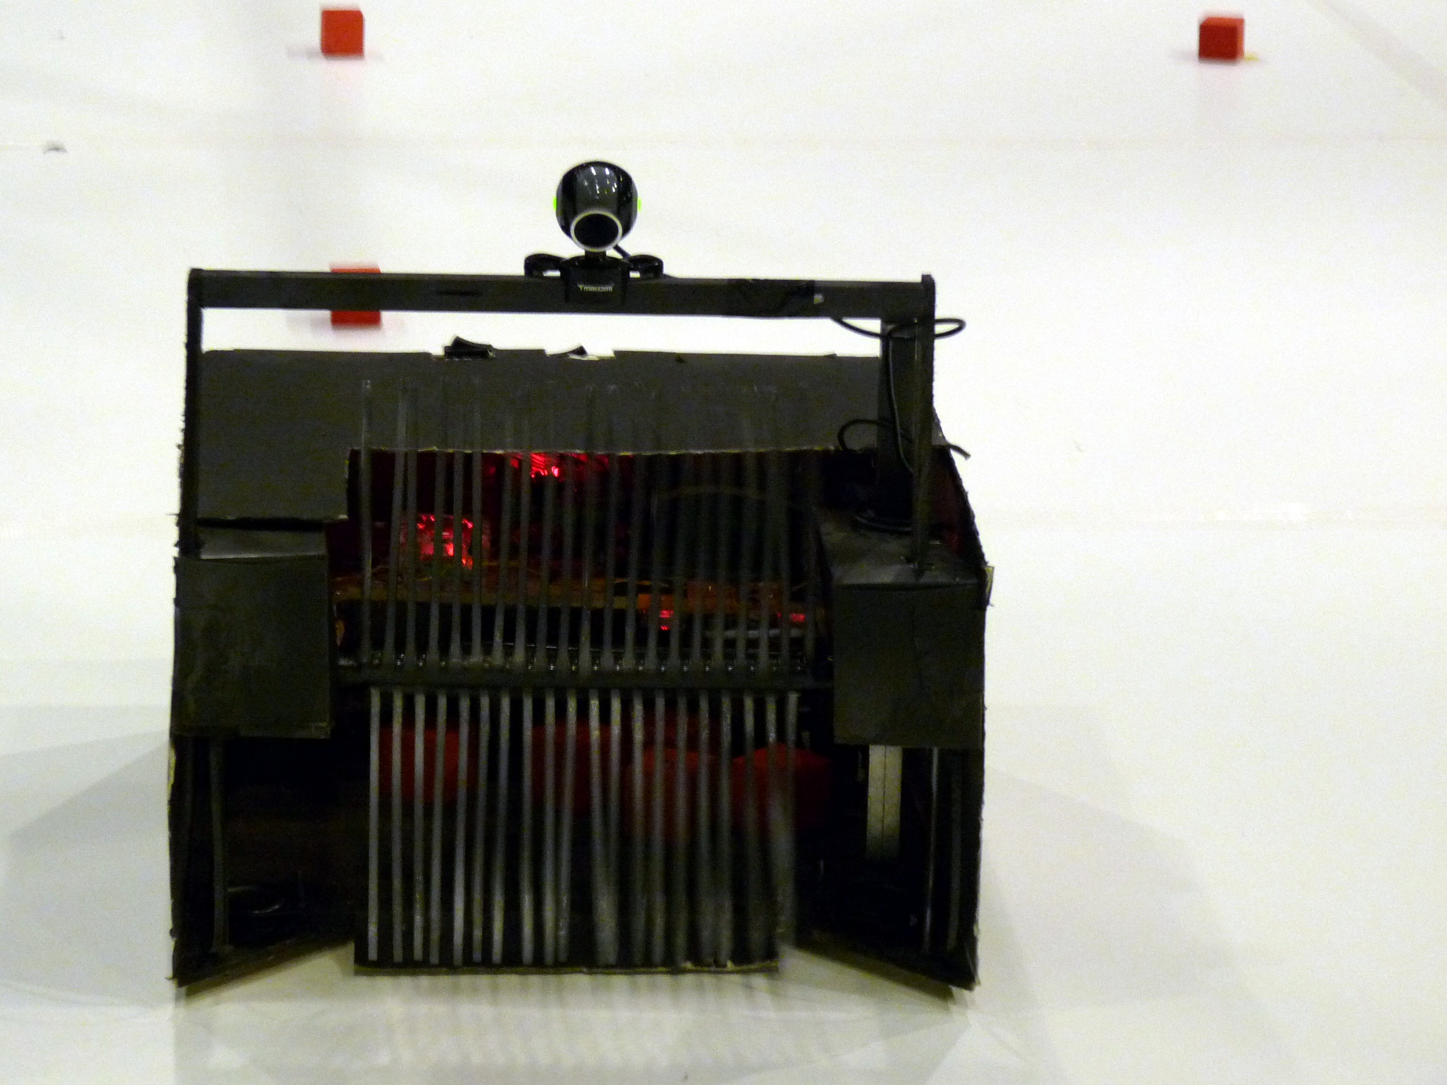
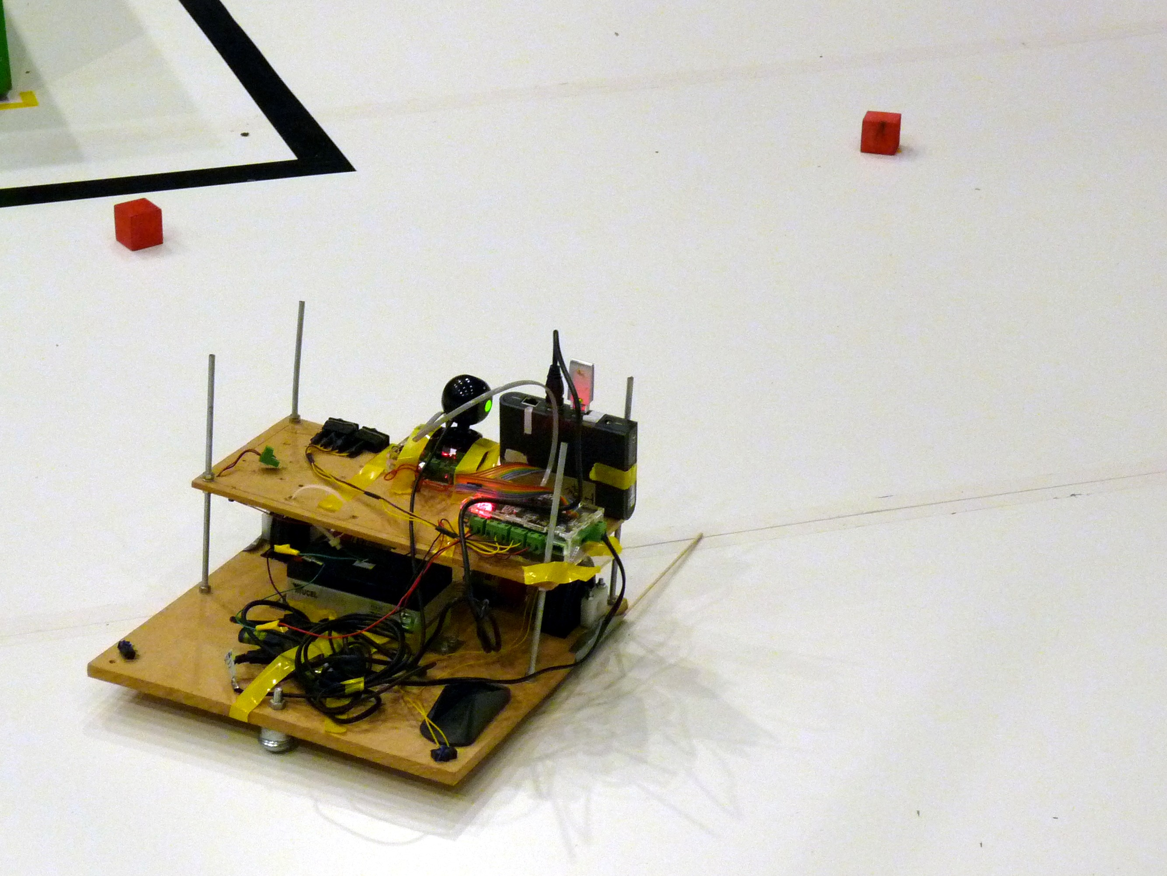
Robots

Slide 5
Robots

Slide 6
Robots

Slide 7
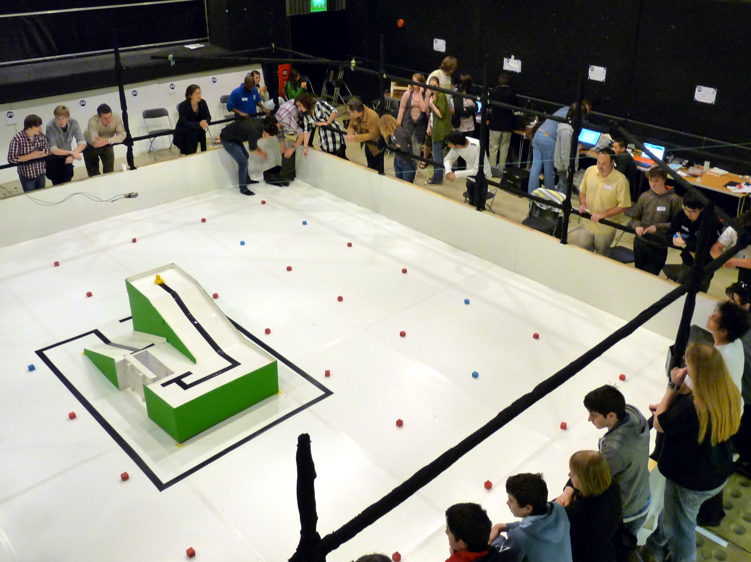
Competition

Slide 8
Programming
C, PHP, Python, Java and others
Robot Firmware – linux + magic
Competition Software
Online programming environment

Slide 9
Electronics
Board design/construction
Analogue and digital
Building robust (sixth former proof) hardware
Interconnect

Slide 10
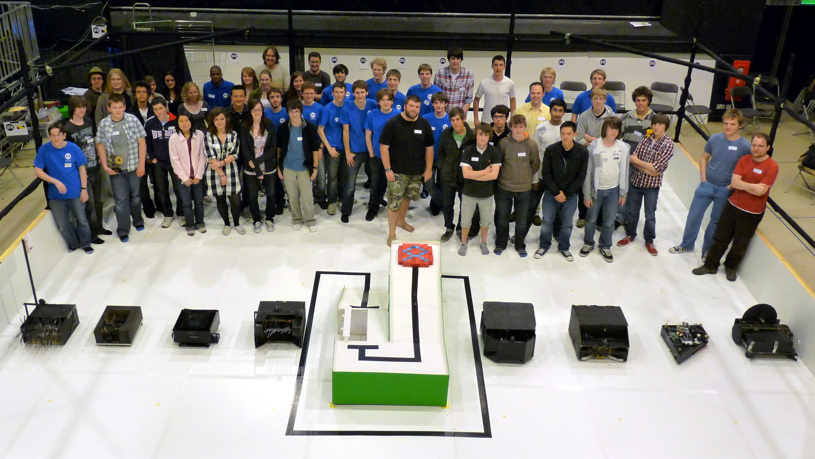
Mentoring

Slide 11
Get in contact
http://studentrobotics.org
sphippen@studentrobotics.org
Irc: irc.zepler.net #srobo
SCA - 4th floor of the union in the do it hub

