Slide 1
Programming
Sam Phippen

Slide 2


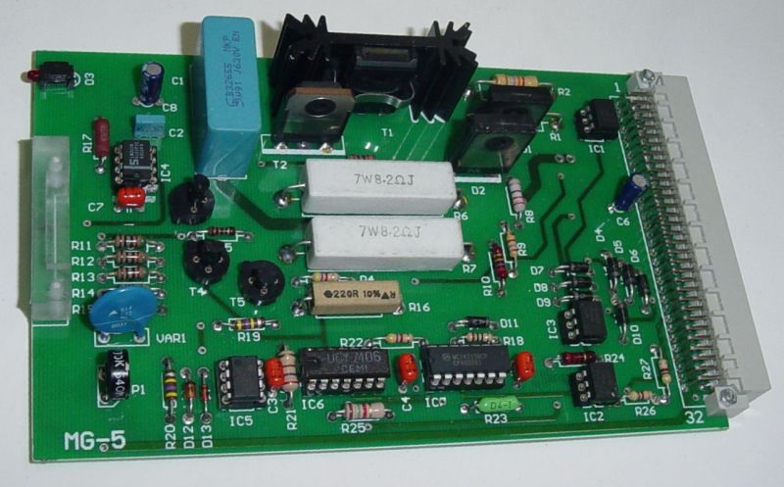
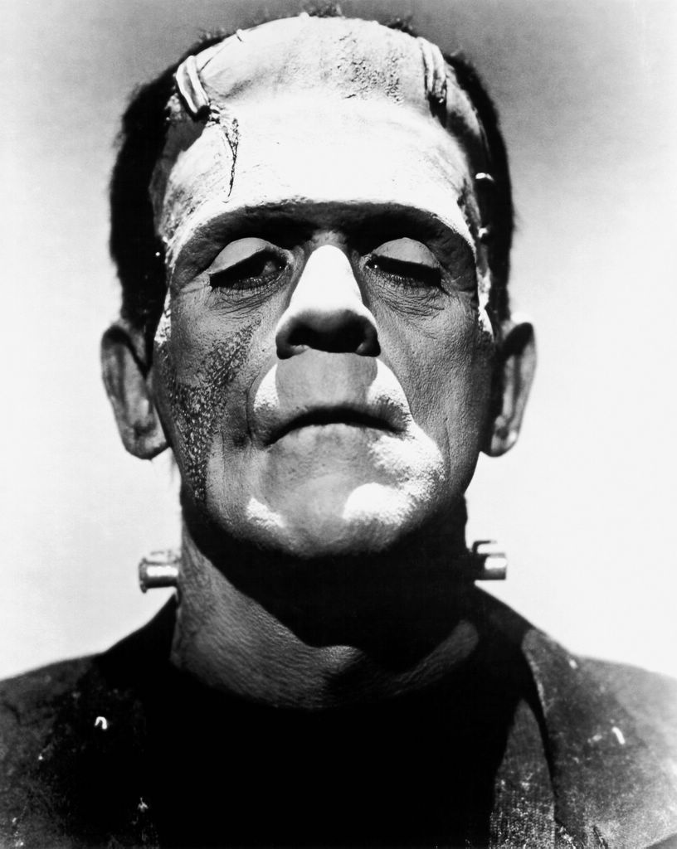
Robot Programming
How to bring your Robot to life.

Slide 3
What is programming?
RoboIDE
Your Robots
Getting help

Slide 4
What is programming?

Slide 5
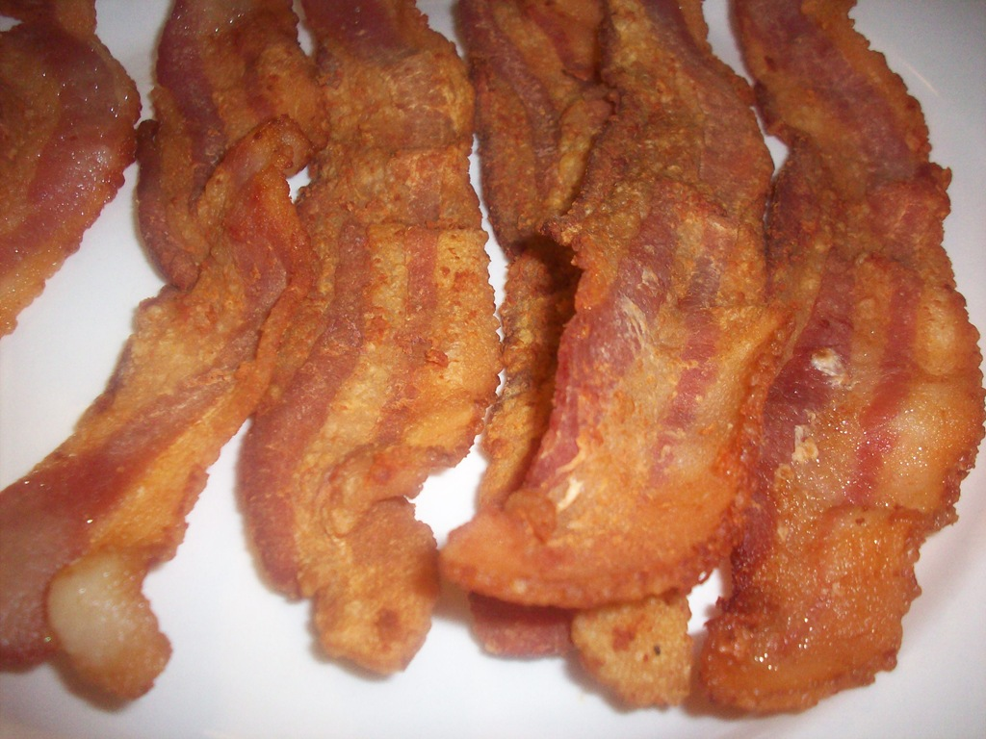

Slide 6
Instructions
Put frying pan on hob
Put oil in frying pan
Turn hob on
Put bacon in frying pan
Wait until bacon is cooked
Eat delicious bacon

Slide 7
Conditionals
If health conscious, grill bacon

Slide 8
Events
Wait until bacon is cooked

Slide 9
Programming
To make a program:
  Make a small change to some code
  Test the code
  Repeat a billion times

Slide 10
Bugs
“My program doesn't work!”
Happens to all of us
What has changed?
How do I fix it?

Slide 11

Python

Slide 12
RoboIDE

Slide 13
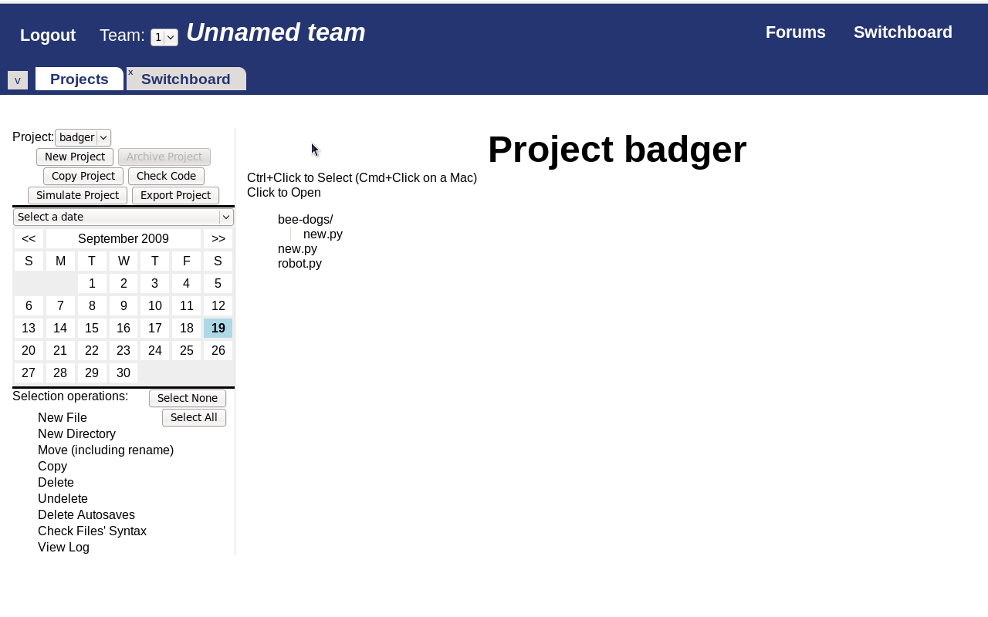
RoboIDE

Slide 14
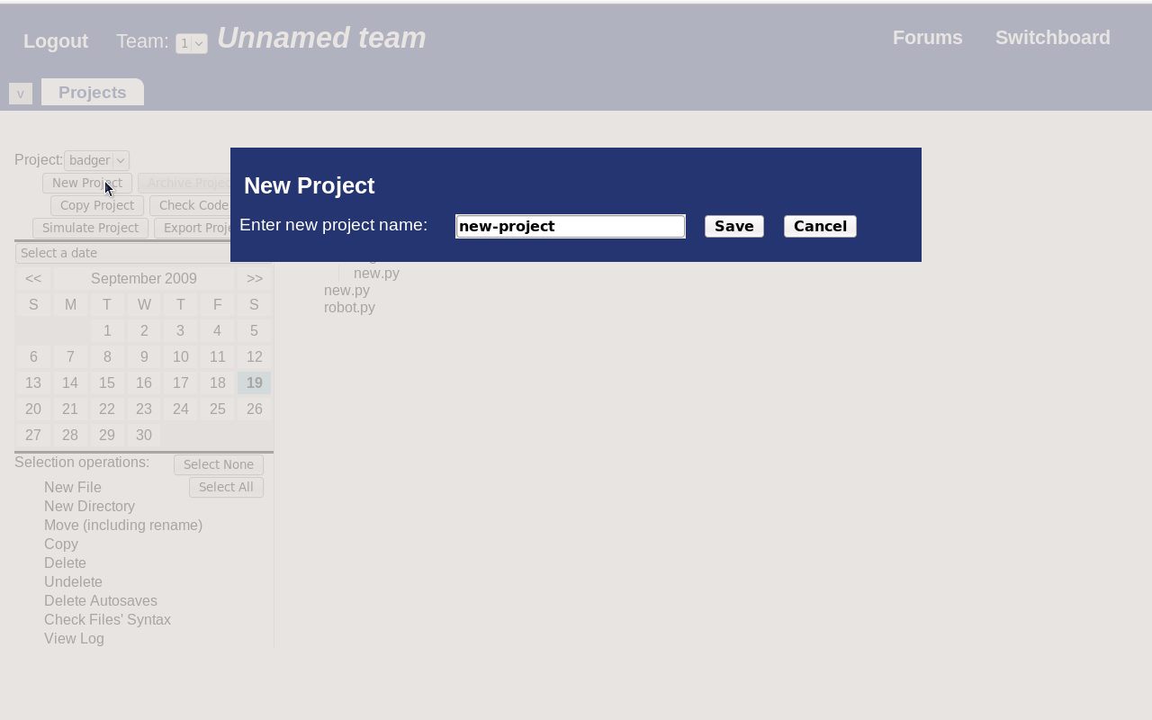
RoboIDE: Projects

Slide 15
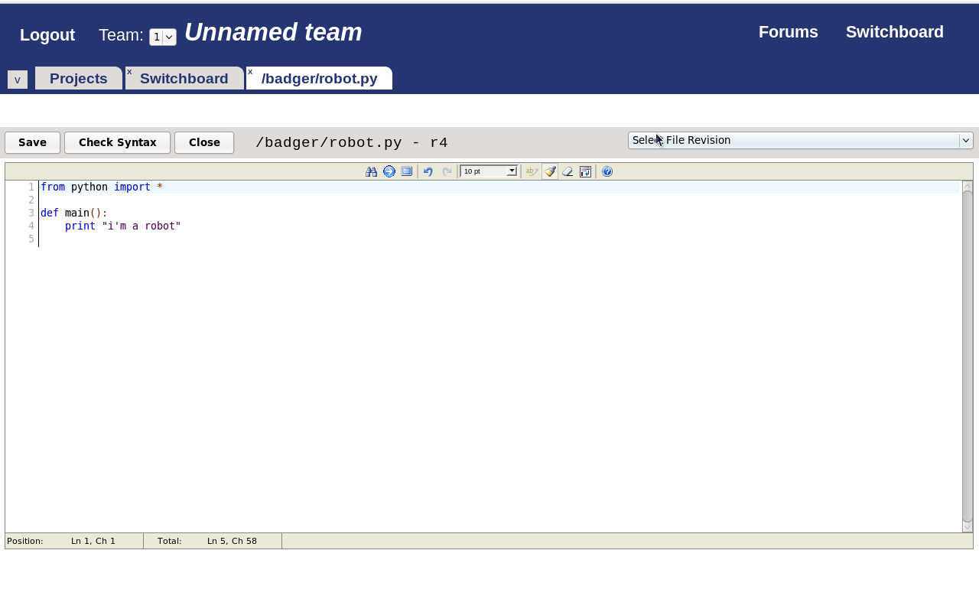
RoboIDE: Edit

Slide 16
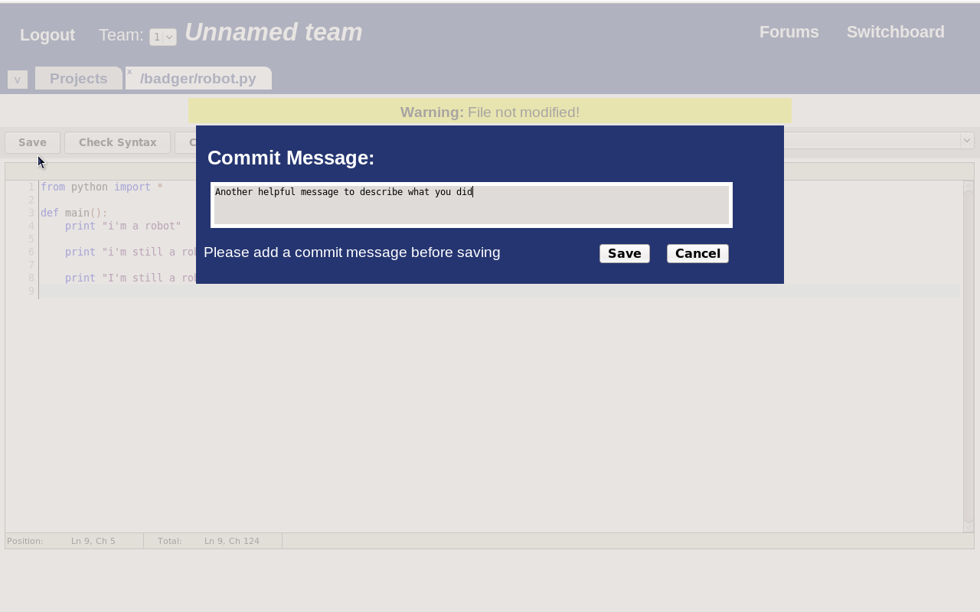
RoboIDE: Saving

Slide 17
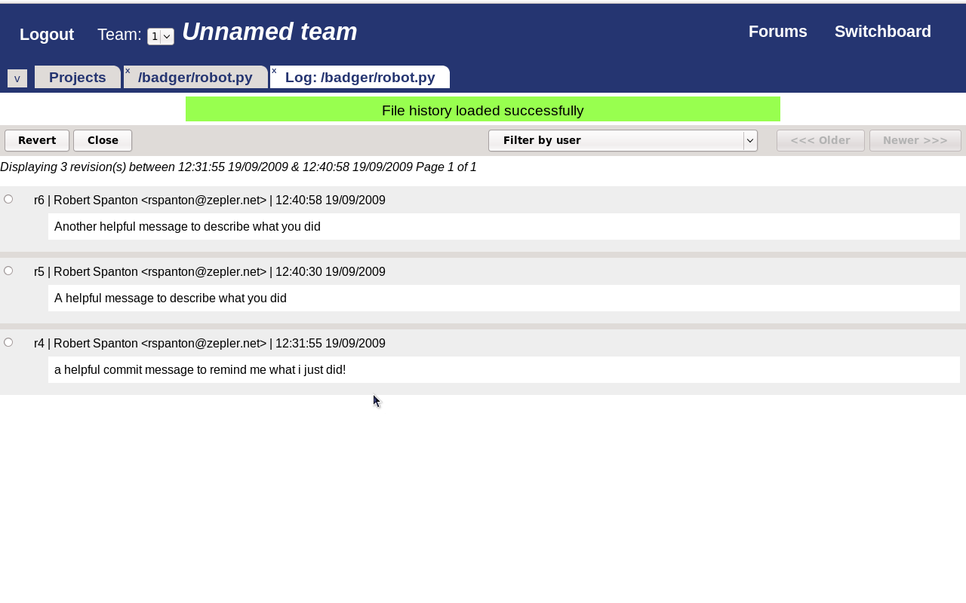
RoboIDE: History

Slide 18

Loading Software

Slide 19
Demo

Slide 20
Your Robots

Slide 21
Moving!
from sr import *
def main():
motor[0].target = 100
motor[1].target = -100
yield query.timeout(3)

Slide 22
Seeing!
from sr import *
def main():
ev = yield vision
for blob in ev.vision.blobs:
if blob.colour == RED:
print “I see red”

Slide 23
Feeling!
from sr import *
def main():
bump_switch = io[0].in[0].d
if bump_switch:
print “switch pressed”
else:
print “switch not pressed”

Slide 24
Getting help

Slide 25
Documentation
https://www.studentrobotics.org/docs/
Walkthrough
Library reference
Tutorials

Slide 26
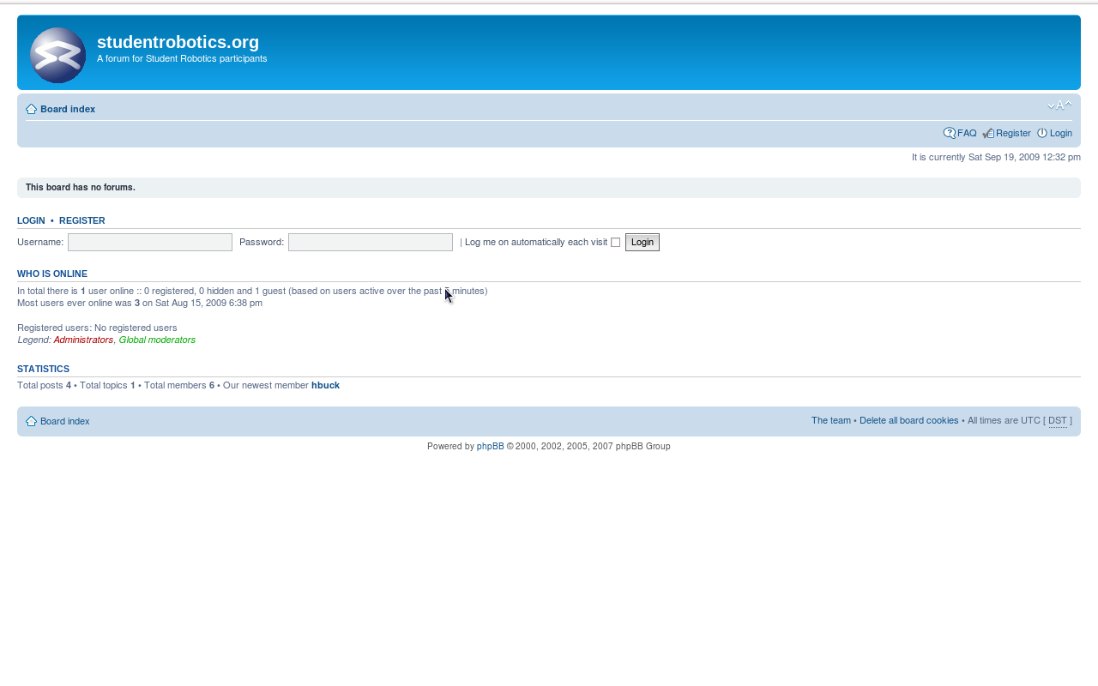
Forums

Slide 27
Mentors
Ask your mentor!

Slide 28

Programming

Slide 29

Experiment

Slide 30
What if?

Slide 31

Try new things

Slide 32

Finally
Small Steps

