Slide 1
Programming
Sam Phippen

Slide 2
Personal Experience

Slide 3


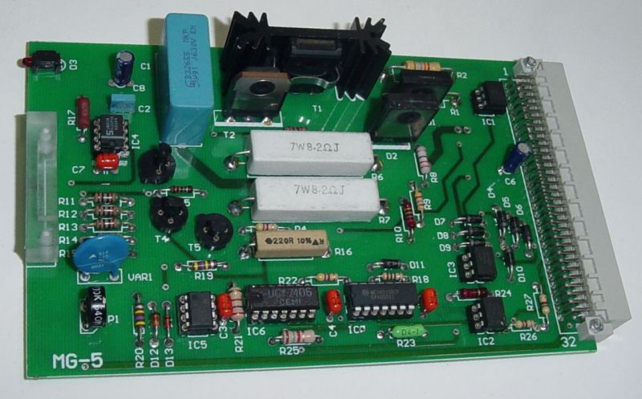
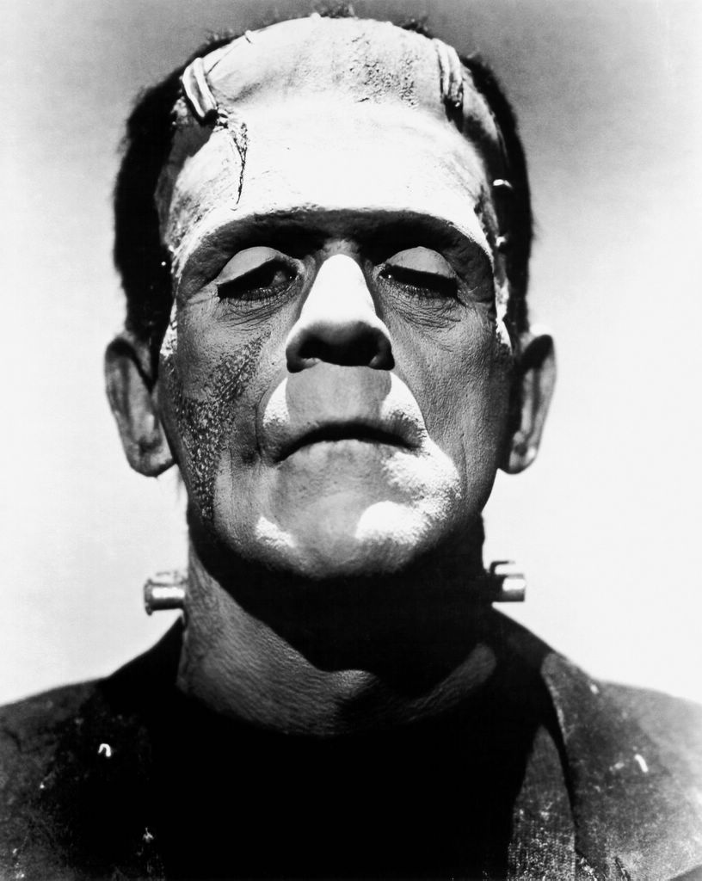
Robot Programming
How to bring your Robot to life.

Slide 4
What is programming?
RoboIDE
Your Robots
Getting help

Slide 5
What is programming?

Slide 6
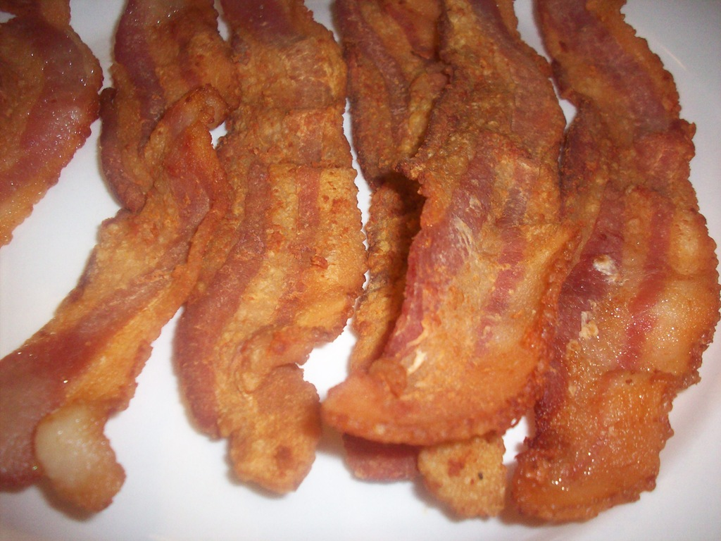

Slide 7
Instructions
Put frying pan on hob
Put oil in frying pan
Turn hob on
Put bacon in frying pan
Wait until bacon is cooked
Eat delicious bacon

Slide 8
Steps
Recipes are a top down series of steps
So are programs
Computers are stupid

Slide 9
Conditionals
If health conscious, grill bacon

Slide 10
Events
Wait until bacon is cooked

Slide 11
Code
def dance():
x = 3
print x
def main():
dance()
print “cheese”
dance()

Slide 12
Programming
To make a program:
  Make a small change to some code
  Test the code
  Repeat a billion times

Slide 13
Bugs
“My program doesn't work!”
Happens to all of us
What has changed?
How do I fix it?

Slide 14

Python

Slide 15
RoboIDE

Slide 16
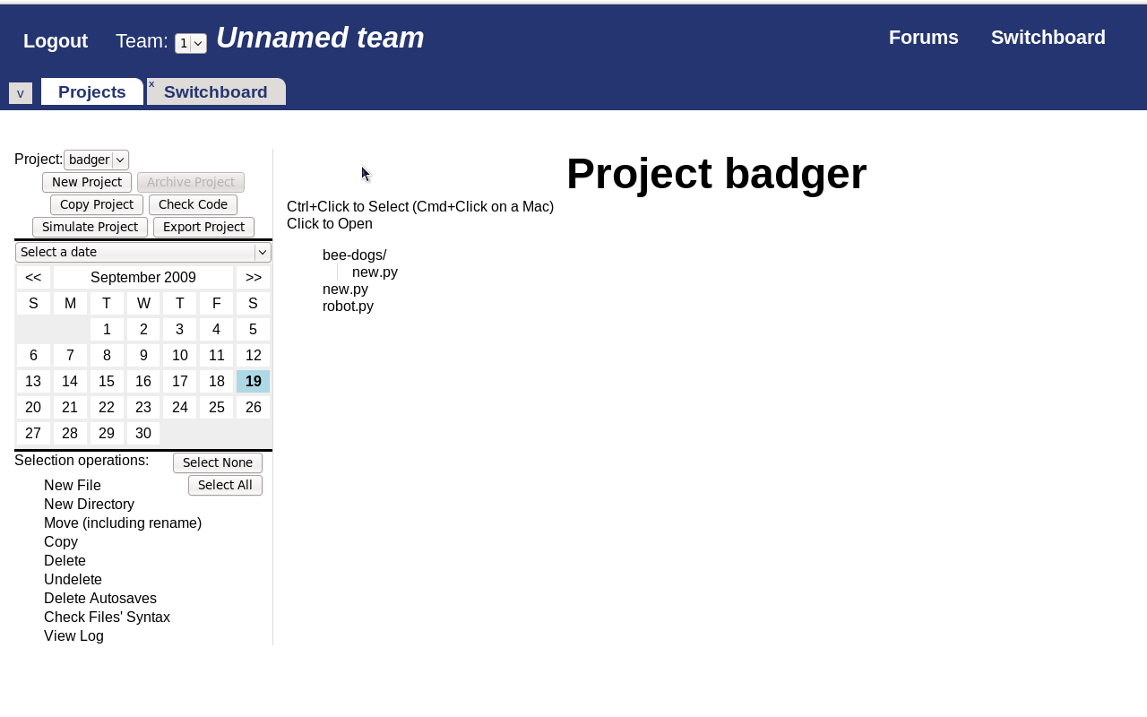
RoboIDE

Slide 17
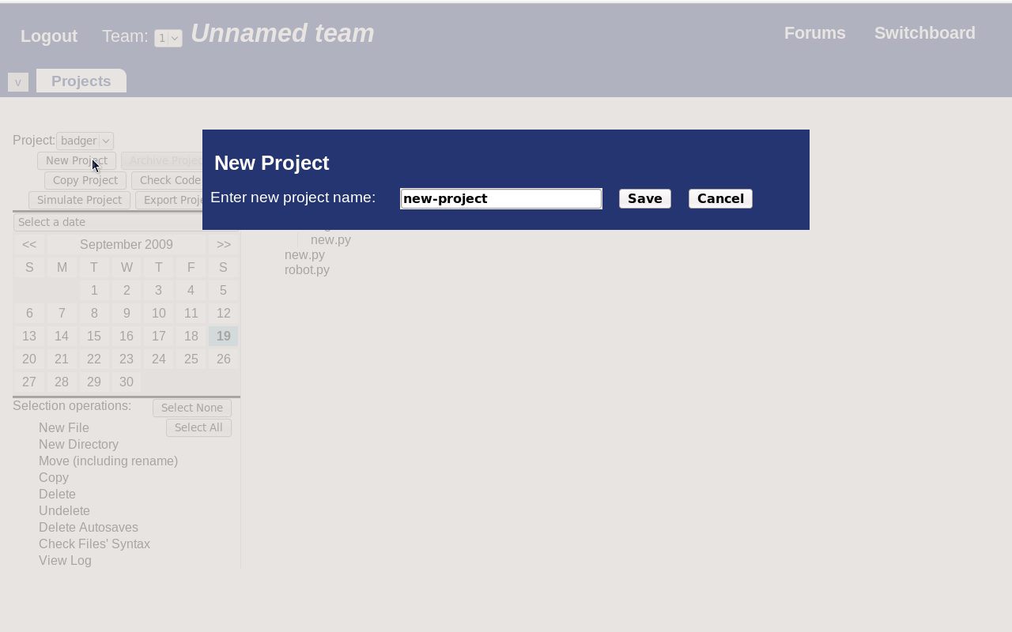
RoboIDE: Projects

Slide 18
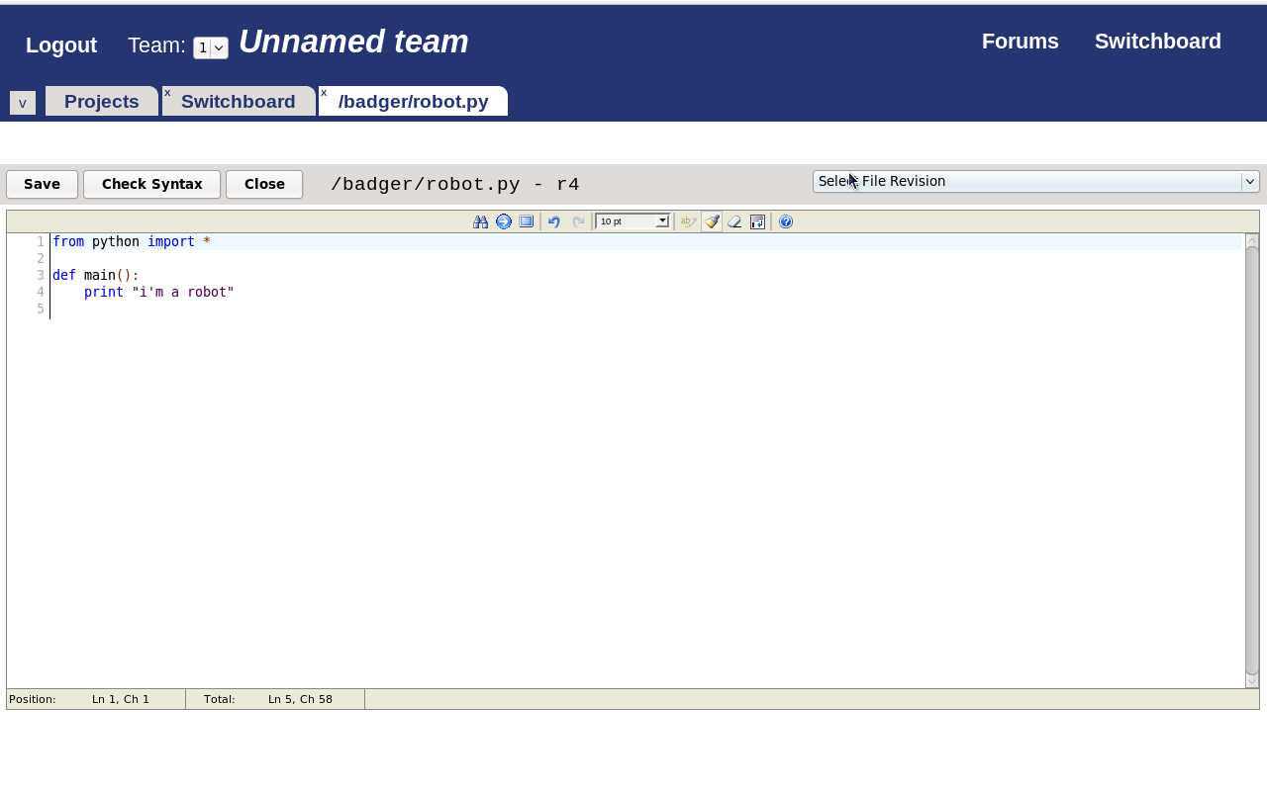
RoboIDE: Edit

Slide 19
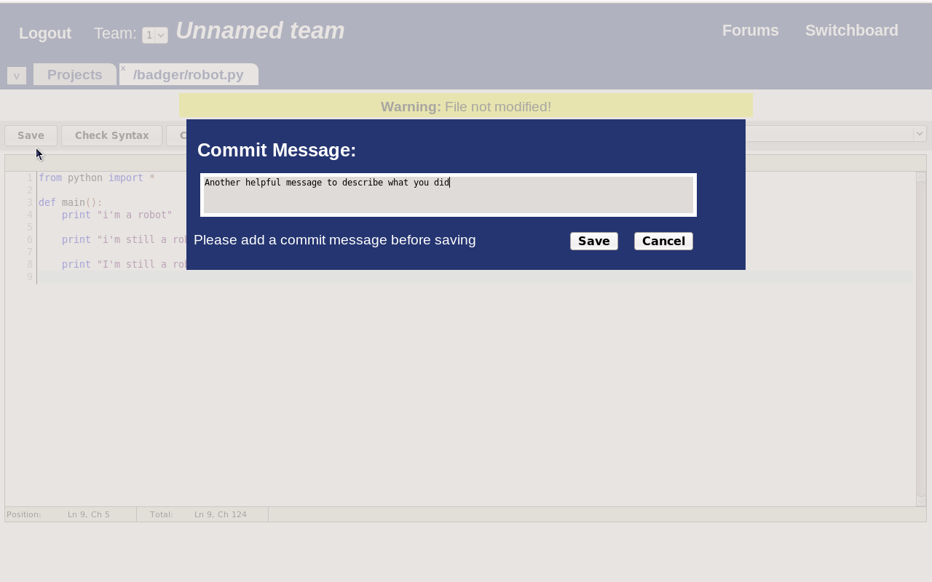
RoboIDE: Saving

Slide 20
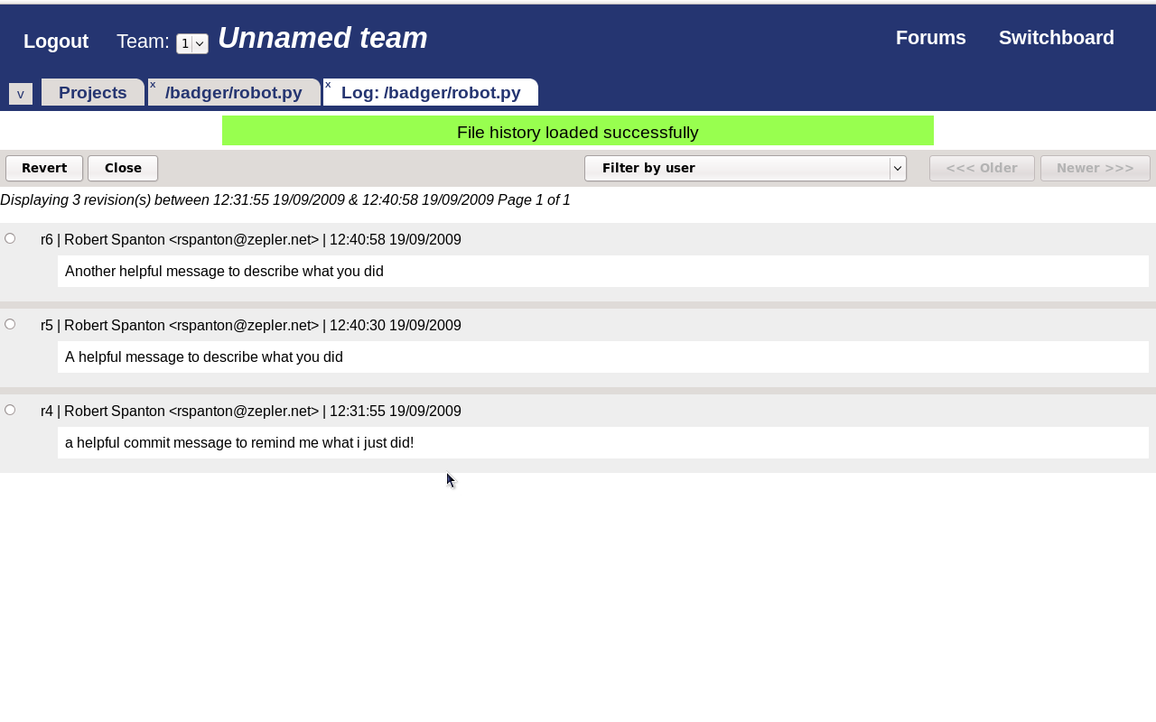
RoboIDE: History

Slide 21

Loading Software

Slide 22
Demo

Slide 23
Your Robots

Slide 24
Moving
from sr import *
def main():
motor[0].target = 100
motor[1].target = -100
yield query.timeout(3)
motor[0].target = 0
motor[1].target = 0

Slide 25
Seeing
from sr import *
def main():
ev = yield query.vision
for blob in ev.vision.blobs:
if blob.colour == RED:
print “I see red”

Slide 26
Vision

Slide 27
Feeling
from sr import *
def main():
bump = io[0].input[0].d
if bump:
print “switch pressed”
else:
print “switch not pressed”

Slide 28
Getting help

Slide 29
Documentation
https://www.studentrobotics.org/docs/
Walkthrough
Library reference
Tutorials

Slide 30
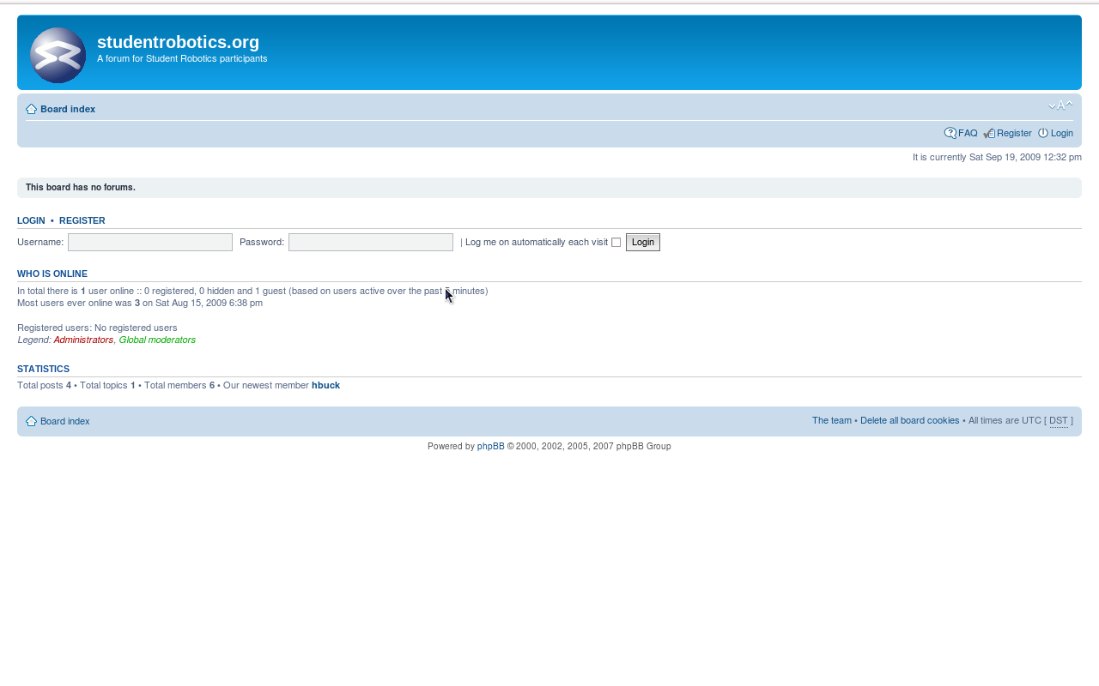
Forums

Slide 31
Mentors
Ask your mentor!

Slide 32

Programming

Slide 33

Experiment

Slide 34
What if?

Slide 35

Try new things

Slide 36

Finally
Small Steps

