Slide 1
Objectives
Move around
Pick up cans

Slide 2


Design Cycle
Design Build Suck

Slide 3
Design Cycle
Design Build Suck

Slide 4
Design Cycle
Design Build Suck

Slide 5
Design Cycle
Design Prototype Build

Slide 6
Design Cycle
Design Prototype Build

Slide 7
Design Cycle
Design
Build Prototype

Slide 8
Design CYCLE
Design
Build Prototype

Slide 9
Prototyping
The only way to answer design questions
Nobody can think of everything
Prevents endless design debates

Slide 10

Prototyping Methods

Slide 11
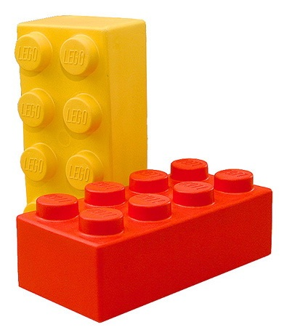
Prototyping Methods

Slide 12
Prototyping
Did I mention it's important?

Slide 13
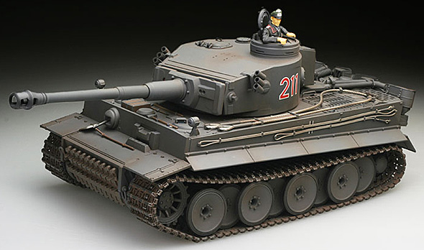
Steering
?

Slide 14
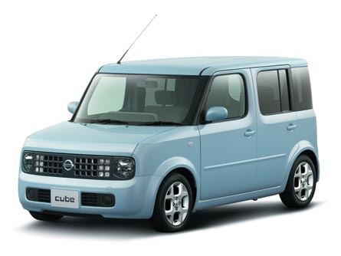
Steering
?

Slide 15
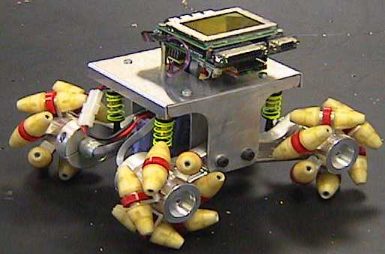
Steering
?

Slide 16
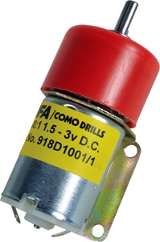
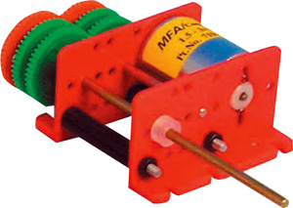
Motors
Getting up the ramp
How much torque?
Prototype to find out

Slide 17
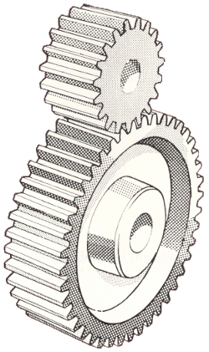
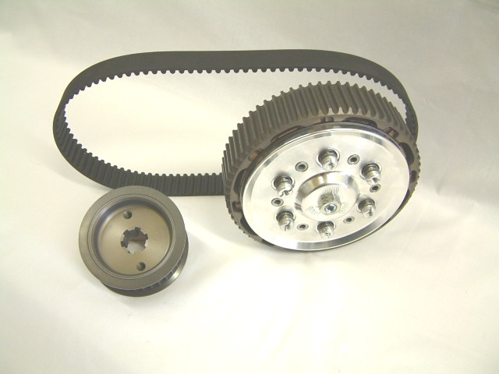
Gearing
Trade speed for torque
Ratio

Slide 18
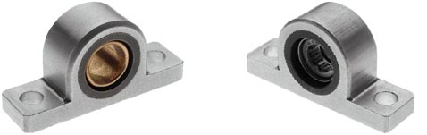
Bearings
Fix the drive components to the chassis

Slide 19
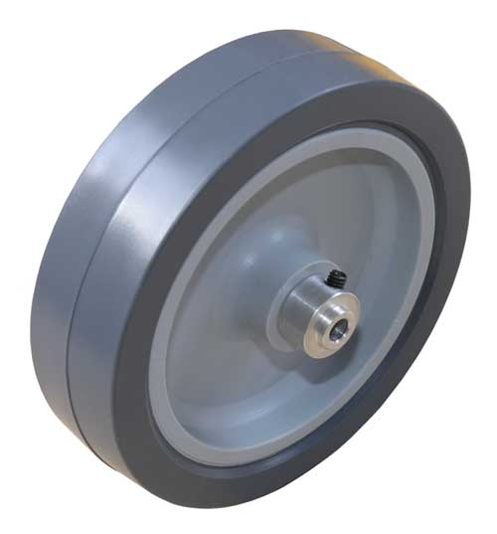
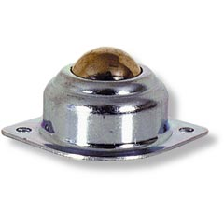
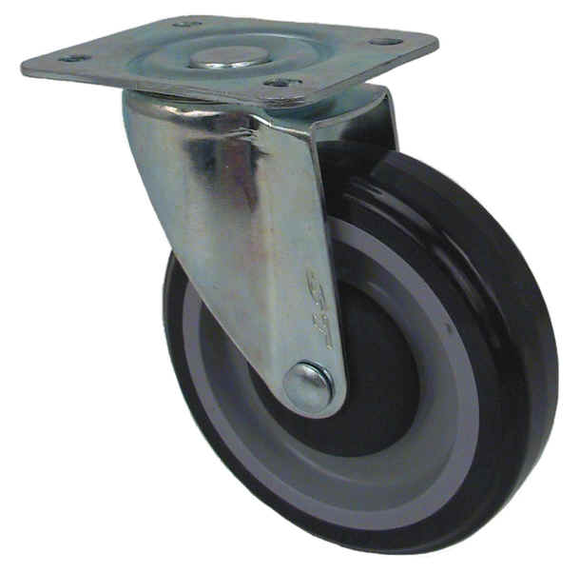
Wheels
Need enough grip
Must keep driven wheels on the ground
Casters / skids for

Slide 20
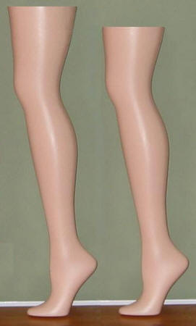
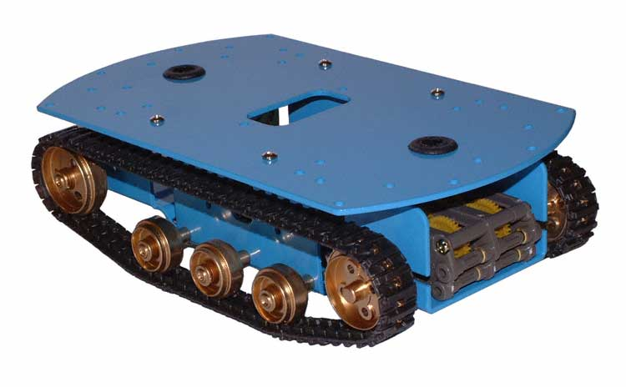
Alternatives

Slide 21
Chassis
Support
Protection
Centre of mass

Slide 22
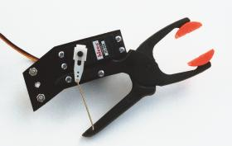
Token Collection
An area for some creative solutions!
Pick up or push?
Carry one or many?

Slide 23
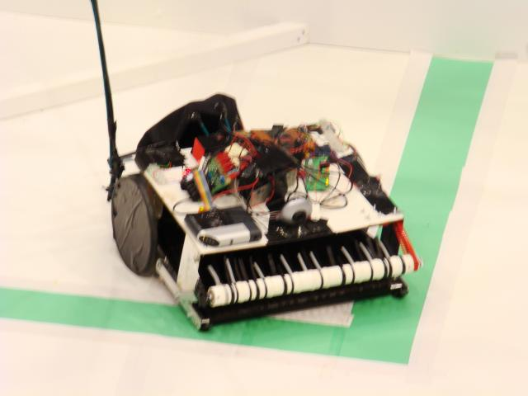
Taunton's Thresher

Slide 24
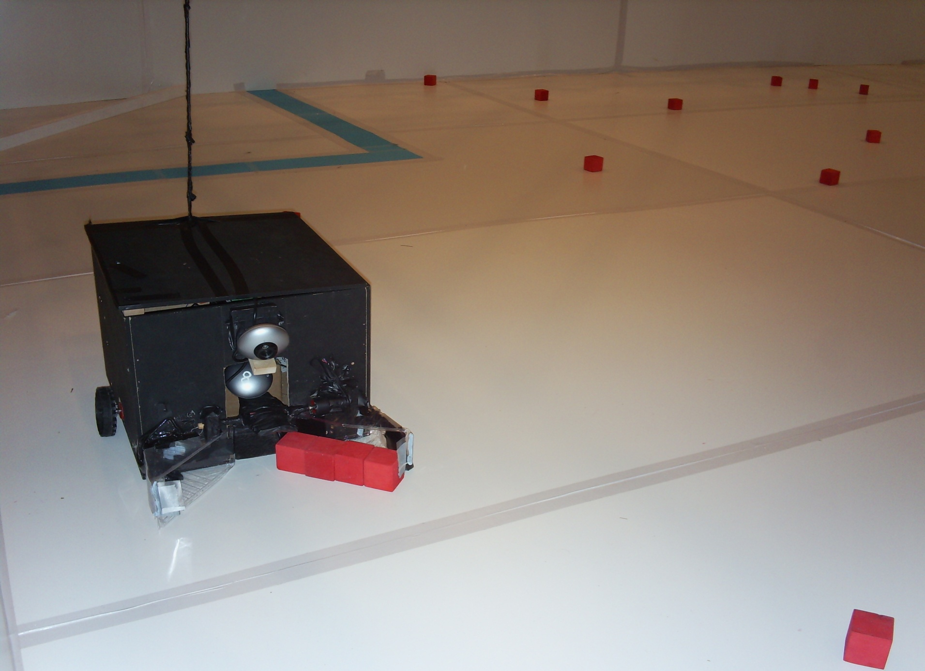
The bodge of St Anne

Slide 25
Buying Things
technobots.co.uk
rswww.com
farnell.co.uk
ebay.co.uk
Hardware shops
B&Q

