Slide 1

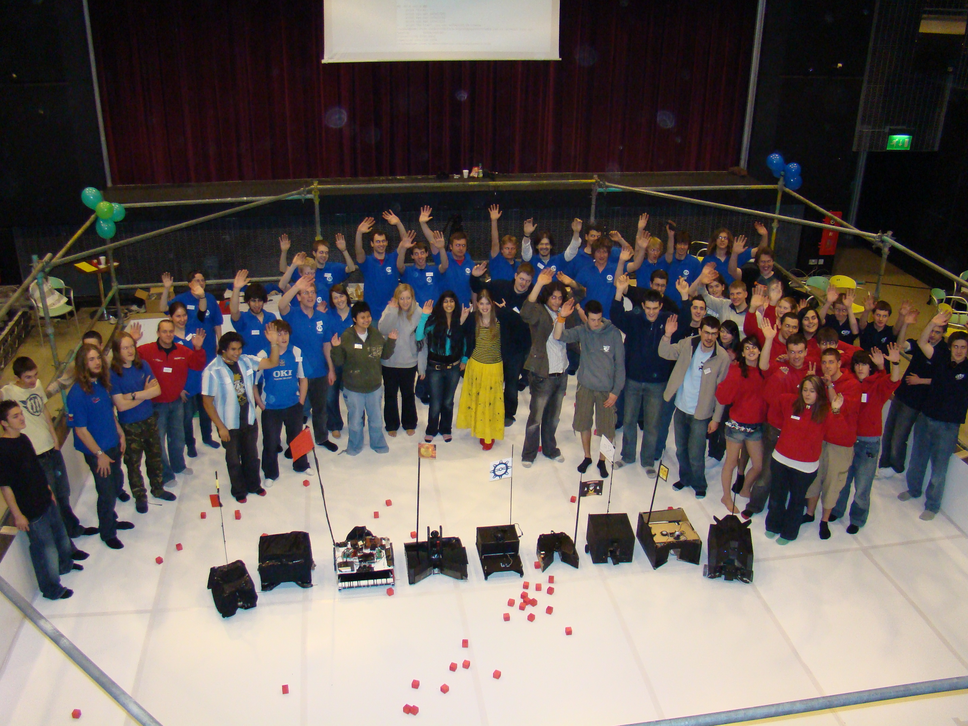
What is Student Robotics?

Slide 2
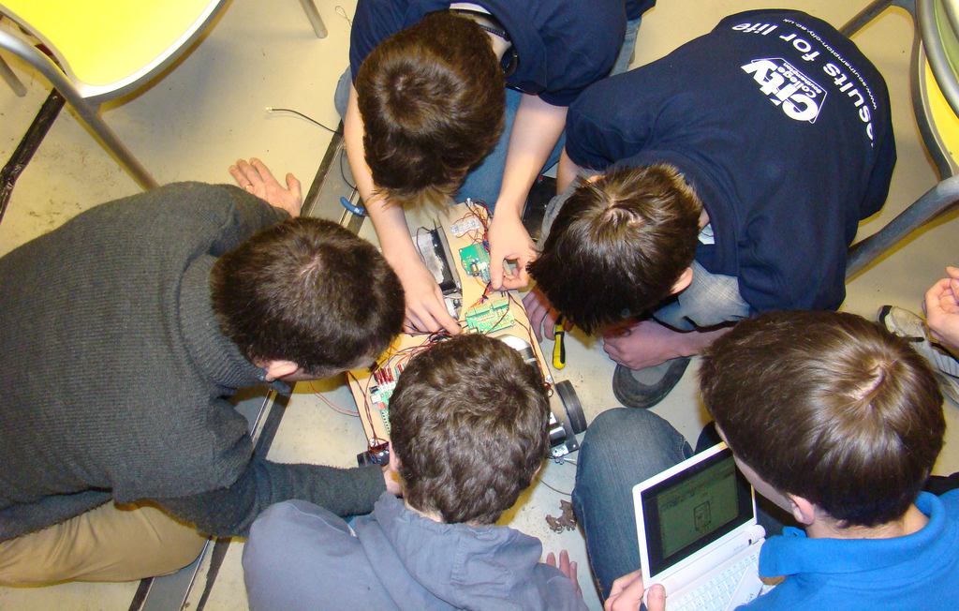
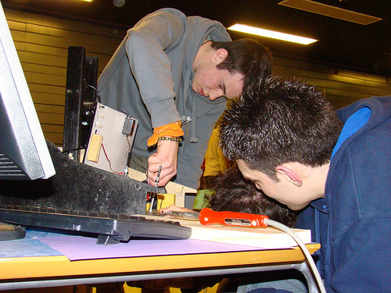
Hardware Hacking
Notes:
Motor Controllers
Control Electronics (Feedback)
Servo Controllers
Microcontroller programming

Slide 3
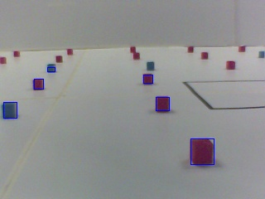
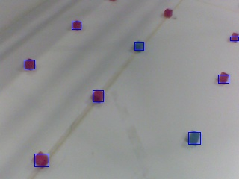

Software Hacking
Vision systems
Embedded Linux
Open source
Notes:
Vision systems
Embedded Linux/C
Open Source
Collaborative programming

Slide 4
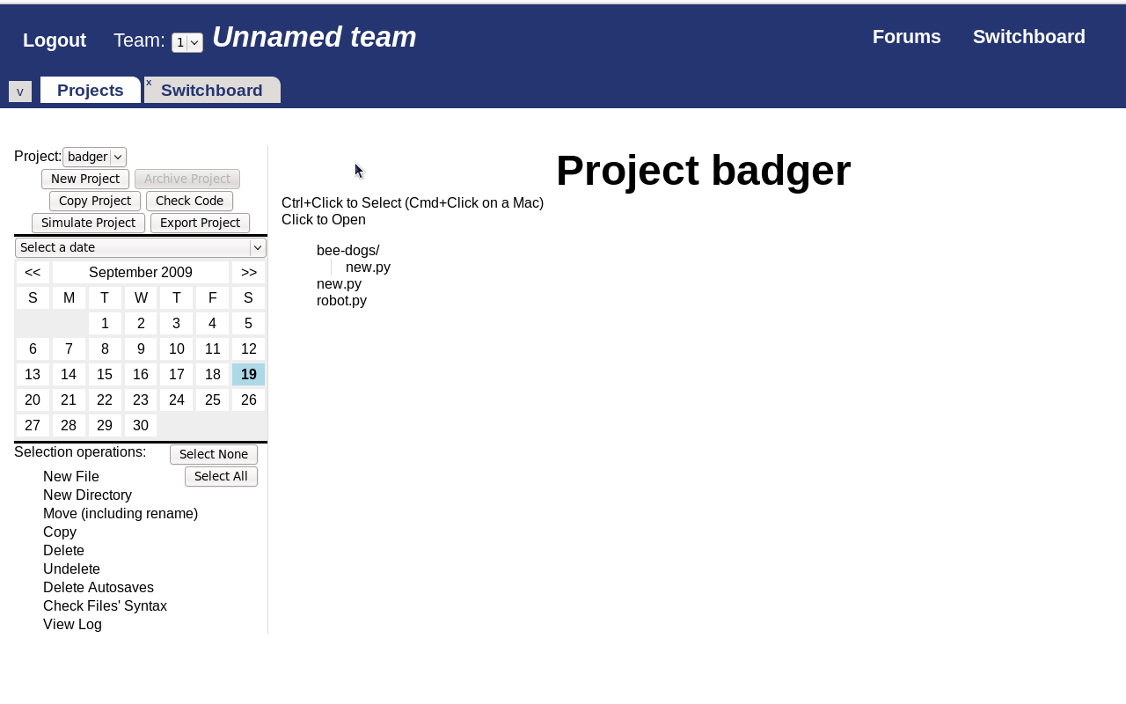
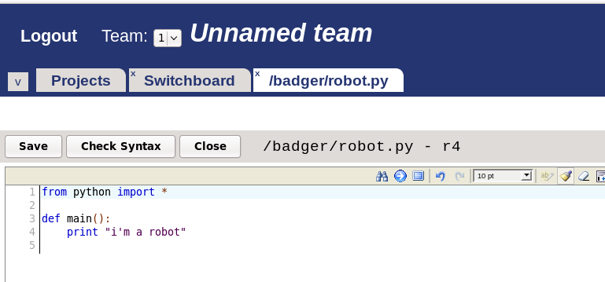
Web Development
Notes:
Python web IDE
Robot Simulators
Forums

Slide 5
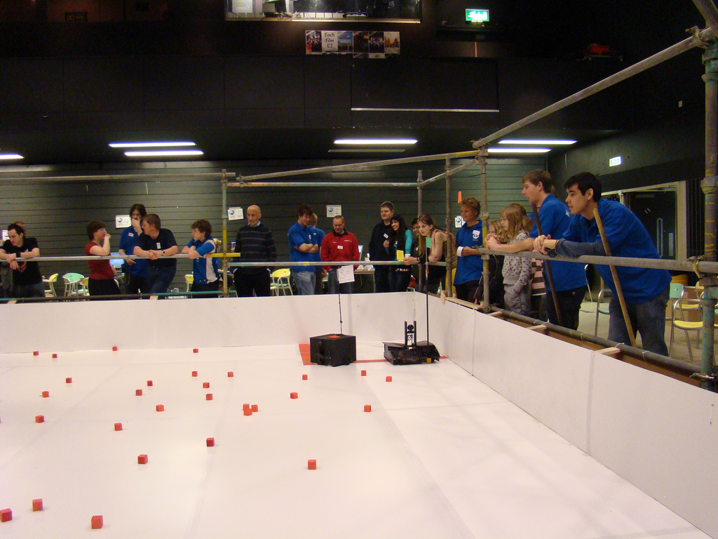
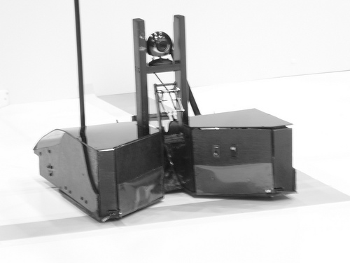
Mechanical Engineering
Notes:
Drive systems
Casing design
Arena construction

Slide 6
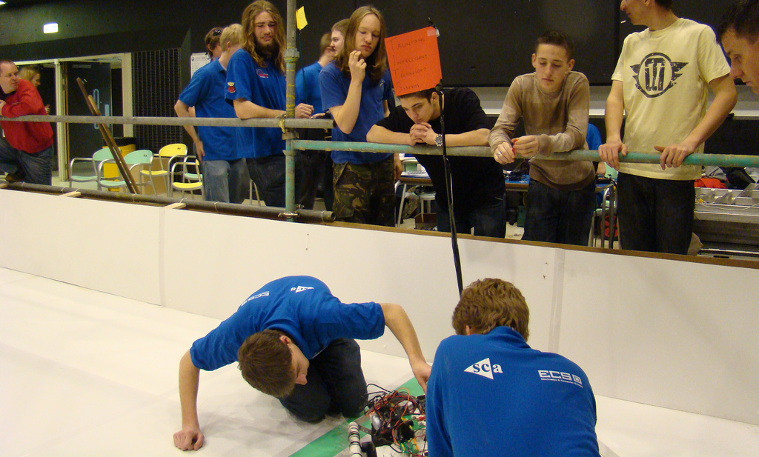
Outreach
Notes:
Promoting engineering
Working with 16-18 year old's

Slide 7
Doings!
Wednesday 7th October
Mountbatten R????
5pm - 11pm
Notes:
Promoting engineering
Working with 16-18 year old's

