Slide 1


Electronics and
Game

Slide 2
Outline
Collect colored tokens
Deposit in team area colored
Navigation
  Vision
  ? Your choice

Slide 3
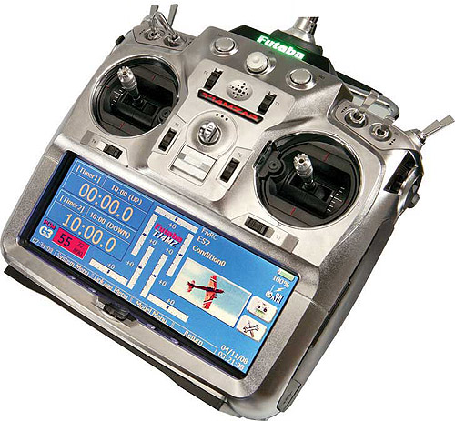
Control
Fully autonomous
  No remote control!!

Slide 4
Demo robot
5 Days
  You should do better

Slide 5
Arena
8x8m (4 times bigger than today)

Slide 6
Boards/Parts
Electronic parts in third phase.
Pre-made PCB's and support materials
System works as a whole, expansion possible/encouraged
Notes:
Pcbs
wire
crimps
switches
standoffs

Slide 7
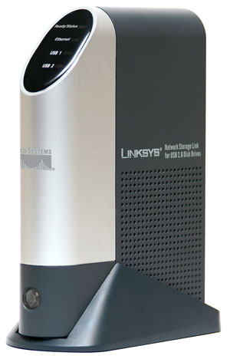
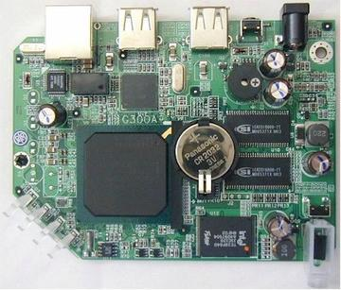
Slug
“Brain” based on modified Network attached storage device(Linksys NSLU2)
Runs custom LINUX
Keep in box
Filesystem on USB key

Slide 8
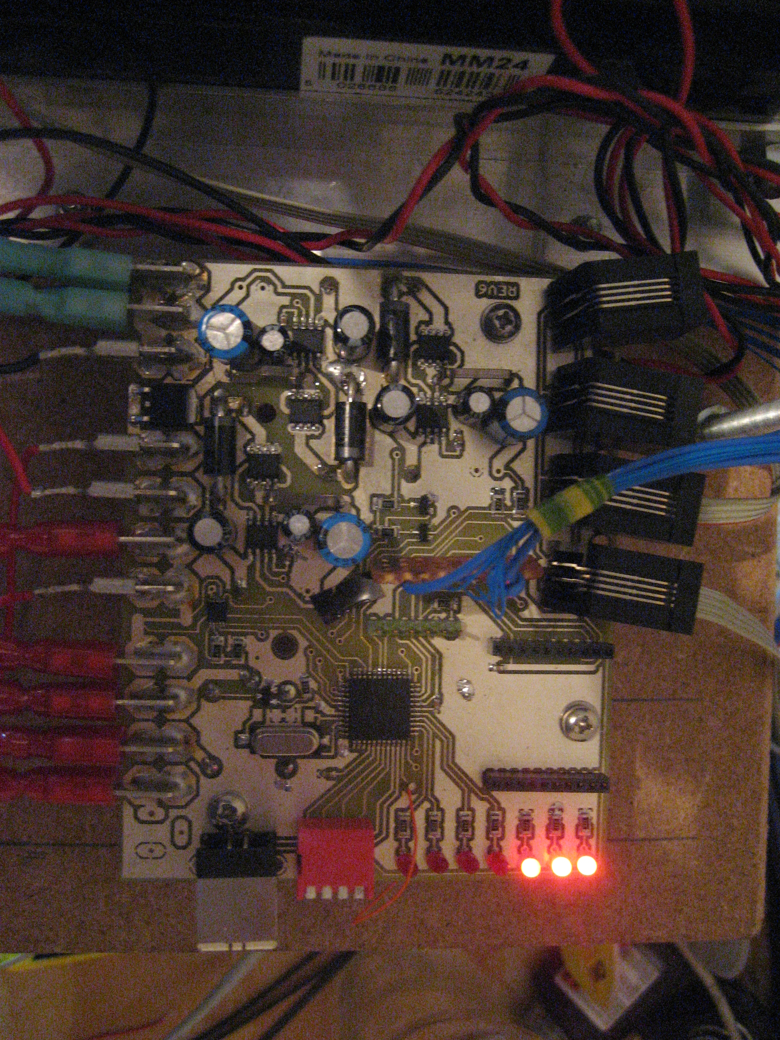
Power board
Power regulation and control
Distributes signals
Usb interface for software upload

Slide 9
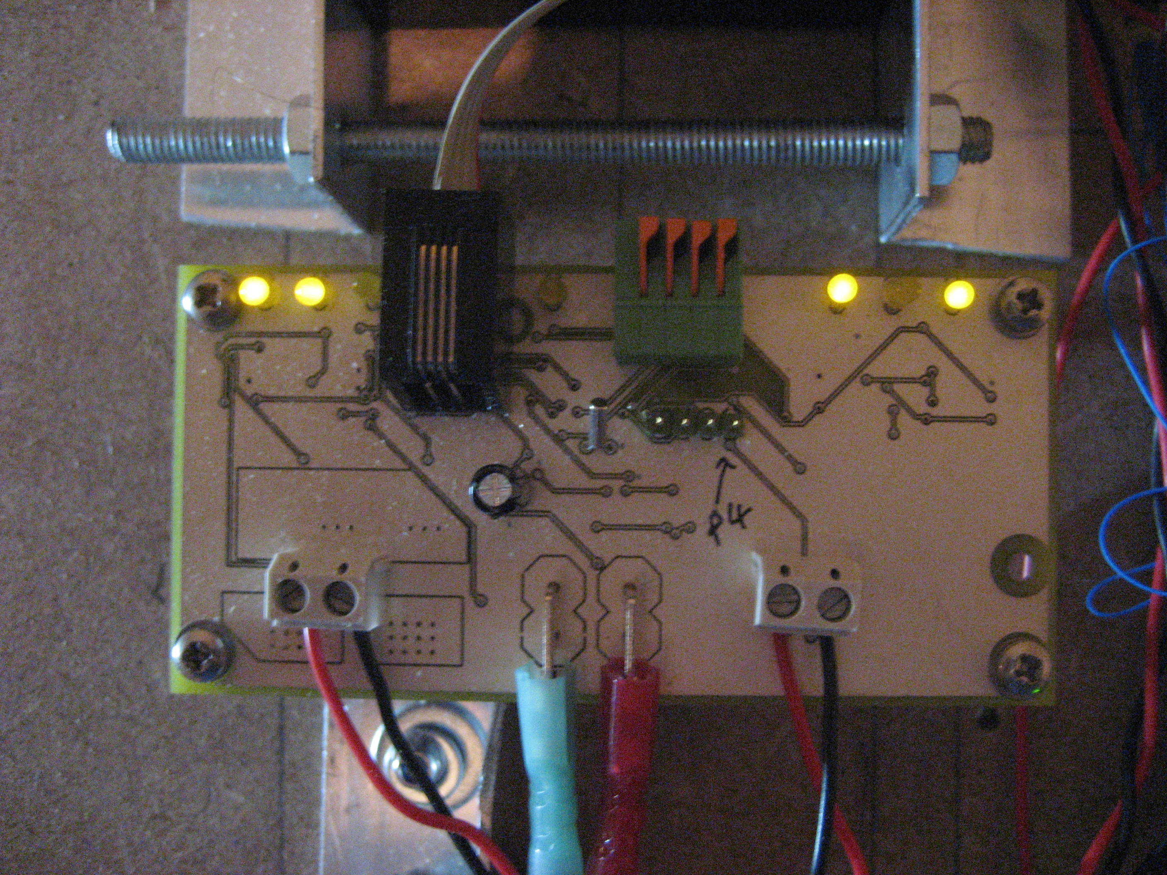
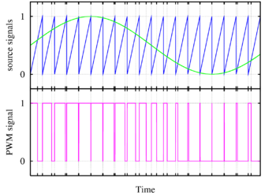
Motor controller
2 Bi-directional outputs
Speed control by PWM

Slide 10
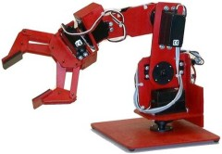
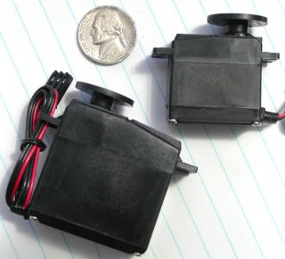
Servo
Six channels
Maximum 8 servos (2 paired)
“Servo 3 to position 90 deg”

Slide 11
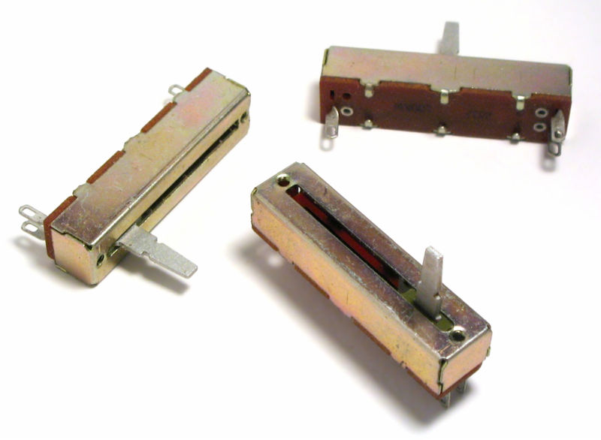
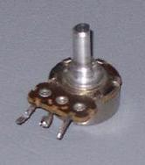
ADC
Provides 8 analogue inputs
Analogue World
Digital system

Slide 12
DIO
Inputs from switches/ logical sensors.
Outputs to drive relays/LEDs/custom electronics
More complex (multiple)inputs – shaft encoder etc

Slide 13
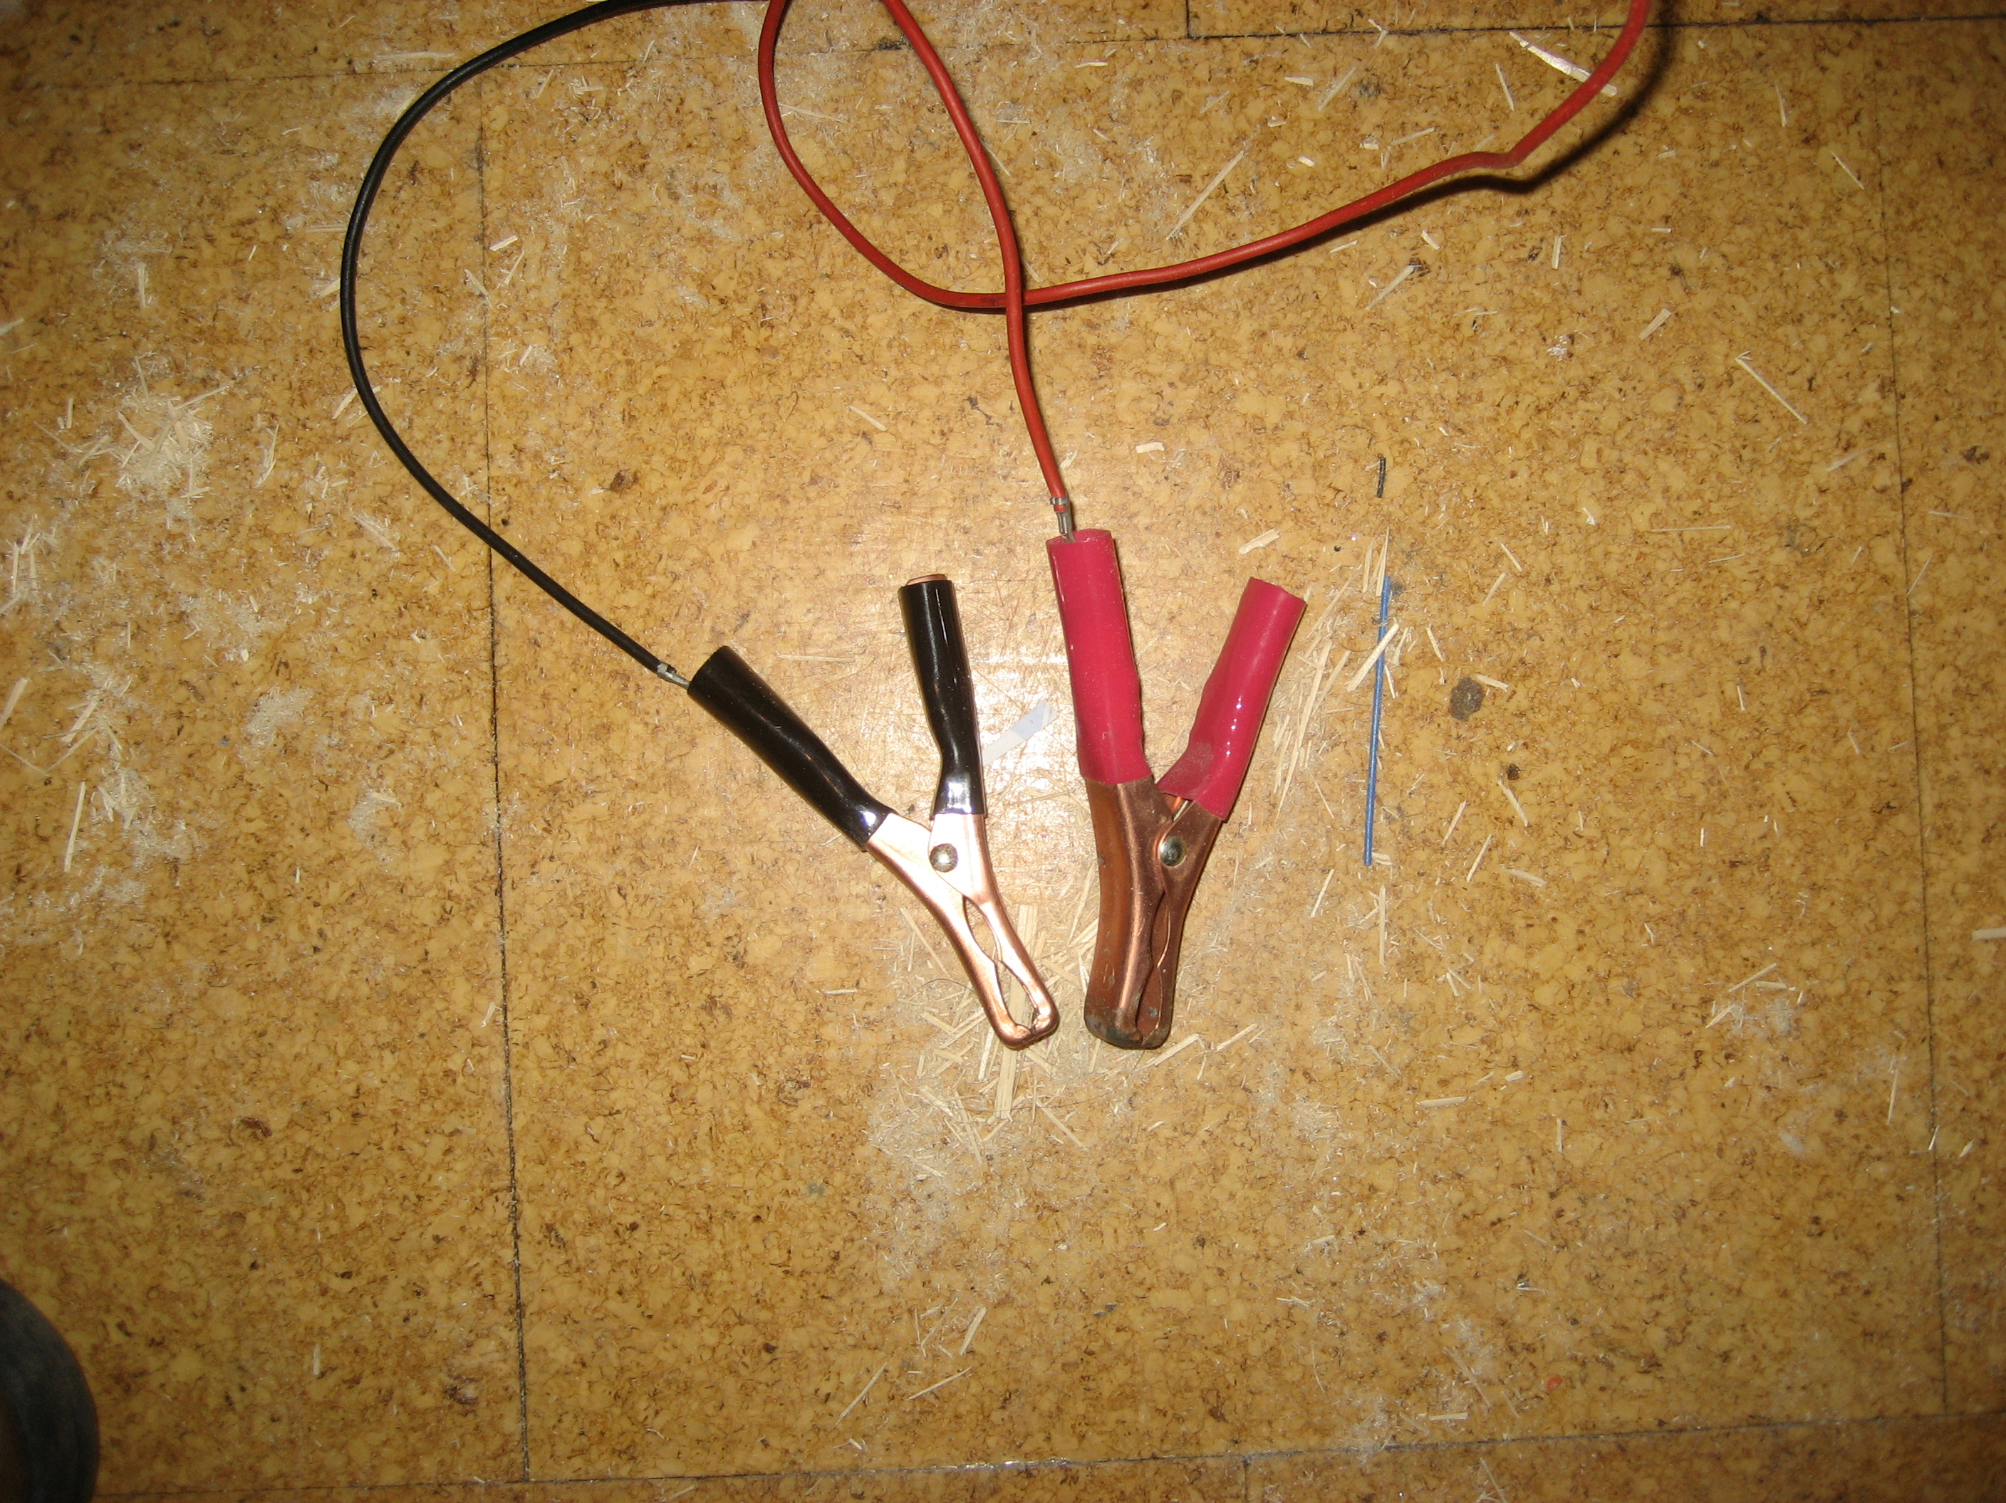
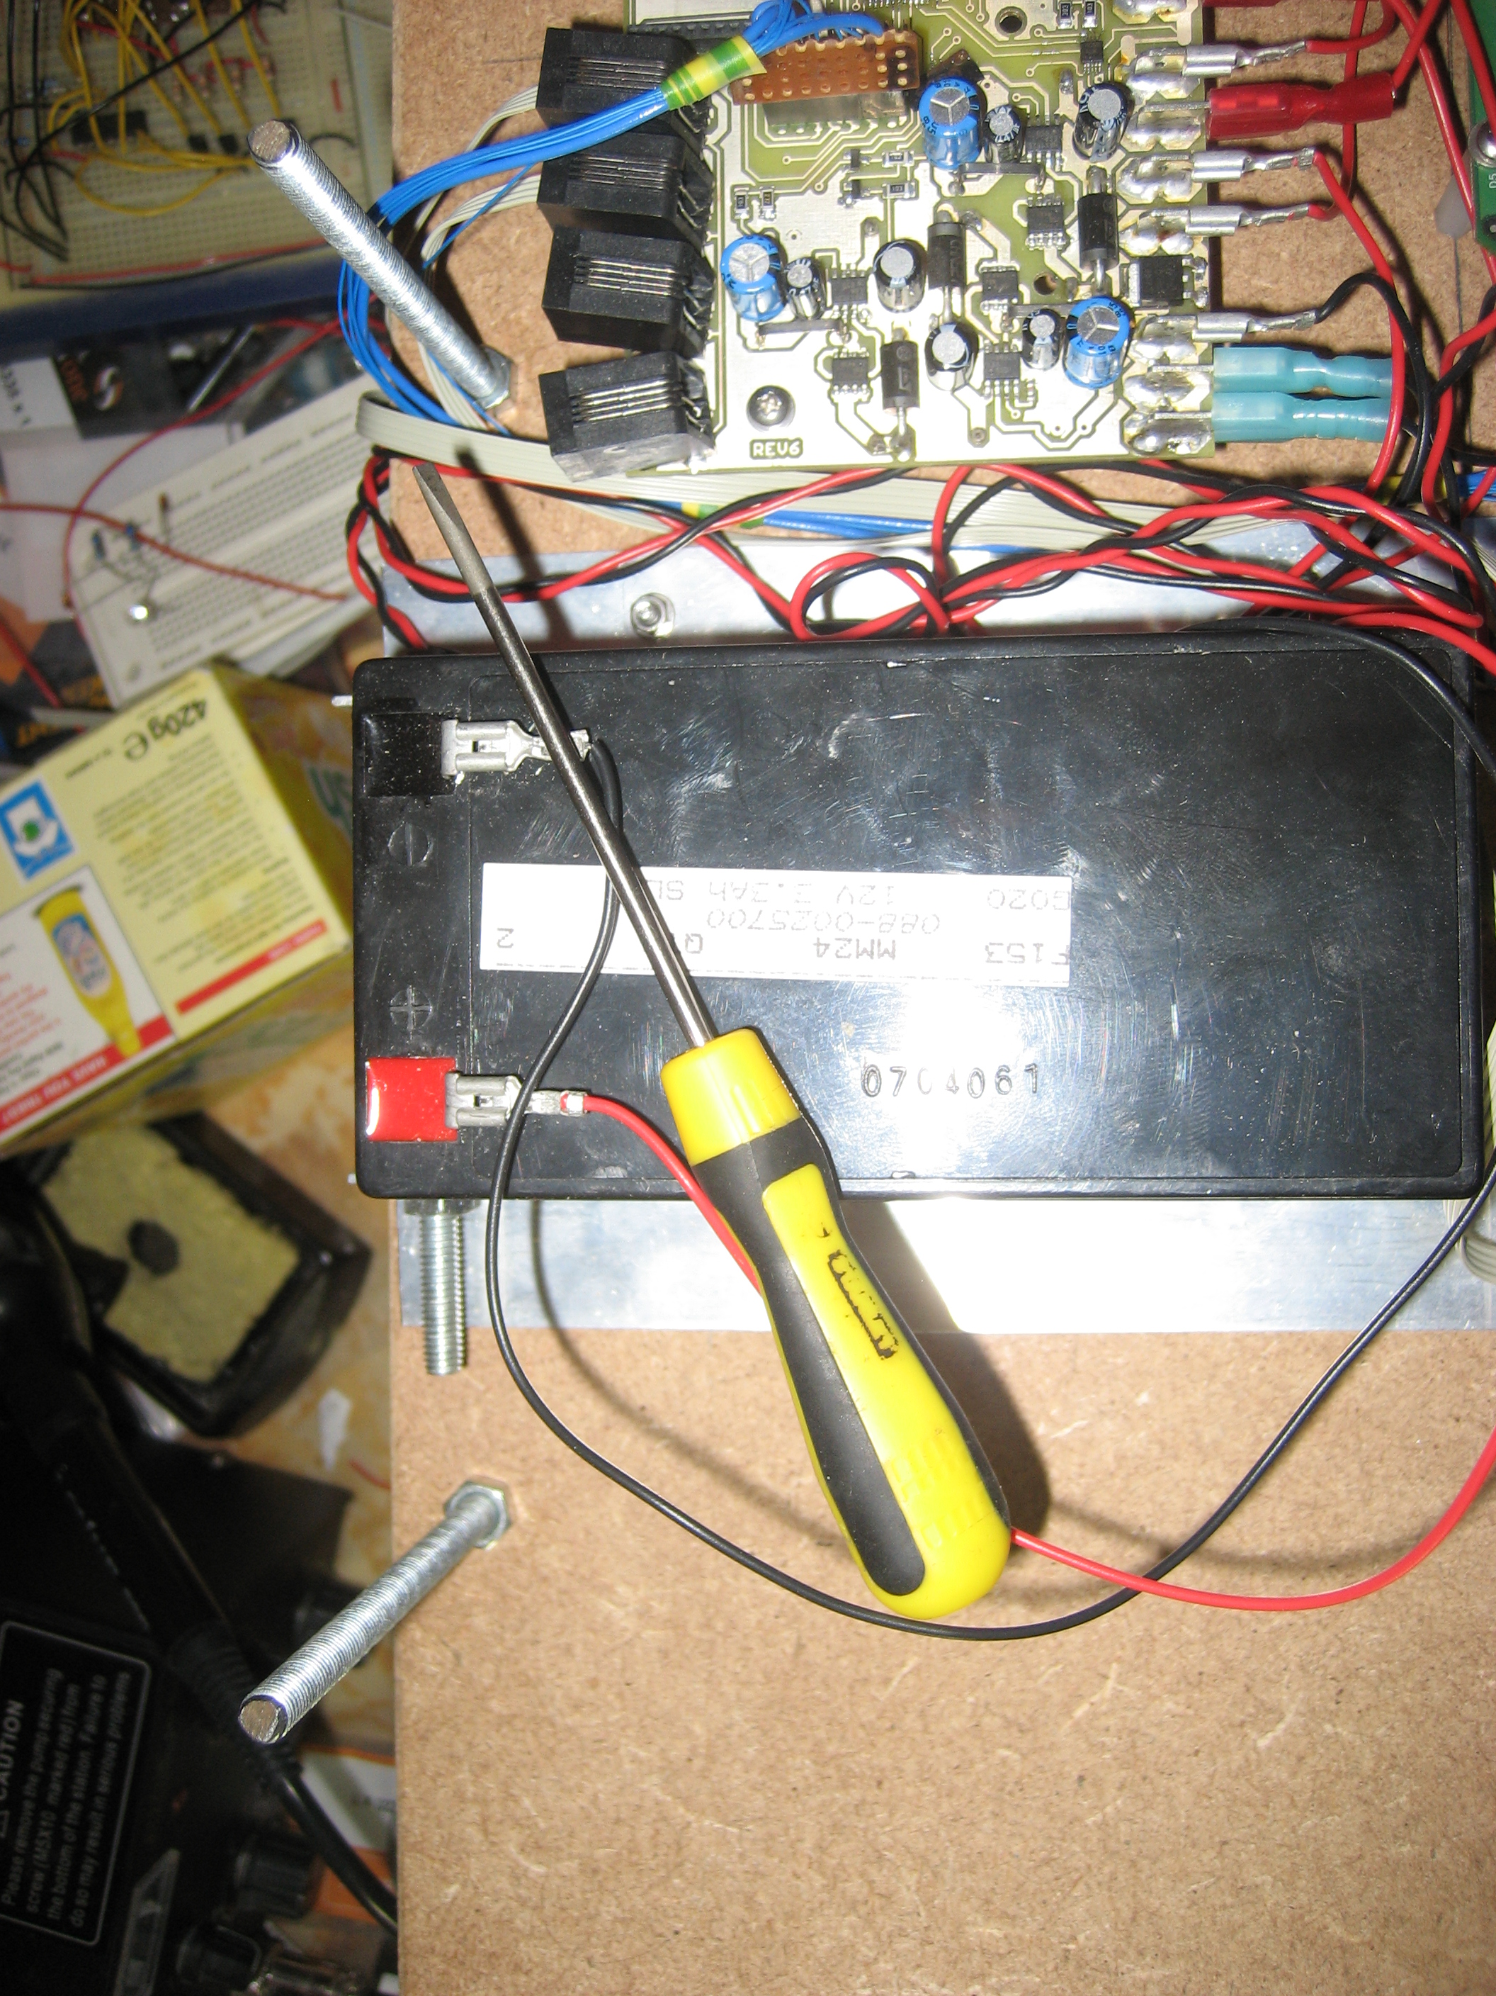
Battery and charging
Provided with one battery and charger.
Battery should last several hours.
Charged on board.
Charging possible whilst using electrical system
  Motors disabled

Slide 14
A/D choice
Pull up
Potential divider

Slide 15
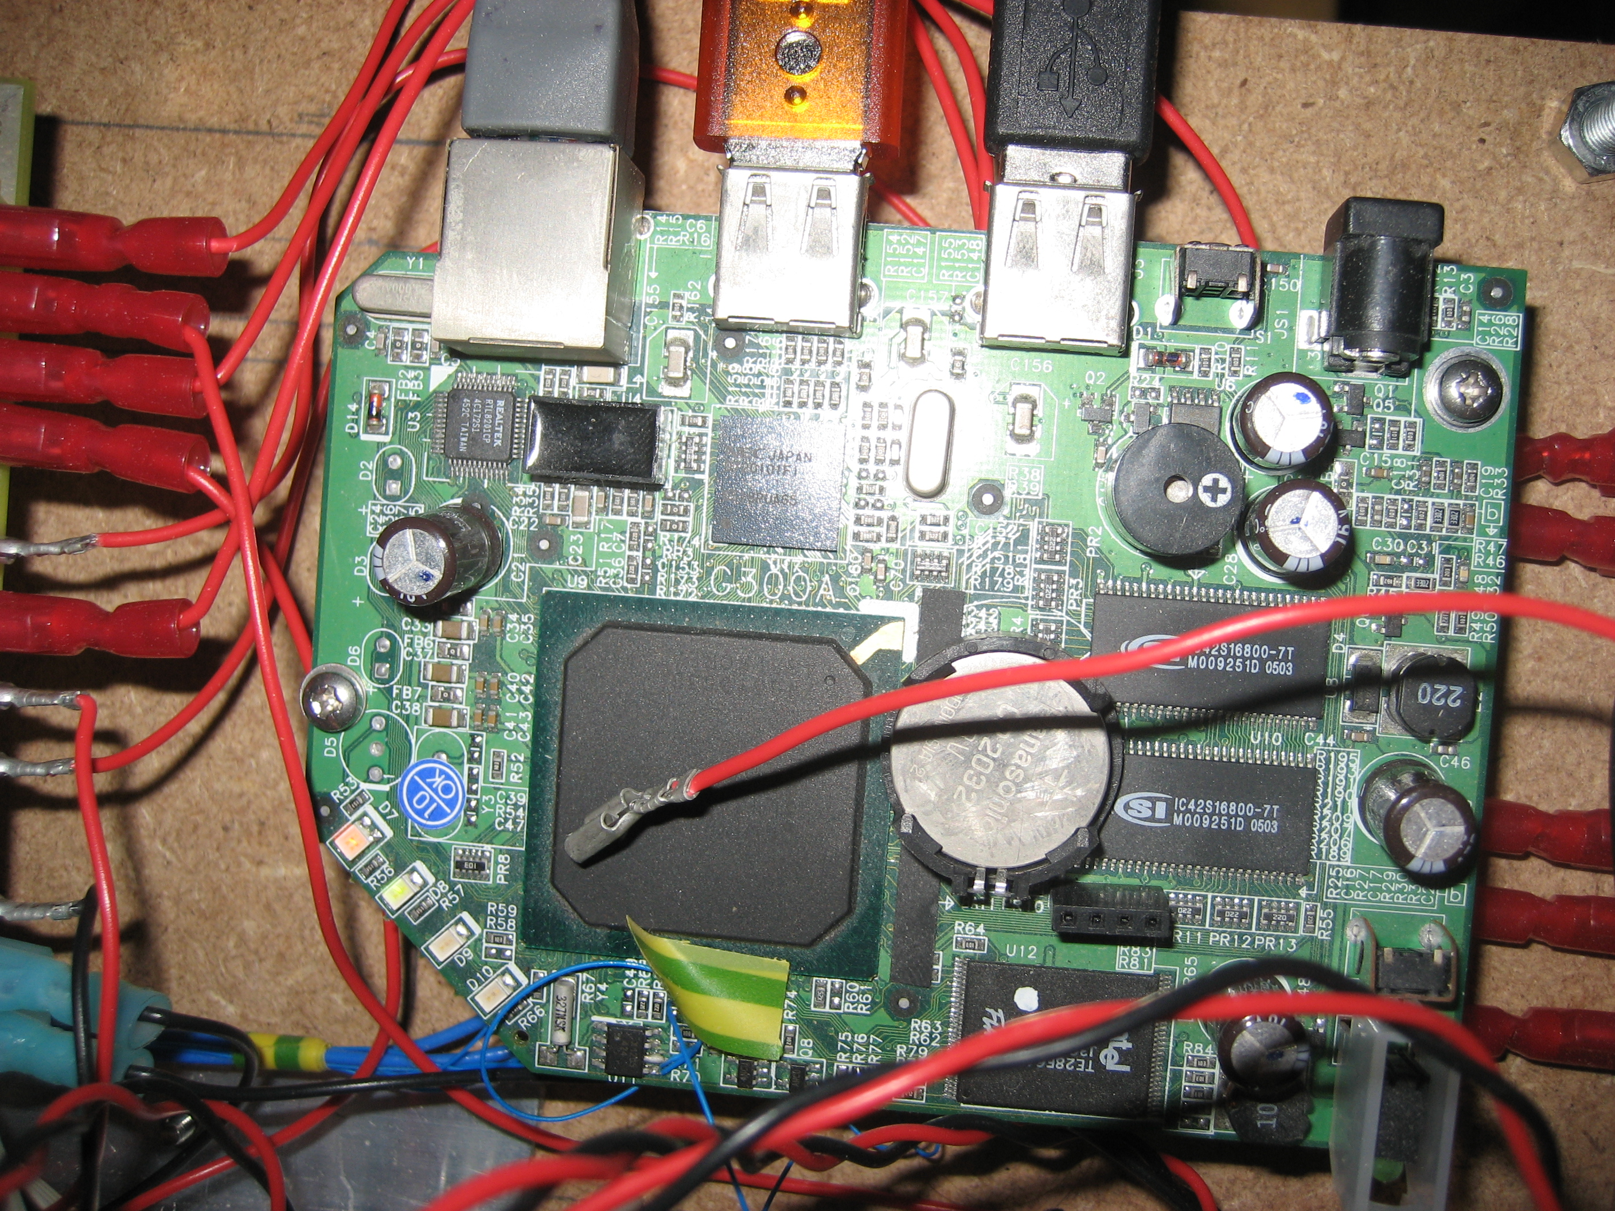
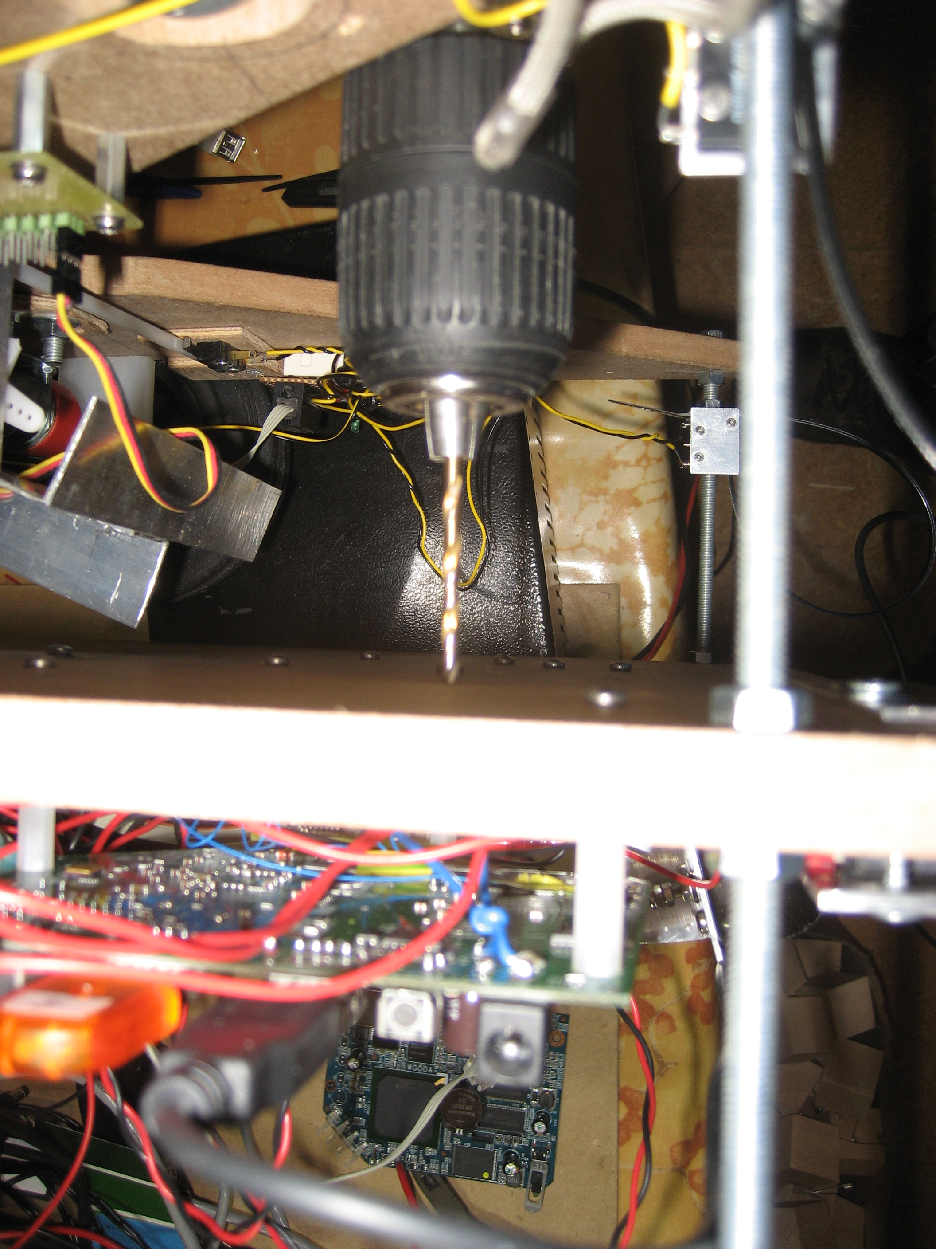
Protection
Keep under cover
Be careful not stress when mounting
No poke/drill
Swarf
Dangling wires

Slide 16
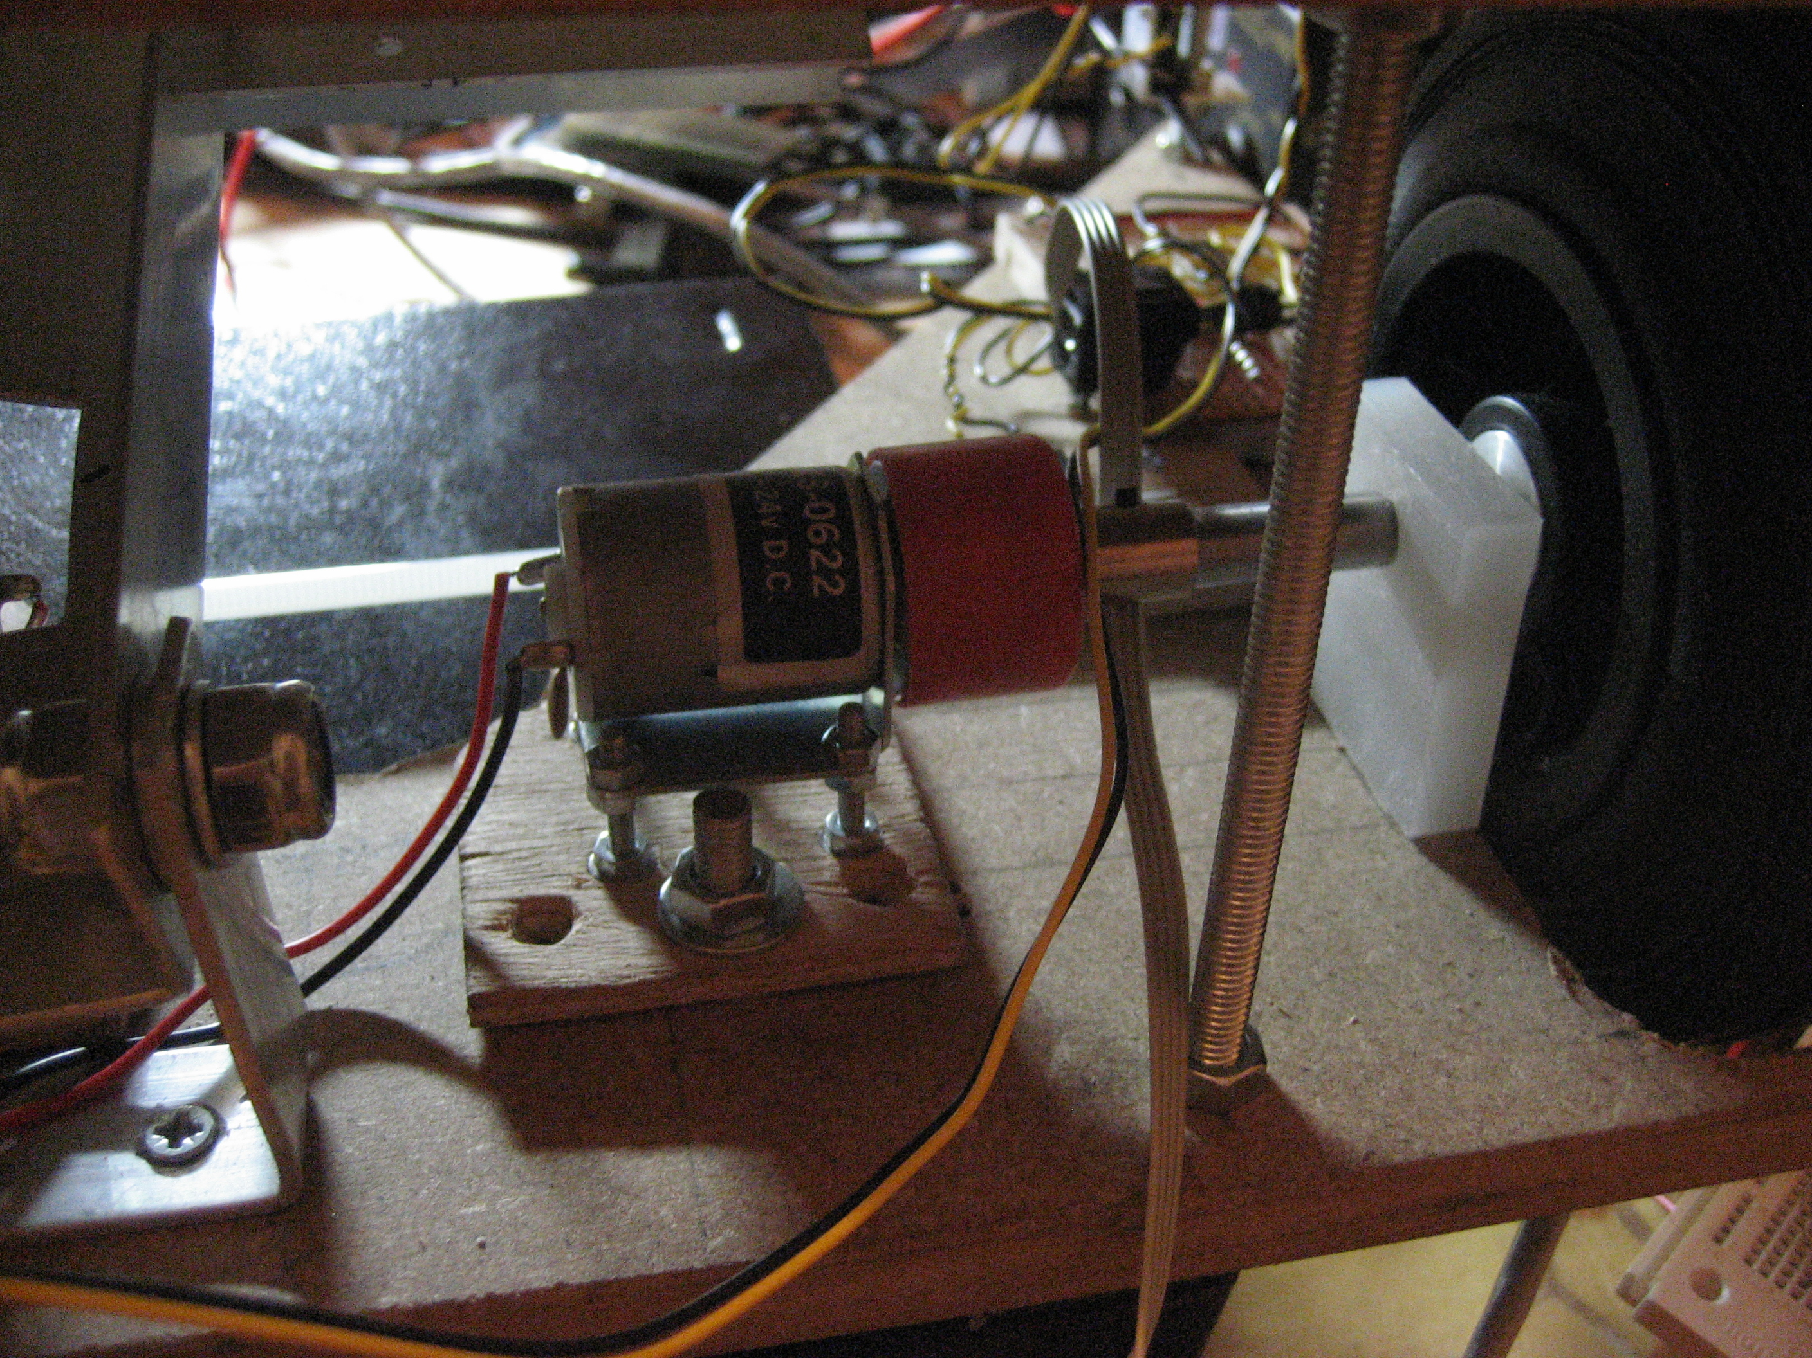
Wiring
Correct gauge
Color coding – use it
Labeling
Leave slack – not to much
Route sensibly
Crimps

Slide 17
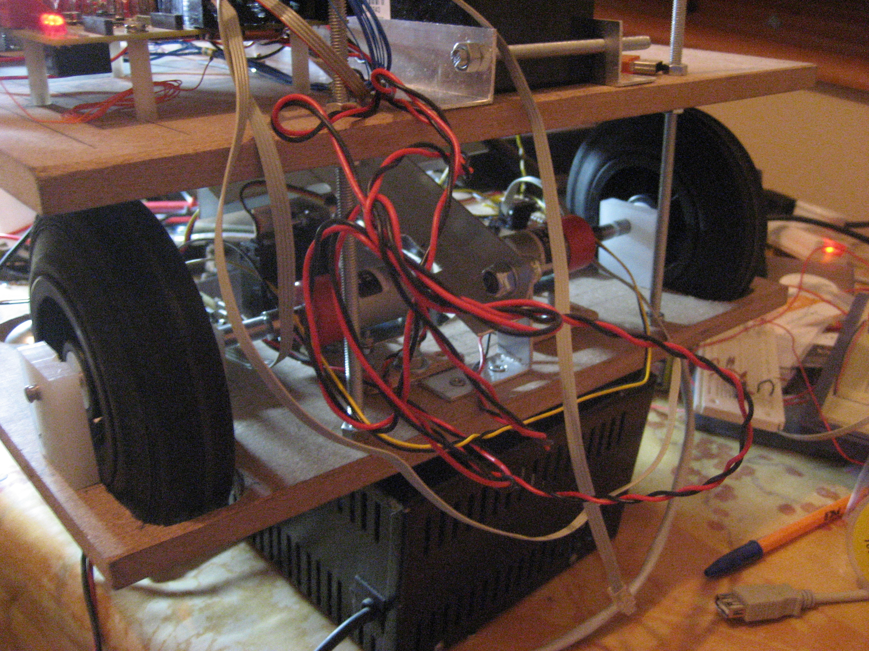
Bad

Slide 18
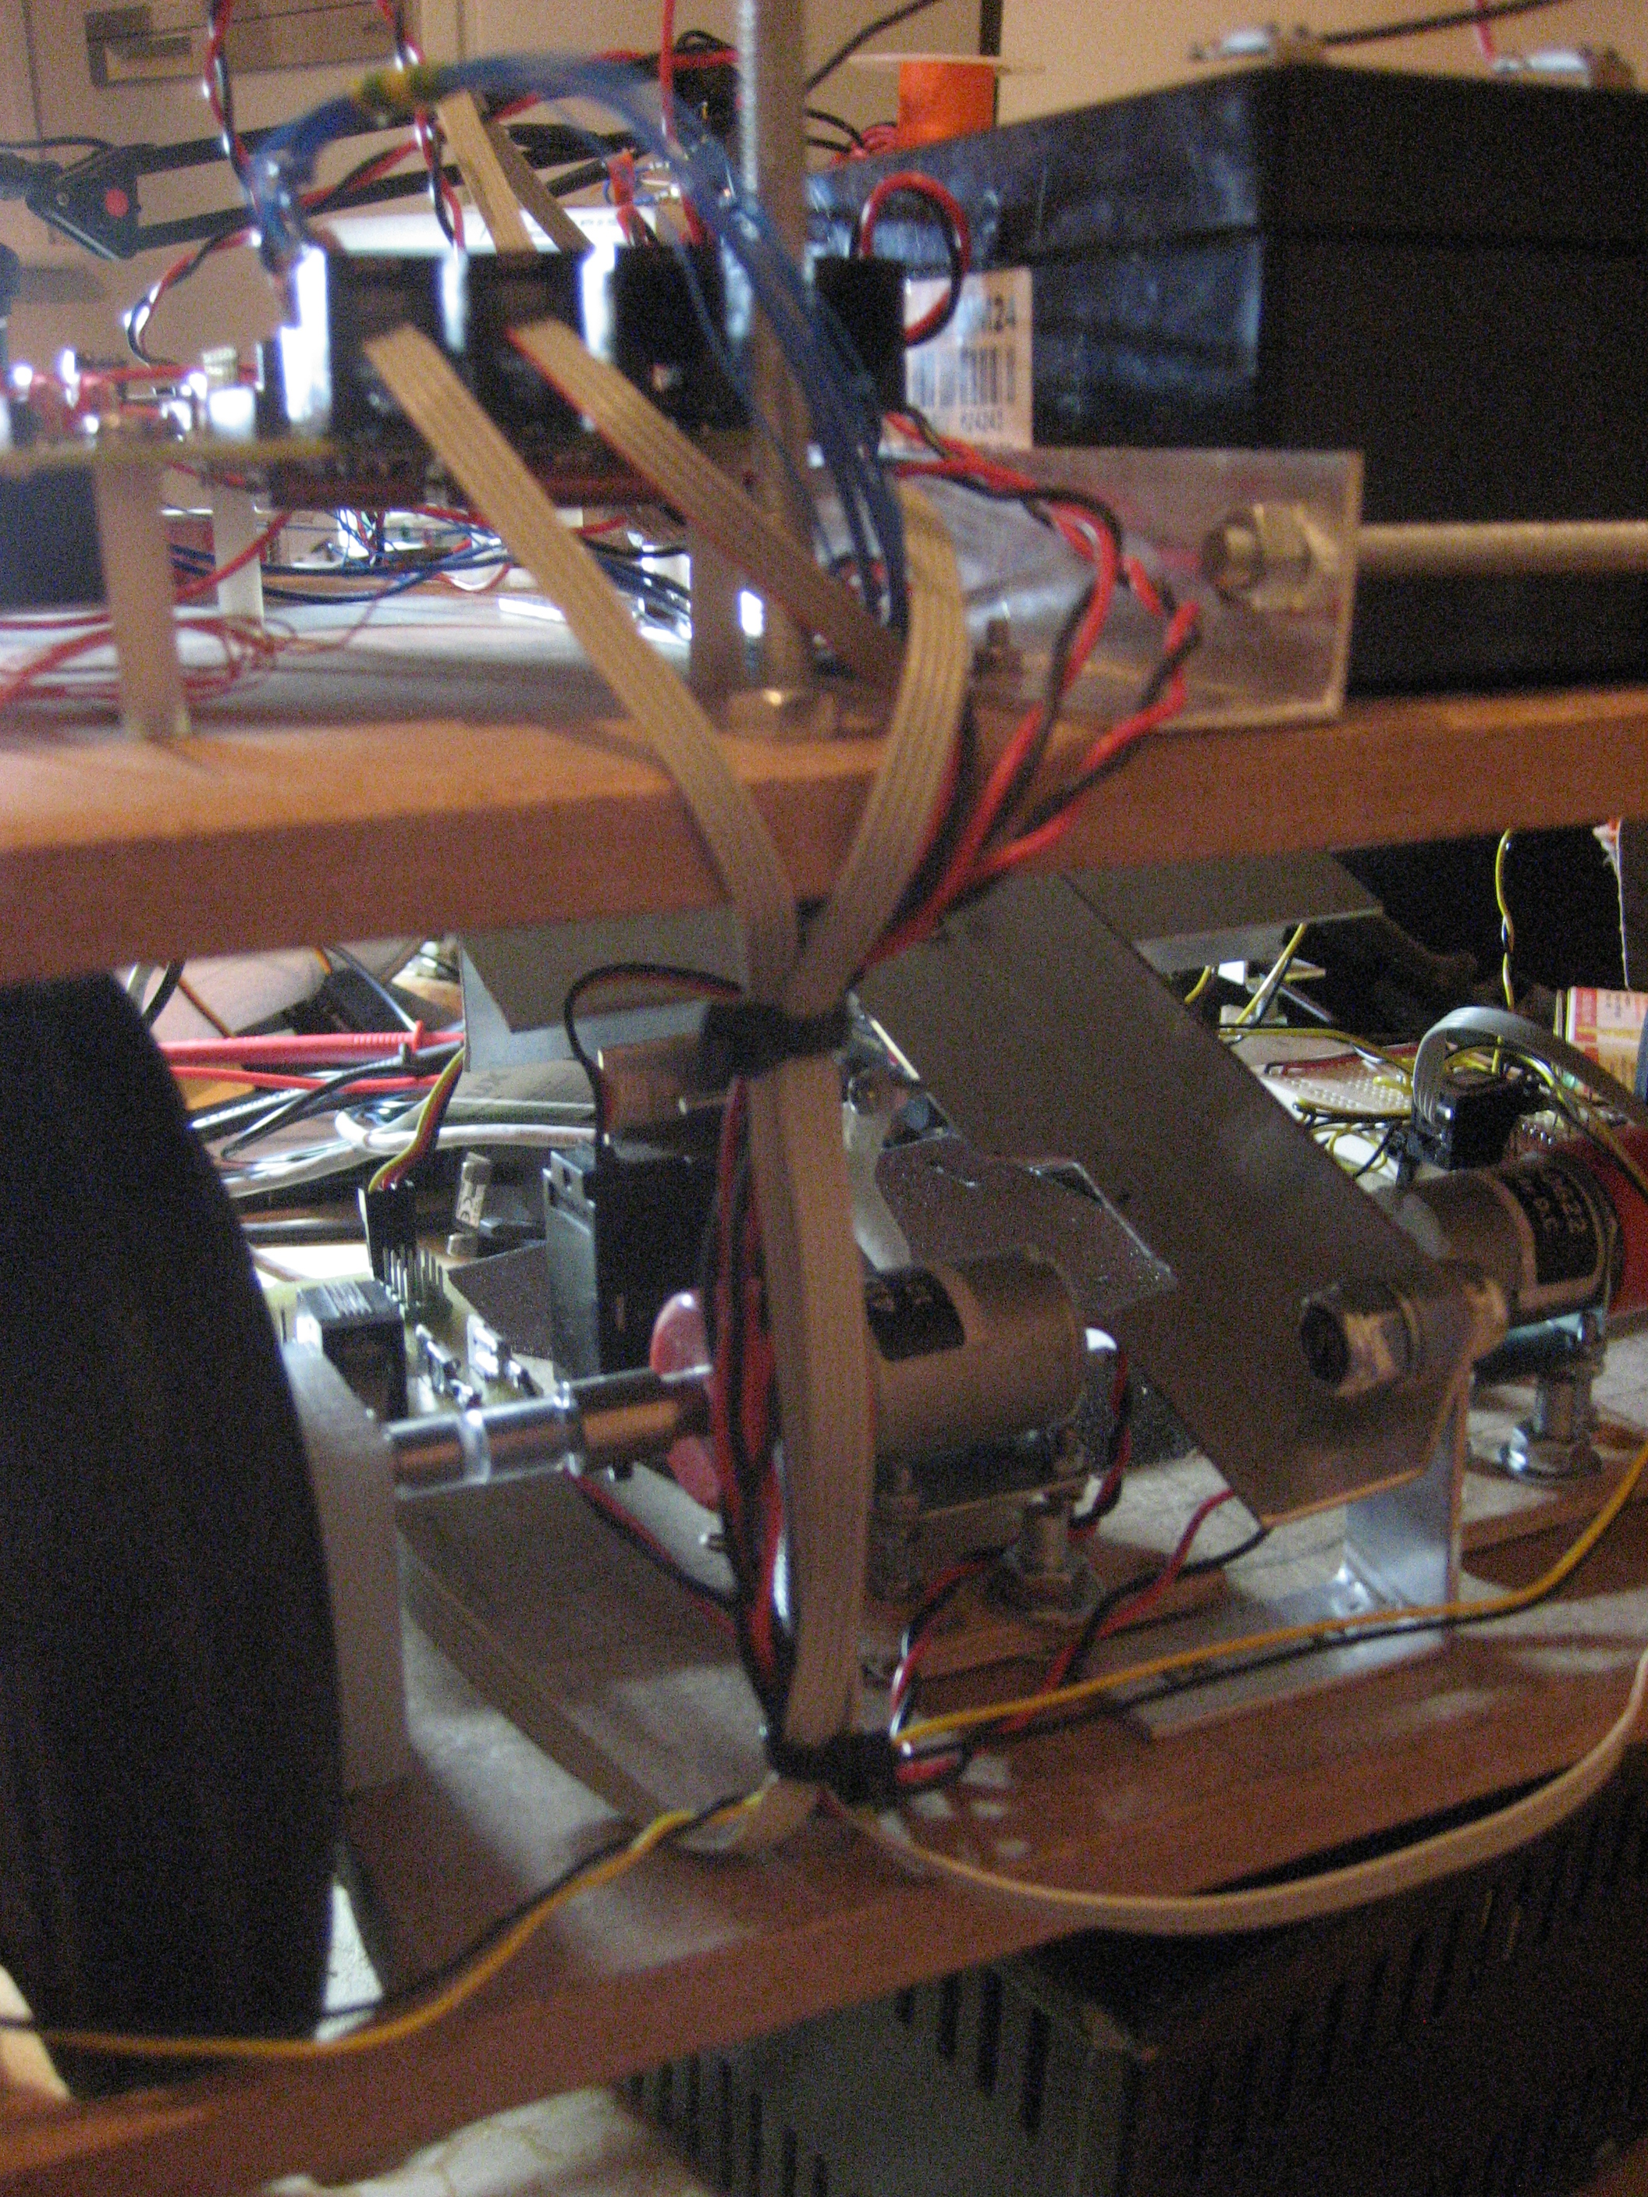
Good

Slide 19
Remote Stop
Will be given radio module, mode disabled by switch on power board
Put motor switch somewhere sensible

Slide 20
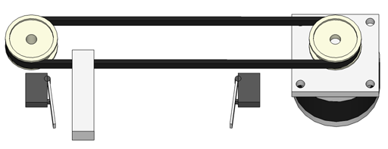
Feedback
Where is your arm/wheel/spatula?
  Analogue – constant position
  Digital – limit switch?

Slide 21
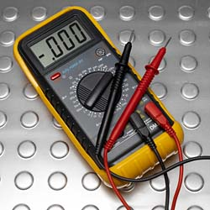
General electronics wisdom
DEBUG!
  Test in sections
  Have you turned it on/plugged it in?
  Debugging - start at the simplest thing

Slide 22
Summary
Look after the boards
Test incrementally
THINK
  Before and after
ONE LAST THING

Slide 23
Algorithm
Two Volunteers ?

