Slide 1
How to Juggle.
Rob Spanton

Slide 2
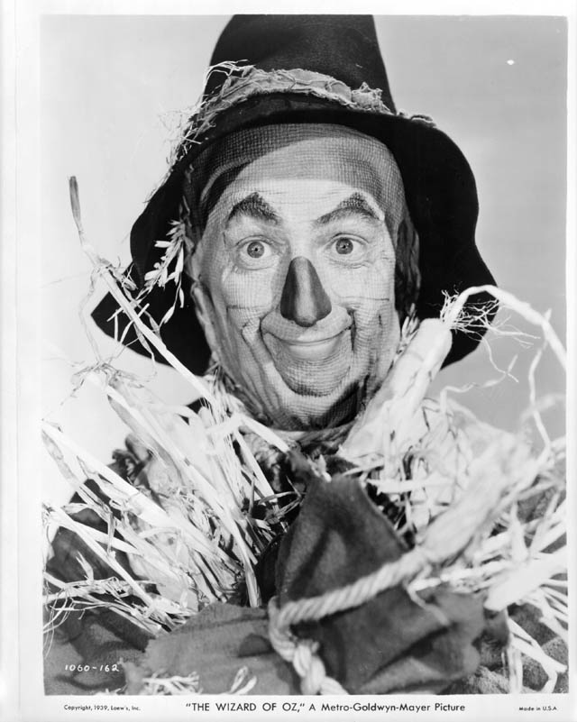
Robots Need Brains!

Slide 3


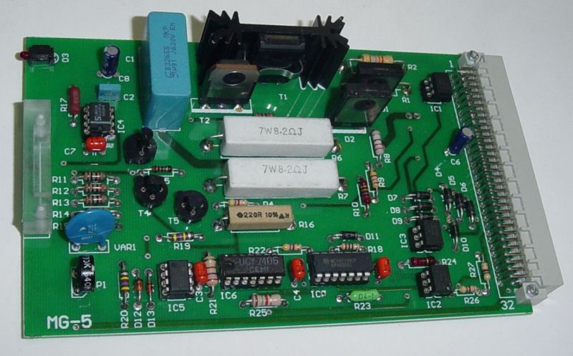
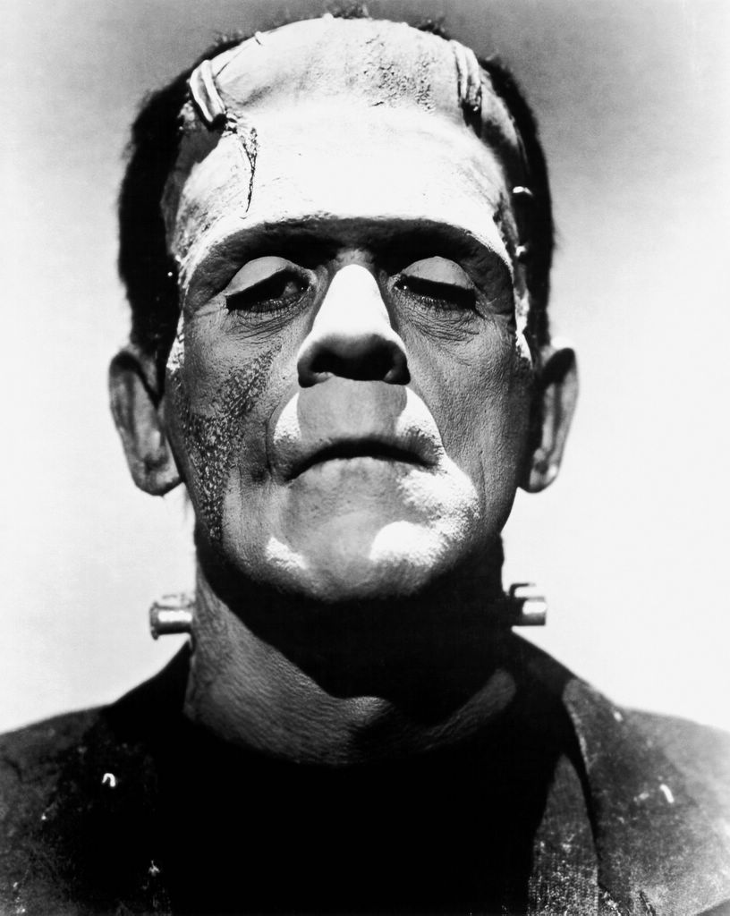
Robot Software
How to bring your Robot to life.

Slide 4

Programmers

Slide 5

Python

Slide 6
Event Based
Wait for Event
Respond to Event

Slide 7
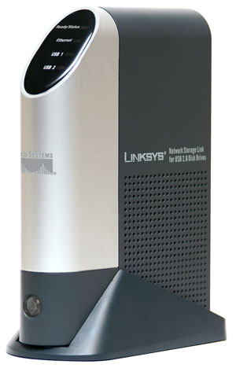
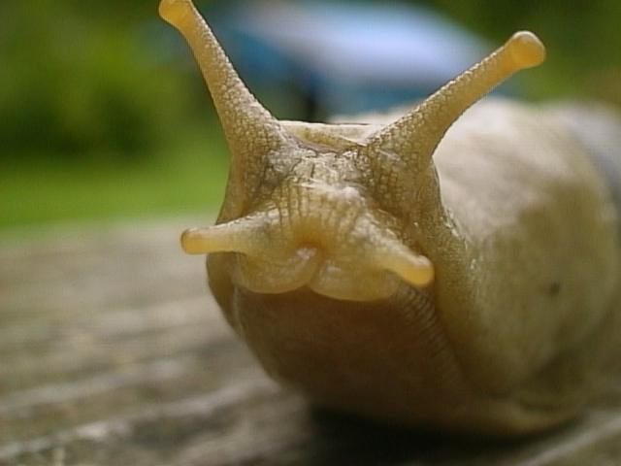
Processing

Slide 8
Example

Slide 9
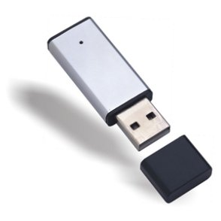
Loading Software

Slide 10

Debugging

Slide 11
Development Cycle
Build
Test
times a million.

Slide 12
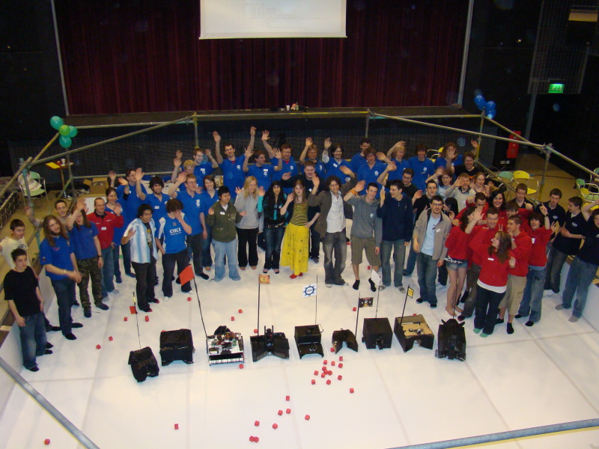
Community

Slide 13
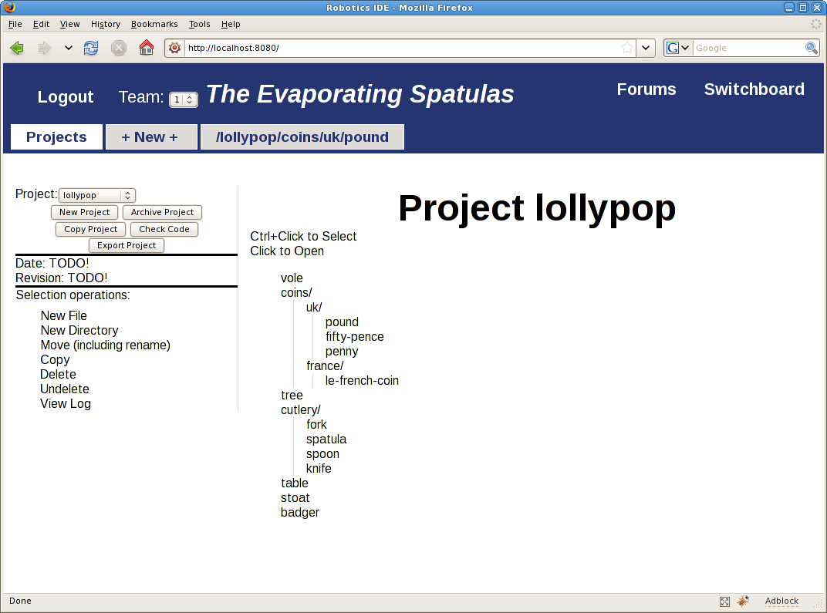
RoboIDE

Slide 14
Feedback

Slide 15

Experiment

Slide 16
What if?

Slide 17
Nothing is Fixed

Slide 18

Photo Source: rumpleproofskin on flickr

Slide 19

Finally
Small Steps

