Slide 1
How to use Subversion
Chris Cross and Rob Spanton
{ccross,rspanton}@studentrobotics.org
www.studentrobotics.org

Slide 2
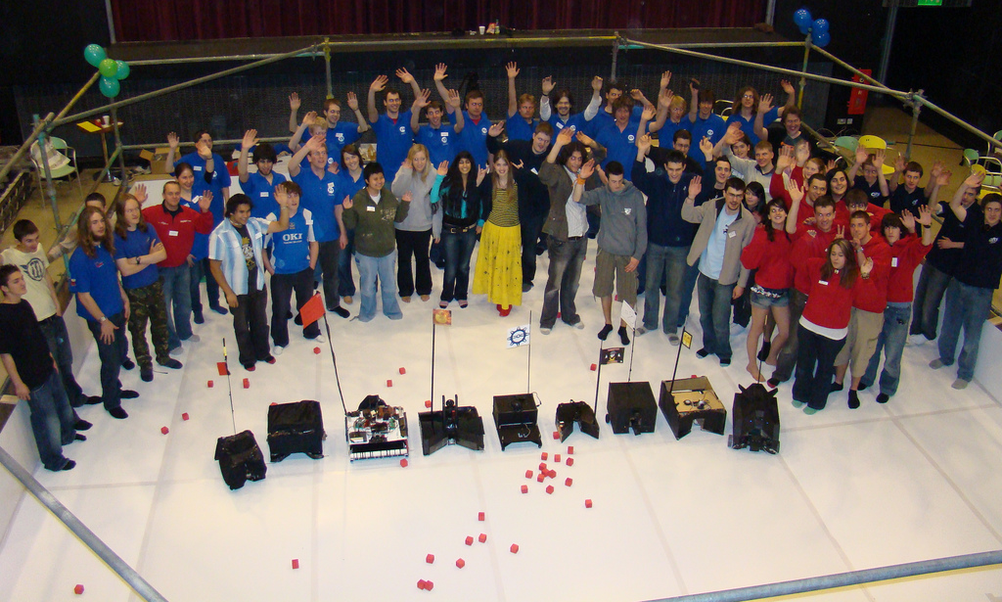
Who we are

Slide 3
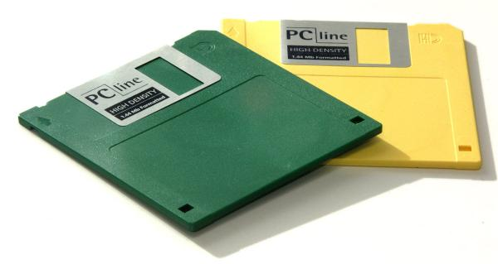
Problem

Slide 4
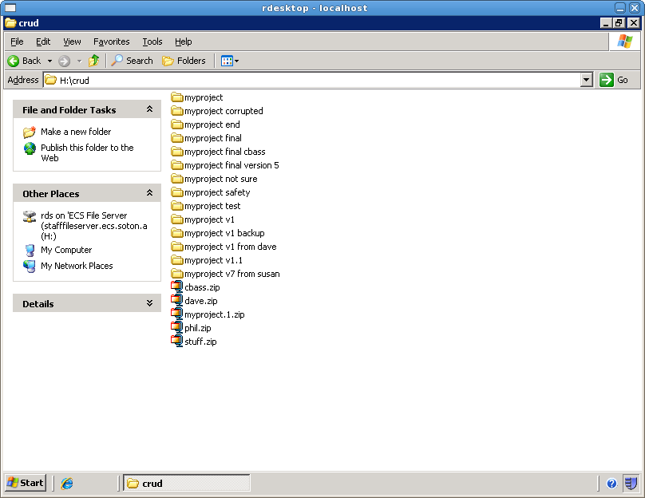
Pain

Slide 6
Solution
Subversion
CVS
Git
Monotone
Bazaar
Microsoft Visual SourceSafe
IBM Rational Clearcase
Darcs
Mercurial
Svk
Bitkeeper
GNU arch

Slide 7
What is Subversion?
“Subversion is a free/open source version control system. That is, Subversion manages files and directories, and the changes made to them, over time.”
Subversion documentation – Collins-Sussman et al.

Slide 8
What is Subversion?
This allows you to recover older versions of your data or examine the history of how your data changed. In this regard, many people think of a version control system as a sort of “time machine”.
Subversion documentation – Collins-Sussman et al.

Slide 9
Applications
Group work
  D4
  GDP
Student Robotics
All work
Used widely by (F)OSS projects and in many companies

Slide 10


Overview
Dave
Phil
Repository
forge.ecs.soton.ac.uk or svn.studentrobotics.org

Slide 11
Example
Dave checks out the project (revision 15), creating a
working copy
% svn checkout http://svn.srobo.org/boards/motor/firmware/trunk
...
A trunk/flash.c
A trunk/common.h
Checked out revision 15.
% ls
common.h i2c.h motor.c README
flash.c init.h motor.h smbus_pec.c
flash.h jtag-map msp430x2234-bottom.x smbus_pec.h
i2c.c LICENSE msp430x2234-top.x timer-b.c
i2c-flash.c main.c pwm.c timer-b.h
i2c-flash.h Makefile pwm.h

Slide 12
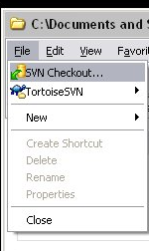
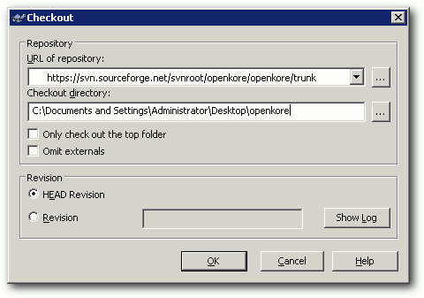
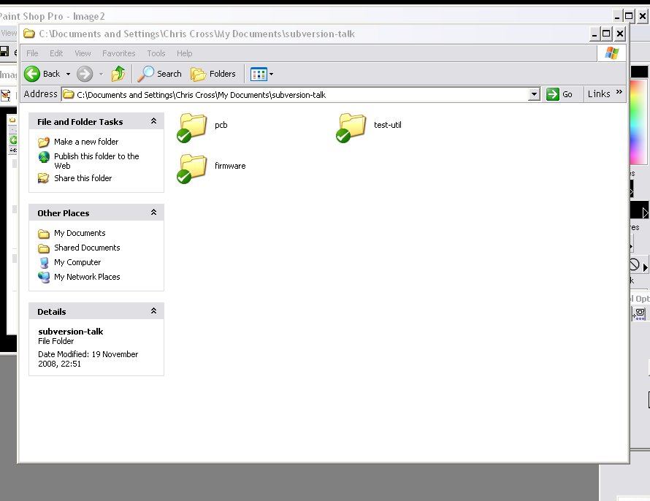
Windows: TortoiseSVN
Integrated into Explorer
Repository URL
SVN Status
http://svn.studentrobotics.org/boards/motor

Slide 13
Example
Dave then makes some changes to main.c
void init( void )
{
pwm_init();
motor_init();
timer_b_init();
flash_init();
i2c_flash_init();
i2c_init();
eint();
}
void init( void )
{
init_gpio();
pwm_init();
motor_init();
timer_b_init();
flash_init();
i2c_flash_init();
i2c_init();
eint();
}
Revision 15
Dave's edited working copy

Slide 14
Example
Dave commits his changes, creating revision 16.
% svn status
M main.c
% svn commit -m “Initialise the motor board GPIO on reset”
Sending main.c
Transmitting file data .
Committed revision 16.
% svn status
%

Slide 15
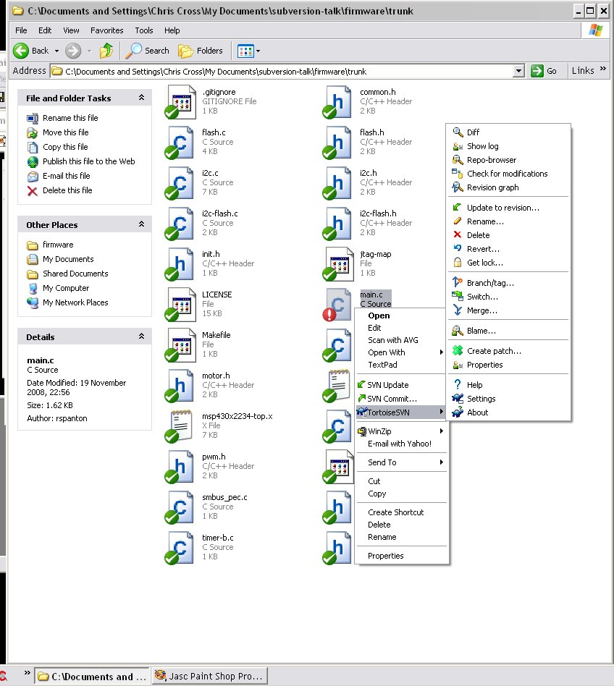
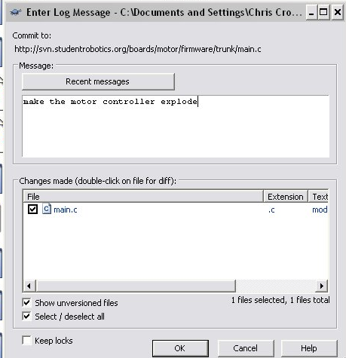
Windows: TortoiseSVN
Log message

Slide 16
Example
Meanwhile, Phil changes some things. He still has revision 15.
void init( void )
{
pwm_init();
motor_init();
timer_b_init();
flash_init();
i2c_flash_init();
i2c_init();
eint();
}
void init( void )
{
explode();
pwm_init();
motor_init();
timer_b_init();
flash_init();
i2c_flash_init();
i2c_init();
eint();
}
Revision 15
Phil's edited working copy

Slide 17
Example
Phil updates before committing his changes.
His changes conflict with Dave's.
% svn update
C main.c
Updated to revision 16.
% svn status
? main.c.mine
? main.c.r15
? main.c.r16
C main.c
% ls main.c.*
main.c main.c.mine main.c.r15 main.c.r16

Slide 18
Example
main.c
Phil's new main.c:
void init( void )
{
<<<<<<< .mine
explode();
=======
init_gpio();
>>>>>>> .r6
pwm_init();
motor_init();
timer_b_init();
flash_init();
i2c_flash_init();
i2c_init();
eint();
}
void init( void )
{
explode();
init_gpio();
pwm_init();
motor_init();
timer_b_init();
flash_init();
i2c_flash_init();
i2c_init();
eint();
}

Slide 19
Example
Phil tells subversion that he's manually resolved the conflict. He then commits his changes to create revision 17.
% svn resolved main.c
% svn status
M main.c
% svn commit -m “Make it explode”
Sending main.c
Transmitting file data .
Committed revision 17.

Slide 20
Example
Later, Dave updates to revision 17 and discovers something's gone wrong
% svn update
M main.c
Updated to revision 17.
...
% make
% ./go
BANG

Slide 21
Example
So Dave looks at the commit history.
% svn log | less
r17 | phil | 2008-11-16 18:55:43 +0000 (Sun, 16 Nov 2008) | 1 line
Make it explode
------------------------------------------------------------------------
r16 | dave | 2008-11-16 12:55:24 +0000 (Sun, 16 Nov 2008) | 1 line
Initialise the motor board GPIO on reset

Slide 22
Example
Dave wonders what Phil did:
% svn diff -r 16:17
Index: main.c
=============================================================
--- main.c (revision 16)
+++ main.c (revision 17)
@@ -1,5 +1,6 @@
void init( void )
{
+ explode();
init_gpio();
pwm_init();
motor_init();

Slide 23
Example
Dave then undoes Phil's commit (r17) creating revision 18.
He could have done this by editing the file.
But Phil decides to use Subversion's merge command:
% svn merge -r 17:16 .
% svn status
M main.c
% svn commit -m “Don't make the motor controller explode.”
Committed revision 18.

Slide 24
Basic Operations
Checkout
Commit
Update
Log
Diff
Resolved
Add
Copy
Move
Delete

Slide 25
{Add,Delet,Remov,Copy}ing
You need to tell subversion which files to track:
% svn add face.c
A face.c
And you should move tracked files using subversion:
% svn move face.c bean.c
A bean.c
D face.c
Also, delete tracked files using subversion:
% svn rm bean.c
D bean.c
Finally, copy tracked files using subversion:
% svn copy bean.c eyes.c
A eyes.c

Slide 26
Windows: TortoiseSVN

Slide 27
Good Practice
Commit messages that say “moo” or “some stuff” don't help anyone, including yourself.
Committing stuff that you have broken can really annoy others who are relying on it working
Commit as often as you can
Running “svn status” before committing

Slide 28

A Good Structure
/
motor
trunk
tags
v1
branches
experimental
feedback

Slide 29
Common Mistakes
Forgetting to update before committing
Forgetting to add files before committing
Not looking at everything you're about to commit (using status and diff)
Not looking at the changes that have been made since you last updated
Ignoring conflicts

Slide 30
Software
Linux
  RapidSVN
  Command line
Windows
  TortoiseSVN
Editors/IDEs:
  emacs, vi, gedit(?)
  Eclipse
  Student Robotics web-based IDE

Slide 31

Documentation
Google for “svn book”

Slide 32
Questions?
www.studentrobotics.org

