Slide 1
Mechanical Presentation
07/08 Designs
Design Aspects
Chassis / Framework
Electronics/Battery Position
Drive & Locomotion
Ball Collection/Launching
Notes:
[slide 1]
Hi my name is chris and i'm going to tell you about the electronics kit
The good news is that we don't expect you to have any previous experience with electronics,

Slide 2
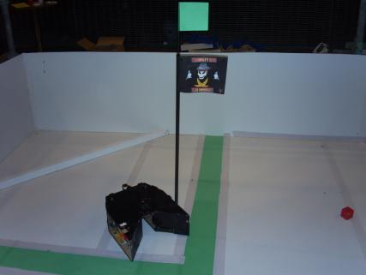
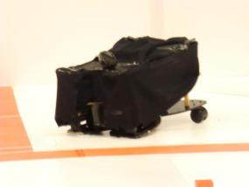
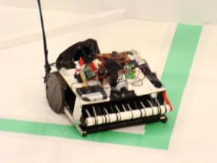
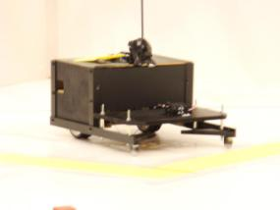
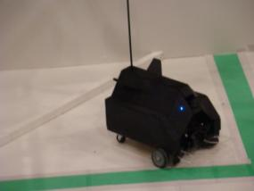
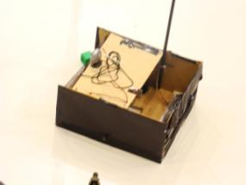
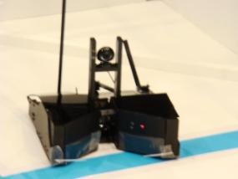
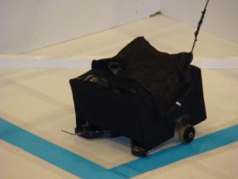
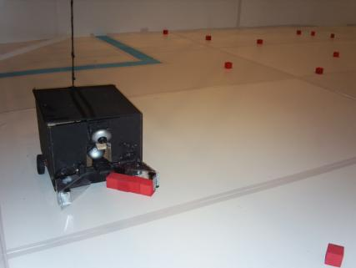
2007-2008 Designs
Notes:
[slide 2]
So before i tell you what kit you will be given, i want you to tell me what features and functionality you might need to complete the task?
To get you started here are a couple of questions to think about, [read out questions]
Ok, you have 1 minute to think up as many useful electronics feature & gadgets as possible
[pause for one minute]
OK, time is up, so can anyone volunteer some suggestions?
[silence, prompt, pick]
[slowly gather some suggestions , if struggling use following:
// . camera
// . light sensors with filters
// . servos to move balls around
// . big drive motors
// . proximity sensors
// . light beams,
// . electronic compas
// . counting wheel revolutions
The point of that exercise was to show you that there's more than one way to answer any of these questions, some are more elaborate and difficult than others, but what we hope we've achieved with the kit is to give you as much freedom as possible.
So, now to take a look at some of the kit each of the teams will be given.

Slide 3
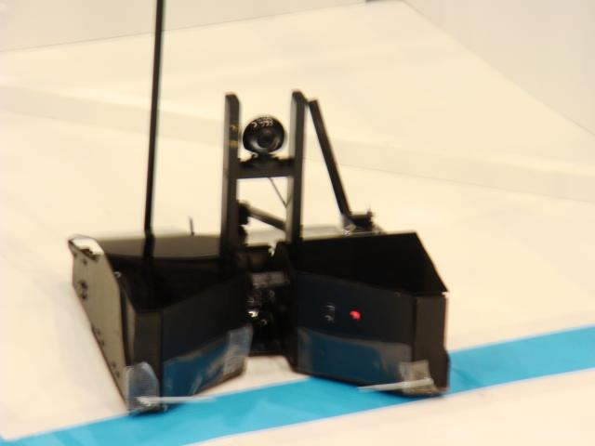
2007-2008 1ST Place
Peter Symonds (2)
Grabber: Rotary Cradle with Selective sorting and drop-off arms
Storage: 8-10 tokens
Front and rear contact sensors

Slide 4
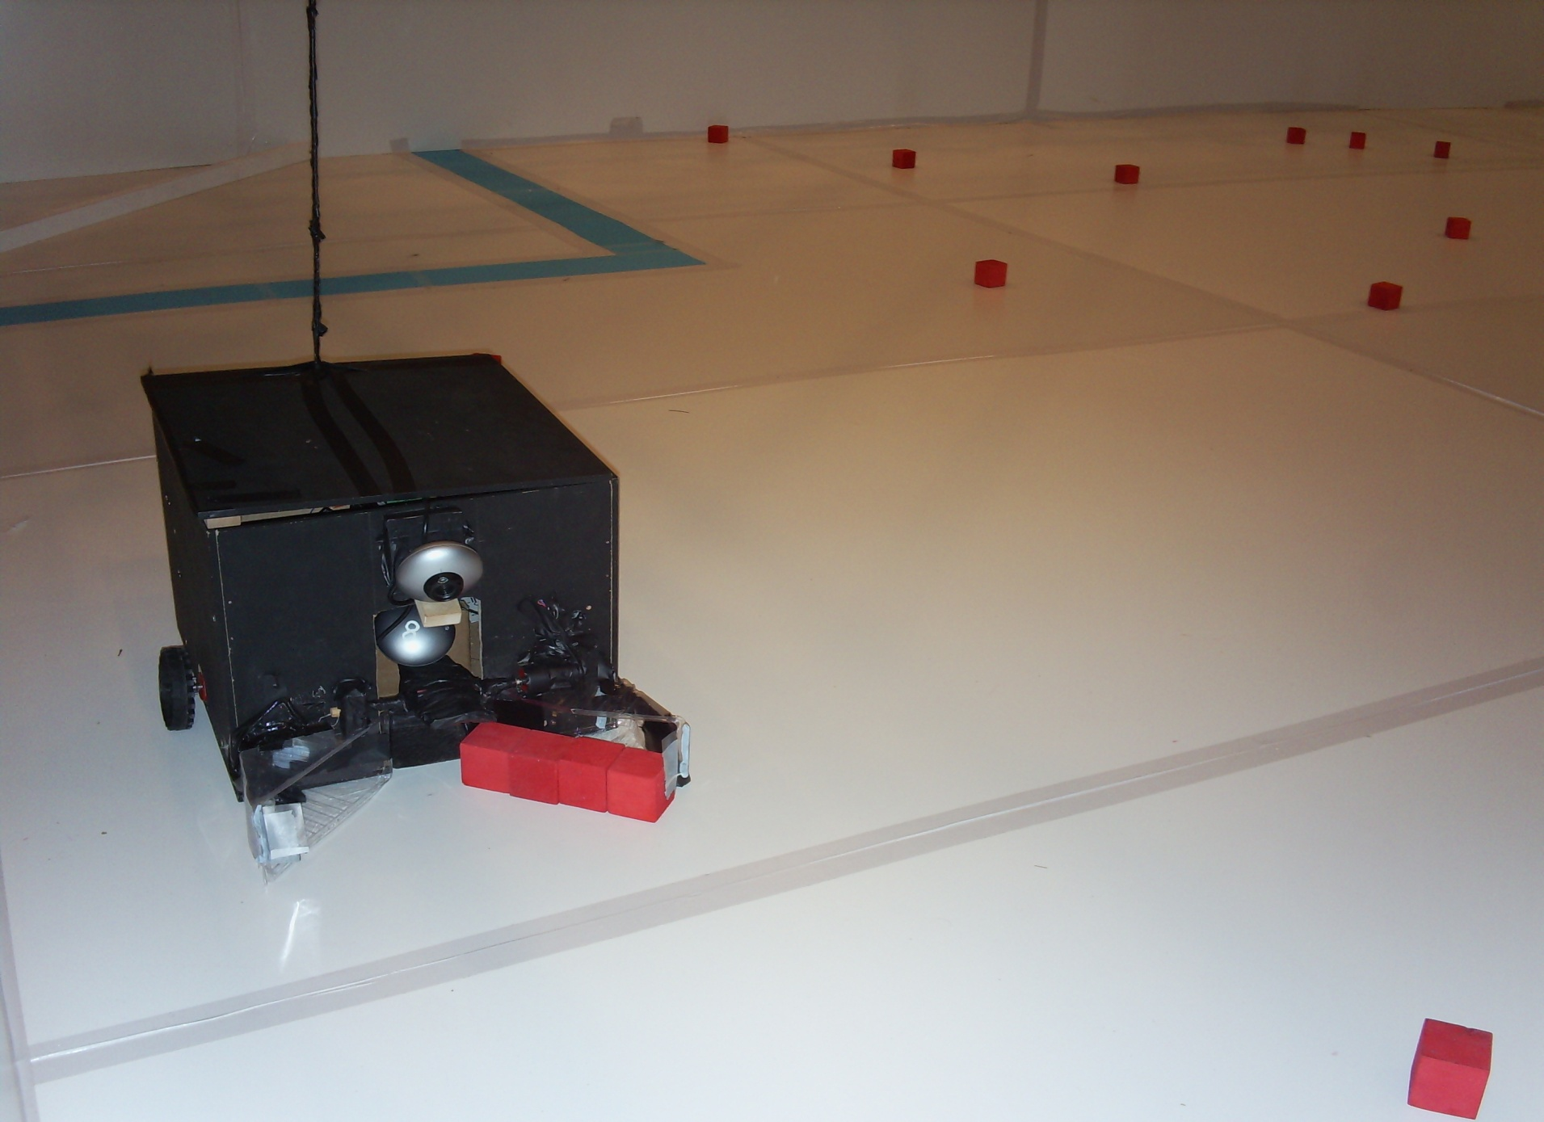
2007-2008 2nd Place
  St Anne's (6)
  Drive: 2 × 12V motors
  Grabber: “Sandwich box” Jaws and Paddle
  Storage: 3-4 tokens

Slide 5

2007-2008 3RD Place
Taunton College (4)
Drive: 2 × 12V motors, Custom Wheels
Grabber: High speed rotary brush with conveyer belt feed into rear storage bag
Storage: 15 – 20 tokens

Slide 6
Design Aspects
Chassis / Framework
Electronics / Battery Position
Drive Motors / Transmission
Locomotion
Ball Collection / Launcher

Slide 7
Design Aspects - Chassis
Electronics/ Battery Position
Ball Collection/ Launcher
Locomotion
Drive Motors/ Transmission

Slide 8
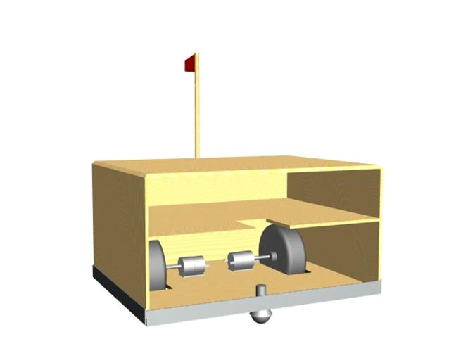
Chassis/Framework
500x500x500
Materials (wood, metal, plastic)
Structural strength
Weight
Levels
Modular Design
Mock-ups

Slide 9
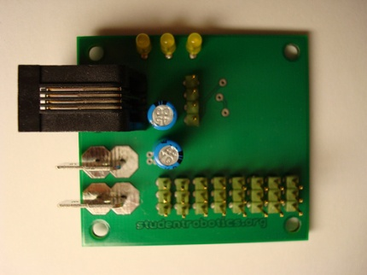
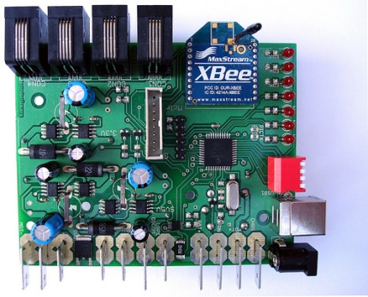
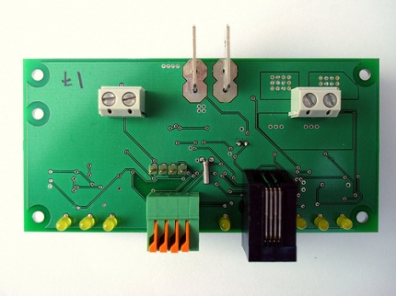
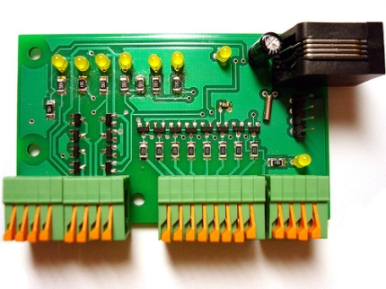
Electronics/Battery position
Securely mounted
Access to boards (Charging, USB etc.)
Near Relevant Components
Battery Weight

Slide 10
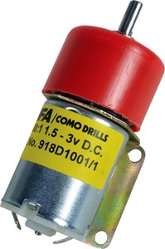
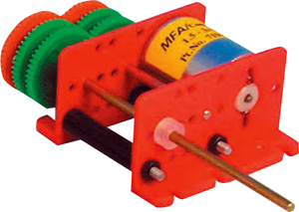
Drive Motors/Transmission
DC Electric Motors (12V)
Gearboxes
Pulley/Belt Drives
Connecting Locomotion
Bearings
Speed/Torque

Slide 11
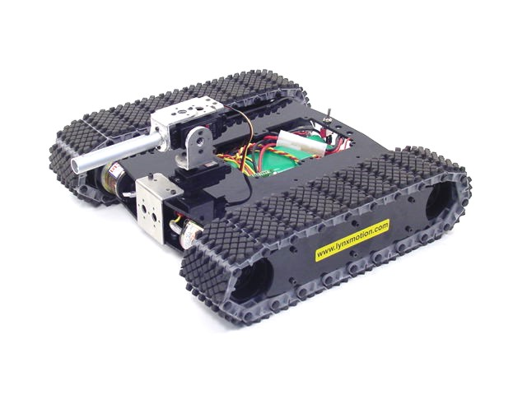
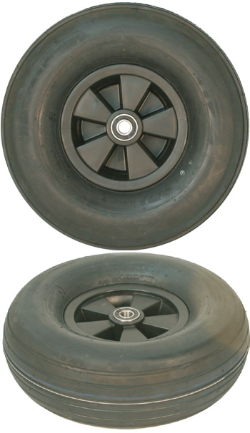
Locomotion
Tracks
Wheels
Castor Wheels
Wheelbase/Track
Grip/Traction
Turning Methods

Slide 12
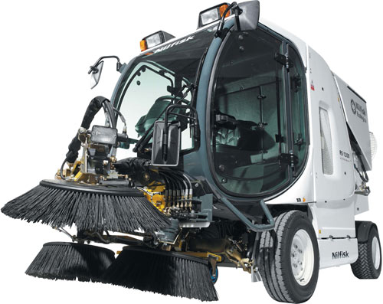
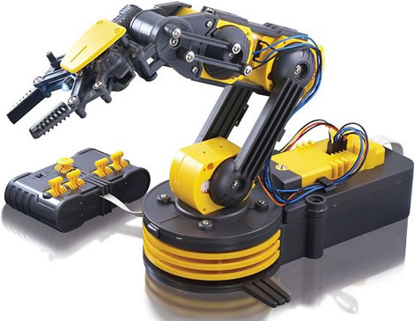
Ball Collection/Launcher
Pick up and move with balls
Sweepers
Arms
“Rakes”
Shunts

Slide 13
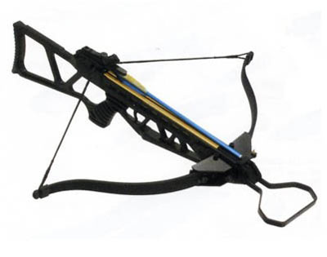
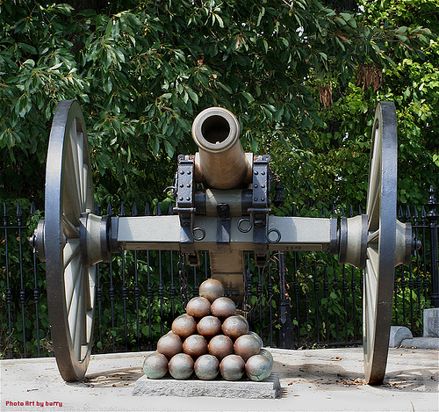
Ball Collection/Launcher
Cannons
“Crossbows”
Catapults
Cranes
“Flywheels”

