Slide 1
Rock and Roll Creation.
Chris Cross and Rob Spanton

Slide 2

Robots Need Brains!

Slide 3
Simple Rules
Clap your hands
Stand on your head
Remove your eyes

Slide 4


Slide 5
Switch off
your robots!

Slide 6
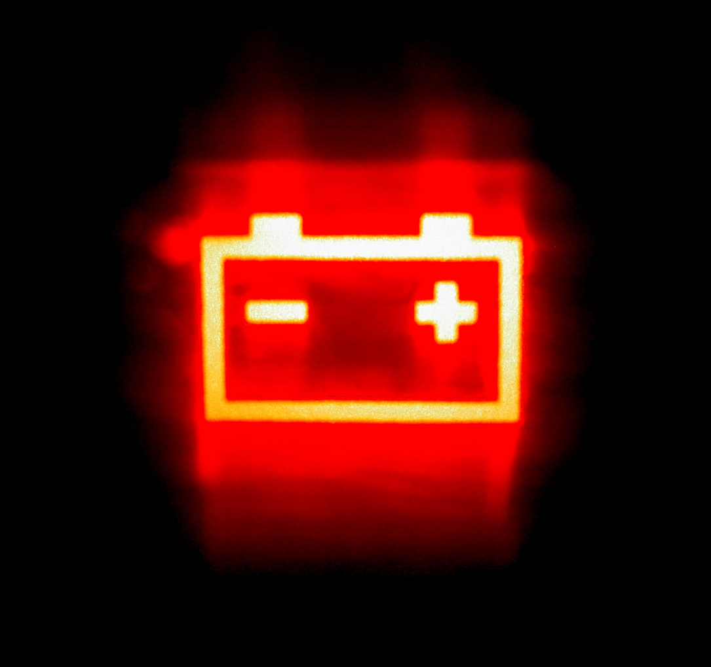

Slide 7
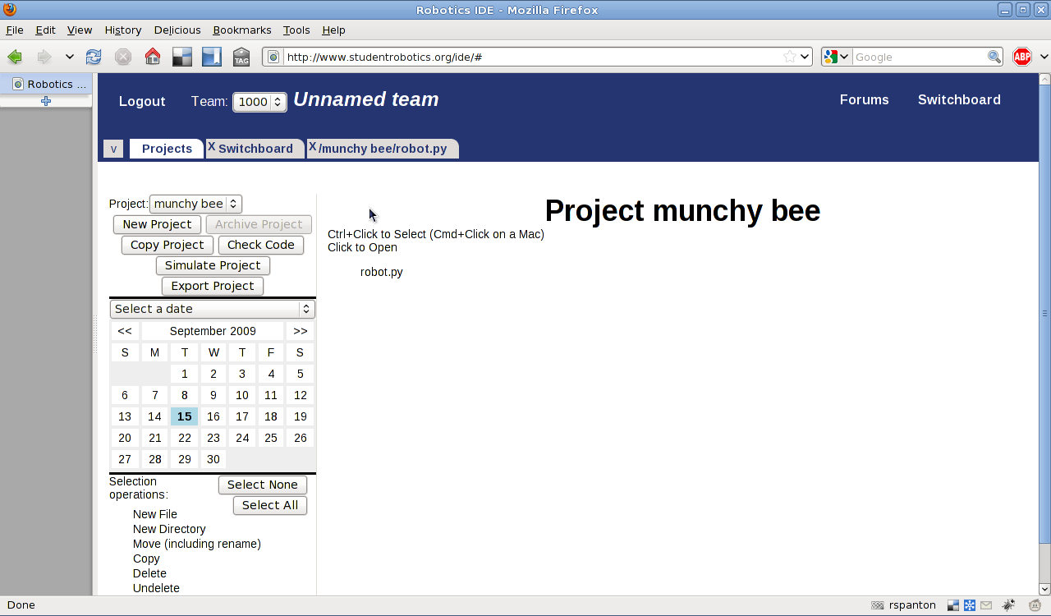
IDE

Slide 8


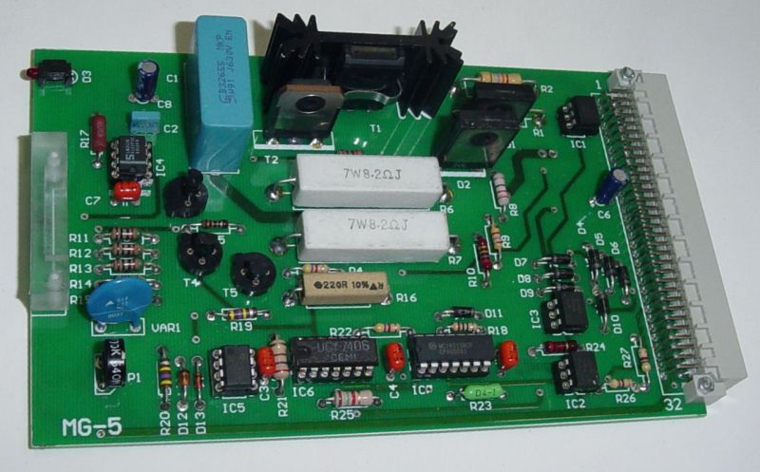
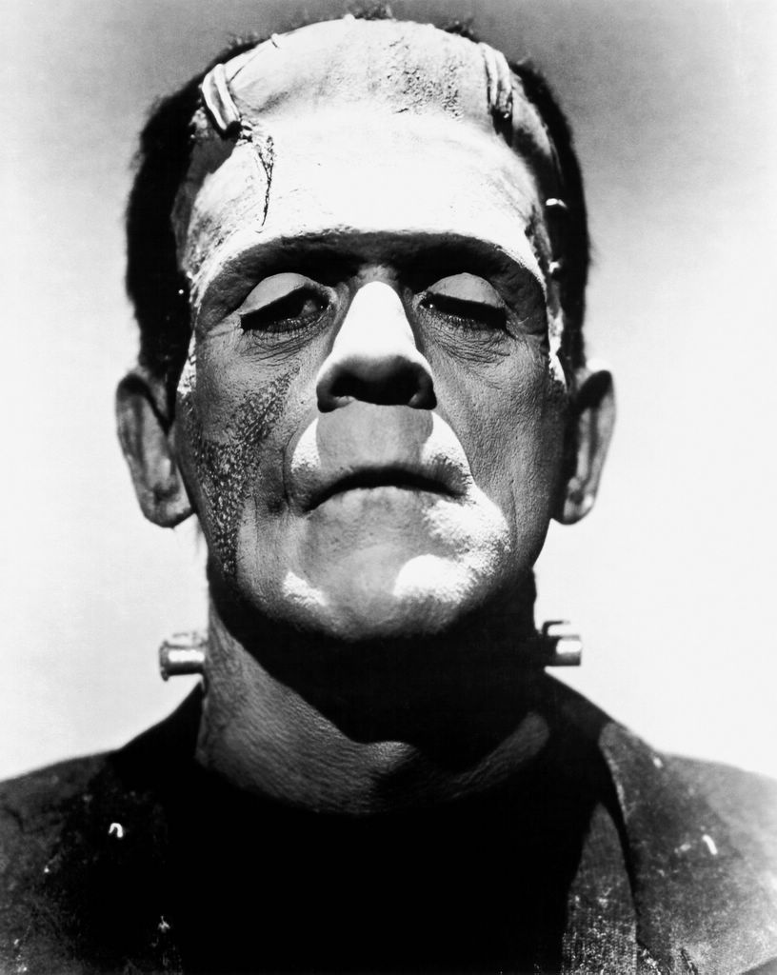
Robot Software
How to bring your Robot to life.

Slide 9

Python

Slide 10
Documentation
TODO: Documentation screenshot + web address

Slide 11
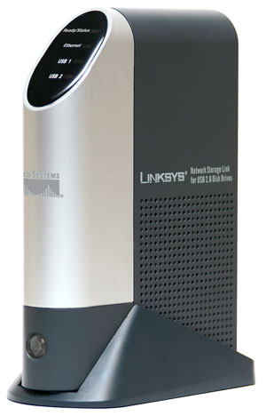
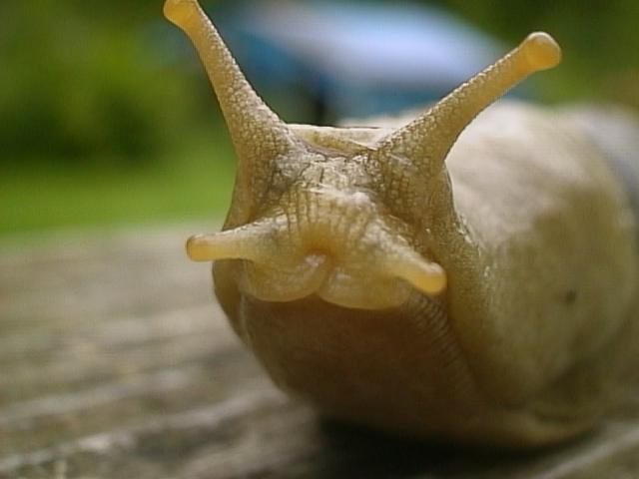
Processing

Slide 12
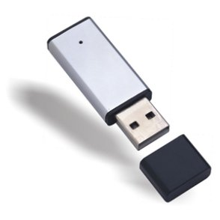
Loading Software

Slide 13
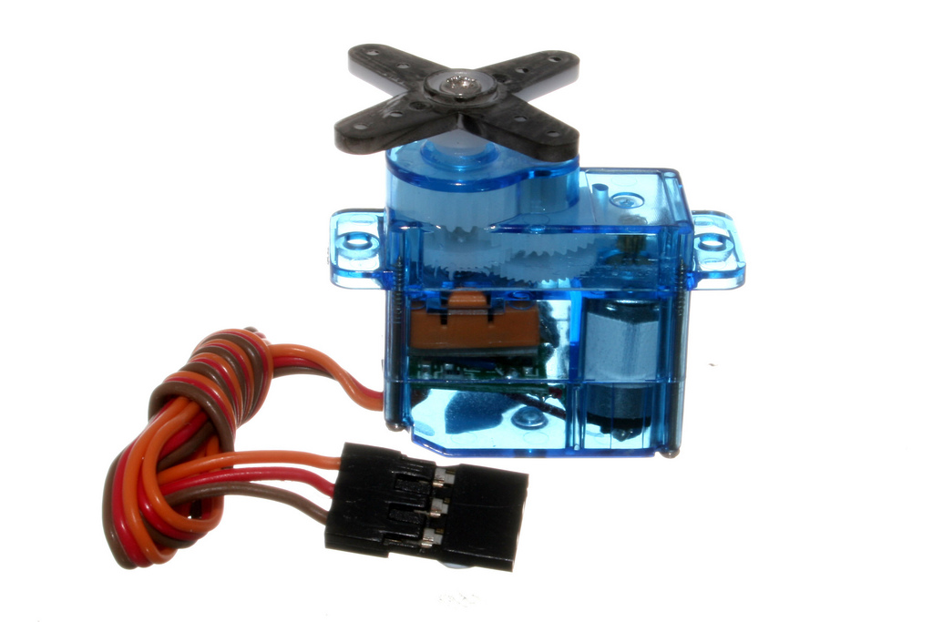
PWM Board
Controls servos

Slide 14
Demo 1: Ball dispensing

Slide 15
JointIO Board
Digital inputs
Analogue inputs
Digital outputs

Slide 16
Demo 2: Button-activated dispensing

Slide 17
Motor Board
Control power to two motors
12V DC motors

Slide 18
Demo 3: Drive at constant power

Slide 19
Demo 4: Open/close gripper

Slide 20
Feedback
Power
“PID Controller”
  Absolute positioning

Slide 21
Demo 5: Put ball in known position

Slide 22
Demo 6: Take ball to hopper and release

Slide 23
Vision

Slide 24
Vision
Detect blobs
White background!

Slide 25
Demo 7: Use vision to find ball

Slide 26
Demo 8: Whole system!

Slide 27
Development Cycle
Build
Test
times a million.

Slide 28

Experiment

Slide 29
What if?

Slide 30
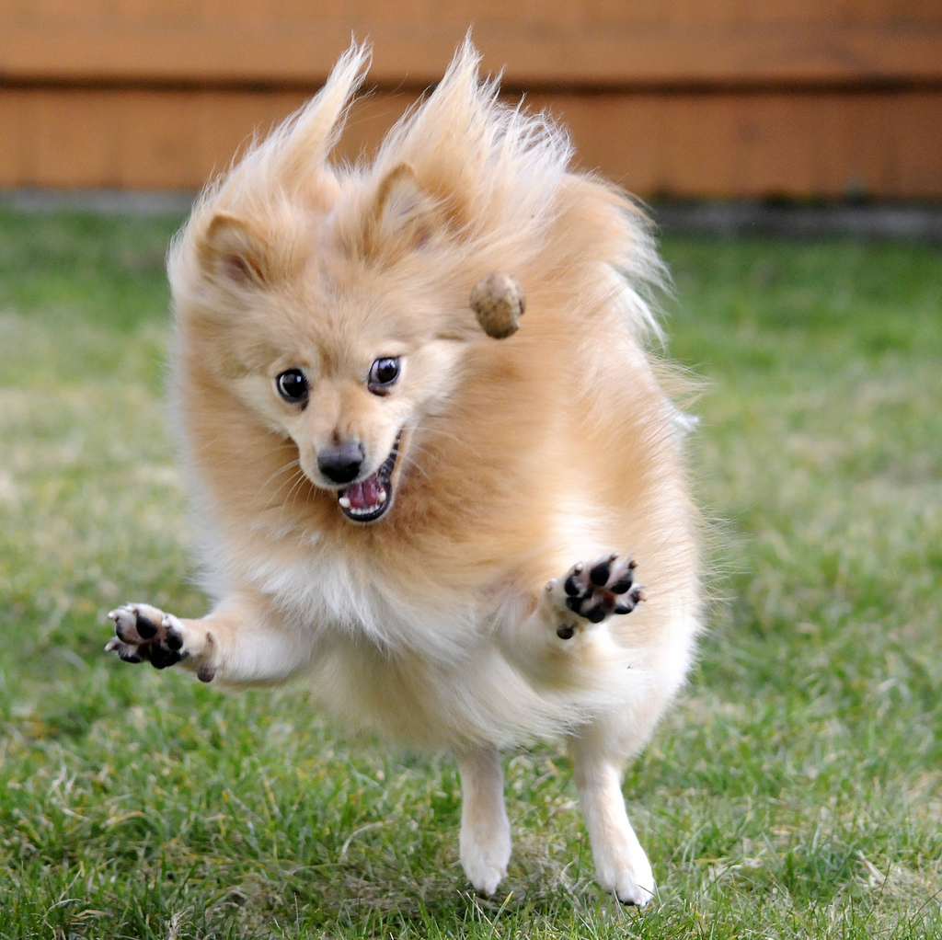

Slide 31
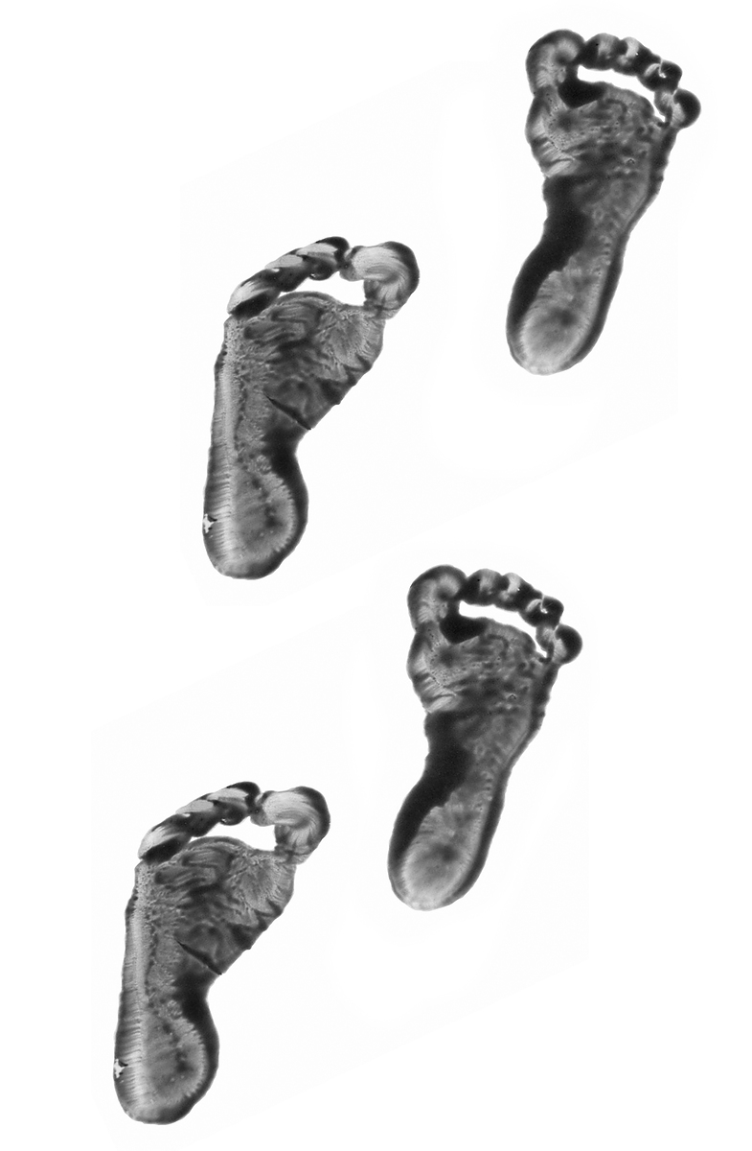
Finally
Small Steps

