Slide 1

Kickstart Event

Slide 2


Welcome
Prof. Steve R Gunn
Information: Signals, Images, Systems Research Group
School of Electronics and Computer Science
University of Southampton

Slide 3
Timetable
12:00 – Arrive
12:30 – Quick Competition
13:25 – Race
13:30 – Lunch
14:00 – Presentations
16:00 – Home

Slide 4

Main Competition

Slide 5
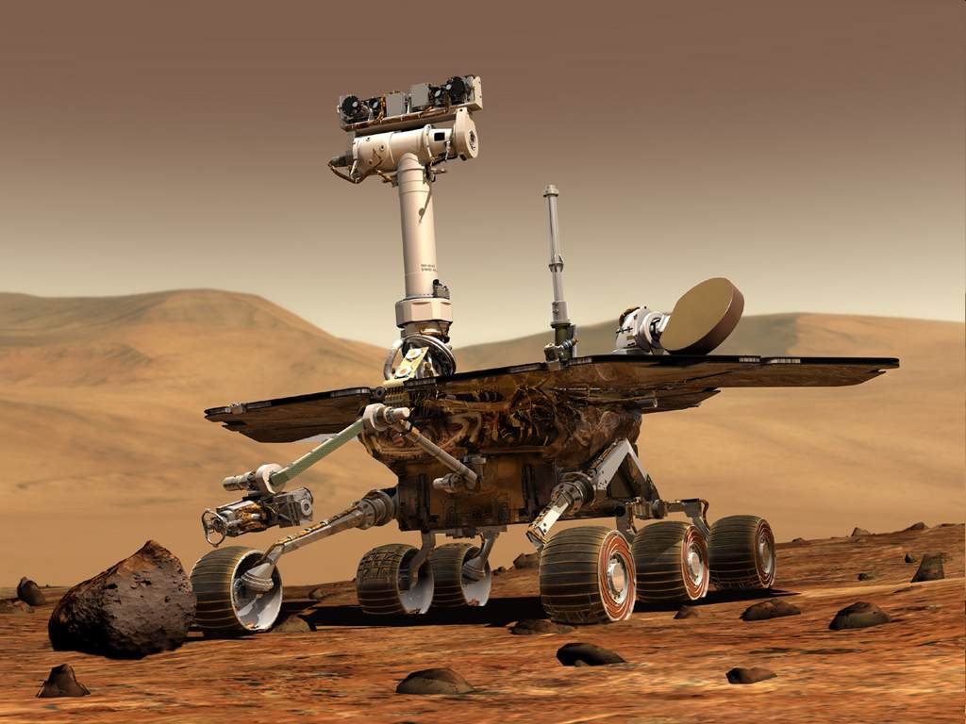
Build a Rover
Notes:
You have to build a rover.
A4 size – specified in the rules
move around the arena

Slide 6
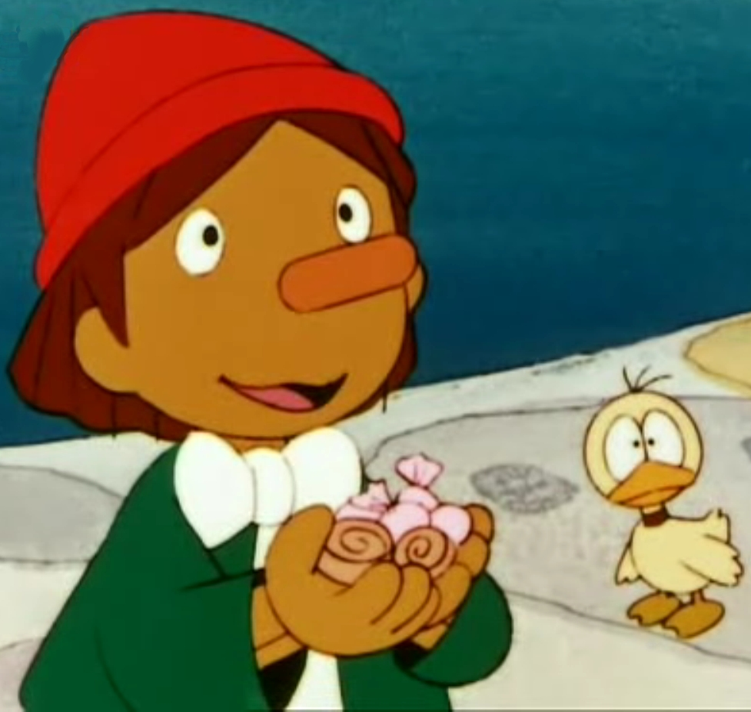
Bring it to life
Notes:
AI !
NOT REMOTE CONTROLLED
Try to prepare it for every situation – algorithm
once the game starts, you no longer have control – trust previous work

Slide 7
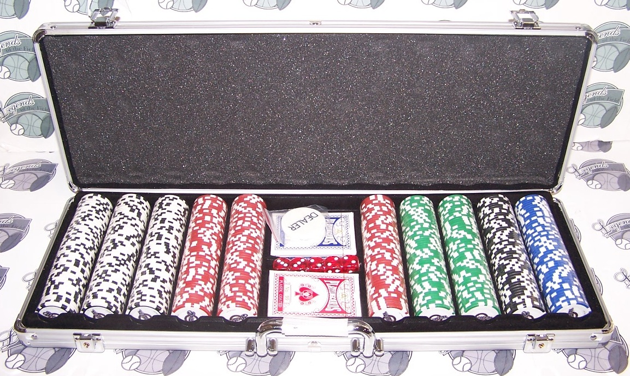
Collecting Tokens
Notes:
Drive around collecting game tokens
deliver them to home space
different colours mean different things

Slide 8

By Easter 2008!
Notes:
Plan your time
Start soon!
This sounds a lot, but it will sneak up on you

Slide 9

Getting Help
http://www.studentrobotics.org
Peers – online forums
Mentor
Teachers
More help
available!
Notes:
2 installments of kit – 1 now, 1 end of November

Slide 10

Quick Competition
Write down a time plan
Brainstorm designs
Build prototype
Build finished product

