Slide 1
Electronics Presentation
What do you need?
Our electronics kit
Features and functionality
Custom electronics & extending functionality
Dispatching the kit
Notes:
[slide 1]
Hi my name is chris and i'm going to tell you about the electronics kit
The good news is that we don't expect you to have any previous experience with electronics,

Slide 2
What do you need?
What functions might you want your robot to perform?
How will you:
    find balls?
    know what colour a ball is?
    collect balls?
    move around?
    avoid the arena walls?
    know where you are?
    know where your opponents are?
    deposit balls?
Notes:
[slide 2]
So before i tell you what kit you will be given, i want you to tell me what features and functionality you might need to complete the task?
To get you started here are a couple of questions to think about, [read out questions]
Ok, you have 1 minute to think up as many useful electronics feature & gadgets as possible
[pause for one minute]
OK, time is up, so can anyone volunteer some suggestions?
[silence, prompt, pick]
[slowly gather some suggestions , if struggling use following:
// . camera
// . light sensors with filters
// . servos to move balls around
// . big drive motors
// . proximity sensors
// . light beams,
// . electronic compas
// . counting wheel revolutions
The point of that exercise was to show you that there's more than one way to answer any of these questions, some are more elaborate and difficult than others, but what we hope we've achieved with the kit is to give you as much freedom as possible.
So, now to take a look at some of the kit each of the teams will be given.

Slide 3
What will you be given!
The student robotics kit consists of 4 custom made boards
  Power Board
  PWM (Servo) Board
  Motor Board
  Joint-IO Board
And a few extras
  Web camera
  SLUG (the CPU)
  Battery, cables, connectors etc.

Slide 4
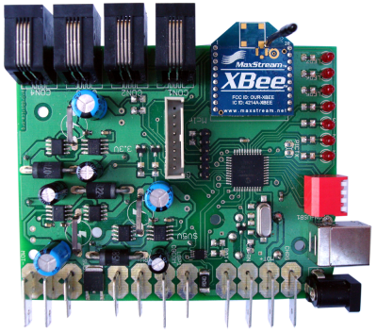
The Power Board
Supplies power to all of the boards
Has data lines to all of the boards
Radio module for remotely starting the games
USB Hub

Slide 5
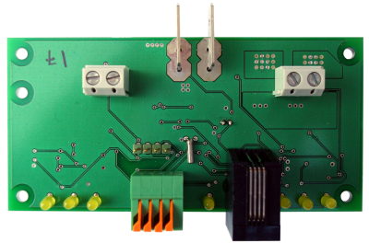
The Motor Board
Control the speed and direction of up to two DC motors
Optional motor feedback

Slide 6
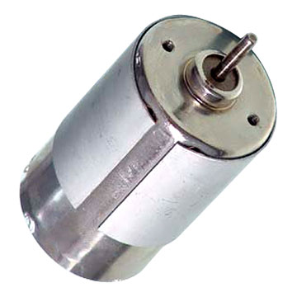
Moving around
DC Motors
  Easy to connect to the Motor board
  Fast and powerful
  Useful for drive motors and
  Variable speed control

Slide 7

Knowing where you are
The motor board supports an optional feedback sensor
Count wheel revolutions and estimate distances
Speed control

Slide 8
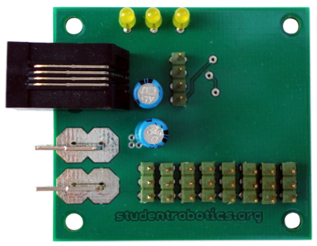
The PWM Board
Control the position of up to 5 servos (independently)

Slide 9
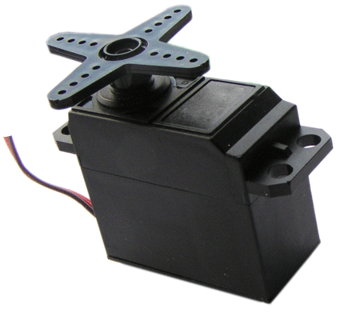
Moving things
Servos
  Easy to connect to the PWM Board
  Perfect for slow but high precision movements
  Simple to program

Slide 10
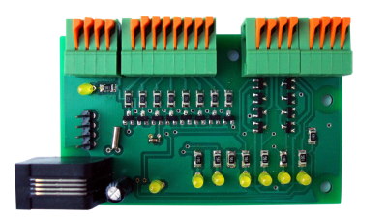
The Joint-IO Board
Connect a maximum of 8 digital or analogue input devices
Connect a maximum of 4 digital output devices

Slide 11
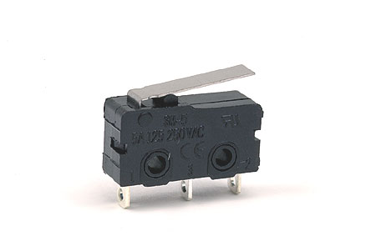
Avoiding things
Mechanical switches
  Easy to connect to the Joint-IO Board
  Bump sensors or position sensors

Slide 12
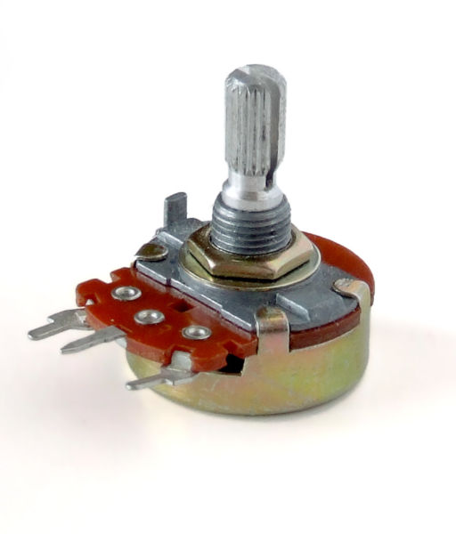
Analogue Input
Rotary variable resistors
  Easy to connect to the Joint-IO Board
  Useful for measuring angular positions

Slide 13
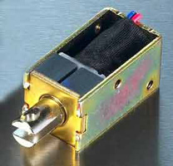
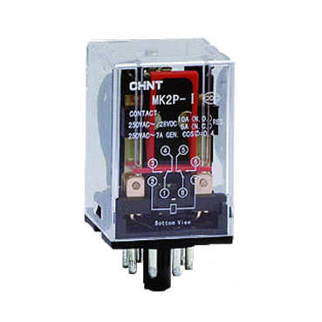
Switching things
Electromechanical devices
  Relays
  Solenoids

Slide 14
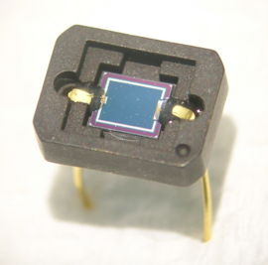

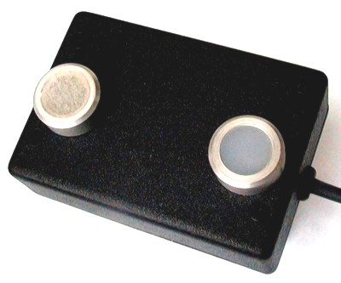
Finding things (2)
Optical sensors
  Easy to connect to the Joint-IO Board
  Detect/follow lines

Slide 15
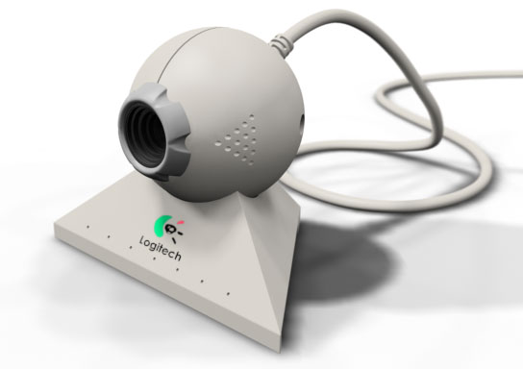
Finding things (1)
A Web Camera
  Can spot blobs of colours (e.g. balls and zones)
  Could be used to estimate distances

Slide 16
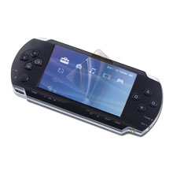
The fifth board...
A Screen for your robot
  View important information (real time)
  Vision system output
  Battery information
  Error messages
  Debugging code
  Lots more...

Slide 17
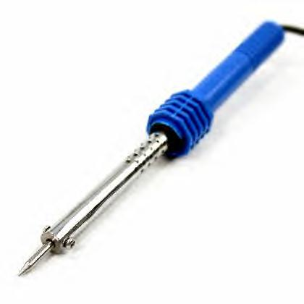
Is that all?
You are encouraged to build your own electronics too
Don't be afraid to try out new ideas
Use the website to find out more about the kit
Ask your mentors
Start early!

Slide 18
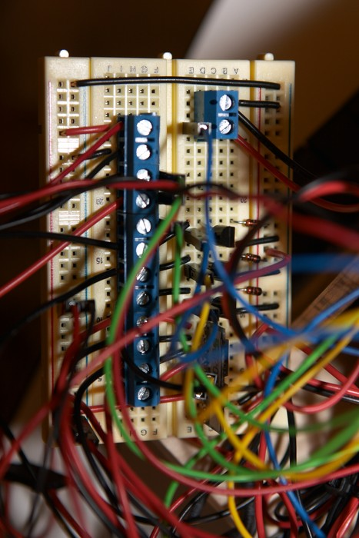
Restrictions & Guidelines
Wiring rules
Help and fact sheets will be available from the website
All devices must be powered from the power board (not directly to the battrey)

Slide 19
Electronics Dispatch
When will the electronics be ready?

Slide 20
Any Questions?
Thank you for your attention

