Slide 1

2009 – 2010
Planning and Team-working

Slide 2
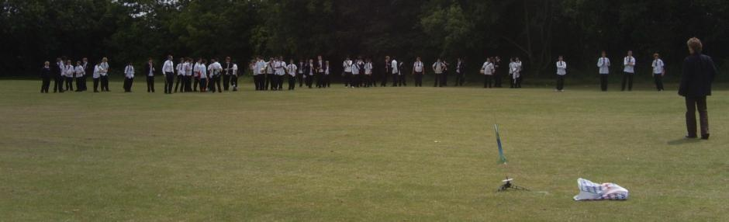
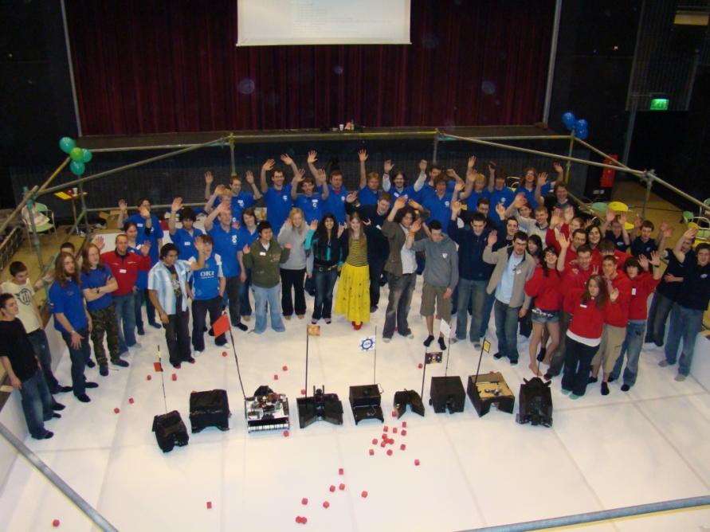

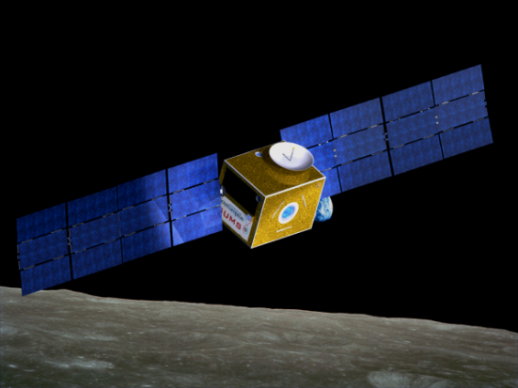
Me = Aron Kisdi
4th year MEng in
Space Systems Engineering
Student Robotics Chairman

Slide 3
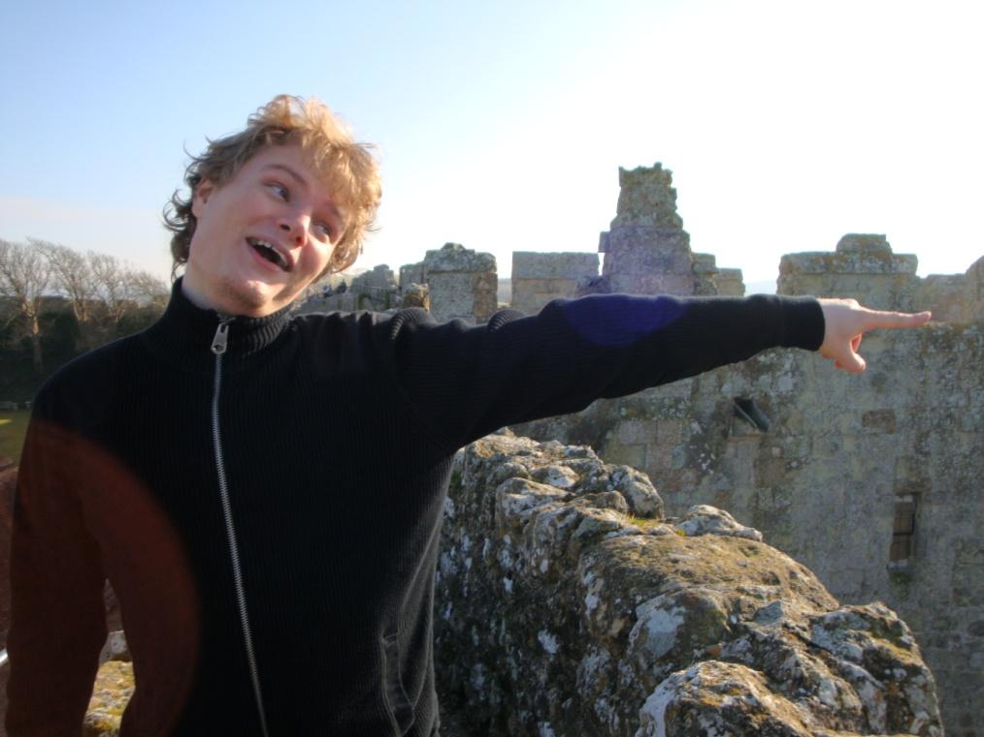
Presented by

Slide 4
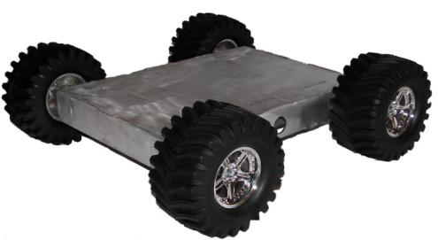
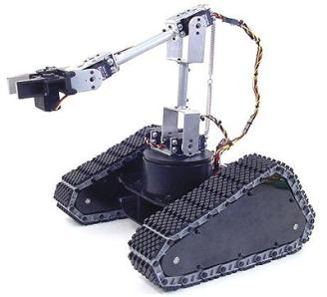
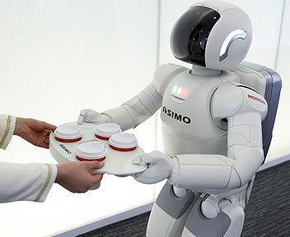
From MiniGame to Timeline
Picture of dolly built
KickStart
Competition
Christmas
A/AS-levels
Easter
I.
II.
III.
I.: a moving robot
II.: a mechanisms built to achieve one or more of the goals.
III.: an autonomous program that reacts to its environment, makes use of sensor input and utilises the effectors accordingly
Notes:
Kickstart in the morning
Stages
It is clever but really-cool

Slide 5
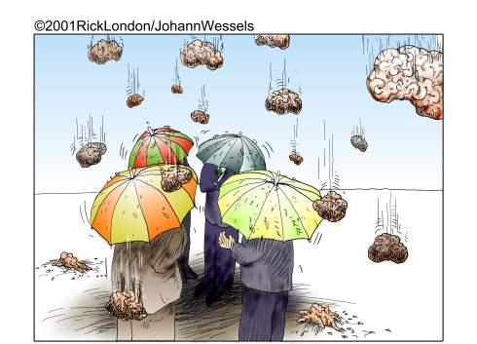
Getting Started

Slide 6
Getting Started
Brainstorming
  No idea is stupid…
  …but keep to the topic
“Aim for the moon, that way, even if you miss you'll still be amongst the stars.”
W. Clement Stone
“Goals without action are empty dreams. Actions turn dreams into goals. Even if a person misses his goal, it does not make him a failure. Delay does not mean defeat. It only means we have to revise our plan to reach our target. Aiming low is the biggest mistake people make. Goals should be challenging! “
Unknown commenter on yahoo.com
Notes:
Can you give me an example for a bad brainstorming idea?
-let’s make a robot which looks like a car
-transporter and ion cannon

Slide 7
Role-playing
You are in a brainstorming session to decide the basic outline of your robot. Give me an example for an idea you wouldn’t say.
Any bad ideas?

Slide 8

Team Work
Take roles
  Team coordinator
  Designers
  Builders
  Programmers
Take roles for tasks

Slide 9
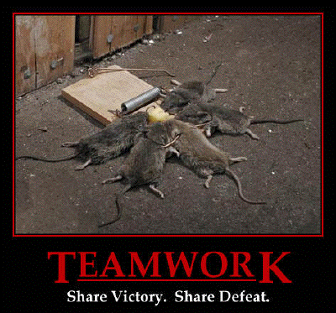
Team Work
Notes:
Don’t blame
On the other hand make sure if a task is assigned to you, you do it in time

Slide 10
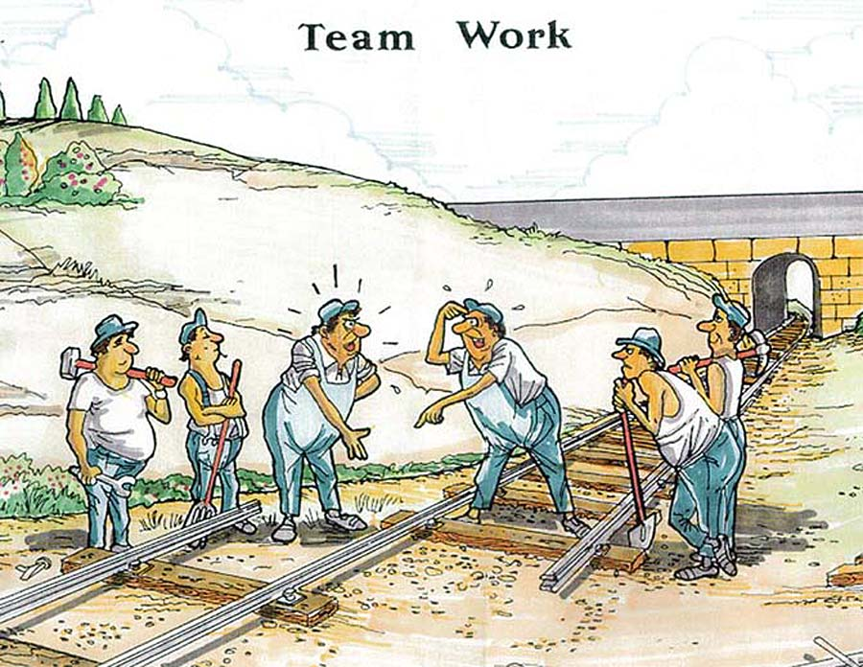
Team Work
Make sure you know what the rest of the team is doing!

Slide 11
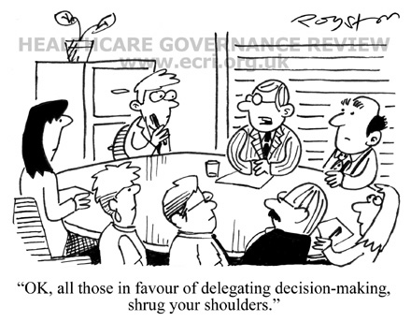
How To Make Decisions
Budget = £70
Don’t be afraid to use it!
Discuss => Decide => Do

Slide 12
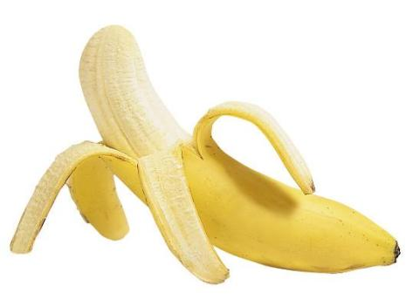
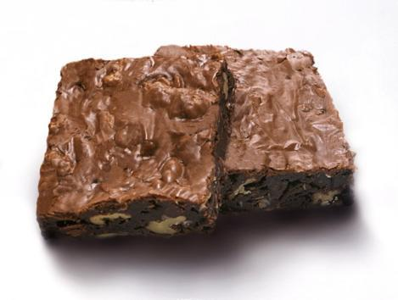
Role-playing
You are approaching a problem: hunger
Two team members come up with a solution.
vs
How do you make the decision?

Slide 13




Building
Fail
Notes:
Modular design. Make sure the basics are working. Makes sure the pars which other parts rely on are working

Slide 14
Role-playing
You came up with a great idea, which according to your calculations works perfectly. Even your team mates agree.
Would you prototype it?

Slide 15
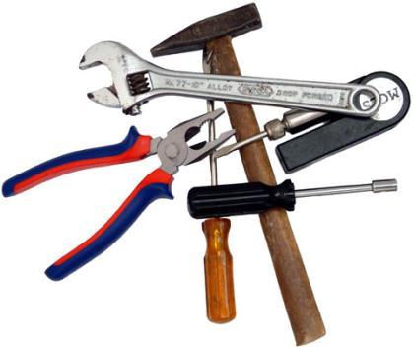
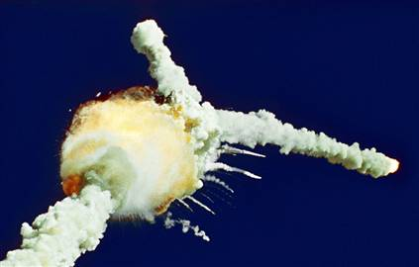
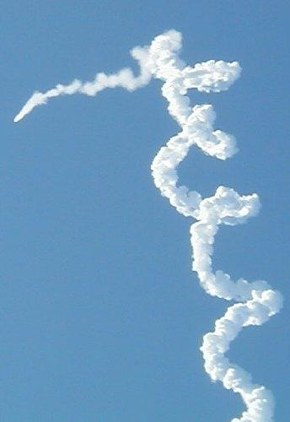
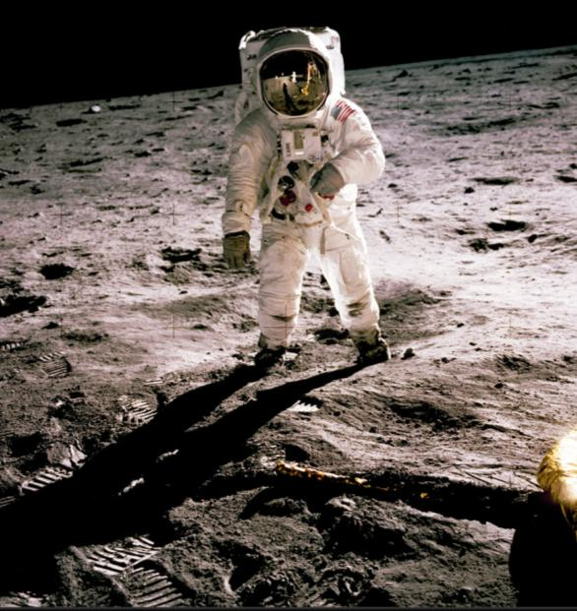
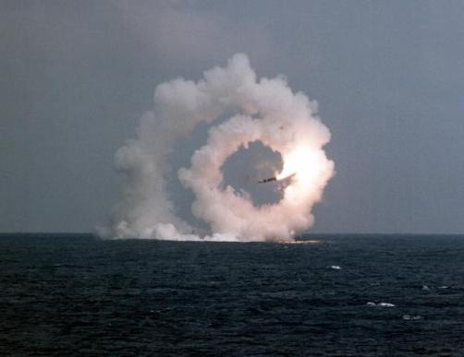
Prototyping
Build
Fail
Succeed
Notes:
http://www.nasa.gov/mission_pages/LRO/multimedia/lroimages/apollosites.html

Slide 16
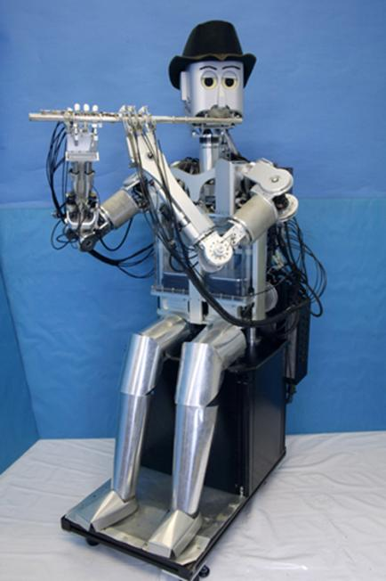
Chairman’s award
To promote initiative, good ideas and clever engineering
You gain points for reaching
Milestones and for impressive
(and working) designs
Share your success!
Student Robotics blog, forum
or even YouTube, twitter.
But strictly no plagiarism

Slide 17
Ask for help
Use an online search engine
Ask on Student Robotics website: www.studentrobotics.org
  forums!
Ask your teacher
Ask someone from Student Robotics
Independent initiative
Share, search, succeed

Slide 18
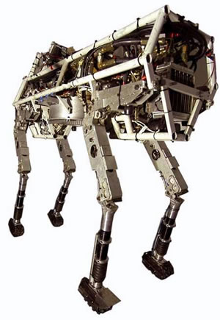
Summary
Aim for the Moon!
Make design decisions
Start simple
Prototype
Start programming early
Don’t be afraid to ask for help and to share your experience
Any questions?
Notes:
http://www.nasa.gov/mission_pages/LRO/multimedia/lroimages/apollosites.html

