Slide 1


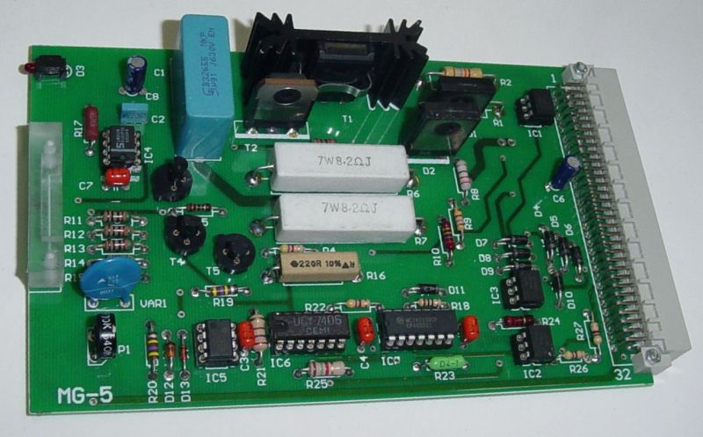
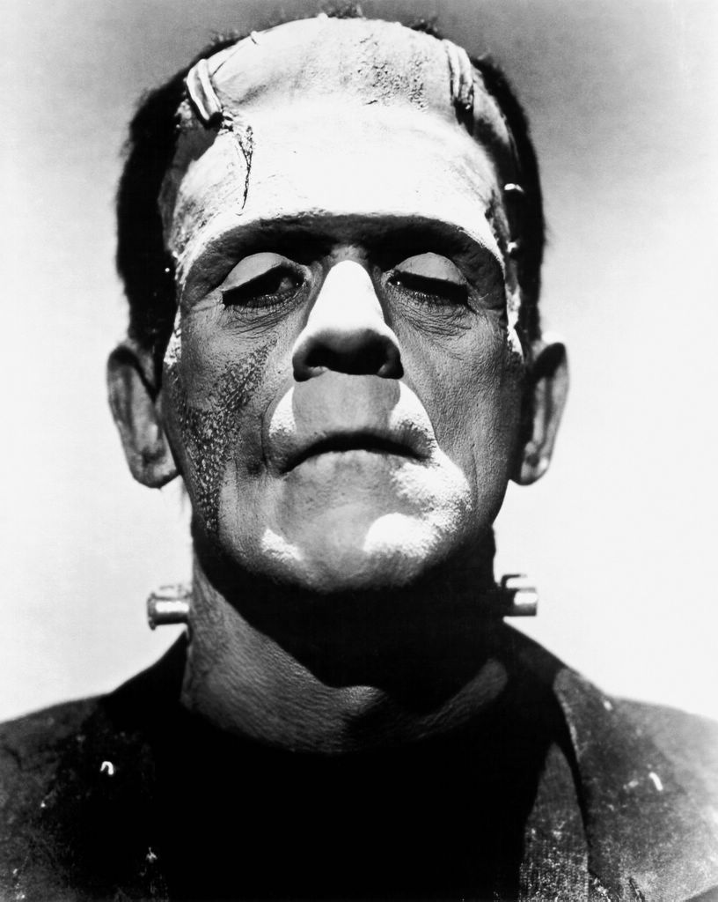
Robot Software
How to bring your Robot to life.
Presented by Stephen English and Rob Spanton

Slide 2

Programmers

Slide 3

Robots Need Brains!

Slide 4
Overview
Inputs
Processing
Outputs

Slide 5
Inputs
Bump Sensor
Camera
Sound
RADAR/SONAR
Accelerometer
Compass
Light
Spoon Position Sensor
Robot Arm Position
Token Presence Switch
Optical Encoder
Potentiometer
Seismometer
Neutrino Detector
PIR
Reed Switch
Explosive Gas Detector

Slide 6
Outputs
Motor
Servo
LED
Spoon Position
Solenoid
Stepper Motor
Speaker
Carrier Pigeon Release
Heater
Jam Dispenser
Compressor
Relays
Linear Actuator
Display
Teasmaid
Bongos

Slide 7
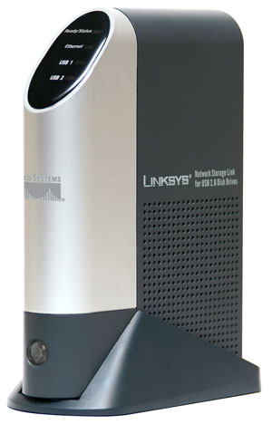
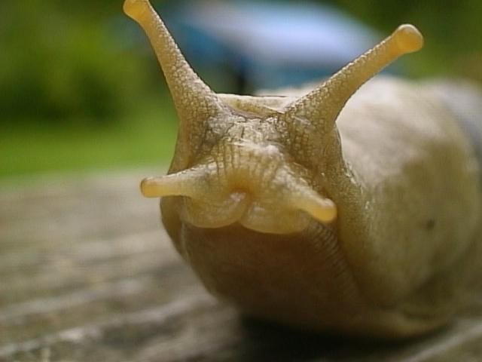
Processing

Slide 8

Python

Slide 9
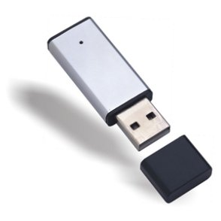
Loading Software

Slide 10

Debugging

Slide 11
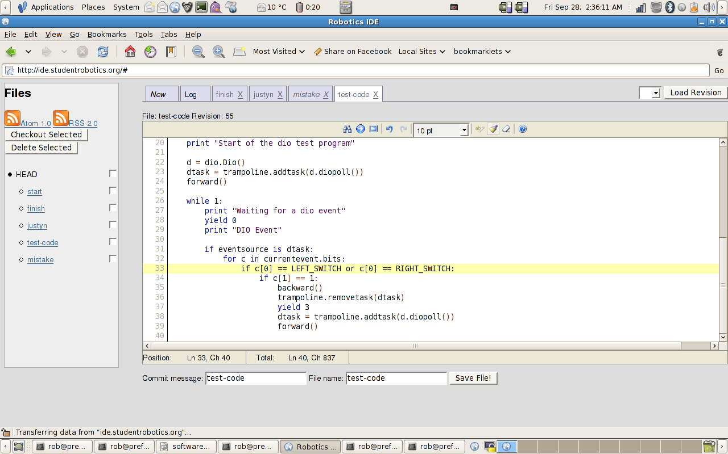
Robo-IDE

Slide 12
Development Cycle
Build
Test

Slide 13
Final Points
Start Simple
Change one thing at a time
Save often
Incremental Improvement
Save often
Change one thing at a time

Slide 14
Robo-IDE
  http://ide.studentrobotics.org

