Slide 1


Design Cycle
Design Build

Slide 2
Design Cycle
Design Build

Slide 3
Design Cycle
Design Prototype Build

Slide 4
Design Cycle
Design Prototype Build

Slide 5
Design Cycle
Design
Build Prototype

Slide 6
Design Cycle
Design
Build Prototype

Slide 7
Prototyping
The only way to answer design questions
Nobody can think of everything
Prevents endless design debates

Slide 8
Prototyping

Slide 9
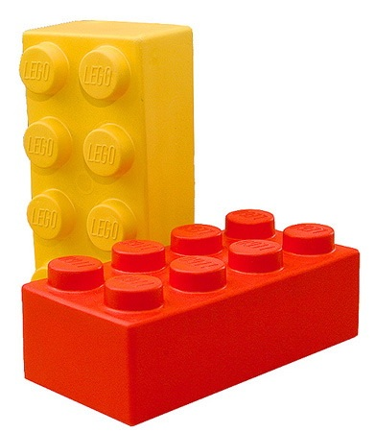
Prototyping Methods

Slide 10
Photo of drivetrain
Ask tom about this

Slide 11
Prototyping
Did I mention it's important?

Slide 12
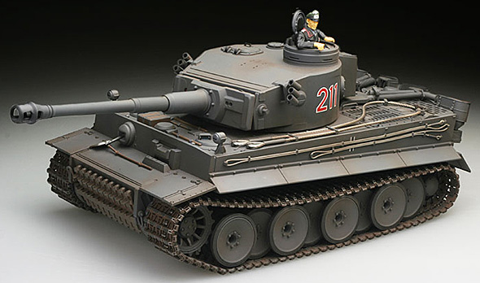
Drive Train - Steering
?

Slide 13
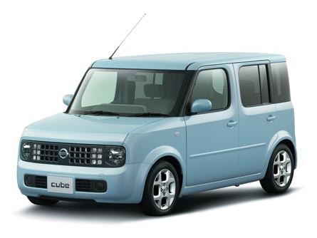
Drive Train - Steering
?

Slide 14
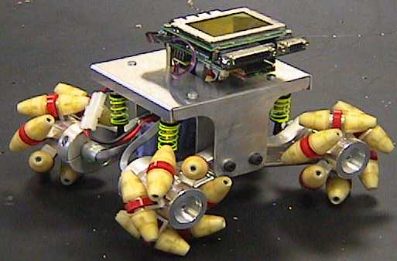
Drive Train - Steering
?

Slide 15
Drive Train - Motor
How much torque?
Prototype to find out

Slide 16
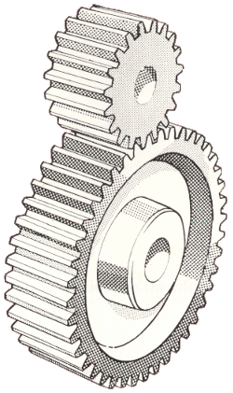
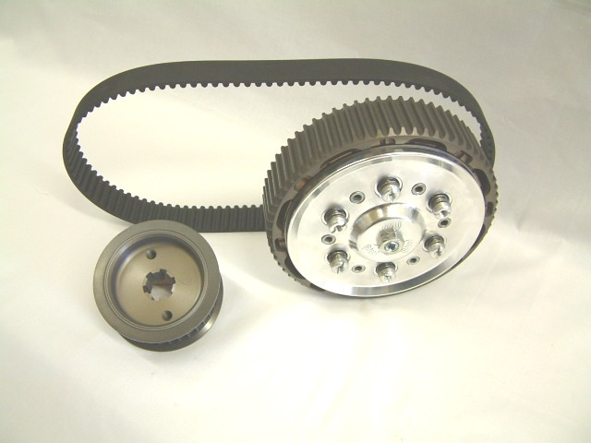
Gearing
Trade speed for torque
Ratio

Slide 17
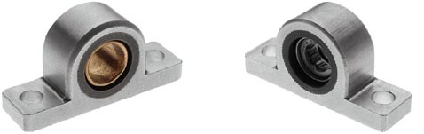
Bearings
Fix the drive components to the chassis

Slide 18
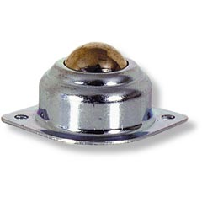
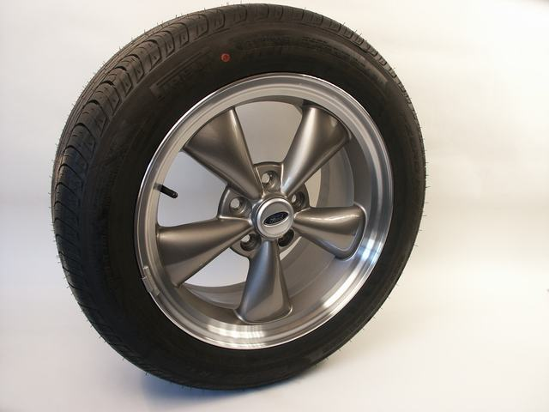
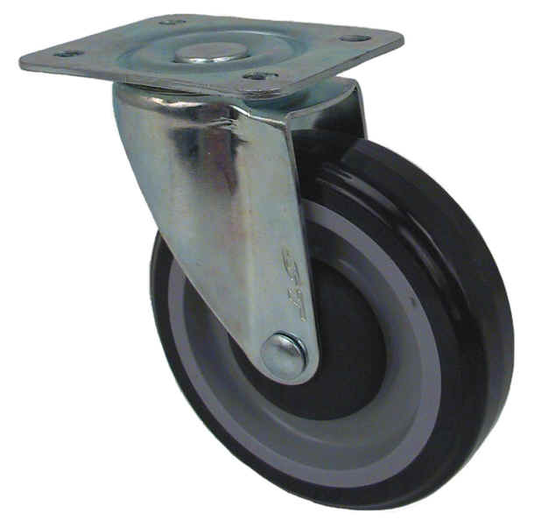
Wheels
Need enough grip to avoid wheel spin
Must keep driven wheels on the ground
Casters / skids?

Slide 19
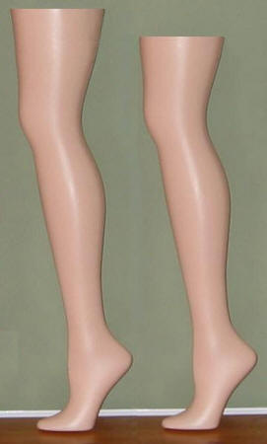
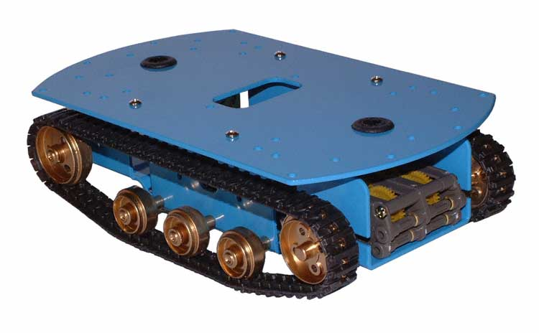
Alternatives

Slide 20
Chassis
Support
Protection
Centre-of-mass

Slide 21
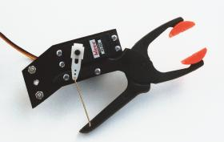
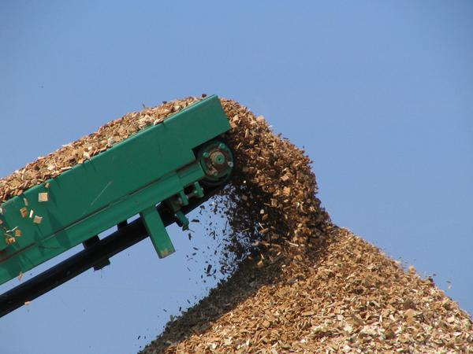
Token Collection
An area for some creative solutions!
Pick up or push?
Carry one or many?

Slide 22
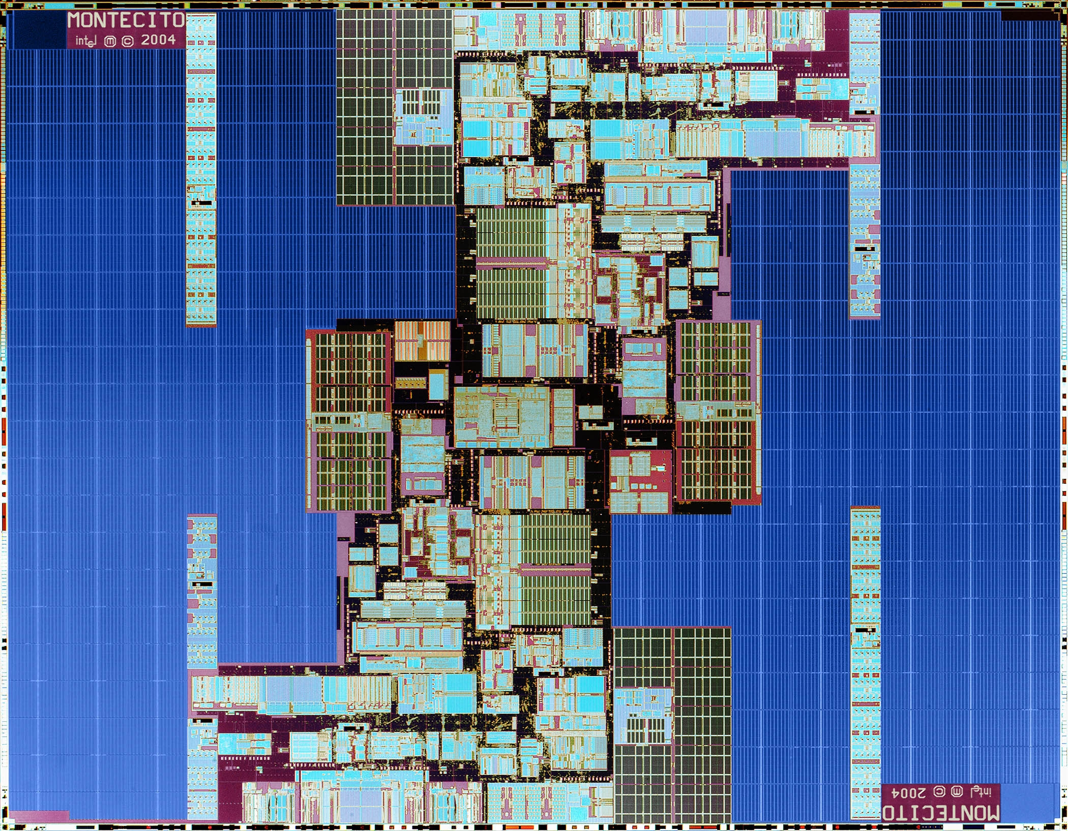
Modularity
!

