Slide 1
Competition 2009
The Arena
8m by 8m
Raised nets in each corner
4 scoring zones – entirely covering arena floor
Notes:
[slide 1]
Hi my name is chris and i'm going to tell you about the electronics kit
The good news is that we don't expect you to have any previous experience with electronics,

Slide 2
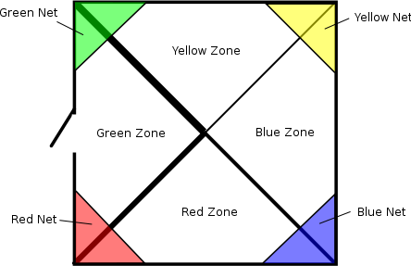
The Arena
Notes:
[slide 1]
Hi my name is chris and i'm going to tell you about the electronics kit
The good news is that we don't expect you to have any previous experience with electronics,

Slide 3
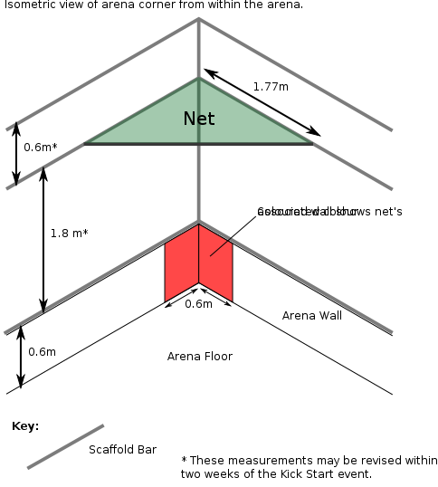
The Arena
Notes:
[slide 1]
Hi my name is chris and i'm going to tell you about the electronics kit
The good news is that we don't expect you to have any previous experience with electronics,

Slide 4
The Games 2009
Golf:
Remove all balls from your zone
Get balls into opponents zones & nets
Balls in your zone: +1 point
Balls in your net: +3 points
Lowest score wins!
Notes:
[slide 1]
Hi my name is chris and i'm going to tell you about the electronics kit
The good news is that we don't expect you to have any previous experience with electronics,

Slide 5
The Games 2009
Squirrel
Your colour balls in your team zone
    +1 point
Your colour balls in your team net
    +3 points
Opponent's balls in your team zone
    -1 point
Opponent's balls in your zone
    -3 points
Notes:
[slide 1]
Hi my name is chris and i'm going to tell you about the electronics kit
The good news is that we don't expect you to have any previous experience with electronics,

Slide 6
The League
The League
First place = +3 League Points
Second place = +2 League Points
Third place = +1 League Point
The team with the most league points at the end of the day will become Student Robotics champion!
Notes:
[slide 1]
Hi my name is chris and i'm going to tell you about the electronics kit
The good news is that we don't expect you to have any previous experience with electronics,

