Slide 1
Management
08/09 Time line
Team work
Decisions
Prototyping
Asking for help
Summary
Notes:
[slide 1]
Hi my name is chris and i'm going to tell you about the electronics kit
The good news is that we don't expect you to have any previous experience with electronics,

Slide 2
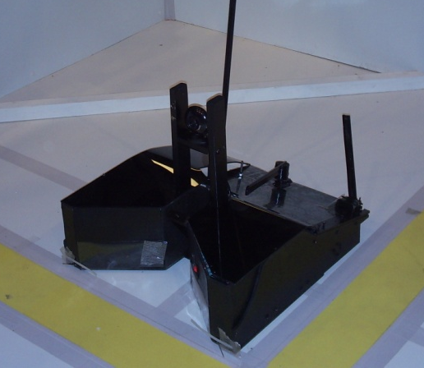
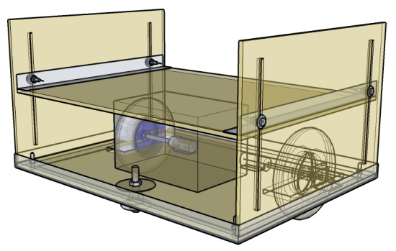
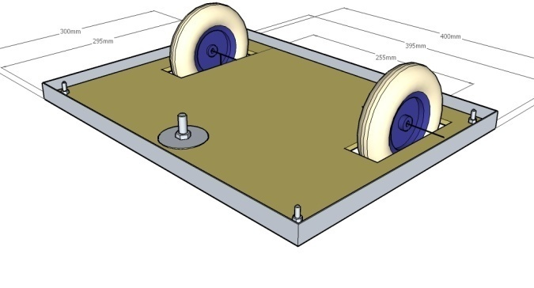
08/09 Time Line
KickStart
Competition
Christmas
A/AS-levels
Easter
I.
II.
III.
Milestone I.: teams should have a moving robot, electronics installed; arm, sensors or program not needed
Milestone II.: mechanical build nearly complete, working arm, some sensors installed, basic program working
Milestone III.: complete robot, minor tweaking, team should concentrate on programming. Programming workshops by SR

Slide 3
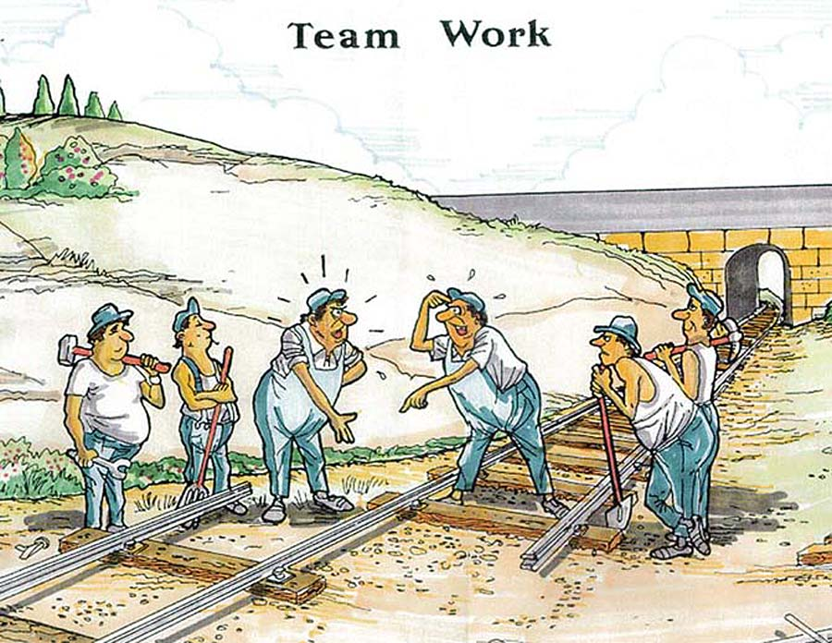
Team Work
Take roles
  Team coordinator
  Designers
  Builders
  Programmers
Make sure you know what you're doing!

Slide 4
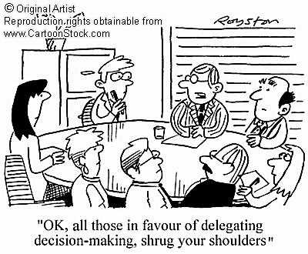
How To Make Decisions
Discuss » Decide » Do

Slide 5




Design
Start with a simple design, then improve
Simple design
Complex design
Fail

Slide 6
Prototyping
Try
Fail
Succeed

Slide 7
Ask for Help
Ask your mentors
Ask your teachers
Ask on the forums
View fact sheets on Student Robotics website: http://www.studentrobotics.org
Ask Google!

Slide 8
Summary
Make design decisions
Start simple
Prototype
Start programming early
Don't be afraid to ask for help

