Slide 1


Electronics
What this covers

Slide 2
boards/parts

Slide 3
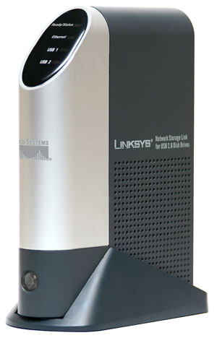
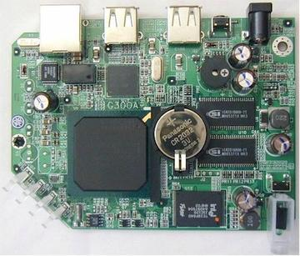
Slug
“Brain” based on modified Network attached storage device(Linksys NSLU2)
Runs custom LINUX
Keep in box
Filesystem on USB key

Slide 4
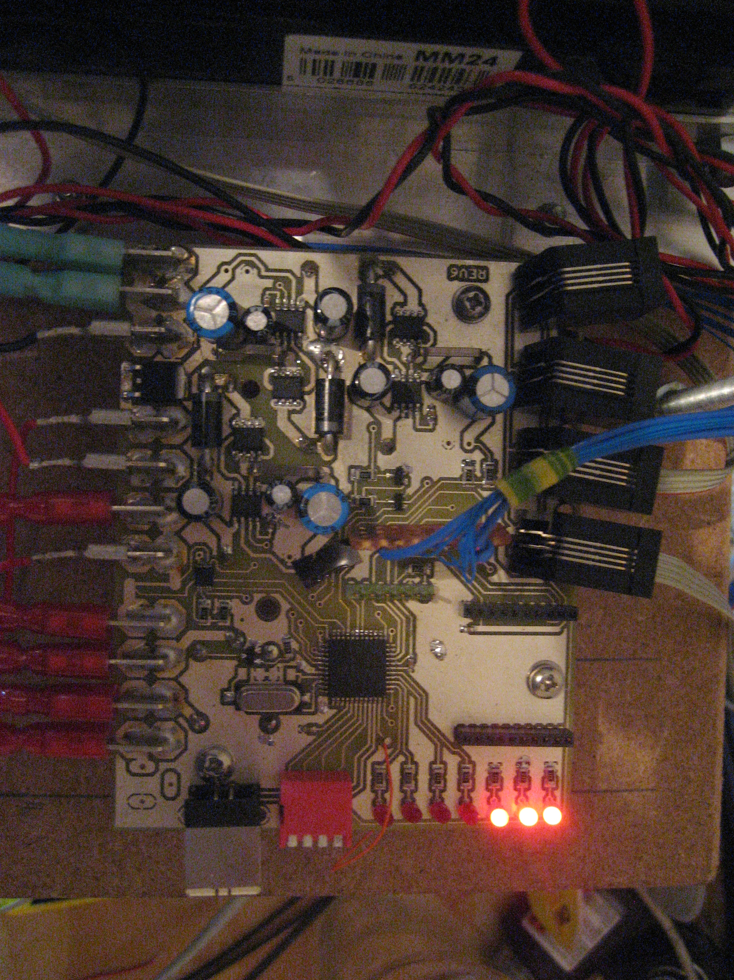
Power board
Power regulation and control
Distributes signals
Usb interface for software upload

Slide 5
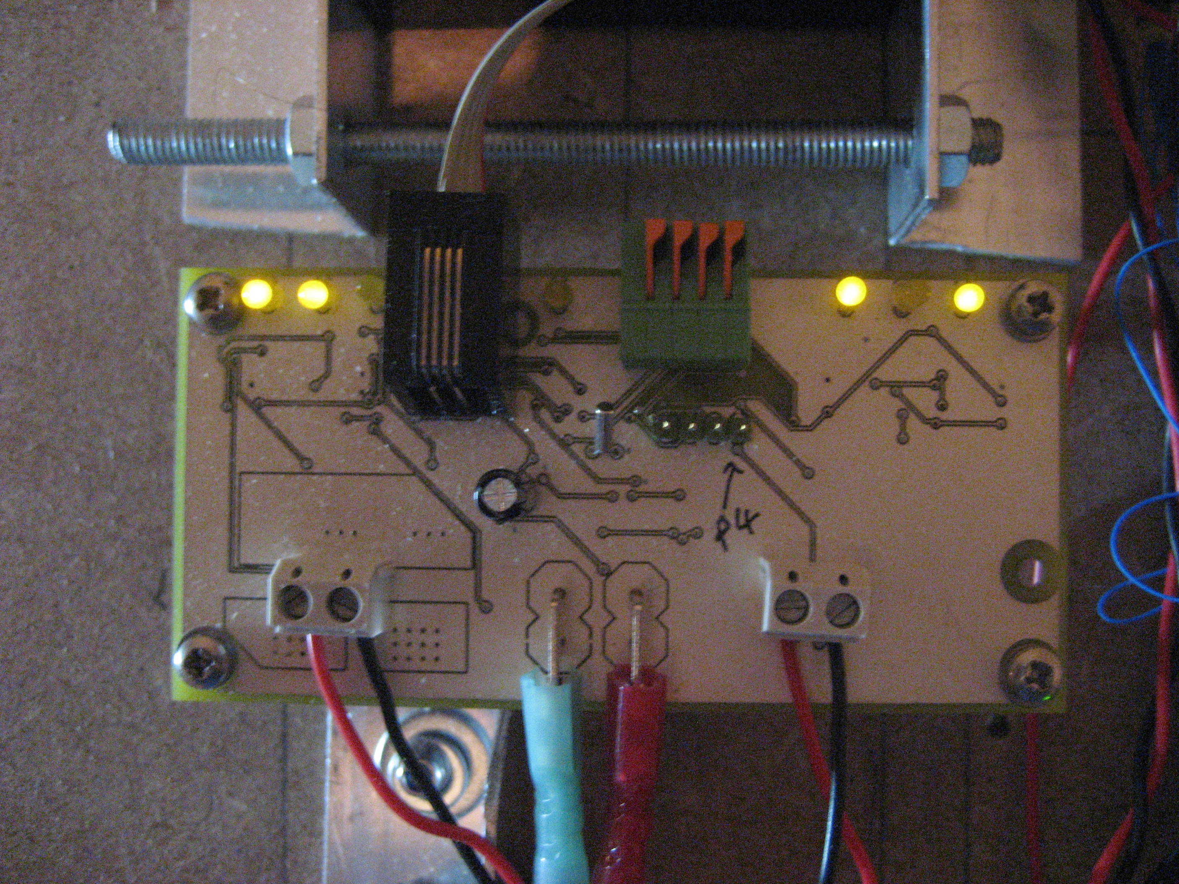
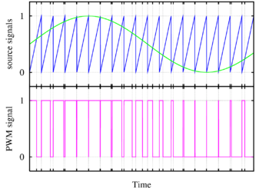
Motor controller
2 Bi-directional outputs
Speed control by PWM

Slide 6
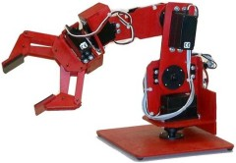
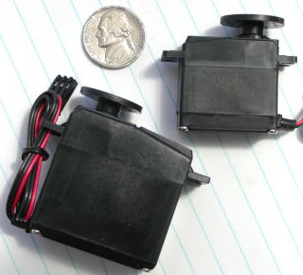
Servo
Six chanels for control of model servos
Upto 8 servos (2 paired)

Slide 7
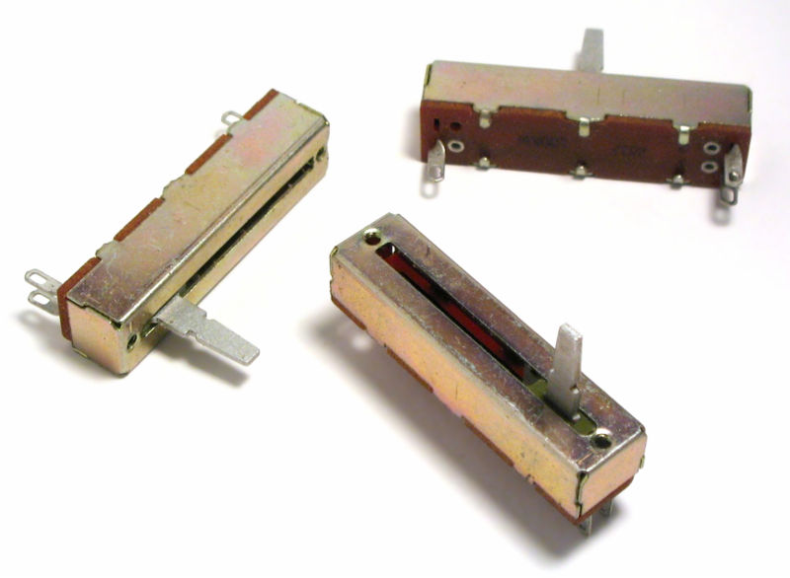
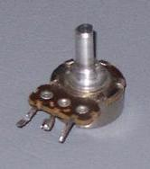
ADC
Provides 8 analogue inputs

Slide 8
DIO

Slide 9
Battery and charging

Slide 10
A/D choice
Pull up
Potential divider

Slide 11
Protection
Cover
No bend
No poke/drill
Swarf
Dangling wires

Slide 12
Wiring
Correct guage
Color coding – use it
labling
Leave slack – not to much
Route sensibly
Crimps

Slide 13
Remote kill
Will be given radio module, mode disabled by switch on power board
Put motor switch somewhere sensible

Slide 14
Feedback
May need to add switch on pot to mechanism.

Slide 15
General electronics wisdom
Test in sections
Have you turned it on/plugged it in?
  Debugging - start at the simplest thing

Slide 16
Summary
Look after the boards
Test incrementally

