Slide 1
Student Robotics
Chris Cross and Rob Spanton
{ccross,rspanton}@studentrobotics.org
www.studentrobotics.org

Slide 2
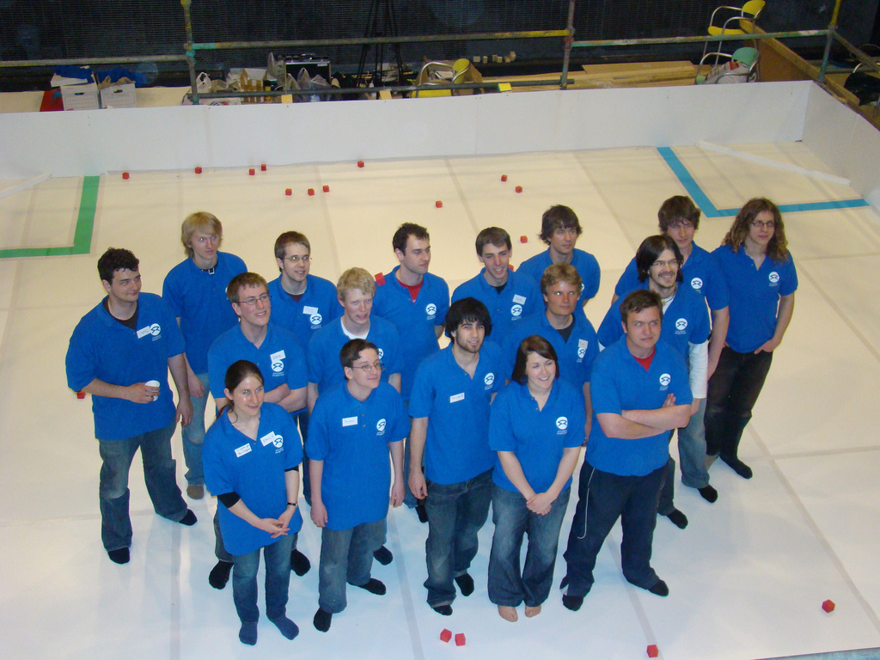

Slide 3
Our Aim
To bring science and technology to young people through the medium of robotics.

Slide 4



Funding

Slide 5
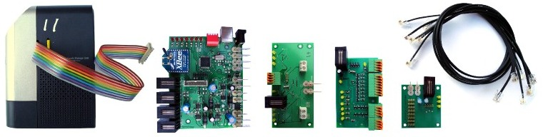
What

Slide 6
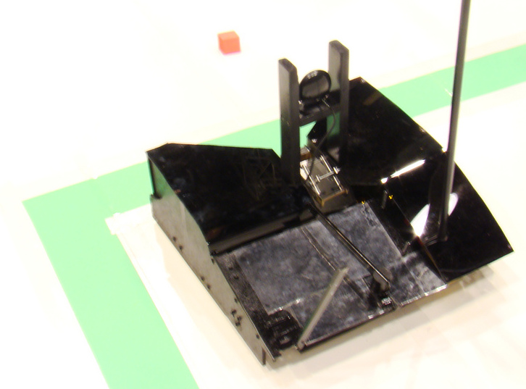

Slide 7
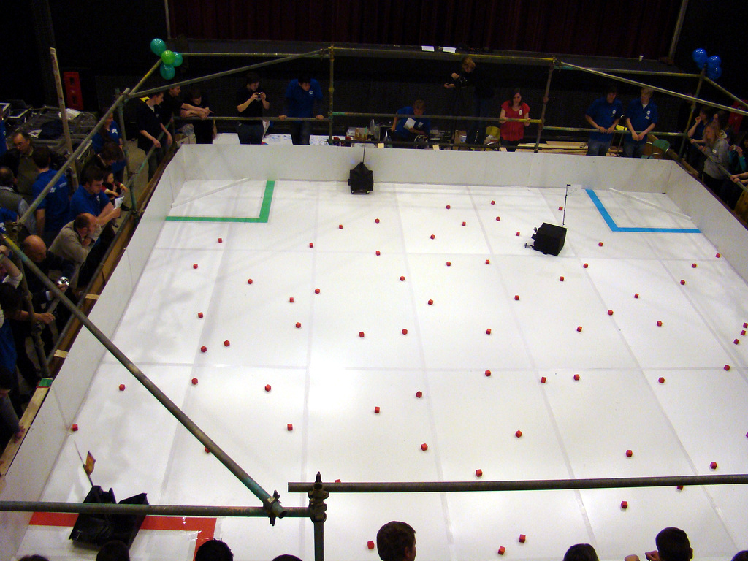

Slide 8
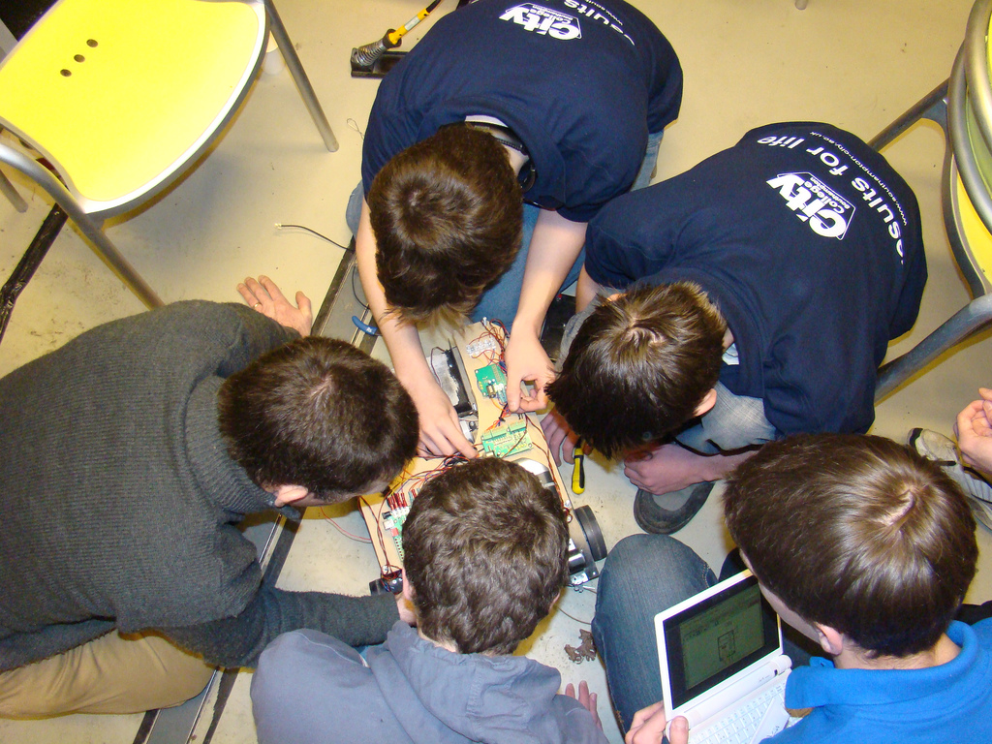

Slide 9
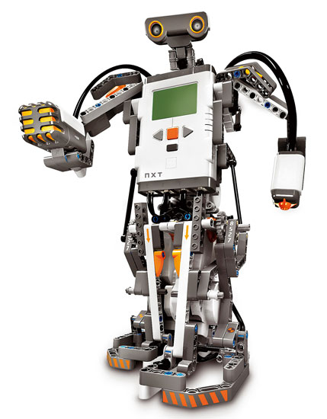

What we are not

Slide 10
What we are
Amorphous
“Big”
Open

Slide 11
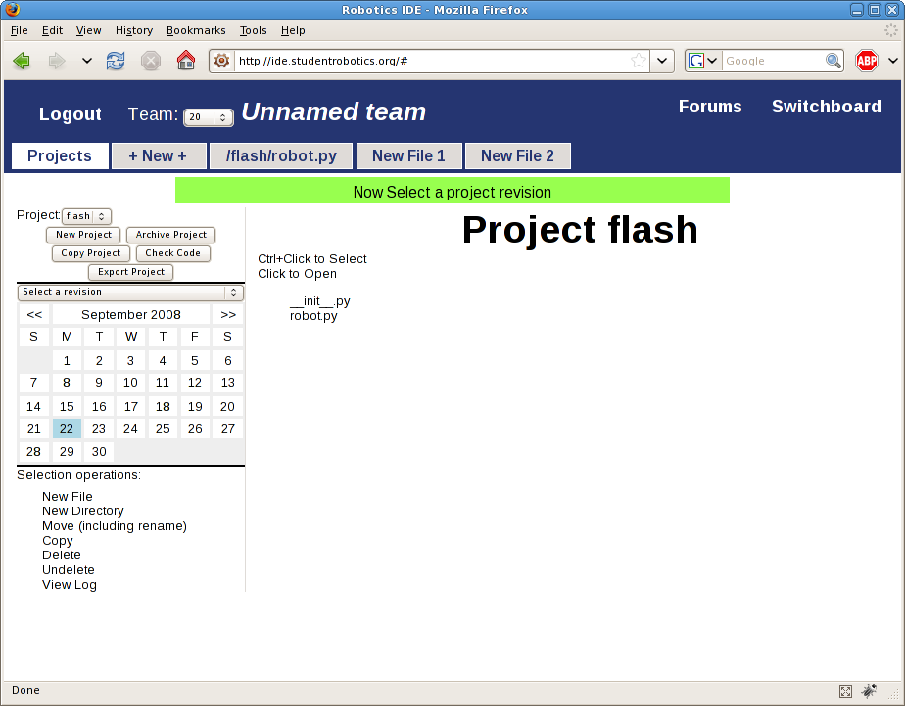
Software

Slide 12
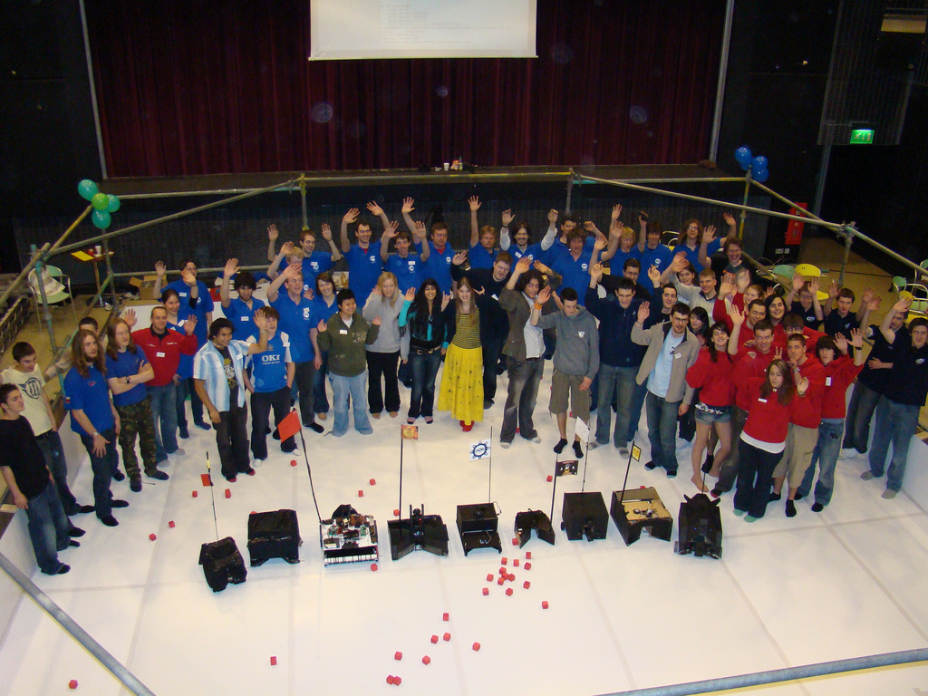

Slide 13
Reflection
Experience
Angle
Context
Community

Slide 14
Acknowledgments
Tom Bennellick
Howard Buck
Justyn Butler
Eric Cooke
Stephen English
Franzi Florack
Jeffrey Gough
Nick Greatbatch
Steve Gunn
Alexis Johnson
Aron Kisdi
Tobias Kleemann
Peter Law
Joyce Lewis
Jeremy Morse
Dan Mulvaney
George Payne
Adrian Pelling
Peter Robinson
Chris Shillitoe
Phil Smith
Sophie Stubbles
Su White
Klaus-Peter Zauner

Slide 15
Questions?
www.studentrobotics.org
Chris Cross and Rob Spanton
{ccross,rspanton}@studentrobotics.org

