Slide 1

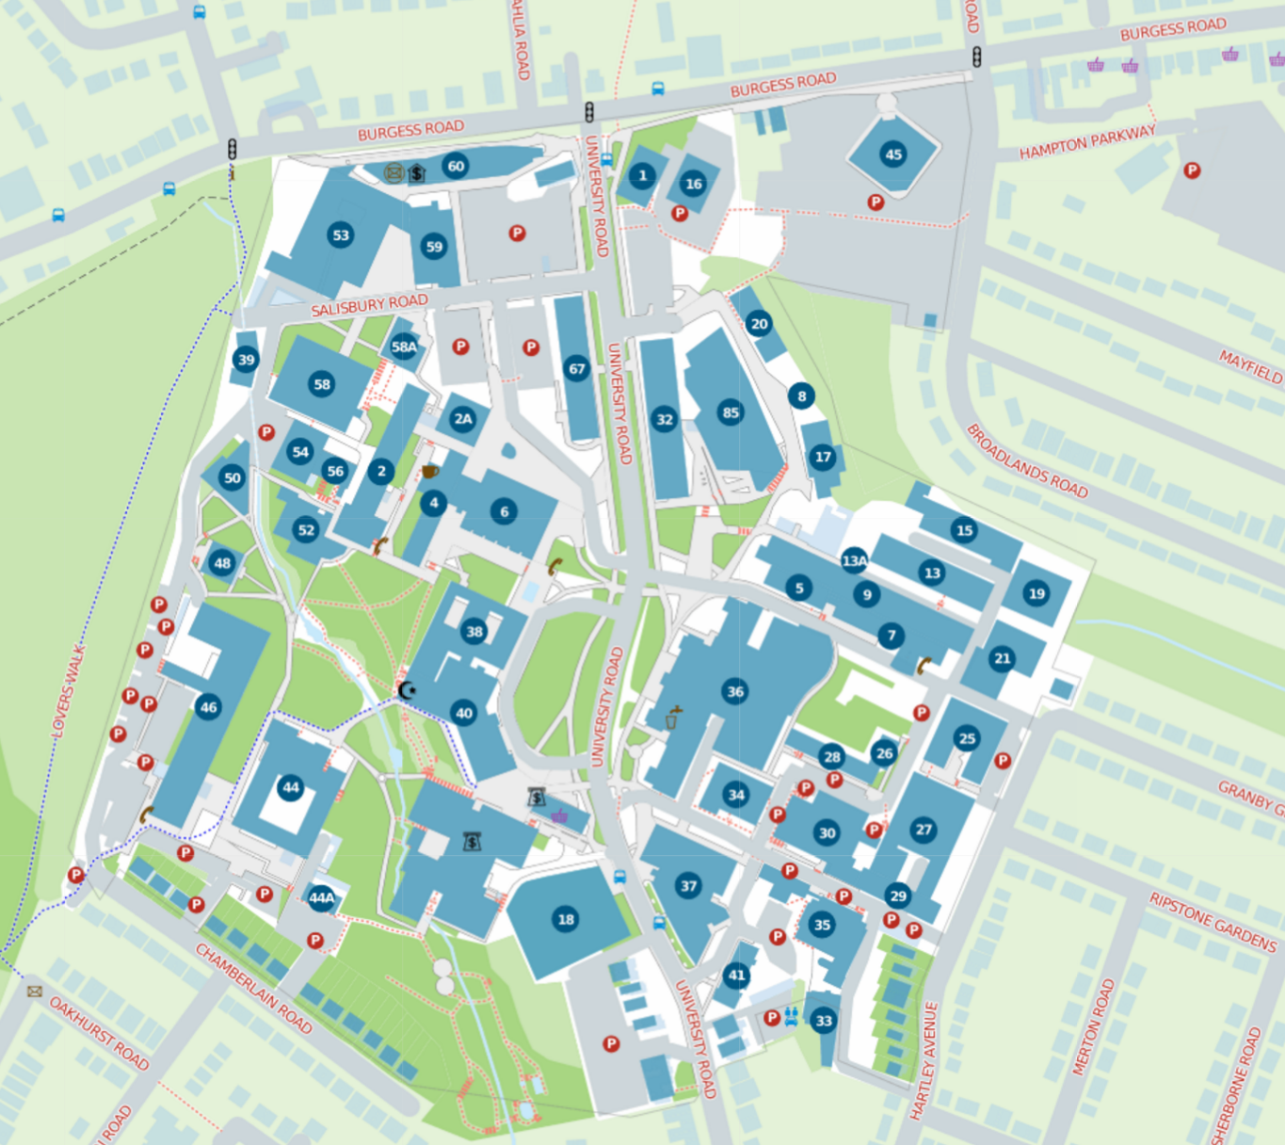
SR2020 Kickstart
For directions to get to campus see: https://goo.gl/MGrBup
Parking
Intro talk

