Slide 1

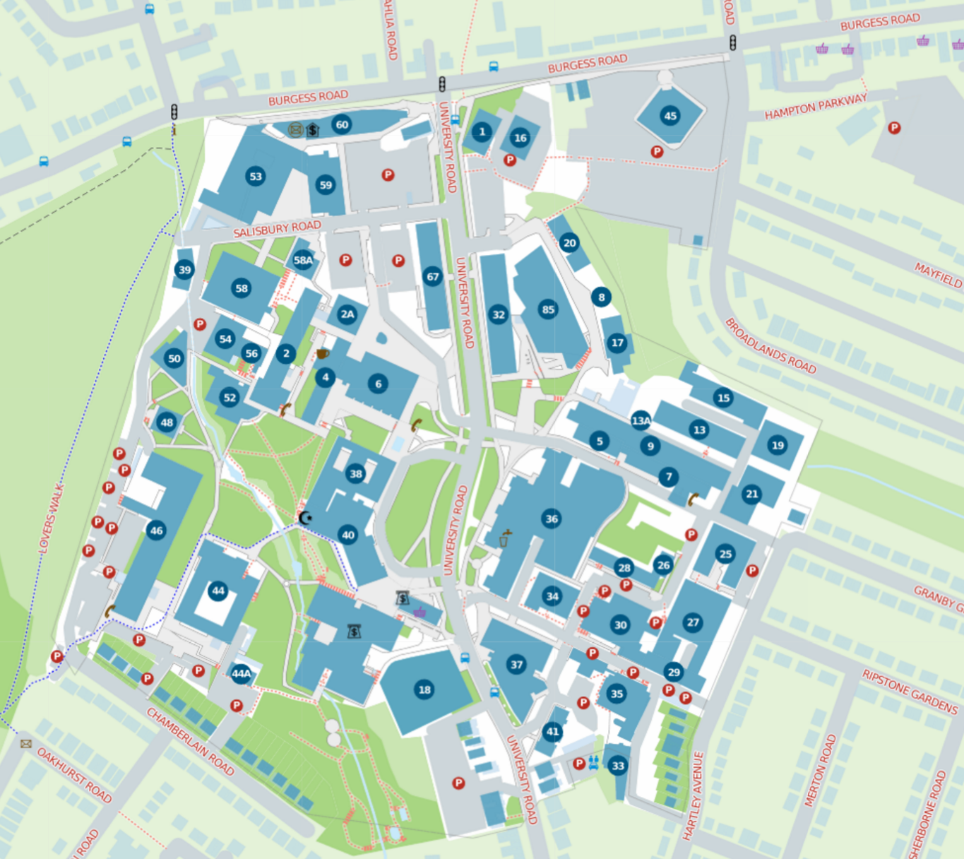
SR 2019 Kickstart
For directions to get to campus see: https://goo.gl/MGrBup
Parking
Intro talk

