Slide 1
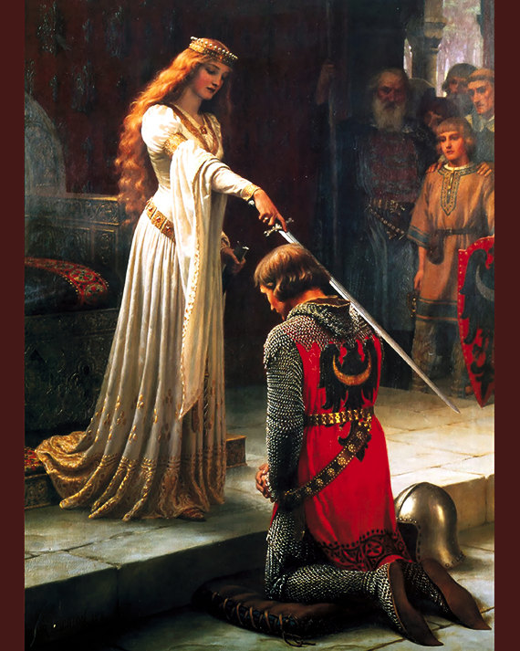
Machine Learning
Text to Script

Slide 2
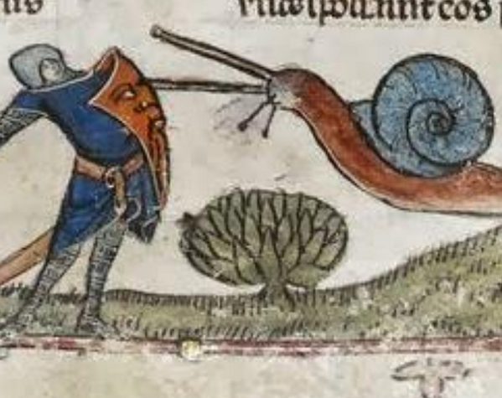
GOAL
WHAT ?
WHY ?

Slide 3
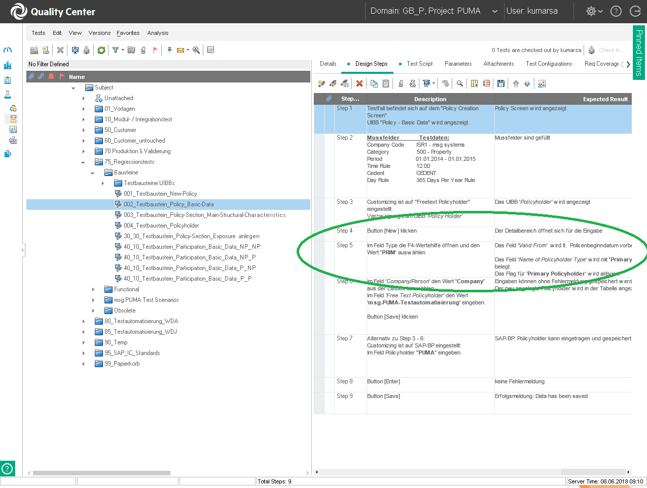
INPUT
TEXT -QC

Slide 4
TEXT
Button [New]klicken
Im Feld Type die F4 Wertehilfe öffnen
Button [Save]
Erfolgsmeldung: Data has been saved

Slide 5

CODE
SAPNWBCShellWindow("msg.PUMA").Page("Menu").SAPButton("Save").Click
Sub PressF4()
Set objKeys = CreateObject("wscript.shell")
objKeys.SendKeys "{F4}"
wait 2
Set objKeys = Nothing
End Sub
GOAL

Slide 6
PROCESS
Dataset
Tokenization
Vectorization
Training Model
Evaluation

Slide 7
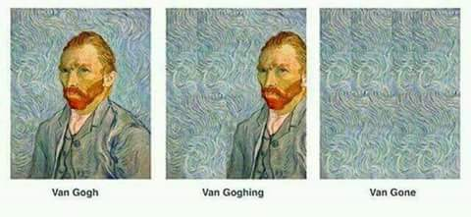
LABELS
PressSave
searchMessage
CheckValue_SAP
PolicySearch
PressUIBBNewButton

Slide 8
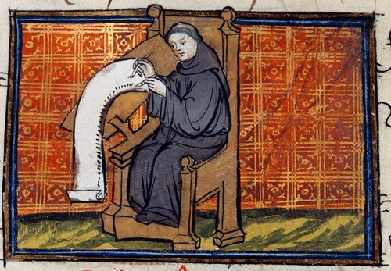
DATABASE
SENTENCES
LABELS
Keine Meldung wird angezeigt | searchMessage
Tabellen Button [Delete] | PressUIBBDeleteButton
Pop-Up Button [Cancel] | PressCancel
Tabelle hat immer noch einen Eintrag | CheckValue_SAP

Slide 9
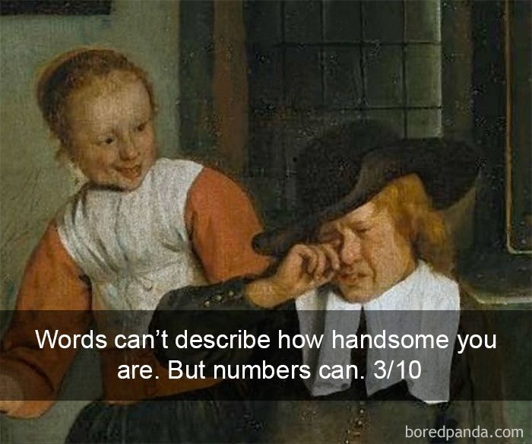
VECTORIZATION

Slide 10
VECTORIZATION
Button [New] im ersten UIBB klicken
1
2
3
100
array([-0.002751 , 0.00021645, 0.00494285, -0.00131294, 0.00262103,…..)

Slide 11


DOC2VEC
WORD2VEC
TF-IDF

Slide 12

TRAINING

Slide 13

DRIVING WORDS

Slide 14
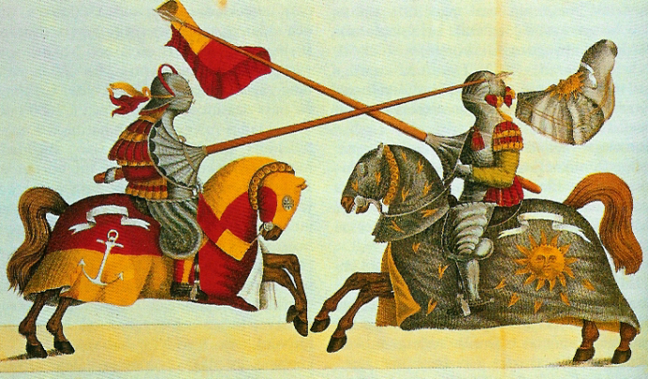
EVALUATION
MEASURE | SCORE
ACCURACY | 93.97
PRECISION | 90.69
RECALL | 88.44

Slide 15

DEMO
Questions ?

