Slide 1

Home

Slide 2
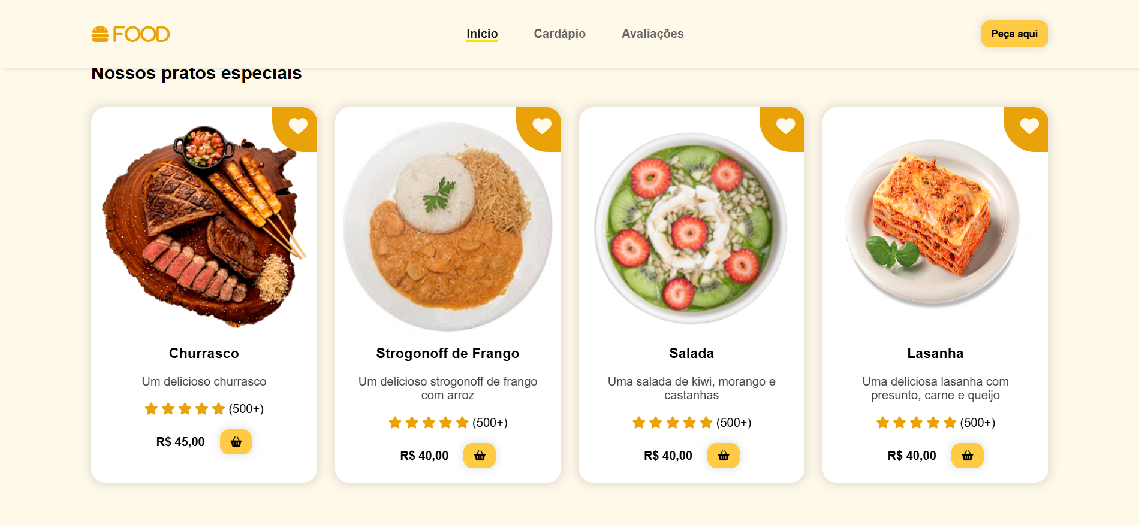
Cardápio

Slide 3


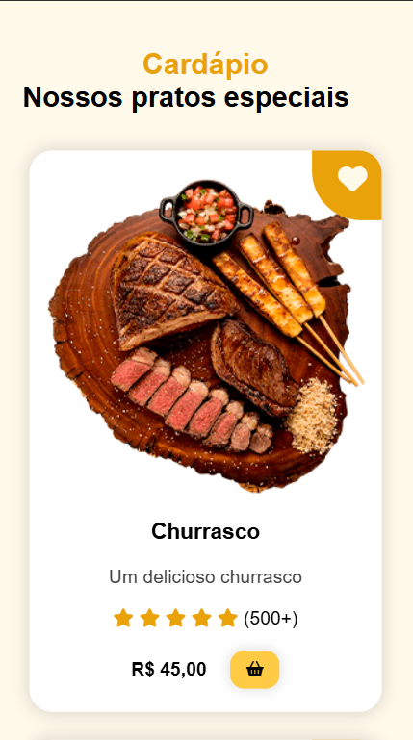
Mobile Responsiva

