Slide 1
Software Comprehension Tools
Pitch Deck

Slide 2
Company Purpose
We will provide the computer-aided software engineering tools,
which automate the currently manual software comprehension activities, so that
programmers are on the order of magnitude more productive
they save 90% of time spent on software comprehension without our tools
and team leads / managers / software architects equipped with our tools get high-quality objective input in the form of
architectural diagrams (nested decompositions of software systems into subsystems)
quality metrics for better monitoring and decision making about software development activities they mentor,
thus letting our clients earn more.

Slide 3
Problem
Currently software engineers spend 95% of time comprehending the software they maintain, and 5% of time actually typing new lines of source code, because of:
Large software: millions of lines of source code
Complex software: a small change causes a lot of side-effects
Currently this issue is mostly not addressed at all (taken as inevitable), or slightly alleviated by means of the following:
Architectural Software Documentation: quickly becomes obsolete or inconsistent. In many projects it’s simply non-existent, because programmers don’t like to document their code and keep the docs up to date, and management cuts costs on such efforts.
Code comments: have the same issue as the documentation (become inconsistent or obsolete, or stay non-existent), plus large software has millions of lines of comments too, which is infeasible to read.
Computer-Aided Software Engineering (CASE): tools which
Provide less helpful metrics than our metrics: interconnectedness of a subsystem with other subsystems; match of subsystems to software packages; etc. – see the research doc;
Don’t provide a high-level view or don’t allow to drill down the hierarchy of subsystems;
Would visualize a large system as a big black dot because of so many nodes and connections between them.

Slide 4
Solution
Technically: use unsupervised machine learning (namely, hierarchical clustering) for inferring the hierarchy of subsystems of the software system, i.e. the nested decomposition of the software system into subsystems.
Business-wise:
Provide objective high-quality metrics taking on input just the source code, so to let team leads / software architects / managers take better decisions.
Provide architectural diagrams with drill-down possibility, so that software engineers can get insights about the source code quickly and estimate the side-effects of a change intended. This increases their productivity, thus also the profit of our clients.
Use-cases:
Architects, Managers, Team Leads: see how software architecture and quality metrics evolve over time – with each commit, nightly build, iteration, release, quarter or year.
Software engineers: comprehend large complex software many times faster, achieving 50/50% share between code typing and comprehension instead of 5%/95%.
Software testers: figure out quickly which areas of the software to test for side effects after a change.
Code reviewers: determine how the suggested changes fit current software architecture, so to keep low quality changes away from merging with the mainline source code.
New hires: get first insights about the source code quickly.
Sale of software: quickly evaluate the maintainability of software being bought, i.e. how productively the buyer company can further maintain this software.

Slide 5
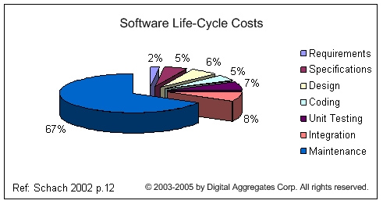
Why Now
Now artificial intelligence is trending: there are many more specialists to hire and companies willing to use or buy artificial intelligence based technology.
Historically, only 33% of software life-cycle costs are spent before maintenance. We are targeting mostly the maintenance phase and there is a lot of software currently in this phase.
In fact, companies in maintenance spend enormous amount of money fighting the growing size and complexity of software.
They employ more and more tools (see static code analysis tools on Wikipedia) that help them to moderate the size and complexity, however these tools are not as efficient as our tool.
Their customers complain about endless bugs, where fix of one bug causes other bugs in the software.
So now is a perfect time to bring to the market an AI tool that will really improve the productivity of software engineering and improve customer satisfaction by breaking the chain of endless bugs in software.
Because software companies will be willing to pay for it.

Slide 6
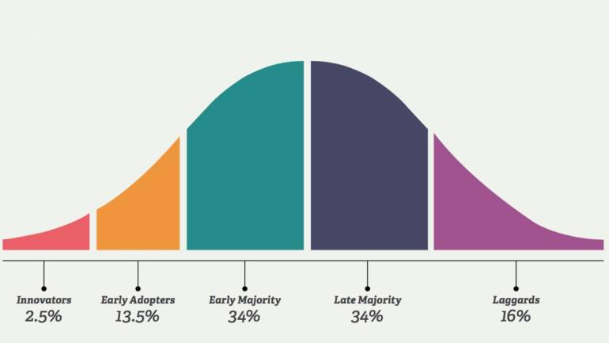
Market Size
Almost every software engineering company is our potential customer.
Because it makes sense to apply our tool to the programs beyond 10 thousand lines of source code. Only tiny software engineering projects are below that size.
TAM (Total Available Market): 1 run of our tool per IT specialist per day.
The US alone has more than 1 million programmers. If we charge $1 per run, then it’s 1 million of programmers times 250 working days times $1 = $250M per year.
There are more than 21 million developers in the world. So when we reach all of them, we will get $5.25B per year.
SAM (Serviceable Available Market): because we provide software as a service (SaaS) over the internet, every software engineering company is within our geographical reach.
SOM (Serviceable Obtainable Market): because we have no direct competitors, we can capture most of the market.
In the first few years after the development we plan to sell the tool to innovators, which is 2.5% of total IT specialists. This should give a revenue of $131M after a year of their usage of our tool.

Slide 7
Competition
AFAIK, we have no direct competitors, so currently only humans can do such reverse engineering.
As to indirect competitors, a list of tools for static code analysis is available on Wikipedia.
Our competitive advantage is in that we provide the users with such conclusions about the software systems which cannot be inferred by the current tools:
Reconstructed Software Architecture as the nested decomposition of the software system into subsystems, with
Drill-down possibility
Navigation, search
Analysis of the side effects of an intended code change
Software quality metrics:
Encapsulation for each subsystem (how much it’s more connected within itself than with the other subsystems)
Correspondence of software packages to subsystems: how well the code is placed where it should be.

Slide 8
Product
Our first product is the tool that aids IT specialists in comprehension of large and complex software source code
Will contain the functionality described throughout this deck.
Provided as a service: users connect to our servers for analysis.
Client-side plugins:
Pre-process the source code so to anonymize and encrypt it before submitting anything to our servers. In fact only a graph of vertices and edges is submitted, so to keep the source code private.
IDE (Integrated Development Environment) plugins for search, navigation, drill-down, visualization, etc.
Server-side application
For the core functionality (hierarchical clustering of graphs)
For charging, accounting, etc.
For the minimal version 26 man*years of development are needed.
Algorithms/C++ team, C# team, Java team
Each team needs 1 team lead, 1 architect and 6 software engineers
1 Project Manager
1 CEO
With sufficient funding, we plan to develop the minimal version in 1 year.

Slide 9
Product – Real World Analogy
Our tool automatically performs the activity analogical to the activity that a human manually performs when writing the brief retelling of a huge book.
Instead of e.g. 1000 pages on input, we produce 20 pages on output.
We also show how the story changes if some detail is added to or removed from the book.
For example, if the software is a game, then this system will likely have top level subsystems of multimedia, AI and control.
Multimedia subsystem will have graphics and sound as its smaller subsystems.
Graphics subsystem will have 3D graphics and 2D graphics subsystems.
Sound subsystem will have special-effects, speech and music subsystems.
Control subsystem will have keyboard and mouse subsystems.
Etc. till the level of separate classes or even methods in object-oriented languages or functions/procedures in e.g. C/JavaScript.
Our prototype takes the source code on input and draws such a hierarchy of subsystems (in computer science terms, a tree) on output.

Slide 10
Product – Example Diagram
Example: nested decomposition of FreeCol game produced by our prototype.

Slide 11
Business Model
We plan to charge $1 per one run of analysis of user software by our tool.
While on average an IT specialist needs to run our tool once per day
We plan to sell our service by means of multiple methods:
Approaching directly the management of other companies
Advertising on the internet by relevant keywords
Answering on forums to the questions asking for similar tools
This way we also approach directly the software engineers of client companies.
As an option, to popularize the tool quickly at the initial stages, we can provide the service for free to open source projects.

Slide 12
Team
Serge Rogatch is the author of the prototype on which the tool will be based.
Is currently a Chief Software Architect at Crossover
In the past was taking Programmer, Architect and Manager positions
Studied Artificial Intelligence at Amsterdam University, The Netherlands
In 2002 and 2003 reached International Olympiad in Informatics and took 3rd category diplomas there.
Specializes in Algorithms & Data Structures, Performance Optimization, Artificial Intelligence, C/C++
Has a number of open source projects of his own on GitHub, and participated in open source projects of the others, e.g. LLVM compiler suite.
Actively asks and answers questions on StackOverflow.

Slide 13
Financials
No company is yet registered
We are at “prototype implemented” stage
The projected revenue is $131M+ after 3 years since investment, as explained earlier

Slide 14
What we need
Investment to pay for 26 man*years of software engineering
In Belarus it amounts to $1.9M, including office expenses, hardware and software
With this amount we will
Finish engineering in 1 year
Additional investment will be required to
Start sales and get to profitability in the 2nd year
In the 3rd year we plan to get to $131M yearly revenue without any additional investments
Then the investors can plan for an exit by means of an IPO
We propose 5% equity to the first-round investor

Slide 15
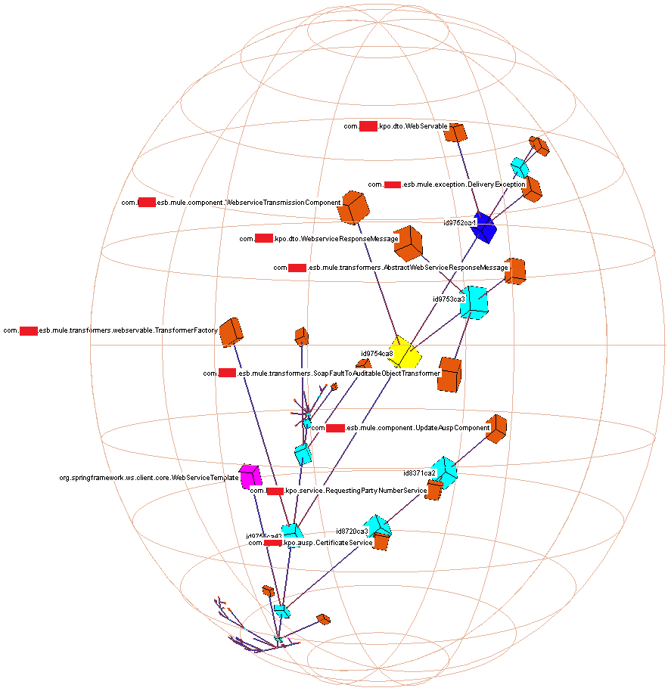
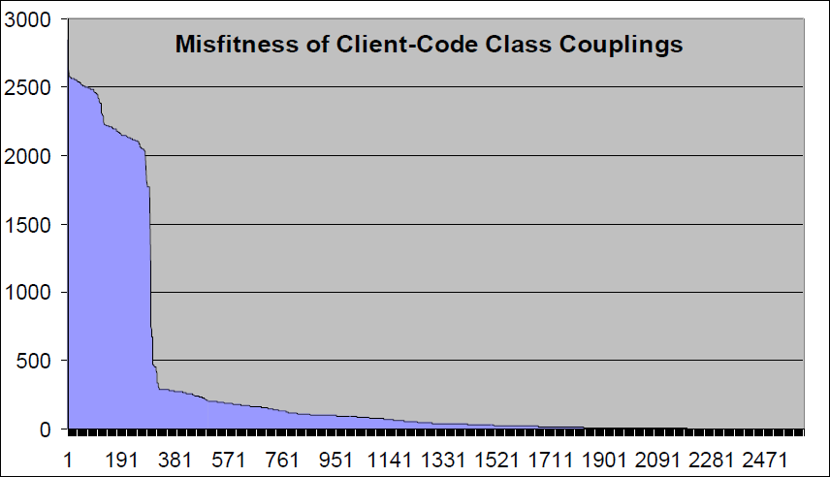
More Details
You can find more details at http://bit.ly/2Mr52Xr

Slide 16
Thank You !

