Slide 1

Department of CSE (IoT & Cybersecurity including Blockchain)
B.M.S. College of Engineering, Bengaluru
AROS
Adaptive Resilience & Operational Security For WindowsOS Based Systems
PHASE - 1 Runtime Behavioral Drift Detection Framework
23IC6PWPP1 | Major Project Phase-1 | 6th Semester | AY 2025–26
S Rohith
O V Yogeswar Reddy
Dadapir N F
1BM23IC057
1BM23IC045
1BM24IC400
Project Guide: Prof. Susmitha Mukund Kirsur, Assistant Professor, Dept. of CSE (ICB), BMSCE.
11 MAY 2026
Notes:
1

Slide 2
Table of Contents
AROS Phase 1
01
02
Motivation & Problem Statement
Proposed System
Runtime security gap & motivating threat class
AROS core concept, scope, and innovation differentiator
03
04
Objectives
High-Level Design
O1–O4: Measurable Phase-1 research targets
5-layer architecture, system flow, tools, evaluation
05
Gaps in Existing System
G1–G6: Six identified research & tooling gaps (2025–26)
AROS — Adaptive Resilience & Operational Security | Phase 1 | Academic Year 2025–26

Slide 3
01 Motivation
600%
287
$4.9M/breach
Rise in ransomware
attacks (2019–2026)
Average days to
detect a breach
Average cost of
a data breach (2025)
Source: Cybersecurity Ventures, “Cybercrime
Statistics 2025–2026”
Source: IBM Security, “Cost of a Data Breach Report 2025”
Source: IBM Security, “Cost of a Data Breach Report 2025”
Most IDS/IPS systems rely on static signatures ineffective against zero-day & APT attacks.
Incident response remains largely manual, causing dangerous delays in threat containment.
No existing production solution integrates detection + RL decision-making + MTD + self-healing in one closed loop.
Therefore there is an need for an autonomous, adaptive cybersecurity framework that acts without human intervention.
AROS — Adaptive Resilience & Operational Security | Phase 1 | Academic Year 2025–26

Slide 4
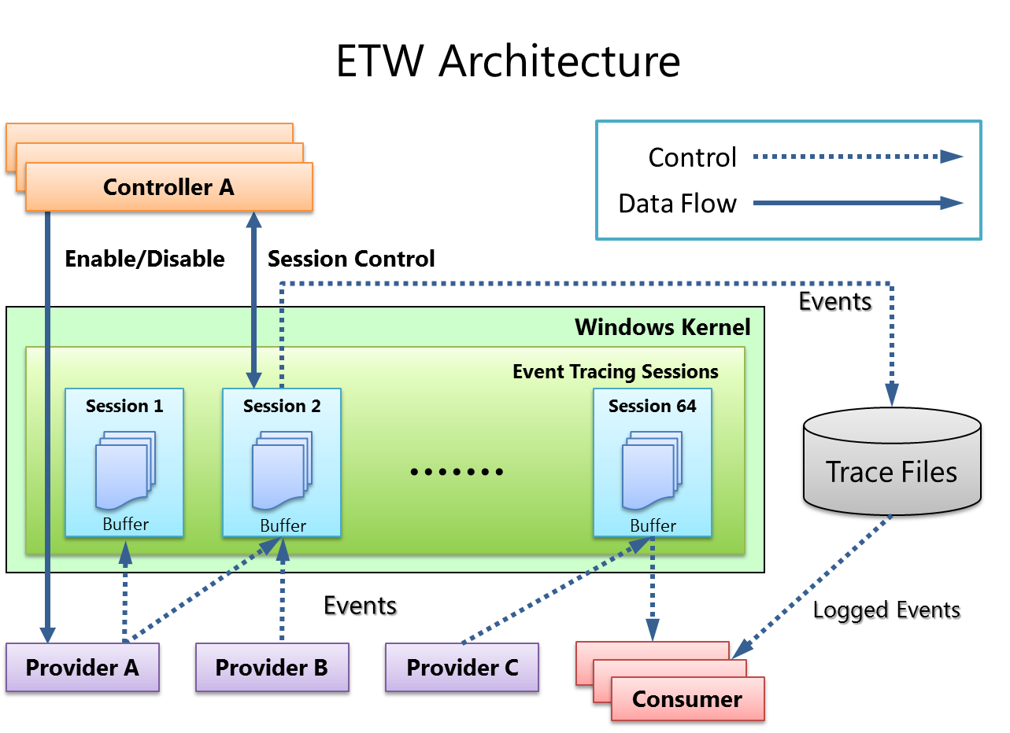
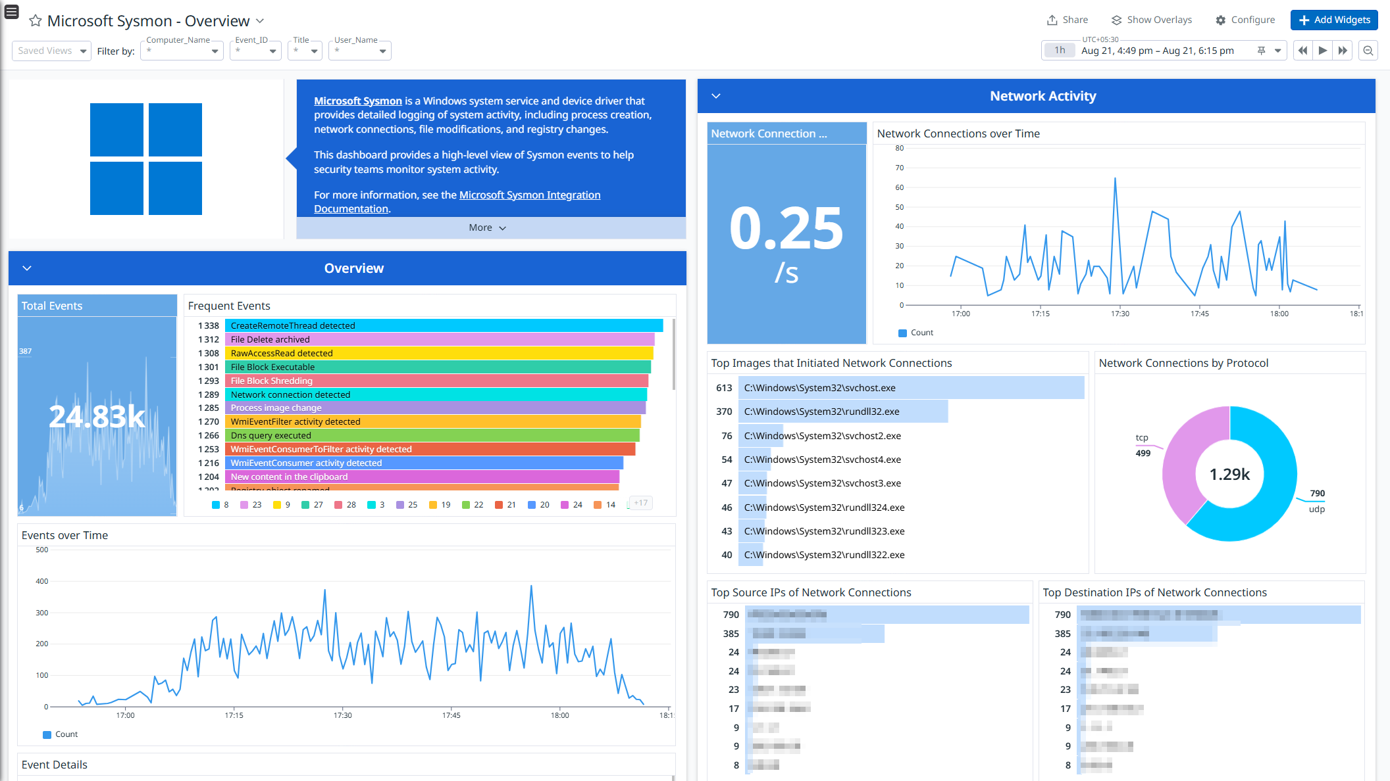
01 Problem Statement
Traditional Windows security systems mainly focus on signature-based detection and short-term anomaly monitoring. However, modern cyber threats such as stealthy malware, insider modifications, configuration drift, persistence mechanisms, and zero-day behavioral changes often evolve gradually during runtime and remain undetected by conventional security tools. Existing solutions generate large volumes of alerts but lack adaptive behavioral understanding of long-term system operations.
Windows environments provide rich runtime telemetry sources such as Event Tracing for Windows (ETW), Sysmon, Event Logs, Performance Counters, and WMI (Windows Management , yet these data sources are not effectively utilized for continuous behavioral drift analysis. As a result, organizations face difficulty in identifying silent operational deviations before they become critical security incidents.
Therefore, there is a need for an adaptive runtime security framework capable of continuously monitoring Windows-based systems, establishing normal behavioral baselines, detecting long-term behavioral drift, and improving operational resilience against evolving and previously unseen threats with minimal system overhead.
AROS — Adaptive Resilience & Operational Security | Phase 1 | Academic Year 2025–26
3 / 14

Slide 5




02 Proposed System AROS
Section 2
Core Concept: Behavioral Identity
AROS treats each monitored service as having a behavioral identity a stable, multi-dimensional statistical profile derived from runtime telemetry under normal operating conditions. Persistent, statistically significant drift from this identity triggers a security-relevant flag.
What AROS Does (Phase 1)
Scope Boundaries
Innovation Differentiator
Collects CPU, memory, process, network & timing telemetry from a target Windows service
Constructs a multi-dimensional behavioral baseline during defined normal operation
Applies statistical distribution comparison & lightweight ML to detect persistent drift
Evaluates performance: detection latency, FPR, accuracy, overhead
Generates structured logs & drift score visualizations
Phase 1 deliverables: Detection · Analysis · Baseline Modeling · Evaluation · Literature Survey · Design
Platform: Windows 10/11 (64-bit) local controlled environment
Recovery & self-healing: architecturally specified but NOT implemented in Phase 1
Formally scoped as Phase-2 extension to avoid overclaiming
No real-world network access fully sandboxed laboratory setting
Long-term behavioral drift not immediate anomaly detection
Models the identity of an individual service not generic network rules
Complete measurable pipeline: telemetry → drift quantification → evaluation
Results are reproducible and academically defensible
Formalized for Windows runtime an under-addressed research domain
AROS — Adaptive Resilience & Operational Security | Phase 1 | Academic Year 2025–26
6 / 14

Slide 6
03 Objectives — Phase 1
Section 3
Four measurable research & development targets — specific, technically defensible, and evaluable within the project timeline.
O1
Instrument & Collect Runtime Telemetry
O2
Construct a Behavioral Baseline Model
Design & implement a lightweight telemetry collection module for Windows capturing CPU usage, memory patterns, process activity metrics, network behavior, and system call timing from a target service at configurable sampling intervals.
Develop a baseline modeling component that aggregates telemetry over a defined normal-operation window and produces a stable, multi-dimensional statistical profile representing behavioral identity — accommodating workload-driven variation without false drift signals.
O3
Detect Persistent Behavioral Drift
O4
Evaluate the Framework Against Defined Metrics
Implement a drift detection engine applying statistical distribution comparison and/or lightweight unsupervised ML to identify persistent divergence from the established baseline, with drift severity expressed as a quantifiable score.
Assess detection performance through controlled experiments measuring: (a) Detection Latency, (b) False Positive Rate (FPR), (c) Monitoring Overhead (CPU/memory), and (d) Drift Sensitivity across gradual-change scenarios.
AROS — Adaptive Resilience & Operational Security | Phase 1 | Academic Year 2025–26
7 / 14

Slide 7
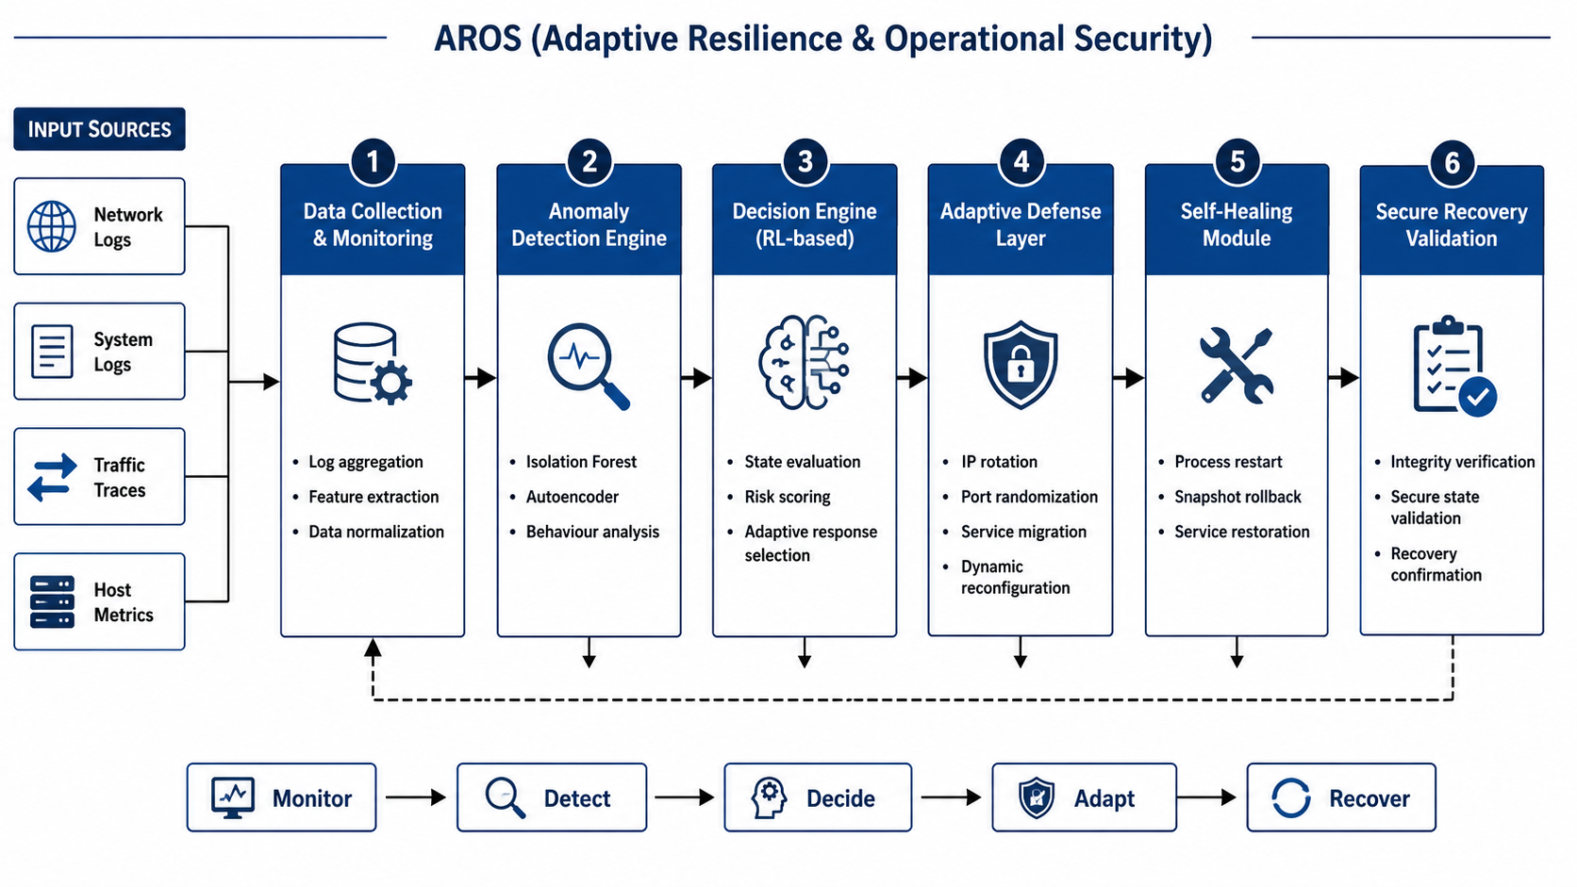
04 High-Level Design — Architecture Layers
Section 4

Slide 8
04.1 High-Level Design — Architecture Layers
Section 4.1
Modular 5-layer sequential pipeline — each layer independently testable before integration.
Layer | Component | Inputs | Processing | Output
1 | Telemetry Collection | Windows service runtime signals | Periodic metric sampling; normalization | Timestamped feature vectors
2 | Pre-processing & Feature Eng. | Raw metric time series | Windowing; aggregation; outlier filtering | Cleaned, windowed dataset
3 | Baseline Modeling | Normal-operation dataset | Statistical profile construction; variance learning | Behavioral identity model
4 | Drift Detection Engine | Live feature vectors + baseline | Distribution comparison; drift scoring; persistence check | Drift score; alert flag
5 | Analysis & Evaluation | Drift scores; alert logs | Metric computation (latency, FPR, overhead); visualization | Evaluation report; drift timeline charts
AROS — Adaptive Resilience & Operational Security | Phase 1 | Academic Year 2025–26
8 / 14

Slide 9





04 System Flow & Processing Pipeline
Section 4.2
Layer 1
Layer 2
Layer 3
Layer 4
Layer 5
Windows
Runtime Telemetry
Pre-processing &
Feature Engineering
Baseline
Modeling
Drift Detection
Engine
Alert & Analysis
Output
CPU · Memory · Process · Network · Timing
Windowing · Aggregation · Outlier Filtering
Mean · Variance · Distributional Profile
Distribution Comparison · Drift Scoring · Persistence
Metrics · Evaluation Report · Timeline Charts
↑ Feedback Loop: Confirmed normal-behavior windows incrementally update the behavioral baseline to accommodate legitimate long-term evolution.
Drift Event Criteria: Score exceeds defined tolerance threshold AND persists across multiple consecutive windows → Event logged with timestamp, affected metrics & drift magnitude
AROS — Adaptive Resilience & Operational Security | Phase 1 | Academic Year 2025–26
9 / 14

Slide 10
04 Tools & Platform
Section 4.3
Component | Tool / Technology | Purpose
Host Platform | Windows 10 / 11 (64-bit) | Target runtime environment
Telemetry Collection | Python 3.x + psutil / WMI / ETW / Sysmon | Metric sampling & event stream extraction
Event Logging | Sysmon + Windows EVTX (Event Log) | Process, network & registry event capture
Data Storage | SQLite / CSV | Baseline and runtime data persistence
ML / Statistics | scikit-learn, NumPy, SciPy | Drift detection modeling
Visualization | Matplotlib / Streamlit | Drift score charts and dashboards
Attack Simulation | Controlled config changes / Kali VM | Generating controlled drift scenarios
Deployment Mode | Agent-Based (SYSTEM) or Agentless (WMI/WinRM) | Flexible on-host or remote collection
Version Control | Git / GitHub | Source management and reproducibility
Development IDE | VS Code | Code development and debugging
Evaluation Metrics
Detection Latency
Drift intro → alert time
FPR
Incorrect alerts under normal load
Drift Accuracy
Correctly identified events
Overhead
AROS CPU & memory usage
Score Stability
Variance during normal op
AROS — Adaptive Resilience & Operational Security | Phase 1 | Academic Year 2025–26
10 / 14

Slide 11
04 Evaluation Framework
Section 4.4
Controlled Experiment Setup
M1
Detection Latency
Time elapsed from drift introduction to first drift alert generation. Lower = better responsiveness.
Deploy target Windows service in isolated lab environment
Monitor service with AROS telemetry collection module
Run an initial observation phase to establish behavioral baseline
Introduce controlled drift scenarios at known time points:
    → Configuration changes
    → Process lifecycle modifications
    → Gradual behavioral shifts (simulated via Kali VM)
Compare detection outcomes against ground truth labels
Compute all four evaluation metrics from accumulated alert log
Generate drift score visualizations and evaluation report
M2
False Positive Rate (FPR)
Proportion of normal-behavior windows incorrectly flagged as drift. Target: < 5% under standard workload.
M3
Drift Detection Accuracy
Correctly identified drift events as a fraction of all introduced drift scenarios. Target: > 90%.
M4
Monitoring Overhead
Additional CPU and memory utilization attributable to AROS telemetry collection and processing pipeline.
M5
Drift Score Stability
Variance of drift scores during confirmed normal operation periods. Low variance indicates reliable baseline.
AROS — Adaptive Resilience & Operational Security | Phase 1 | Academic Year 2025–26
11 / 14

Slide 12
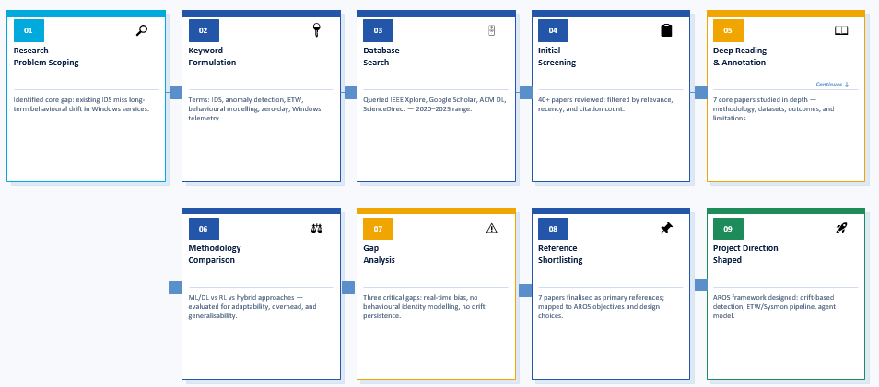
05 Literature Survey
Section 5 — Part A
AROS — Adaptive Resilience & Operational Security | Phase 1 | Academic Year 2025–26
4 / 14

Slide 13

05 Gaps in Existing System (2025–26)
Section 5 — Part A
Six critical research and tooling gaps identified through literature review:
G1
G2
Real-Time Bias in Detection Systems
Absence of Behavioral Identity Modeling
Existing IDS and anomaly detection systems analyze discrete events or short time windows. They are designed for sudden attacks but cannot detect threats that evolve over days or weeks. Long-term behavioral drift falls entirely outside their detection horizon.
No current tool models the 'behavioral identity' of a specific software service. Generic thresholds and network-layer signatures cannot distinguish between legitimate workload-driven variation and security-relevant drift.
G3
Root Cause
Lack of Drift Persistence Analysis
Even statistical anomaly tools evaluate each time window in isolation — they cannot determine if a deviation is transient (e.g., a maintenance task) or persistent (e.g., a backdoor gradually increasing outbound traffic). This causes high false-positive rates and missed chronic threats.
All three gaps stem from the same fundamental design decision: existing tools optimize for immediate precision, not temporal persistence. AROS addresses this by tracking behavioral identity over long time horizons.
AROS — Adaptive Resilience & Operational Security | Phase 1 | Academic Year 2025–26
4 / 14

Slide 14
05 Gaps in Existing System (2025–26)
Section 5 — Part B
Continued — structural gaps specific to Windows-based service-level monitoring:
G4
G5
Windows Runtime Security Under-Addressed
No Integrated Detect-Analyze-Evaluate Pipeline
Most research on runtime monitoring, behavioral modeling, and drift detection targets Linux or cloud-native environments. Windows-based systems — dominant in enterprise and educational settings — receive comparatively little behavior-centric security research attention.
Existing research isolates single aspects — feature engineering, ML model accuracy, or system overhead. There is no integrated pipeline from telemetry collection through drift quantification with measurable outcomes in a controlled Windows environment.
G6
Gap Summary Matrix
Recovery Without Detection Foundation
Gap | Domain | Impact
G1–G3 | Detection Design | High FPR / Missed drift
G4 | Platform Coverage | Windows gap in research
G5 | Pipeline Integration | No end-to-end eval
G6 | Recovery Readiness | No detection foundation
Self-healing and adaptive recovery are active research areas, but the foundational problem of accurate behavioral drift detection — a prerequisite for meaningful recovery — remains underexplored for Windows runtime service-level monitoring.
AROS — Adaptive Resilience & Operational Security | Phase 1 | Academic Year 2025–26
5 / 14

Slide 15
05. Literature Survey (1/2)
P.No
Title of Paper
Year
Key Outcome
Gap Identified
1
Machine Learning and Deep Learning Methods for Cybersecurity: A Survey
2025
Reviews ML/DL techniques for IDS, including modern datasets, adversarial attacks, and AI-based detection.
Current IDS lack adaptability, real-time response, and robustness against modern cyber threats.
2
AI-Driven Cybersecurity Framework for Anomaly Detection
2025
LSTM + Random Forest anomaly detection with high accuracy.
No RL decision-making, dynamic reconfiguration, or autonomous recovery.
3
Autonomous Cyber-Physical Security Middleware for IoT
2025
Multi-layer architecture with anomaly detection and automated mitigation.
Limited RL integration; no complete closed-loop adaptive security framework.
AROS | Dept. of CSE (ICB), BMSCE | MPP-1

Slide 16
Literature Survey (2/2)
P.No
Title of Paper
Year
Key Outcome
Gap Identified
4
Artificial Intelligence in Cybersecurity: Emerging Trends
2025
AI applications in intrusion detection, malware analysis, and autonomous security.
Theoretical only; no implementation of an integrated adaptive framework.
5
A Systematic Survey on Intrusion Detection using Deep Learning in Cybersecurity
2025
Covers deep learning architectures (CNN, RNN, transformers) for intrusion detection.
Traditional ML-based IDS assume fixed environments, lack adaptability to evolving threats, and fail in real-world dynamic network conditions.
6
Adaptive Learning for Moving Target defence: Enhancing Cybersecurity Strategies
2025
Reinforcement learning + game theory to dynamically adapt defense strategies against attackers. Improves system security by enabling adaptive, evolving defense mechanisms against changing threats
Limited real-world validation, Focus mainly on simulation-based testing
7
Reinforcement Learning for Autonomous Resilient Cyber Defence
2025
Reinforcement learning for autonomous cyber defence decision making, Enables self-adaptive and resilient response to dynamic cyber threats
Reward design difficulty,
Incomplete system visibility, Poor generalization.
AROS | Dept. of CSE (ICB), BMSCE | MPP-1

Slide 17

06 REVIEW OF PROJECT
Section 6 — Part A
TP1
What problem are you solving?
TP2
Why is this novel not just another IDS?
Most security tools detect immediate attacks or known signatures. AROS addresses a different threat class: slow, stealthy behavioral drift in runtime systems that develops over days or weeks and is missed by conventional alerting. We model what normal looks like for a specific Windows service and detect when that changes persistently.
An IDS looks for sudden deviations or known signatures. AROS looks for gradual departure from a service-specific behavioral identity over long time windows. The novelty lies in modeling behavioral identity, applying drift persistence checks, and producing quantified drift scores not matching rules or signatures.
TP3
How will you measure success?
TP4
What is the scope and why is recovery not in Phase 1?
We define four concrete metrics: detection latency, false positive rate, drift detection accuracy, and monitoring overhead. All are computed from controlled experiments where drift is introduced at known time points — making results reproducible and comparable against ground truth.
Phase 1 delivers the complete detection and analysis pipeline with measurable evaluation. Recovery is architecturally designed but not implemented in Phase 1. This is intentional — recovery without an accurate detection foundation would produce unstable results. We avoid overclaiming.
AROS Research Positioning: Fills the gap between network-level IDS research and cloud self-healing providing service-level behavioral identity modeling for Windows runtime environments. A research prototype with formalized, measurable outcomes.
AROS — Adaptive Resilience & Operational Security | Phase 1 | Academic Year 2025–26
12 / 14

Slide 18
06 Guide Review Talking Points
Section 6 — Part B
TP5
Is this realistic for a student project?
Yes. We monitor one Windows service in a controlled local environment using standard Python libraries and system telemetry. No heavy compute, no GPU, no real-world network access. The scope is bounded and executable within the Phase-1 timeline. The controlled lab setting ensures reproducibility.
TP6
What is the research contribution?
The formalization of behavioral drift detection for Windows runtime systems: defining what constitutes behavioral identity, designing persistence-based drift scoring, and evaluating the pipeline with quantified metrics. This positions AROS as a research prototype rather than a product implementation.

