Slide 1
Digitizer Data Processing
Manual and algorithm review

Slide 2
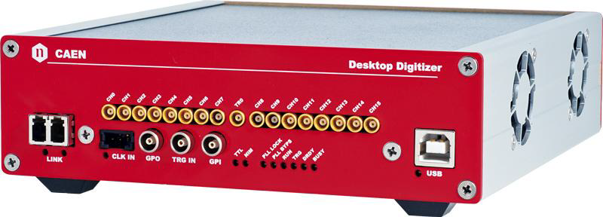
Digitizer data processing algorithms
Mod. DT5742 Desktop Waveform Digitizer
16+1 Channels 12bit 5GS/s
The DC offset is adjustable via a 16-bit DAC in the range ±1V
1024 storage cells per channels (200 ns recorded time per event)
200ps per time channel
Notes:
2

Slide 3
Digitizer save data as float arrays with size 1024 per event per channel. For each digitizer channel corresponds data file “wave_<channel>.dat”. Arrays follow one to each other for entries in files. The scope window 200ns consist of 1024 points; arrays values are voltages values in channels (0,28ch per volts). Digitizer voltage range is 1 volts, and has nonlinearity on edges. There are two channels groups and trigger signal is written for both in to separate files TR_0_0.dat and TR_0_1.dat. So far as two groups have time jitter, two different trigger's times must be decremented from signals' times for different groups. It should be noted what where are other possibilities to take a trigger and writing formats. These options may be configured in digitizer configuration file, and are not considered in this document.
Package “digdataprocessing” serves to process digitizer data into signals parameters as signal time, amplitude, e.c.t.
For each channel must be set polarity, signal type and signal name that putted in data configuration file in the same with data. Data name, data comment also included in file. Configuration file has name “DataConfig.txt” by default. Lines starts with # are comments and skipped. Next line after key [RUNNAME] follows data name, it must be one word. Data comment follows after key [DATACOMMENTS]. [CHANNELSTABLE] is key for channels table, colons separated by spaces or tabs are: channel number; is channel is on; channel polarity (0+, 1-); signal type (0 no signal, 1 logic, 2 amplitude); channel name; channel comment (may be several words). There are also coordinates signals types for special module which are not described here.
To open run in terminal: digdataprocessing use ./path/digdataprocessing/digdataprocessing -g

Slide 4
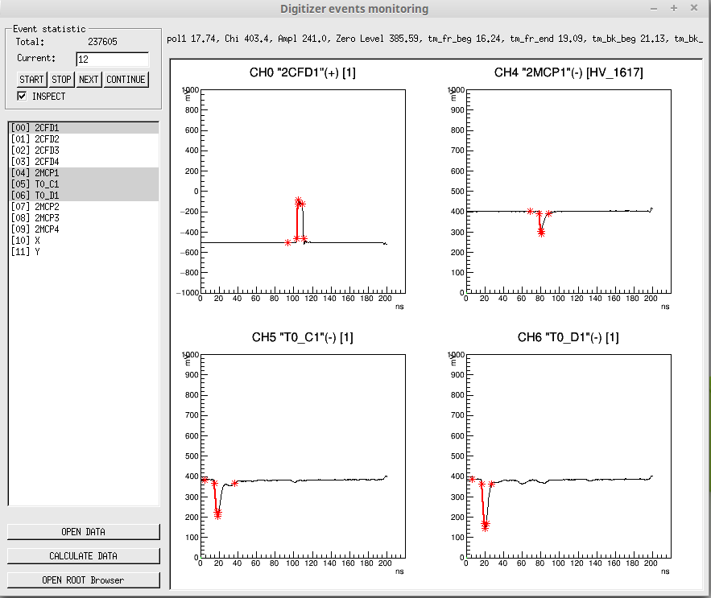
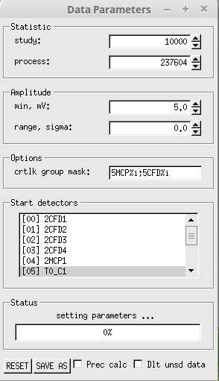
Main window
Total events number in file
Number of total events
Start and stop to show events in loop
Show next event
Switch to last event and wait for new ones to show them, useful while data taking
Calculated signals parameters are shown if switched
Table of channels, selected ones are plotted
Name and comment of data, signals parameters written if inspect switcher is on
To open data, choose data configuration file;
Process opened data in ROOT Tree
To inspect saved file with ROOT Tree, open root browser
Parameters window
Enter the number of event to process

Slide 5
While data processing a blackman filter applied to data to annihilate 500Mhz noise come from data digitizing. Then maximum of amplitude recognized as signal peak (accordance to signal polarity). Zero level and zero level RMS found out of signals. Also signals front and back edges found at 0.1 and 0.9 level of signal amplitude. These values are showed if “inspect” switcher turned on.

