Slide 1
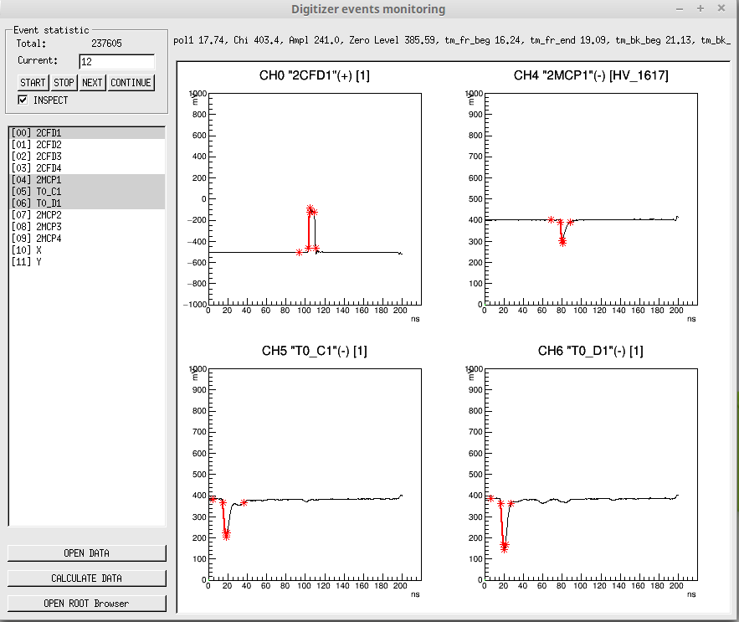
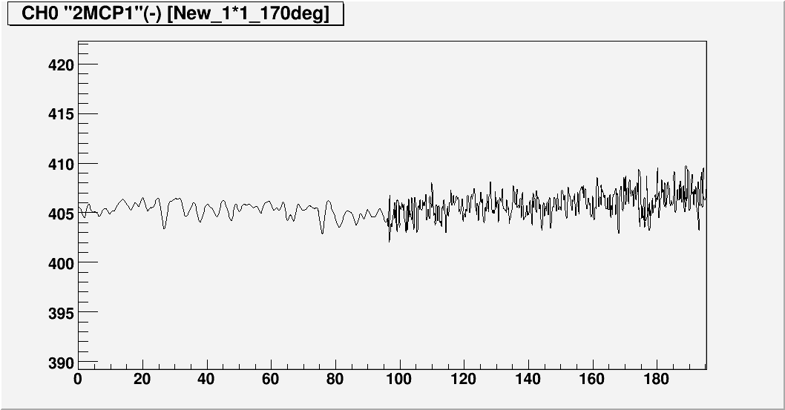
DigDataProcessing project
Objective of the project is the analysis of the data recorded with CAEN digitizer with special signals recognition algorithms
GUI interface allow to monitor data online, and process data on the fly
Raw data from digitizer converted to ROOT TTree format very convenient for analysis with ROOT facility
Calculation of signals amplitude, signal’s time at ½ of amplitude, signal’s front and back length
Time of signal is determined by signal’s front fit with polynomial function power 1 and 3
Special algorithms for different types of signals applied: amplitude, logic NIM, XY coordinate detector’s signals
blackman filter applied to data allow to annihilate 500Mhz noise come from data digitizing
Project’s structure is open to the simple addition of new types of signals and new versions of analysis algorithms
GUI main window: online signal monitoring
Blackman filter
No filter

Slide 2
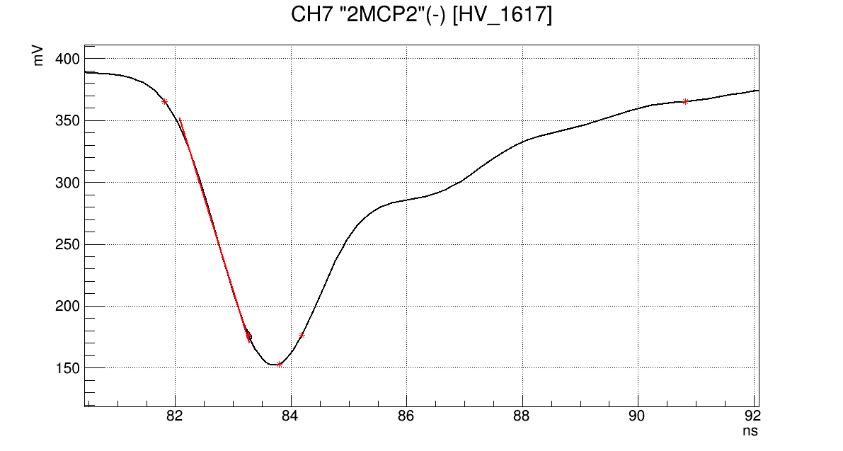
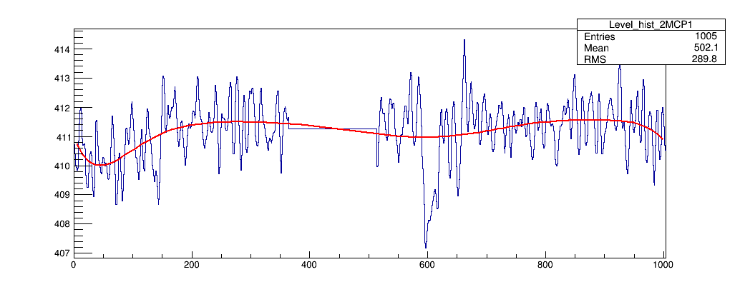
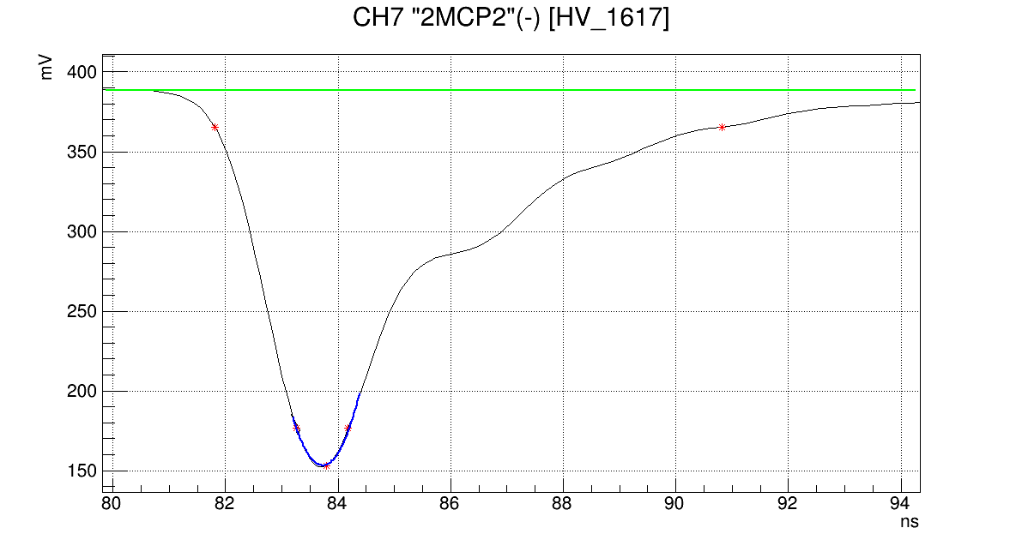
Zero level
Under development
A/10
Front begin
Back end
Signal’s gap
Time
A/2
Front fit
Zero level by polynomial fitting
A
Front end
Back begin
Zero level fit
A/10
Amplitude
Zerol level is mean level out of signal
Amplitude is signal’s extreme
Frond and back edges placed at A/10
Time determined by pol1 (pol3) fit at A/2
Charge is area under signal from Front begin to Back end
Signal’s peak pol2 fit
Simulation of
Time above threshold (TOT)
Leading edge discriminator (LED)
Constant fraction discriminator (CFD)

