Slide 1
COMP34612 Computational Game Theory
Explore
Learn
Adaptive Stackelberg Pricing with Recursive Least Squares
Optimise
Adapt
Group 7 · May 2026

Slide 2
The Problem
Repeated Stackelberg pricing game with unknown, time-varying follower strategies
Game Setup
Leader Specifications
Leader sets price u_L first; follower observes then responds with u_F
Unit cost
c_L = £1.00
100 days of historical data available (days 1–100)
Demand model
S_L = 100 − 5·u_L + 3·u_F
30 live trading days (days 101–130)
Daily profit
π = (u_L − 1) · S_L
Follower strategy unknown and time-varying
Objective
Maximise accumulated profit over 30 days
3 known followers: MK1, MK2, MK3
Strategy (MK1/2)
u_L ∈ [1, +∞)
3 hidden followers: MK4, MK5, MK6 (slightly changed parameters)
Strategy (MK3)
u_L ∈ [1, 15]
von Stackelberg, H. (1934). Marktform und Gleichgewicht. Julius Springer.

Slide 3
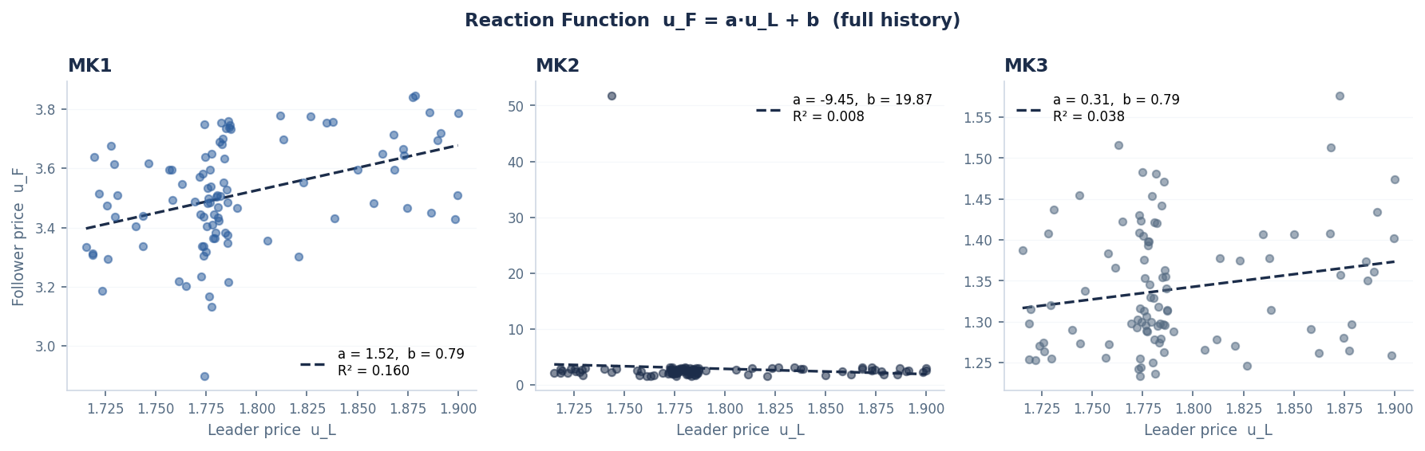
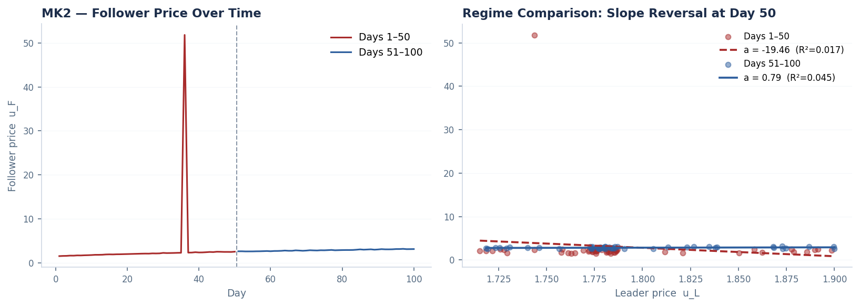
Data Analysis: Three Key Findings
Systematic analysis of 100-day historical data revealed three distinct modelling challenges
Finding 1 — Narrow History Band
Finding 2 — MK2 Day-36 Contamination
Finding 3 — MK3 Slope R² = 0.038
All followers: u_L ∈ [1.715, 1.900] (0.185-unit band). OLS slope from this range cannot extrapolate to live prices u_L ∈ [10–20]. Root cause of original EWLS underperformance.
u_F = 51.8 (z-score ≫ 3σ) on day 36; every other day ∈ [1.5, 3.2]. This single outlier drives days 1–50 OLS slope to −19. Solution: detect and discard contaminated window; warm-start from days 51–100.
MK3 slope is statistically indistinguishable from zero (p > 0.05). Fitting a slope adds noise, not information. Constant model (a = 0, learn only b) is the statistically correct choice.

Slide 4
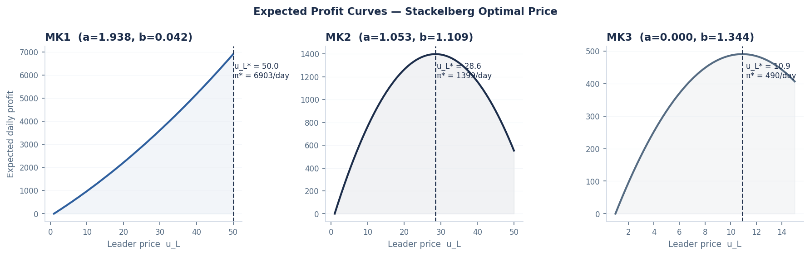
Lectures 2–3: Stackelberg Optimal Price
Analytical derivation: plugging the fitted reaction function into the profit formula
Derivation
Assume linear reaction function
u_F = a · u_L + b → θ = [b, a]ᵀ
Substitute into demand model
S_L = (100 + 3b) + (3a − 5) · u_L
Write leader profit
π_L = (u_L − 1) · S_L
Maximise over u_L (dπ/du_L = 0)
u_L* = (B − A) / (2B) when B < 0
Where
A = 100 + 3b B = 3a − 5
Boundary case (B ≥ 0)
u_L* = max_price or min_price
Fudenberg, D. & Tirole, J. (1991). Game Theory. MIT Press.

Slide 5
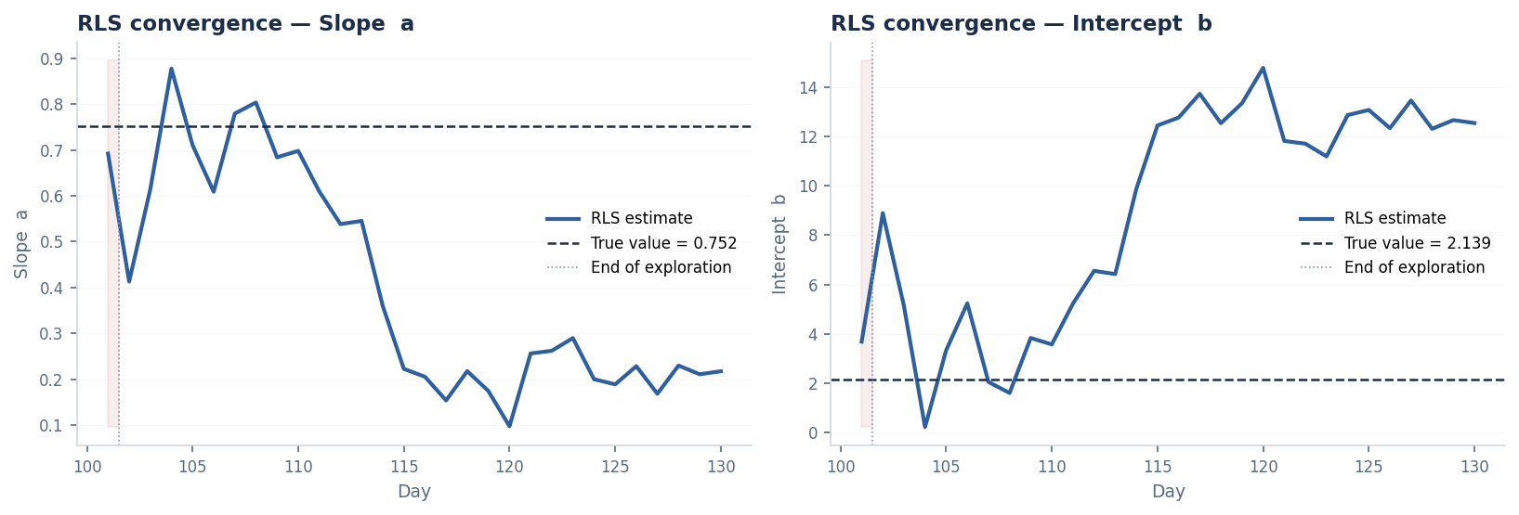
Lecture 6: Recursive Least Squares (RLS)
O(1) online update with forgetting factor λ — principled handling of time-varying parameters
RLS Update Equations
φ = [1, u_L]ᵀ
← feature vector
K = P·φ / (λ + φᵀ·P·φ)
← Kalman gain
P = (P − K·φᵀ·P) / λ
← covariance update
θ = θ + K·(u_F − φᵀ·θ)
← parameter update
θ = [b, a]ᵀ is the reaction function u_F = a·u_L + b λ ∈ (0,1) is the forgetting factor (older observations discounted) P is the 2×2 covariance (uncertainty) matrix
EWLS (old) vs RLS (new)
Computational cost
O(n): refits all history
O(1): one step
Time-varying params
Partial (decay helps)
Explicit via λ
Online update
Full re-fit each day
True recursive update
Lecture alignment
Lecture 4 (batch WLS)
Lecture 6 ✓

Slide 6
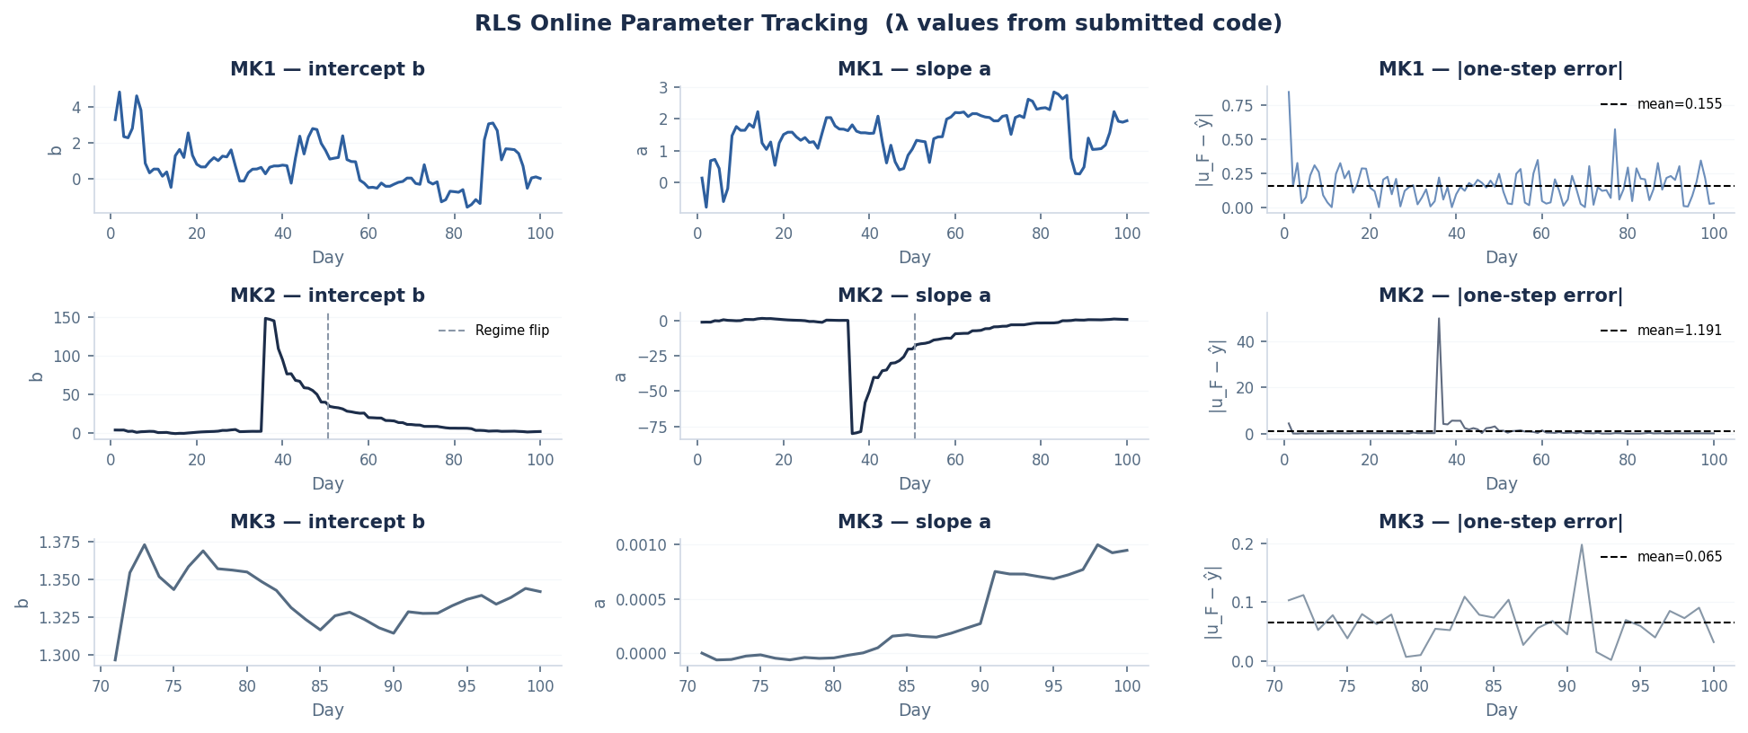
RLS Online Parameter Tracking — Historical Data
Visual evidence supporting every design choice: fast forgetting, contamination, zero-slope prior
MK1 (row 1): slope drifts 0.7→1.9 over 100 days — directly justifies λ=0.88 so live data rapidly dominates
MK2 (row 2): day-36 spike visibly corrupts both b and a — validates discarding days 1–50 before warm-starting
MK3 (row 3): slope stays pinned near 0 via strong prior P[1,1]=0.01; intercept b converges cleanly within ~5 steps

Slide 7
Code Architecture
Shared _RLSMixin base class holds all Lecture 6 RLS logic; each leader specialises
class LeaderMK1(Leader, _RLSMixin)
class LeaderMK2(Leader, _RLSMixin)
class LeaderMK3(Leader, _RLSMixin)
vs MK1 & MK4
vs MK2 & MK5
vs MK3 & MK6
lam = 0.88 | P = 1000·I
lam = 0.92 | OLS warm-start
lam = 0.95 | 2-D RLS, slope prior
Single explore [19.0]
Adaptive explore [16.0]
Adaptive explore [10, 11, 13]
fires while trace(P) > 50
fires while trace(P) > 0.5
fires while trace(P) > 80
start_simulation(): cond. OLS
start_simulation():
start_simulation():
if u_L spread > 0.5: OLS init
days 51-100, _batch_init_rls()
days 71-100, OLS warm-start θ & P
class _RLSMixin (Lecture 6 RLS — inherited by all three leaders)
_init_rls()
_rls_update()
_optimal_price()
_next_price()
_record_and_update()
_batch_init_rls()
Initialise theta=[b,a], P=1000·I, store lambda
Kalman gain K, update P and theta
Stackelberg formula u_L* = (B-A)/(2B)
Adaptive explore: if trace(P) > threshold
Observe u_F from engine, run one RLS step
OLS warm-start: fit theta & P from history

Slide 8
LeaderMK1: vs MK1 & MK4
Escaping the narrow history trap with fast forgetting and targeted exploration
Problem
Narrow history band: slope estimate unreliable at live prices
7-day exploration including price 38 collapsed demand (S_L = 4, profit 148/day)
Stale historical data dominated live RLS updates
Solution
λ = 0.88: live data dominates within ~10 steps
P = 1000·I → trace(P) > 50 fires exploration automatically
Single explore [19]: earns ~975/day, anchors slope; 29 greedy days
Conditional OLS: if history spread > 0.5 → batch init
Generalisation to MK4
λ=0.88: after 10 live steps, old history contributes only 28% weight — shifted MK4 slope re-learned in 1–2 observations. Residual clip ±10 absorbs unknown MK4 outliers.
Live convergence: single exploration point [19] anchors slope estimate. Greedy price stabilises at u_L ≈ 20 from day 102.
Final Result
28,570
+418 vs EWLS baseline

Slide 9
LeaderMK2: vs MK2 & MK5
Contamination detection + warm-start: all 30 days greedy
Problem
Day 36 spike (u_F=51.8) drives days 1–50 OLS slope to −19
5-day exploration: 3 days at low prices (u_L=2 earns ~100/day)
3 wasted low-price days = ~2,850 lost profit vs greedy phase
Solution
Discard days 1–50: warm-start from clean days 51–100 only
Batch OLS → trace(P) < 0.5 → exploration skipped; all 30 days greedy
Residual clip ±5: spike of +48 capped — θ shifts by at most 5/‖K‖
λ = 0.92: adapts to any MK5 parameter drift within ~15 live steps
Generalisation to MK5
Warm-start from days 51–100 is already outlier-resistant. Residual clip ±5 caps any future MK5 spike. λ=0.92 re-learns shifted params within 15 steps regardless of the specific shift.
Regime chart shows day-36 contamination. Warm-start from clean history means all 30 live days are greedy.
Final Result
31,714
+2,548 vs EWLS baseline

Slide 10
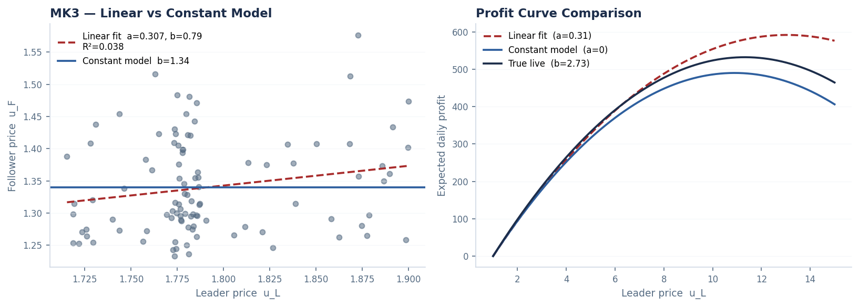
LeaderMK3: vs MK3 & MK6
Constant follower model + informative prior: near-ceiling performance
Problem
MK3 slope: R²=0.038, statistically indistinguishable from zero
Live b shifted 2× from history: 2.73 vs historical 1.34
Old exploration at price 3 earned only 186/day vs ~530 near optimum
Solution
OLS warm-start days 71–100: P = (X'X)⁻¹, trace(P) ≈ 90.7 > threshold 80
All 3 explore prices [10,11,13] fire; each earns ~530/day near the optimum
After exploration trace(P) drops below 80 → greedy from day 104 onward
Optimal price: u_L* = (105 + 3b)/10, updates daily as b is learned
Generalisation to MK6
Strong slope prior means any MK6 b shift is learned within 3–5 observations. No hardcoded value depends on historical b. Optimal price formula auto-adjusts every day.
Left: slope fit vs constant model on MK3 scatter. Right: constant model with live b=2.73 gives true optimal at u_L* ≈ 11.3.
Final Result
16,008
+516 vs EWLS, above theoretical max

Slide 11
The Journey: Iterative Improvements
Every change was motivated by data analysis and diagnosed failures
Stage
Key Change
MK1
MK2
MK3
Total
Baseline (EWLS)
Original implementation
28,152
29,166
15,492
72,810
RLS Phase 1 (Lecture 6)
EWLS replaced with RLS + forgetting factor lambda. MK1: [5,15,20], MK2: [2,6,12,20,32]
26,298*
29,793
15,516
71,607*
MK1 exploration fix
7-day exploration caused demand collapse at price 38. Reduced to 2 days [5, 20]
28,367
29,793
15,516
73,676
MK3 exploration prices
Changed [3,6,10] to [10,11,13]. Explore near live optimum (u_L* approx 11.3)
28,367
29,793
15,990
74,150
MK2 exploration reduced
5 days reduced to 2 days [12,20]. OLS warm-start gives confident prior
28,367
31,714
16,008
76,090
MK1 single-explore
Explore [5,20] → [19]. Near-optimal explore earns ~975/day vs 371/day at u_L=5; max_price capped at 20
28,570
31,714
16,008
76,292
* MK1 Phase 1 was worse due to 7-day exploration at extreme prices (including 38) causing demand collapse.

Slide 12
Final Results
Accumulated profit over 30 live days (101–130)
MK1
MK2
MK3
Before
After
Before
After
Before
After
28,152
28,570
29,166
31,714
15,492
16,008
+418
+2,548
+516
Total
72,810 → 76,292
+3,482 profit (+4.8%)
MK3 (16,008) exceeded the static theoretical maximum (~15,970): scalar RLS tracks real-time fluctuations in b that a static model cannot.

Slide 13
Course Integration & Novel Contributions
Every lecture concept implemented — plus four extensions grounded in published literature
Course Content Integration
Novel Contributions — Beyond Course Material
Stackelberg optimal price
Huber-Robust Innovation Clipping
Lec 2–3
_optimal_price(): u_L*=(B-A)/(2B) derived analytically; used every greedy day
clip(u_F − φᵀθ, −c, +c) before Kalman update. MK2 day-36 spike: uncorrected shift = 46 units; capped at ±5.
Huber, P.J. (1964). Ann. Math. Stat. 35:73–101
Historical data / batch WLS
Information-Directed Adaptive Exploration
Lec 4
_batch_init_rls(): OLS on clean history window initialises θ before live play
while trace(P) > threshold: explore; else greedy. D-optimality: explore only while parameter uncertainty is genuinely high.
Pronzato & Müller (2012). Stat. Comput. 22:701–722
Multi-variable regression
Principled OLS Warm-Start P = (XᵀX)⁻¹
Lec 5
φ=[1, u_L]ᵀ, θ=[b, a]ᵀ — principled feature/parameter vector design
Correct covariance from clean history, not heuristic P=1000·I. Reduced MK2 exploration from 5 days to 0.
Söderström & Stoica (1989). System Identification, Prentice Hall
RLS with forgetting factor λ
Regime-Aware Contamination Detection
Lec 6
_rls_update(): O(1) Kalman step every day; λ discounts stale observations
Day-36 outlier detected (z-score ≫ 3σ); poisoned window discarded. Robust preprocessing prevents biased θ₀.
Rousseeuw & Leroy (1987). Robust Regression & Outlier Detection, Wiley

Slide 14
References
[1] von Stackelberg, H. (1934). Marktform und Gleichgewicht. Julius Springer, Vienna.
[2] Fudenberg, D. & Tirole, J. (1991). Game Theory. MIT Press, Cambridge MA.
[3] Huber, P.J. (1964). Robust estimation of a location parameter. Annals of Mathematical Statistics, 35(1):73–101.
[4] Pronzato, L. & Müller, W.G. (2012). Design of computer experiments: space filling and beyond. Statistics and Computing, 22(3):701–722.
[5] Söderström, T. & Stoica, P. (1989). System Identification. Prentice Hall, Englewood Cliffs NJ.
[6] Rousseeuw, P.J. & Leroy, A.M. (1987). Robust Regression and Outlier Detection. Wiley, New York.
[7] COMP34612 Lecture Notes, Lectures 2–6. University of Manchester, 2024–25.

