Slide 1


Design and implementation of an eBPF-based runtime security monitoring Tool
End-to-End Pipeline and Hook Implementation
Simone Romano

Slide 2


Project Reference and Architectural Constraints
General-purpose, multi-kernel runtime security.
Ring buffer as the primary transport channel.
Reference for the probe registry, pipeline, and event model.
Targeted at Rocky Linux 8, kernel 4.18.
Adapted to verifier constraints and provable memory offsets.
Perf buffer as the main operational transport.
Lightweight policy layer.
Tracee - Reference
Our Approach
Not a Tracee replica, but a more focused and controllable runtime.

Slide 3
End-to-End Architecture and Pipeline
Runtime Diagnostics (Zap)
Event Output
eBPF Kernel Space
Go Userspace
Cobra CLI / YAML
Probe Registry / libbpfgo
eBPF Hook
Perf Buffer
Go Decoder
Normalized Event
Cobra CLI: Parses configuration and initializes the runtime.
Collection and transport: eBPF hooks submit events through the perf buffer.
Routing: Normalized events are sent to raw output and the detection engine.
Policy & Detector
Alert Output

Slide 4
Binary Contract and Event Normalization
Kernel
[ event_context_t + argnum + args buffer ]
Binary contract: Shared context, indexed arguments, and synchronized C/Go registries.
Unique mapping: eBPF event ID, event name, and decoding schema.
Enrichment: Userspace normalization of capabilities, flags, bitmasks, and errno values.
From binary records
Shared C/Go Registry
to typed, indexed arguments
Userspace
Event: security_file_open
Path: /etc/shadow
Flag: O_RDONLY

Slide 5
Policy and Detection Layer (YAML)
Policy YAML Selects What to Observe
Detector YAML Evaluates Threat Conditions
Alert Output
Detection Result
Selected Events
Normalized Event
[Within t seconds]
security_task_fix_setuid
(new_euid=0)
sched_process_exec
(uid=0)
Alert: Privilege Escalation
[MITRE: TA0004]

Slide 6
Kernel Hook Implementation Strategy
Semantic hooks: Primarily based on kprobes and security hooks exposing resolved kernel objects.
Enter/exit model: Entry stores arguments; exit adds the final return value.
Kernel adaptation: Designed around Rocky Linux 4.18 verifier constraints.
Required Information
Is the Return Value Required?
Yes
No
Enter/Exit Model
Semantic Hook
Normalized Event in Go Userspace

Slide 7
Common eBPF Implementation Pattern
program_data_t
event_data_t
init_program_data()
Context Initialization
Per-hook working state
Event under construction
event_context_t
timestamp
event ID
save_to_submit_buf() /
save_str_to_buf() /
save_str_arr_to_buf()
Typed Serialization
task_context_t
args_buffer_t
Indexed and serialized arguments.
events_perf_submit()
Perf-Buffer Submission
When the return value is required, entry stores the arguments and exit completes the event with the syscall outcome.

Slide 8
Process Lifecycle
fork / vfork / clone
Syscall Request:
Capture the initial process-creation request.
task_rename
Task transition:
Track changes to the process comm.
sched_process_exit
Termination:
Record process exit and exit code.
sched_process_fork
Parent-child relationship:
Observe the task relationship established by the kernel.
sched_process_exec
Executable image:
Confirm successful image replacement.

Slide 9
Execution Monitoring: Attempts and Outcomes
sched_process_exec
Successful outcome: Confirms executable-image replacement.
Initial request
execve
security_bprm_check
Security Validation:
Observes executable-image security checks.
security_bprm_creds_for_exec
Credential preparation:
Observes credentials prepared for the new image.
execveat
process_execute_failed
Failed outcome: Reports isolated failures with a normalized errno.

Slide 10
Identity, Credentials, and Capabilities
Previous Credentials
Capability and process control
cap_capable: Observes checks for specific capabilities.
ptrace and security_task_prctl: Observe direct process interaction and state manipulation.
setuid / setgid Families
Userspace Request
security_task_fix_setuid
Security-Path Validation
commit_creds
Final Credential Commit

Slide 11
File, Permission, and Filesystem Security
File Access
open: reports the syscall outcome.
security_file_open / security_file_permission: expose stable metadata (path, inode, device, and ctime)
Permissions
The chmod and chown families monitor permission and ownership changes, including return values.
Inode
unlink, rename, symlink and mknod: track structural filesystem changes.
Mounting
security_sb_mount / security_sb_unumount: observe mount points and associated flags.

Slide 12
Memory and Namespaces
Memory Management
mmap
mprotect
pkey_mprotect
memfd_create
process_vm_readv / process_vm_writev
Visibility into executable-memory transitions, fileless execution, unusual mappings, and cross-process memory access.
Namespace Transitions
setns
unshare
switch_task_ns
Observes isolation requests and verifies the namespace changes effectively applied by the kernel.

Slide 13
Kernel Hardening and Modules
Module lifecycle:
module_load,
module_free,
do_init_module.
Example of a scenario observable through distinct events
module load
eBPF surface:
security_bpf,
security_bpf_map,
security_bpf_prog.
register_kprobe
Dynamic instrumentation:
register_kprobe,
kallsyms_lookup_name.
Kernel interfaces:
proc_create,
call_usermodehelper,
security_kernel_read_file.
procfs Entry

Slide 14
Experimental Validation Setup
Monitor Pod
eBPF Agent
Filtering on UID 10001
Trigger Pod
Exploit Client
(Attacker)
Attack sequence:
Exploit -> ROP chain
-> /bin/sh -> /bin/cat ->
File Exfiltration
Target Pod
Vulnerable CTF Service (UID 10001)
Contains Flag Secret
Shared Linux Kernel (Rocky Linux 8.10)

Slide 15
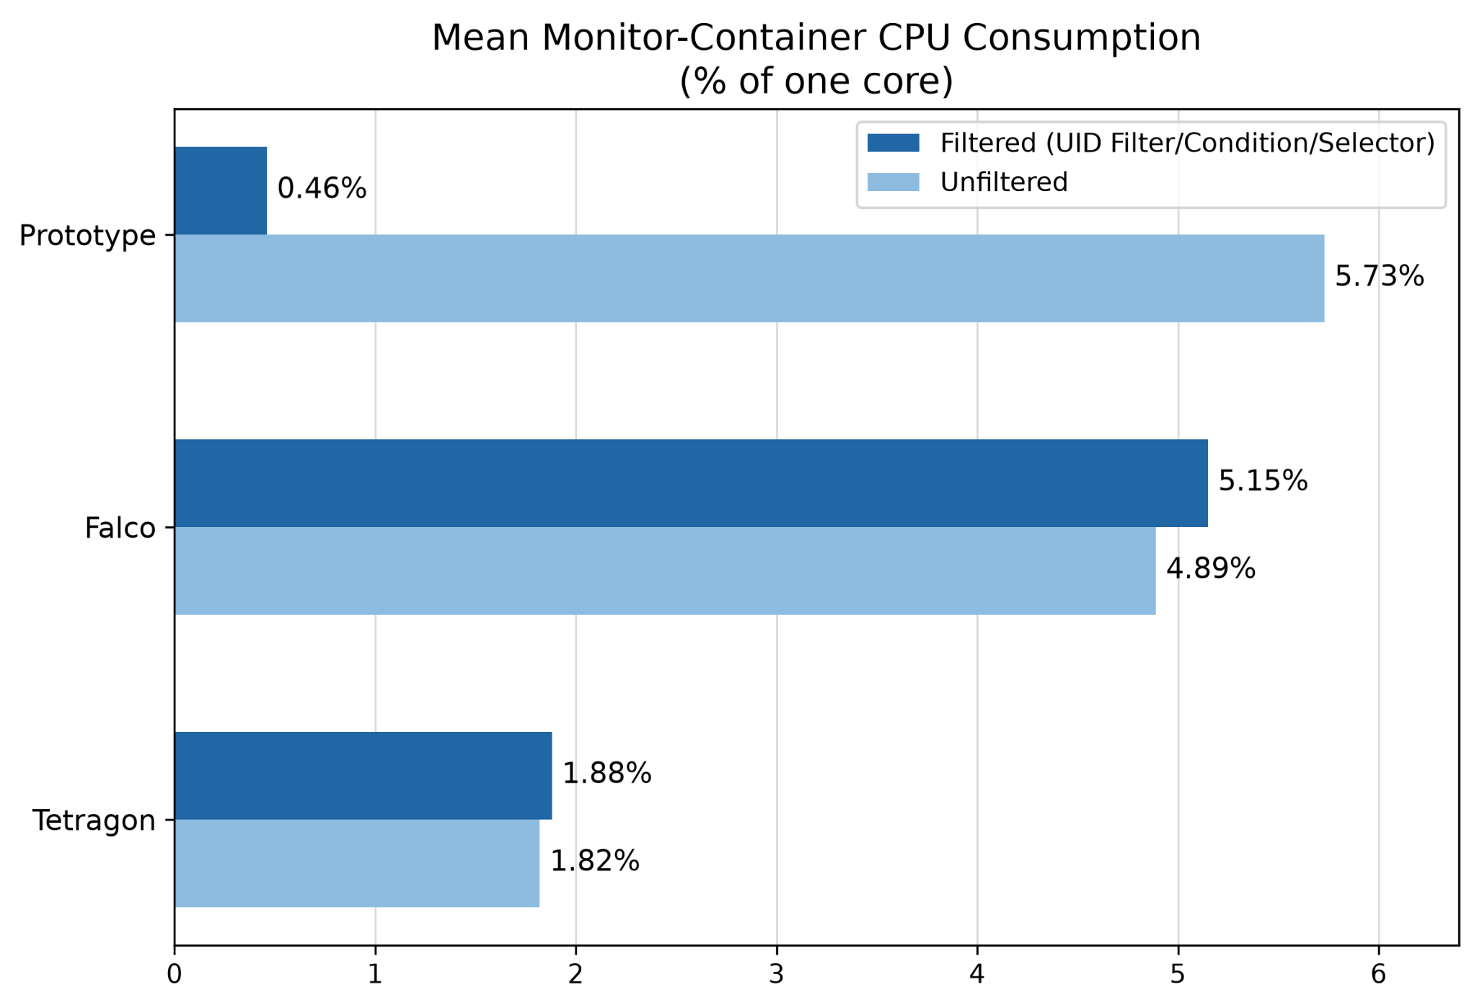
Evaluation Results: CPU Consumption
The prototype reduced mean CPU by about 92% through filtering before transport.
All retained runs recovered the flags and produced the required evidence.
Falco, Tetragon, and the prototype apply UID selection at different stages

Slide 16
Conclusions
Key Findings
Kernel observations can be transformed into consistent security evidence.
Configurable monitoring supports different investigation task, useful for the security analyst.
Early filtering can reduce performance cost
Broader coverage and higher event rates remain future work.
Any question?

