Slide 1


Design and implementation of an eBPF-based runtime security monitoring Tool
Master’s Degree in Cybersecurity Engineering
Supervisor
Prof. Riccardo Sisto
Company Supervisor
Dr. David Soldani
Academic Year
2025-2026
Simone Romano s344024 · Giuseppe Insalaco s
Notes:
Good morning, everyone. I am Giuseppe Insalaco, and today, together with my colleague Simone Romano, I will present our thesis work on the design and implementation of an eBPF-based runtime security monitoring tool. The work was carried out in collaboration with Rakuten Mobile and is based on a common system architecture, while our individual theses focus on different components of the system.

Slide 2
What is eBPF?
User Space
eBPF program
Kernel Space
Verifier
Attach to kernel hook
Why eBPF for runtime monitoring?
Visibility: observes operations directly from the kernel.
Data selection: irrelevant activity can be discarded before transfer to userspace.
Safe execution: verifier checks programs before loading.
Kernel event triggers eBPF program
Collect event data
Notes:
Before presenting the system and our individual contributions, I will briefly introduce the technology on which it is based. eBPF allows small programs to run within the Linux kernel. The program is initially loaded from user space and checked by the kernel verifier, which ensures that it can execute safely. After verification, the program is attached to a specific kernel hook. When the corresponding kernel event occurs, the hook triggers the eBPF program, which reads the available context and collects the relevant event data. This approach provides direct visibility into kernel activity. It also allows unnecessary data to be discarded before transferring information to user space, reducing processing overhead. These properties make eBPF a suitable foundation for the runtime security monitoring system presented in this thesis.

Slide 3
Project Context and Design Constraints
01
PLATFORM COMPATIBILITY
02
OPERATIONAL REQUIREMENT
03
ARCHITECTURAL REFERENCE
Rocky Linux 8.10
CPU usage < 5%
Tracee
4.18-based enterprise kernel
of one logical core
Open-source multi-kernel runtime security and observability tool
Program types, helpers, maps and attachment mechanisms had to be verified on the deployed kernel.
The threshold applies to the recommended workload-scoped configuration.
Reference for the common event model and the separation between kernel collection and user-space processing.
Notes:
With this background, I can now introduce the project context. The system had to satisfy two main requirements.
The first was compatibility with Rocky Linux 8.10 and its 4.18-based enterprise kernel. Since enterprise distributions backport selected capabilities, eBPF support could not be determined from the kernel version alone. Therefore, program types, helpers, maps and attachment mechanisms had to be verified on the target platform.
The second requirement concerned performance: CPU usage had to remain below 5 percent of one logical core under the recommended workload-scoped configuration.
In addition, we used Tracee, an open-source multi-kernel runtime security and observability tool, as an architectural reference, particularly for the common event model and the separation between kernel collection and user-space processing.

Slide 4
End-to-End Monitoring Pipeline
Setup prepares the instrumentation. Event processing begins after the probes are attached.
SETUP PATH · USER SPACE
01
Validate inputs
02
Prepare run
03
Activate probes
CLI, policies and detectors
event scope and eBPF object
maps and event channel
EVENT PATH
USER SPACE
Event output
eBPF programs
Perf event buffer
Decode, enrich, filter
collect and submit
binary records
normalized event
KERNEL SPACE
Detector
Alert output
Diagnostics follow a separate path from events and alerts.
Notes:
The pipeline has a setup path and an event path. Setup runs in user space. The runtime first validates the command-line configuration, policies and detectors. It then prepares the monitoring run by resolving the event scope, the eBPF object and the BTF source. Finally, it prepares the maps and event channel and attaches the selected instrumentation. After monitoring starts, the eBPF programs collect the available context and submit binary records through the perf event buffer. The Go runtime receives each record, decodes and enriches it, then applies event and policy filtering. Events and detector alerts are delivered through distinct, dedicated output channels, completely isolated from operational diagnostics.
Now I'll leave the floor to Simone to continue with the general architecture.

Slide 5
Binary Contract and Event Normalization
Kernel
[ event_context_t + argnum + args buffer ]
Binary contract: Shared context, indexed arguments, and synchronized C/Go registries.
Unique mapping: eBPF event ID, event name, and decoding schema.
Enrichment: Userspace normalization of capabilities, flags, bitmasks, and errno values.
From binary records
Shared C/Go Registry
to typed, indexed arguments
Userspace
Event: security_file_open
Path: /etc/shadow
Flag: O_RDONLY
Notes:
Once a kernel program collects an observation, the information must be transferred to user space in a consistent format. For this purpose, every
record contains a common context, the number of arguments, and a buffer of indexed values. The context identifies the event and the process that
generated it.
The event ID connects the binary record to a shared registry. This registry tells the Go decoder the event name, the argument names, and their types.
The decoder can therefore transform a compact kernel record into a typed event. It also adds readable labels for values such as flags, capabilities,
and error codes.

Slide 6
Policy and Detection Layer (YAML)
Policy YAML Selects What to Observe
Detector YAML Evaluates Threat Conditions
Alert Output
Detection Result
Selected Events
Normalized Event
[Within t seconds]
security_task_fix_setuid
(new_euid=0)
sched_process_exec
(uid=0)
Alert: Privilege Escalation
[MITRE: TA0004]
Notes:
After decoding, events pass through the policy and detection layer.
A policy defines the scope of a monitoring task. It selects which events are relevant. For example, a policy can admit only process-
execution events generated by a specific UID.
A detector instead defines the security condition that the system must recognise. It checks the events admitted by the policy and generates an alert when
its conditions, defined by a YAML, are satisfied.
The example in the bottom part of the slide looks for a credential change followed by program execution as root. If both events occur in the correct order and within the configured time window, the detector generates a privilege-escalation alert, enriched by MITRE ATT&CK metadata.

Slide 7
Configuration, Logging, and Output Routing
Clear separation: Zap handles runtime lifecycle logs, while dedicated printers format events and alerts.
--alerts-only mode: Hides raw terminal output while keeping events available to detectors.
Kubernetes readiness: Independent streams support containerized and centralized deployments.
Runtime Diagnostics
Runtime Lifecycle
Zap Logger
stderr
(Console/JSON)
Monitoring
Normalized eBPF events
Event Printer
stdout
(Table/JSON)
Security
Detector Alerts
Alert Printer
stdout
(Table/JSON)
Notes:
The monitoring tool produces three different types of output.
The first contains the normalized kernel events. The second contains security alerts generated by detectors, and both can be formatted as readable text or
JSON format.
The third type contains operational diagnostics, such as startup errors, decoding failures and event losses. These messages are written separately
through the Zap logger library used for diagnostics.
We have also implemented an alerts-only option during startup that hides raw events from the terminal, so that only detector’s output is visible. In this way the separation will makes the output easier to manage.

Slide 8
Experimental Validation Setup
Monitor Pod
eBPF Agent
Filtering on UID 10001
Trigger Pod
Exploit Client
(Attacker)
Target Pod
Vulnerable CTF Service (UID 10001)
Shared Linux Kernel (Rocky Linux 8.10)
Notes:
For the evaluation, we created a Kubernetes test environment using Minikube.
We deployed three separate Pods. The target Pod hosted the vulnerable service. The trigger Pod acted as the attacker and sent the exploit to the
target through the Kubernetes network. The monitor Pod ran our eBPF-based monitoring tool.
Kubernetes isolated the Pods from each other using separate process and network namespaces. Despite this isolation, operations performed inside each
Pod were still handled by the shared node kernel.
The target service ran with UID 10001. In one experimental configuration, this UID was used to discard unrelated events inside the kernel before
transferring data to user space. We will present the result of each evaluation later in the next slides

Slide 9
Host level Hook Implementation Strategy
Semantic hooks: Primarily based on kprobes and security hooks exposing resolved kernel objects.
Enter/exit model: Entry stores arguments; exit adds the final return value.
Kernel adaptation: Designed around Rocky Linux 4.18 verifier constraints.
Required Information
Is the Return Value Required?
Yes
No
Enter/Exit Model
Semantic Hook
Normalized Event in Go Userspace
Notes:
I will now focus on the host level hook implementation. The key principle is one: hooks are selected according to the information required by each event. When possible, the monitor uses semantic hooks that expose the kernel object involved in an operation. For example, a security hook can provide a resolved file instead of only
the pathname originally supplied by the application.
When the final result is required, the monitor uses an enter-and-exit model. The entry program stores the request data, while the exit program adds
the return value. All these choices must also satisfy the verifier and the capabilities available on the target kernel.

Slide 10
Common eBPF Implementation Pattern
program_data_t
event_data_t
init_program_data()
Context Initialization
Per-hook working state
Event under construction
event_context_t
timestamp
event ID
save_to_submit_buf() /
save_str_to_buf() /
save_str_arr_to_buf()
Typed Serialization
task_context_t
args_buffer_t
Indexed and serialized arguments.
events_perf_submit()
Perf-Buffer Submission
When the return value is required, entry stores the arguments and exit completes the event with the syscall outcome.
Notes:
The hooks that produce events share a common implementation pattern.
program_data_t represents the working context of the eBPF program. It keeps references to the configuration, the event under construction, and the
available process information.
event_data_t contains the normalized event context and the buffer used to serialize its arguments. The context includes the timestamp, the event
identifier, and task information such as PID, TID, UID, namespaces, and command name.
Event construction starts with init_program_data. Common helper functions then serialize the arguments, and events_perf_submit sends the completed
event through the perf buffer channel.
For enter-and-exit flows, the entry program temporarily stores the arguments. The exit program retrieves them, adds the return value(so the result), and submits the
event.

Slide 11
Process Lifecycle
fork / vfork / clone
Syscall Request:
Capture the initial process-creation request.
task_rename
Task transition:
Track changes to the process comm.
sched_process_exit
Termination:
Record process exit and exit code.
sched_process_fork
Parent-child relationship:
Observe the task relationship established by the kernel.
sched_process_exec
Executable image:
Confirm successful image replacement.
Notes:
Process monitoring covers the main stages of a process lifecycle.
The fork, vfork and clone probes record process-creation requests. sched_process_fork records the parent and child established by the kernel.
A process can later change its command name, which is observed through task_rename hook implemented. If it successfully loads a new executable, sched_process_exec
records the new image. Finally, sched_process_exit reports its termination and exit code.
These events allow the analyst to follow how a process is created, transformed and terminated.

Slide 12
Execution Monitoring: Attempts and Outcomes
sched_process_exec
Successful outcome: Confirms executable-image replacement.
Initial request
execve
security_bprm_check
Security Validation:
Observes executable-image security checks.
security_bprm_creds_for_exec
Credential preparation:
Observes credentials prepared for the new image.
execveat
process_execute_failed
Failed outcome: Reports isolated failures with a normalized errno.
Notes:
Program execution is observed through complementary checkpoints. execve and execveat describe the initial attempt and collect the pathname and
arguments. execveat also includes the directory file descriptor(unique identifier of a file/process opened) and flags. security_bprm_check observes the subsequent security checks on the executable. security_bprm_creds_for_exec instead monitor the kernel when it prepares the credentials for a new image loaded.
These checkpoints alone do not prove that execution succeeded. sched_process_exec confirms that the executable image was actually replaced.
Instead process_execute_failed is generated only when the execution returns an error.
This allows the monitor to distinguish attempts, successful executions, and failures. Error numbers are also normalized into
readable values in the process_execute_failed hook.

Slide 13
Identity, Credentials, and Capabilities
Previous Credentials
Capability and process control
cap_capable: Observes checks for specific capabilities.
ptrace and security_task_prctl: Observe direct process interaction and state manipulation.
setuid / setgid Families
Userspace Request
security_task_fix_setuid
Security-Path Validation
commit_creds
Final Credential Commit
Notes:
Credential monitoring follows a similar idea.
The setuid and setgid syscall families represent requests to change identity. security_task_fix_setuid observes the security stage that validates the
new credentials. commit_creds records the point where the kernel applies them.
Other hooks cover capability checks of processes, ptrace(by which one process
(the "tracer") may observe and control the execution of another
process (the "tracee") operations and changes made through prctl(system call to change the behavior of a process).
This tells to the analyst whether a process requested a privilege change, passed the relevant kernel checks, or actually obtained the new
credentials.

Slide 14
File, Permission, and Filesystem Security
File Access
open: reports the syscall outcome.
security_file_open / security_file_permission: expose stable metadata (path, inode, device, and ctime)
Permissions
The chmod and chown families monitor permission and ownership changes, including return values.
Inode
unlink, rename, symlink and mknod: track structural filesystem changes.
Mounting
security_sb_mount / security_sb_unumount: observe mount points and associated flags.
Notes:
Filesystem monitoring is divided into four main event families.
The first family covers file access. The open event records the pathname, access flags and syscall result. Security hooks such as security_file_open
and security_file_permission identify the file resolved by the kernel and collect its path, device and inode.
The second family covers permissions and ownership. The chmod and chown events report the requested changes and whether the corresponding operation
succeeded.
The third family covers structural changes to the filesystem. Events for unlink, rename, symlink and mknod record the removal, movement and creation
of filesystem objects.
The fourth family covers mounting. security_sb_mount and security_sb_umount observe mount and unmount operations, including the affected mount point
and the available flags.
These four families provide visibility into file use, permission changes, filesystem structure and mounted resources.

Slide 15
Memory and Namespaces
Memory Management
mmap
mprotect
pkey_mprotect
memfd_create
process_vm_readv / process_vm_writev
Visibility into executable-memory transitions, fileless execution, unusual mappings, and cross-process memory access.
Namespace Transitions
setns
unshare
switch_task_ns
Observes isolation requests and verifies the namespace changes effectively applied by the kernel.
Notes:
Memory events cover mappings, protection changes, memory-backed files and access to another process’s address space.
These operations are relevant to cases such as executable-memory creation, fileless execution and cross-process memory manipulation.
Namespace monitoring covers both the request and the resulting change. The setns event records a process request to join an existing namespace,
including the file descriptor, namespace type and syscall result. The unshare event records a request to create a separate execution context and
reports which namespace types were requested through its flags.
The switch_task_ns hook observes the point where the kernel assigns the new namespace configuration to the process. It reports the identifiers that
actually changed for mount, PID, UTS, IPC, network and cgroup namespaces.

Slide 16
Kernel Hardening and Modules
Module lifecycle:
module_load,
module_free,
do_init_module.
Example of a scenario observable through distinct events
module load
eBPF surface:
security_bpf,
security_bpf_map,
security_bpf_prog.
register_kprobe
Dynamic instrumentation:
register_kprobe,
kallsyms_lookup_name.
Kernel interfaces:
proc_create,
call_usermodehelper,
security_kernel_read_file.
procfs Entry
Notes:
This group covers operations that can change kernel behaviour or introduce new instrumentation and control interfaces.
Module events describe the loading, initialization and removal of kernel code. The security_bpf hooks observe the creation and loading of eBPF
programs and maps. Other hooks record kprobe registration, kernel-symbol lookup, procfs entry creation and the execution of user-space helpers from
the kernel.
A single event does not necessarily indicate malicious activity, because administrative and monitoring tools can perform the same operations. The
sequence provides the relevant context.
For example, a module load followed by kprobe registration and the creation of a procfs entry describes a complete chain of kernel-level changes that
an analyst can investigate.

Slide 17
AES beta exploit and detected evidence
Target Service
Vulnerable CTF encryption service
Kubernetes pod, UID 10001
Flag:
/opt/aes-beta/flag
Final payload:
system(“cat flag”)
Kernel Evidence
/bin/sh executed
sched_process_exec
/bin/cat executed
sched_process_exec
Flag access observed
security_file_open
Successful open
open -> fd 2
Detector Result
High severity alert
Command execution and flag access
4 correlated events
MITRE ATT&CK:
TA0002 Execution
TA0009 Collection
T1059.004 Unix shell
T1005 Data from Local system
Notes:
To validate the complete pipeline, we used AES-beta, a vulnerable encryption service from a public CTF challenge. The service ran inside the target
Pod as UID 10001, and the synthetic flag was stored at /opt/aes-beta/flag.
The exploit reconstructs the information required to execute a final payload equivalent to system("cat flag"). This produces four relevant
observations. First, the kernel confirms the execution of /bin/sh. The same process then executes /bin/cat. Next, security_file_open observes access
to the resolved flag path. Finally, the open event returns file descriptor 2, confirming that the operation succeeded.
The collective detector correlates these four observations within the same local process tree and a five-second window. It produces one high-severity
alert containing the complete evidence and the corresponding MITRE ATT&CK classification.

Slide 18
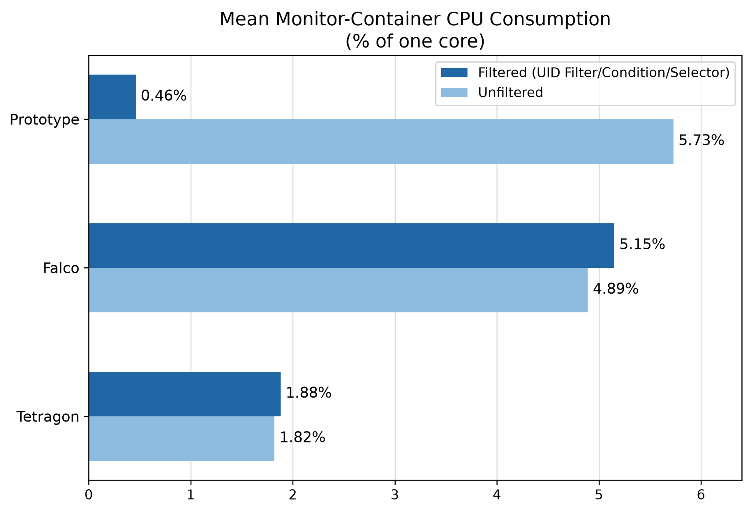
Evaluation Results: CPU Consumption
The prototype reduced mean CPU by about 92% through filtering before transport.
All retained runs recovered the flags and produced the required evidence.
Falco, Tetragon, and the prototype apply UID selection at different stages
Notes:
We compared the prototype with Falco 0.44.1 and Tetragon 1.7.1 on the same testbed.
Falco is a runtime security engine. It collects system-call events and evaluates declarative rules to generate alerts. Tetragon is an eBPF
observability and enforcement tool from the Cilium project. It uses tracing policies to select kernel hooks, collect data and apply selectors.
Each tool completed three runs with a UID condition and three runs without it. Every retained run recovered the flag and produced the required
evidence.
With the kernel UID filter enabled, our prototype used 0.46 percent of one CPU core on average. Without the filter, it used 5.73 percent. The
reduction was about 92 percent.
Falco recorded 5.15 percent with its UID condition and 4.89 percent without it. Tetragon recorded 1.88 percent with its selector and 1.82 percent
without it.
The main result is clear: filtering before context enrichment and transport substantially reduced the work performed by our runtime. Falco checks the
UID during rule evaluation. Tetragon applies the selector to the configured file hooks, but its base process sensor remains active. Their UID
configurations therefore removed less work from the measured pipeline.

Slide 19
Networking Subsystem
The network path combines process context with packet and protocol metadata.
01
02
03
04
OBSERVE
CORRELATE
DECODE
ENRICH
Socket operations
and packets
Process context
with each packet
Binary records into
normalized events
Socket fields and
protocol metadata
Kernel space: observation and correlation
User space: decoding and enrichment
19
Notes:
I will now continue with the networking subsystem, which is the part of the system I worked on. Its processing path can be divided into four stages. First, eBPF programs observe and collect data about socket operations and packet traffic. They then associate each packet with the context previously captured from the socket path. The resulting binary records are transferred to the Go runtime, where the generic decoder reconstructs normalized events. Finally, networking-specific enrichment exposes socket endpoint fields and protocol metadata that can be used by policies, detectors, and output components

Slide 20
Network Observation Surfaces
Socket-level kprobes observe socket operations, cgroup_skb programs collect packet traffic.
SOCKET OPERATIONS
PACKET TRAFFIC
LSM socket dispatch functions
cgroup_skb packet programs
kprobes on security_socket functions
attached to a directory in the cgroup v2 hierarchy
Observation point
Attachment
entry of an LSM socket dispatch function
cgroup v2 directory with ingress and egress attach types
Available context
current task and native socket arguments
Available context
Collected state
packet available through the restricted BPF context: struct __sk_buff
public socket events and process/workload context
Platform constraint
Collection state
kernel 4.18 lacks the BPF LSM program type
packet headers, payload bytes, lacks process identity
Socket probes provide process identity. cgroup_skb programs provide packet visibility.
20
Notes:
The networking subsystem uses two observation points. At socket level, kprobes attach to selected security_socket functions on the Linux Security Module dispatch path. LSM functions are kernel validation points reached when a socket operation is checked. I used kprobes because the target Rocky Linux 8 kernel, version 4.18, does not provide the BPF LSM program type. The probes remain observational and do not change the LSM decision. Packet collection uses cgroup_skb programs. These programs attach to a directory in the cgroup v2 hierarchy. The packet is available to each program through the restricted BPF context struct __sk_buff, which exposes headers and selected payload bytes but not the originating task. This limitation motivates the need to correlate socket-level operations with packet-level events to provide a complete context for every network communication.

Slide 21
Packet tracing with cgroup v2
Attach point
Two eBPF programs are attached to a cgroup, one for ingress and one for egress. The kernel runs them for the socket traffic associated with that cgroup and its descendants.
Why cgroup v2
Cgroup v2 provides one unified process hierarchy for all processes. Attaching at the root covers the whole visible cgroup hierarchy.
Cgroup2 mountpoint
The attach operation requires a filesystem path representing the target cgroup. Rocky Linux 8 normally uses cgroup v1, so the runtime creates a temporary cgroup2 mount when none is available.
Packet interception
When eligible socket traffic crosses the ingress or egress path, the kernel invokes the corresponding program and provides a struct __sk_buff packet context.

Slide 22
Process-Packet Correlation
Socket-associated task context reaches the packet program through a short-lived handoff.
Store socket context
Recover task context
Store per-packet context
Correlate and emit
sock_alloc_file
__cgroup_bpf_run_filter_skb
ingress / egress map
cgroup_skb ingress/egress
Creates the struct file that backs the socket descriptor
Kernel dispatcher that invokes the applicable cgroup_skb programs
The packet direction selects one short-lived map
The packet program receives only struct __sk_buff
entry: track by host TID
return: inode → task context
struct sock: inode lookup
struct sk_buff: packet key
key: shared packet identifier
value: attributed event context
rebuild key, parse packet
submit event
SHARED HANDOFF KEY
timestamp + IP packet length + L4 protocol + source IP + destination IP + checksum
The same helper builds the key before insertion and before lookup. The checksum field remains zero for IPv6.
No current-task fallback
If attribution fails, the monitor emits no event and lets the packet continue unchanged.
26
Notes:
The packet hooks can inspect network traffic, but they do not directly expose the task that owns the socket. The purpose of this mechanism is therefore to recover the process identity before packet analysis begins and then hand it to the packet program.
The first step creates persistent socket-level state. When a new socket is turned into a file descriptor, the kernel creates the struct file that connects the socket to the process file-descriptor table. The entry probe records the relevant call under the host thread identifier because the returned file is not available yet. The return probe then reads that file, extracts the socket inode and stores a reduced task context under the inode. Later send and receive probes refresh this association, so it follows the task that is currently using the socket.
The second step begins when a packet reaches a cgroup network hook. The kernel enters the dispatcher shown in the second box. This is a normal kernel function that selects and invokes the cgroup_skb programs attached along the socket's cgroup hierarchy. A kprobe at its entry can see both the native struct sock and struct sk_buff. The socket gives access to the inode, which is used to recover the task context saved in the first step. The packet structure provides the fields required to identify this specific packet.
The recovered context cannot be passed directly to the cgroup_skb program because the kprobe returns before that program runs and the two programs have separate stacks. The dispatcher probe therefore writes a short-lived entry into one of two handoff maps. Ingress traffic uses the ingress map and egress traffic uses the egress map. Each packet is written to only one of them. The key contains the packet timestamp, total IP length, transport protocol, source and destination addresses and, for IPv4, the header checksum. The value contains the attributed task context together with the network direction.
The final step is not another kprobe. It is the cgroup_skb ingress or egress program. This program receives the restricted struct __sk_buff context, reconstructs exactly the same key and queries the map for its direction. When the lookup succeeds, it combines the recovered process context with the packet data, performs protocol processing and submits the enabled network events. After processing, it removes the handoff entry.
The association is intentionally best effort. The current task is never used as a fallback because, especially on ingress, it may be an interrupt or kernel thread rather than the socket owner. If no valid context is found, the system produces no attributed event, but the packet is still allowed to continue because the monitoring path is observational.

Slide 23
Process Packet correlation
Socket hook
2. Kernel correlation state
3. cgroup / skb hook
The socket operation runs in process context, so the identity of the caller is directly available.
Stored in inodemap using the socket inode as key
A kprobe on __cgroup_bpf_run_filter_skb reads the socket inode and recovers the saved context.
It then builds a packet indexer and stores the prepared network event context.
The packet program rebuilds the same indexer and retrieves the same event context.
It adds addresses, ports, protocol and payload metadata.
pid, tid,uid, cgroup id
process context + packet metadata
||
userspace
cgrpctxmap[indexer] = net_event_context
The socket inode recovers the process context, while the packet indexer carries that context into packet processing.

Slide 24
Kernel-side Packet Parsing and Event Fan-out
Packet
sk_buff
IPv4/IPv6
TCP/UDP/
ICMP
DNS/TLS/
HTTP
net_packet_*
submission
How each layer is identified L3: Socket family and IP version (IPv4/IPv6 headers)
IP protocol dispatch: IP protocol fields (TCP, UDP or ICMP)
L7: Port numbers + payload signatures (e.g., TLS record, HTTP method)
One packet may generate multiple layer-specific events
net_packet_raw
net_packet_ip
net_packet_tcp
net_packet_udp
net_packet_icmp
net_packet_dns
net_packet_http
net_packet_tls
Benefit: layer-specific events simplify filtering, protocol decoding and detector rules.
Notes:
Once the process context has been recovered, the packet enters the kernel-side parsing stage. The packet is accessed through the restricted struct __sk_buff context provided to the cgroup_skb program.
The handler first identifies IPv4 or IPv6. It then uses the IP protocol field to dispatch processing to TCP, UDP or ICMP. For selected TCP and UDP traffic, bounded payload checks can also identify DNS, TLS and HTTP.
Depending on the active policies, a single packet may generate multiple layer-specific events. Since parsing and event selection occur in the kernel, each event transfers only the required packet fields and payload portion to user space, rather than the entire packet. This reduces unnecessary data transfer and simplifies filtering, decoding and detector rules.

Slide 25
User-Space Protocol Decoding and Enrichment
Selected packet bytes become structured arguments for policies, detectors and output components.
DNS
HTTP
TLS
Decode questions, record types and answer records
Parse the request or status line and the Host header
Inspect unencrypted ClientHello
EXTRACTED FIELDS
EXTRACTED FIELDS
EXTRACTED FIELDS
dns_query · dns_qtype
dns_answer
http_method · http_path
http_host · http_status
tls_sni when the extension is available
DNS CONTEXT FOR LATER EVENTS
DNS response
Bounded cache
Later packet
Enriched event
dns_query · dns_answer
Up to 8 entries per IP
destination IP
dst_hostname
Context, not attribution
The cached hostname provides context for the destination IP, but does not prove that the same process performed the DNS lookup.
28
Notes:
In user space, the runtime converts the packet bytes selected in kernel space into structured event arguments. DNS decoding extracts the query name, query type and answer records. HTTP decoding reads the request or status line and the Host header, exposing the method, path, host and response status when available. For TLS, a small parser scans the extensions of a ClientHello and adds tls_sni without decrypting the connection or reconstructing the session. DNS answers also populate a bounded cache. Each IP can retain up to eight recent hostnames, and a later TCP, UDP or TLS event with a matching destination IP can receive dst_hostname. This hostname provides observed context but does not prove that the same process performed the DNS lookup.

Slide 26
Functional Evaluation
EXPERIMENTAL SETUP
CROSS-POD VISIBILITY
Single-node Minikube cluster
Events retained their originating workload and process context.
ATTACK SCENARIO
DETECTION RESULTS
01
SSRF
HTTP request to port 9000
BENIGN TRACE
02
Command Injection
Reverse connection on port 4444
0
alerts
03
Data exfiltration
HTTP upload to port 9001
BEHAVIOR-BASED DETECTORS
CONTROLLED ATTACK
4
D1 Unexpected egress port
3 alerts: 9000, 4444, 9001
alerts
D2 Outbound HTTP upload
1 alert: HTTP POST to 9001
Detection relied on network-profile deviations, not exploit-specific signatures.
27
Notes:
As Simone explained when presenting the experimental setup, the tool was evaluated on a single-node Minikube cluster. Here, I will focus on the functional results.
The controlled attack consisted of three stages. First, an SSRF caused the application to send an HTTP request to port 9000. Then, a stored command injection opened a reverse connection on port 4444. Finally, the application database was exfiltrated through an HTTP POST request to port 9001.
The monitor preserved the originating workload and process context across Pods. During the benign trace, neither detector generated an alert. During the controlled attack, the unexpected-egress-port detector produced three alerts, while the HTTP-upload detector identified the final POST request.
Overall, the system generated four alerts by detecting deviations from the expected network profile, without relying on exploit-specific signatures.

Slide 27
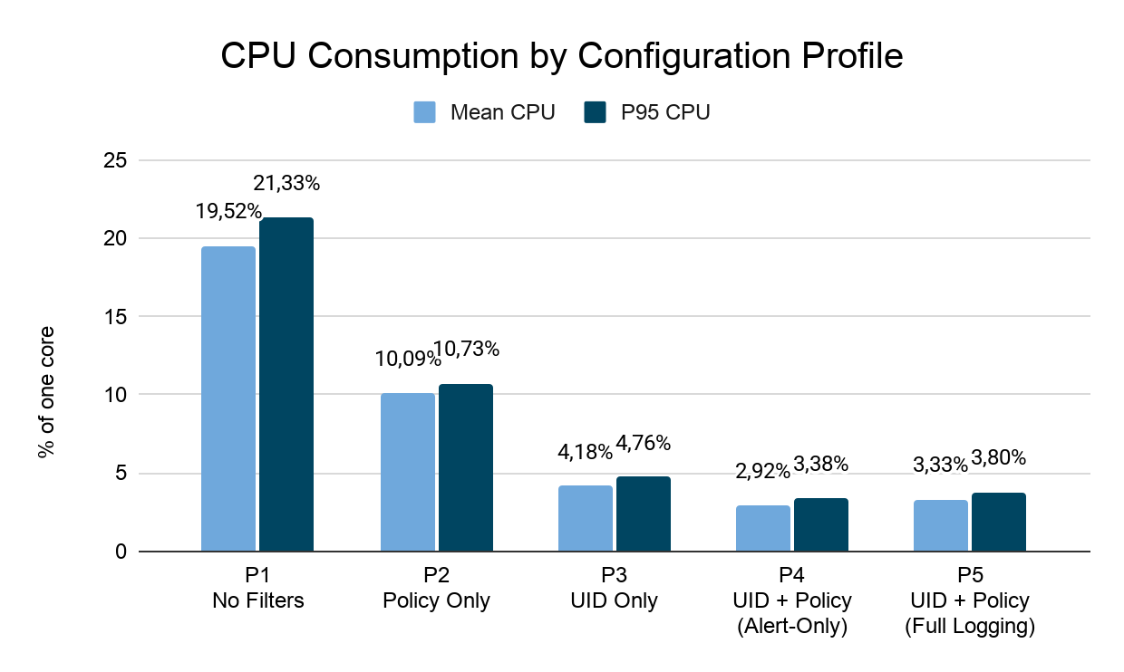
Performance Evaluation
TEST CONDITION
120 s
measurement window
10 ms
between request cycles
~ 1 s
CPU sampling interval
KEY FINDINGS
lower mean CPU with UID filtering
71 - 79%
<5% CPU
usage
for every UID-filtered profile
Full logging added only limited overhead
Notes:
Moving to the performance evaluation, I measured CPU consumption under five different configuration profiles. Each run included a 30-second stabilisation period followed by a 120-second measurement interval. During the test, traffic was continuously generated with a 10-millisecond delay between request cycles.
As shown in the chart, UID-based filtering significantly reduced CPU consumption. In particular, P4, which combines UID filtering, policy selection and alert-only output, achieved the best result, with a mean CPU usage of 2.92 percent and a P95 of 3.38 percent. This remained below our operational requirement of five percent of one logical core. Finally, P5 shows that enabling full event logging introduced only a limited additional overhead.

Slide 28
Conclusions
Key Findings
Kernel observations can be transformed into consistent security evidence.
Configurable monitoring supports different investigation task, useful for the security analyst.
Early filtering can reduce performance cost
Broader coverage and higher event rates remain future work.
Any question?

