Slide 1
covAI-19
AI project for Covid-19 diffusion prediction in Italy
Simone Romano - https://www.linkedin.com/in/simoneromano92/
3/15/2020
Simone Romano - https://www.linkedin.com/in/simoneromano92/

Slide 2
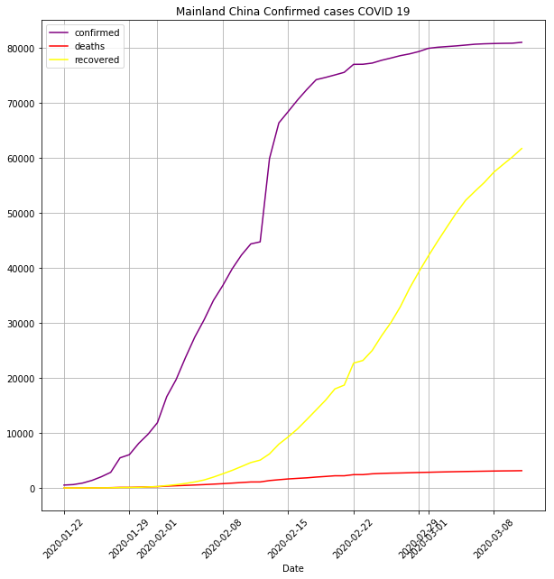
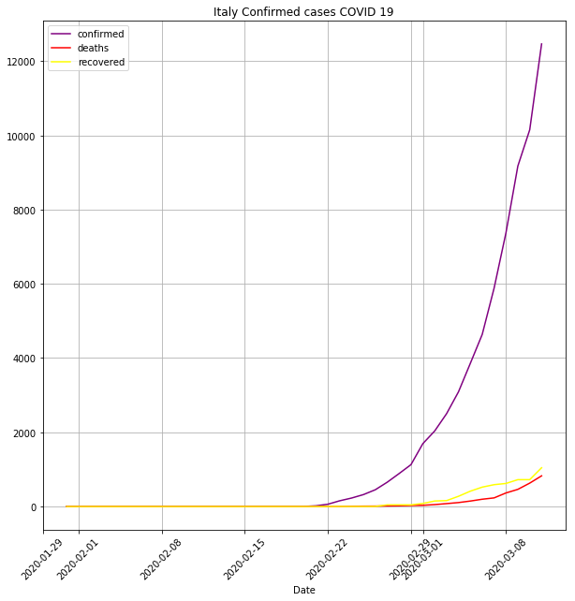
Dataset China - Italy
3/15/2020
Simone Romano - https://www.linkedin.com/in/simoneromano92/

Slide 3
Regression dataset
covid_19_open_line_list_countryFiltered |  |  |  |  |  |  |  |  |  |  |  |  |  |  |  |  | covid_19_data_countryFiltered
The features are extracted from the "covid_19_open_line_list.csv" dataset. In order to predict the "Confirmed", "Deaths", and "Recovered" at the day "x", we will consider the previous x-7 days of data. different_cities_count = number of different cities present in the last 7 days - column "city" of the dataset number_of_reported_trips = "summary" of number of entries in the "travel_history_dates" column number_of_trips_days_previous_n_days = "summary" of number of entries in the "travel_history_location" column |  |  |  |  |  |  |  |  |  |  |  |  |  |  |  |  | The features are extracted from the "covid_19_data.csv" dataset. In order to predict the "Confirmed", "Deaths", and "Recovered" at the day "x", we will consider the previous x-7 days of data.
FEATURES |  |  |  |  |  |  |  |  |  |  |  |  |  |  |  |  | TARGET
increment_confirmed_previous_n_days | increment_deaths_previous_n_days | increment_recovered_previous_n_days | min_age_previous_n_days | max_age_previous_n_days | mean_age_previous_n_days | std_age_previous_n_days | male_count_previous_n_days | female_count_previous_n_days | different_cities_count_previous_n_days | different_province_count_previous_n_days | gps_coordinates_distribution_previous_n_days | mean_num_of_days_from_onset_symptoms_previous_n_days | variance_num_of_days_from_onset_symptoms_previous_n_days | sd_num_of_days_from_onset_symptoms_previous_n_days | number_of_reported_trips-previous_n_days | number_of_trips_days_previous_n_days | ObservationDate | Confirmed | Deaths | Recovered
NA | NA | NA | NA | NA | NA | NA | NA | NA | NA | NA | NA | NA | NA | NA | NA | NA | 1/22/2020 | 547 | 17 | 28
NA | NA | NA | NA | NA | NA | NA | NA | NA | NA | NA | NA | NA | NA | NA | NA | NA | 1/23/2020 | 639 | 18 | 30
NA | NA | NA | NA | NA | NA | NA | NA | NA | NA | NA | NA | NA | NA | NA | NA | NA | 1/24/2020 | 916 | 26 | 36
NA | NA | NA | NA | NA | NA | NA | NA | NA | NA | NA | NA | NA | NA | NA | NA | NA | 1/25/2020 | 1399 | 42 | 39
NA | NA | NA | NA | NA | NA | NA | NA | NA | NA | NA | NA | NA | NA | NA | NA | NA | 1/26/2020 | 2062 | 56 | 49
NA | NA | NA | NA | NA | NA | NA | NA | NA | NA | NA | NA | NA | NA | NA | NA | NA | 1/27/2020 | 2863 | 82 | 58
NA | NA | NA | NA | NA | NA | NA | NA | NA | NA | NA | NA | NA | NA | NA | NA | NA | 1/28/2020 | 5494 | 131 | 101
 |  |  |  |  |  |  |  |  |  |  |  |  |  |  |  |  | 1/29/2020 | 6070 | 133 | 120
 |  |  |  |  |  |  |  |  |  |  |  |  |  |  |  |  | 1/30/2020 | 8124 | 171 | 135
 |  |  |  |  |  |  |  |  |  |  |  |  |  |  |  |  | 1/31/2020 | 9783 | 213 | 214
 |  |  |  |  |  |  |  |  |  |  |  |  |  |  |  |  | 2/1/2020 | 11871 | 259 | 275
 |  |  |  |  |  |  |  |  |  |  |  |  |  |  |  |  | 2/2/2020 | 16607 | 361 | 463
3/15/2020
Simone Romano - https://www.linkedin.com/in/simoneromano92/

Slide 4
Training dataset 1: tomorrow prediction
covid_19_open_line_list_countryFiltered |  |  |  |  |  |  |  |  |  |  |  |  |  |  |  |  | covid_19_data_countryFiltered
The features are extracted from the "covid_19_open_line_list.csv" dataset. In order to predict the "Confirmed", "Deaths", and "Recovered" at the day "x", we will consider the previous x-7 days of data. different_cities_count = number of different cities present in the last 7 days - column "city" of the dataset number_of_reported_trips = "summary" of number of entries in the "travel_history_dates" column number_of_trips_days_previous_n_days = "summary" of number of entries in the "travel_history_location" column |  |  |  |  |  |  |  |  |  |  |  |  |  |  |  |  | The features are extracted from the "covid_19_data.csv" dataset. In order to predict the "Confirmed", "Deaths", and "Recovered" at the day "x", we will consider the previous x-7 days of data.
FEATURES |  |  |  |  |  |  |  |  |  |  |  |  |  |  |  |  | TARGET
increment_confirmed_previous_n_days | increment_deaths_previous_n_days | increment_recovered_previous_n_days | min_age_previous_n_days | max_age_previous_n_days | mean_age_previous_n_days | std_age_previous_n_days | male_count_previous_n_days | female_count_previous_n_days | different_cities_count_previous_n_days | different_province_count_previous_n_days | gps_coordinates_distribution_previous_n_days | mean_num_of_days_from_onset_symptoms_previous_n_days | variance_num_of_days_from_onset_symptoms_previous_n_days | sd_num_of_days_from_onset_symptoms_previous_n_days | number_of_reported_trips-previous_n_days | number_of_trips_days_previous_n_days | ObservationDate | Confirmed | Deaths | Recovered
NA | NA | NA | NA | NA | NA | NA | NA | NA | NA | NA | NA | NA | NA | NA | NA | NA | 1/22/2020 | 547 | 17 | 28
NA | NA | NA | NA | NA | NA | NA | NA | NA | NA | NA | NA | NA | NA | NA | NA | NA | 1/23/2020 | 639 | 18 | 30
NA | NA | NA | NA | NA | NA | NA | NA | NA | NA | NA | NA | NA | NA | NA | NA | NA | 1/24/2020 | 916 | 26 | 36
NA | NA | NA | NA | NA | NA | NA | NA | NA | NA | NA | NA | NA | NA | NA | NA | NA | 1/25/2020 | 1399 | 42 | 39
NA | NA | NA | NA | NA | NA | NA | NA | NA | NA | NA | NA | NA | NA | NA | NA | NA | 1/26/2020 | 2062 | 56 | 49
NA | NA | NA | NA | NA | NA | NA | NA | NA | NA | NA | NA | NA | NA | NA | NA | NA | 1/27/2020 | 2863 | 82 | 58
NA | NA | NA | NA | NA | NA | NA | NA | NA | NA | NA | NA | NA | NA | NA | NA | NA | 1/28/2020 | 5494 | 131 | 101
NA | NA | NA | NA | NA | NA | NA | NA | NA | NA | NA | NA | NA | NA | NA | NA | NA | 1/29/2020 | 6070 | 133 | 120
NA | NA | NA | NA | NA | NA | NA | NA | NA | NA | NA | NA | NA | NA | NA | NA | NA | 1/30/2020 | 8124 | 171 | 135
NA | NA | NA | NA | NA | NA | NA | NA | NA | NA | NA | NA | NA | NA | NA | NA | NA | 1/31/2020 | 9783 | 213 | 214
NA | NA | NA | NA | NA | NA | NA | NA | NA | NA | NA | NA | NA | NA | NA | NA | NA | 2/1/2020 | 11871 | 259 | 275
NA | NA | NA | NA | NA | NA | NA | NA | NA | NA | NA | NA | NA | NA | NA | NA | NA | 2/2/2020 | 16607 | 361 | 463
NA | NA | NA | NA | NA | NA | NA | NA | NA | NA | NA | NA | NA | NA | NA | NA | NA | 2/3/2020 | 19693 | 425 | 614
NA | NA | NA | NA | NA | NA | NA | NA | NA | NA | NA | NA | NA | NA | NA | NA | NA | 2/4/2020 | 23680 | 490 | 843
NA | NA | NA | NA | NA | NA | NA | NA | NA | NA | NA | NA | NA | NA | NA | NA | NA | 2/5/2020 | 27409 | 562 | 1115
NA | NA | NA | NA | NA | NA | NA | NA | NA | NA | NA | NA | NA | NA | NA | NA | NA | 2/6/2020 | 30553 | 632 | 1476
Extracted from
today
features
target
3/15/2020
Simone Romano - https://www.linkedin.com/in/simoneromano92/

Slide 5
Training dataset 2: 1week prediction
covid_19_open_line_list_countryFiltered |  |  |  |  |  |  |  |  |  |  |  |  |  |  |  |  | covid_19_data_countryFiltered
The features are extracted from the "covid_19_open_line_list.csv" dataset. In order to predict the "Confirmed", "Deaths", and "Recovered" at the day "x", we will consider the previous x-7 days of data. different_cities_count = number of different cities present in the last 7 days - column "city" of the dataset number_of_reported_trips = "summary" of number of entries in the "travel_history_dates" column number_of_trips_days_previous_n_days = "summary" of number of entries in the "travel_history_location" column |  |  |  |  |  |  |  |  |  |  |  |  |  |  |  |  | The features are extracted from the "covid_19_data.csv" dataset. In order to predict the "Confirmed", "Deaths", and "Recovered" at the day "x", we will consider the previous x-7 days of data.
FEATURES |  |  |  |  |  |  |  |  |  |  |  |  |  |  |  |  | TARGET
increment_confirmed_previous_n_days | increment_deaths_previous_n_days | increment_recovered_previous_n_days | min_age_previous_n_days | max_age_previous_n_days | mean_age_previous_n_days | std_age_previous_n_days | male_count_previous_n_days | female_count_previous_n_days | different_cities_count_previous_n_days | different_province_count_previous_n_days | gps_coordinates_distribution_previous_n_days | mean_num_of_days_from_onset_symptoms_previous_n_days | variance_num_of_days_from_onset_symptoms_previous_n_days | sd_num_of_days_from_onset_symptoms_previous_n_days | number_of_reported_trips-previous_n_days | number_of_trips_days_previous_n_days | ObservationDate | Confirmed | Deaths | Recovered
NA | NA | NA | NA | NA | NA | NA | NA | NA | NA | NA | NA | NA | NA | NA | NA | NA | 1/22/2020 | 547 | 17 | 28
NA | NA | NA | NA | NA | NA | NA | NA | NA | NA | NA | NA | NA | NA | NA | NA | NA | 1/23/2020 | 639 | 18 | 30
NA | NA | NA | NA | NA | NA | NA | NA | NA | NA | NA | NA | NA | NA | NA | NA | NA | 1/24/2020 | 916 | 26 | 36
NA | NA | NA | NA | NA | NA | NA | NA | NA | NA | NA | NA | NA | NA | NA | NA | NA | 1/25/2020 | 1399 | 42 | 39
NA | NA | NA | NA | NA | NA | NA | NA | NA | NA | NA | NA | NA | NA | NA | NA | NA | 1/26/2020 | 2062 | 56 | 49
NA | NA | NA | NA | NA | NA | NA | NA | NA | NA | NA | NA | NA | NA | NA | NA | NA | 1/27/2020 | 2863 | 82 | 58
NA | NA | NA | NA | NA | NA | NA | NA | NA | NA | NA | NA | NA | NA | NA | NA | NA | 1/28/2020 | 5494 | 131 | 101
NA | NA | NA | NA | NA | NA | NA | NA | NA | NA | NA | NA | NA | NA | NA | NA | NA | 1/29/2020 | 6070 | 133 | 120
NA | NA | NA | NA | NA | NA | NA | NA | NA | NA | NA | NA | NA | NA | NA | NA | NA | 1/30/2020 | 8124 | 171 | 135
NA | NA | NA | NA | NA | NA | NA | NA | NA | NA | NA | NA | NA | NA | NA | NA | NA | 1/31/2020 | 9783 | 213 | 214
NA | NA | NA | NA | NA | NA | NA | NA | NA | NA | NA | NA | NA | NA | NA | NA | NA | 2/1/2020 | 11871 | 259 | 275
NA | NA | NA | NA | NA | NA | NA | NA | NA | NA | NA | NA | NA | NA | NA | NA | NA | 2/2/2020 | 16607 | 361 | 463
NA | NA | NA | NA | NA | NA | NA | NA | NA | NA | NA | NA | NA | NA | NA | NA | NA | 2/3/2020 | 19693 | 425 | 614
NA | NA | NA | NA | NA | NA | NA | NA | NA | NA | NA | NA | NA | NA | NA | NA | NA | 2/4/2020 | 23680 | 490 | 843
NA | NA | NA | NA | NA | NA | NA | NA | NA | NA | NA | NA | NA | NA | NA | NA | NA | 2/5/2020 | 27409 | 562 | 1115
NA | NA | NA | NA | NA | NA | NA | NA | NA | NA | NA | NA | NA | NA | NA | NA | NA | 2/6/2020 | 30553 | 632 | 1476
today
Extracted from
features
target
3/15/2020
Simone Romano - https://www.linkedin.com/in/simoneromano92/

Slide 6
Dataset generation: x data
Features Extraction Data range
Target data
Confirmed|Deaths|Recovered
5494 | 131 | 101
6070 | 133 | 120
8124 | 171 | 135
9783 | 213 | 214
11871 | 259 | 275
16607 | 361 | 463
INFO:root:[2020-01-22 00:00:00, 2020-01-28 00:00:00] - 2020-01-28 - 2020-02-04 00:00:00
INFO:root:[2020-01-23 00:00:00, 2020-01-29 00:00:00] - 2020-01-29 - 2020-02-05 00:00:00
INFO:root:[2020-01-24 00:00:00, 2020-01-30 00:00:00] - 2020-01-30 - 2020-02-06 00:00:00
INFO:root:[2020-01-25 00:00:00, 2020-01-31 00:00:00] - 2020-01-31 - 2020-02-07 00:00:00
INFO:root:[2020-01-26 00:00:00, 2020-02-01 00:00:00] - 2020-02-01 - 2020-02-08 00:00:00
INFO:root:[2020-01-27 00:00:00, 2020-02-02 00:00:00] - 2020-02-02 - 2020-02-09 00:00:00
…
INFO:root:[2020-02-19 00:00:00, 2020-02-25 00:00:00] - 2020-02-25 - 2020-03-03 00:00:00
INFO:root:[2020-02-20 00:00:00, 2020-02-26 00:00:00] - 2020-02-26 - 2020-03-04 00:00:00
INFO:root:[2020-02-21 00:00:00, 2020-02-27 00:00:00] - 2020-02-27 - 2020-03-05 00:00:00
INFO:root:[2020-02-22 00:00:00, 2020-02-28 00:00:00] - 2020-02-28 - 2020-03-06 00:00:00
INFO:root:[2020-02-23 00:00:00, 2020-02-29 00:00:00] - 2020-02-29 - 2020-03-07 00:00:00
INFO:root:[2020-02-24 00:00:00, 2020-03-01 00:00:00] - 2020-03-01 - 2020-03-08 00:00:00
INFO:root:[2020-02-25 00:00:00, 2020-03-02 00:00:00] - 2020-03-02 - 2020-03-09 00:00:00
INFO:root:[2020-02-26 00:00:00, 2020-03-03 00:00:00] - 2020-03-03 - 2020-03-10 00:00:00
INFO:root:[2020-02-27 00:00:00, 2020-03-04 00:00:00] - 2020-03-04 - 2020-03-11 00:00:00
INFO:root:[2020-02-28 00:00:00, 2020-03-05 00:00:00] - 2020-03-05 - 2020-03-12 00:00:00
INFO:root:[2020-02-29 00:00:00, 2020-03-06 00:00:00] - 2020-03-06 - 2020-03-13 00:00:00
…
INFO:root:[2020-03-05 00:00:00, 2020-03-11 00:00:00] - 2020-03-11 - 2020-03-18 00:00:00
… … …
80735 | 3120 | 58735
80757 | 3136 | 60106
80921 | 3161 | 61644
****PREVISIONS****
??? | ??? | ???
??? | ??? | ???
??? | ??? | ???
3/15/2020
Simone Romano - https://www.linkedin.com/in/simoneromano92/

Slide 7
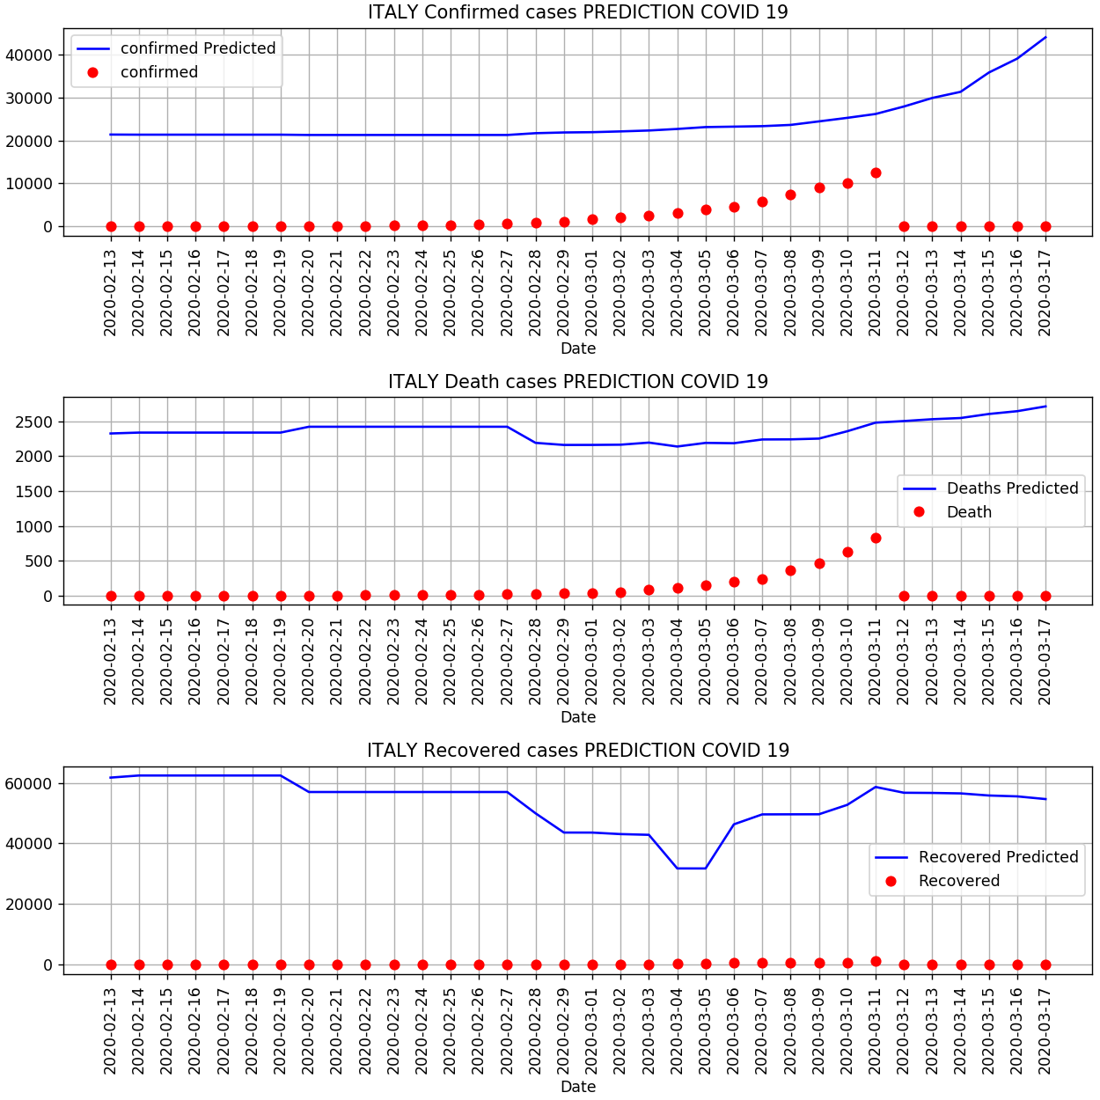







Architectural diagram
Web UI
Google Kubernetes Engine
Service
Deployment
Google Cloud Storage
FrontEnd
FrontEnd
Google Compute Engine
Docker sromano41/covaifronted
Deployment
Service
/predict API
Backend
Backend
Datasets | Models | Results
… | … | …
Docker sromano41/covai19ml
Offline training…
3/15/2020
Simone Romano - https://www.linkedin.com/in/simoneromano92/

