Slide 1
kubedev
a continuous delivery Standard for your K8s workloads on IBM Cloud
Simone Romano – https://www.linkedin.com/in/simoneromano92/

Slide 2


Versioning and continuous delivering
Runtime
Code/artifacts versioning
Deployment.yaml
kubectl apply
docker1
docker2
Kpeye git repo
…
dockern
toolchain
docker push
rollback
Docker registry

Slide 3

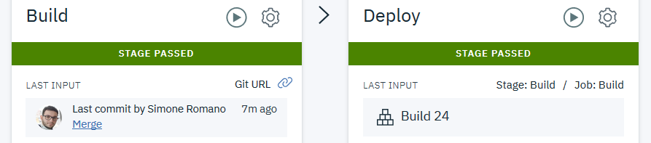
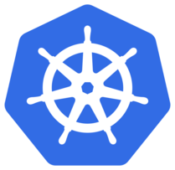


Continuous delivery
GitHub repo
git branches
git push
dev
test
master
Deployment.yaml
docker1:dev_BUILD_NUMBER docker2:dev _BUILD_NUMBER … dockern:dev _BUILD_NUMBER
Deployment.yaml
docker1:test _BUILD_NUMBER docker2:test _BUILD_NUMBER … dockern:test _BUILD_NUMBER
Deployment.yaml
docker1:prod _BUILD_NUMBER docker2:prod _BUILD_NUMBER … dockern:prod _BUILD_NUMBER
docker1
docker1
docker1
…
…
…
dockern
dockern
dockern
toolchain
toolchain
toolchain
rollback
rollback
rollback
Toolchain dev
Toolchain test
Toolchain prod
generate deployment.yaml
Rollback file push
Ibm-proj namespace
Ibm-proj-test namespace
bx cr build dockers: dev_BUILD_NUMBER
git tag date_dev_BUILD_NUMBER
kubectl apply
Notes:
1) All start from developer push: developer could not know nothing about deploy process; all is tracked (Slack, git tag) 2) Toolchain trigger: git tag, update registry (docker tag with the correct environment – dev, test and prod – concatenated to automatically generate BUILD_NUMBER ), kubectl apply to correct namespace; before the “kubectl apply” command, the “deployment.yaml” file is updated by replacing the image tag for each container with the new tag (ex: image: uk.icr.io/ibm-kpeye/engine:BUILD_NUMBER → image: uk.icr.io/ibm-kpeye/engine:dev_48)
3) App up and running to Kubernetes

Slide 4
deployment.yaml versioning
Deployment.yaml
docker1:dev_BUILD_NUMBER docker2:dev _BUILD_NUMBER … dockern:dev _BUILD_NUMBER
docker1
…
dockern
apiVersion: batch/v1beta1
kind: CronJob
metadata:
name: container1
spec:
jobTemplate:
containers:
- name: container1
image: container1:BUILD_NUMBER
---
apiVersion: batch/v1beta1
kind: CronJob
metadata:
name: container2
spec:
schedule: "*/1 * * * *"
jobTemplate:
containers:
- name: container2
image: container2:BUILD_NUMBER
toolchain
rollback
deployment_dev_48.yaml
Toolchain
apiVersion: batch/v1beta1
kind: CronJob
metadata:
name: container1
spec:
jobTemplate:
containers:
- name: container1
image: container1:48
---
apiVersion: batch/v1beta1
kind: CronJob
metadata:
name: container2
spec:
schedule: "*/1 * * * *"
jobTemplate:
containers:
- name: container2
image: container2:48
container1:48
container2:48
bx cr build dockers: dev_BUILD_NUMBER

Slide 5
Rollback
Deployment.yaml
docker1
docker2
deployment_dev_1.yaml
Kpeye git repo
…
dockern
…
rollback
deployment_dev_n.yaml
kubectl apply
docker1:dev_2
docker1:dev_1
dockern:dev_1
docker2:dev_2
docker2:dev_1
docker2:prod_1
dockern:dev_2

Slide 6

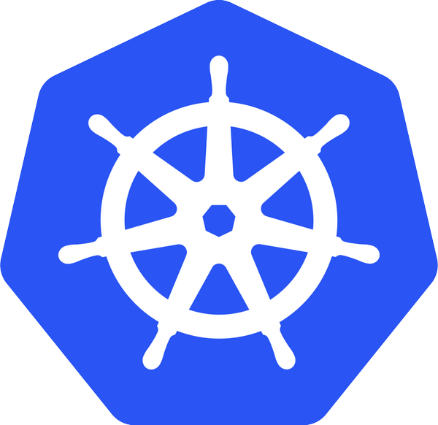



Technologies stack
Kubernetes Cluster
Continuous Delivery Service
Deployment
Service
FrontEnd
FrontEnd
IBM Container Registry
GitHub
Deployment
Service
Backend
Backend
Kubernetes as a Service
Software as a Service

Slide 7


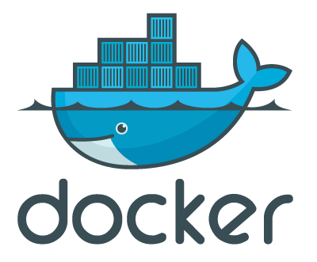
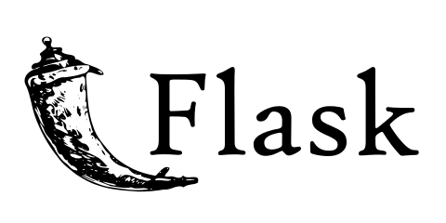
Architectural diagram
External user
Kubernetes Cluster
IBM
Container Registry
Deployment
Service
FrontEnd
FrontEnd
Service
FrontEnd
Backend
Deployment
Backend
Backend

Slide 8

Architectural diagram
External user
Kubernetes Cluster
IBM
Container Registry
Deployment
Service
FrontEnd
FrontEnd
Service
FrontEnd
Backend
Deployment
Backend
Backend

