Slide 1
C442 Database Systems
Chapter Two:
Introduction to Structured Query Language
2-<number>

Slide 2
Chapter Objectives
To understand the use of extracted data sets in business intelligence (BI) systems
To understand the use of ad-hoc queries in business intelligence (BI) systems
To understand the history and significance of Structured Query Language (SQL)
To understand the SQL SELECT/FROM/WHERE framework as the basis for database queries
To create SQL queries to retrieve data from a single table
2-<number>

Slide 3
Chapter Objectives
To create SQL queries that use the SQL SELECT, FROM, WHERE, ORDER BY, GROUP BY, and HAVING clauses
To create SQL queries that use the SQL DISTINCT, AND, OR, NOT, BETWEEN, LIKE, and IN keywords
To create SQL queries that use the SQL built-in functions of SUM, COUNT, MIN, MAX, and AVG with and without the use of a GROUP BY clause
2-<number>

Slide 4
Chapter Objectives
To create SQL queries that retrieve data from a single table but restrict the data based upon data in another table (subquery)
To create SQL queries that retrieve data from multiple tables using an SQL join operation
2-<number>

Slide 5
Business Intelligence (BI) Systems
Business intelligence (BI) systems are information systems that assist managers and other professionals:
  Assessment
  Analysis
  Planning
  Control
2-<number>

Slide 6
Ad-Hoc Queries
Ad-hoc queries:
  Questions that can be answered using database data
  Example: “How many customers in Portland, Oregon, bought our green baseball cap?”
  Created by the user as needed, instead of programmed into an application
  Common in business
2-<number>

Slide 7
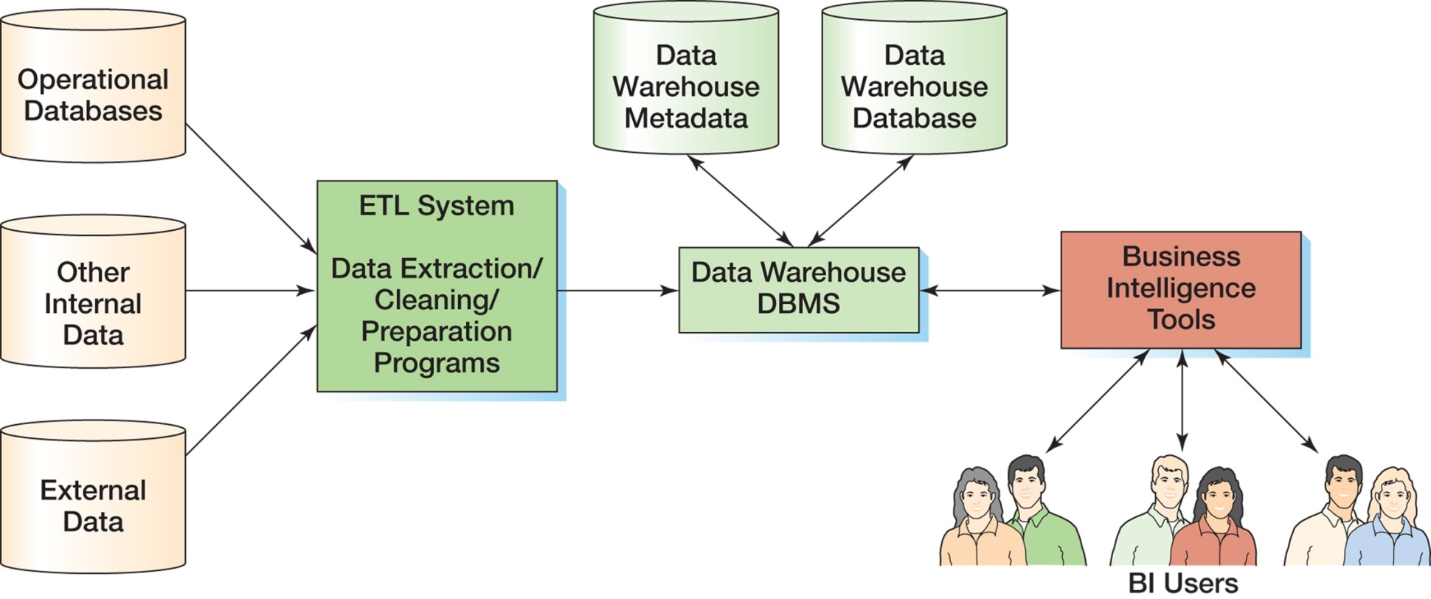
Components of a Data Warehouse
2-<number>

Slide 8
Structured Query Language
Structured Query Language (SQL) was developed by the IBM Corporation in the late 1970’s.
SQL was endorsed as a U.S. national standard by the American National Standards Institute (ANSI) in 1992 [SQL-92].
Newer versions exist, and they incorporate XML and some object-oriented concepts.
2-<number>

Slide 9
SQL As a Data Sublanguage
SQL is not a full featured programming language.
  C, C#, Java
SQL is a data sublanguage for creating and processing database data and metadata.
SQL is ubiquitous in enterprise-class DBMS products.
SQL programming is a critical skill.
2-<number>

Slide 10
SQL DDL, DML, and SQL/PSM
SQL statements can be divided into three categories:
  Data definition language (DDL) statements
    Used for creating tables, relationships, and other structures
    Covered in Chapter 7
  Data manipulation language (DML) statements
    Used for queries and data modification
    Covered in this chapter (Chapter 2)
2-<number>

Slide 11
SQL DDL, DML, and SQL/PSM
  SQL/Persistent Stored Modules (SQL/PSM) statements
    Add procedural programming capabilities
      Variables
      Control-of-flow statements
    Covered in Chapters:
      7 (general introduction)
      10 (SQL Server 2008 R2)
      10A (Oralce Database 11g)
      10B (MySQL 5.5)
2-<number>

Slide 12
CASE STUDY: CAPE CODE DATABASE
2-<number>

Slide 13
Cape Codd Outdoor Sports
Cape Codd Outdoor Sports is a fictitious company based on an actual outdoor retail equipment vendor.
Cape Codd Outdoor Sports:
  Has 15 retail stores in the United States and Canada.
  Has an online Internet store.
  Has a (postal) mail order department.
All retail sales are recorded in an Oracle database.
2-<number>

Slide 14
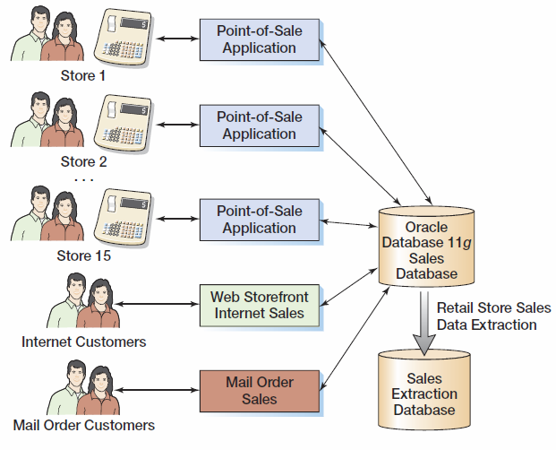
Cape Codd Retail Sales Structure
2-<number>

Slide 15
Cape Codd Retail Sales Data Extraction
The Cape Codd marketing department needs an analysis of in-store sales.
The entire database is not needed for this, only an extraction of retail sales data.
The data is extracted by the IS department from the operational database into a separate, off-line database for use by the marketing department.
2-<number>

Slide 16
Three tables are used:
  RETAIL_ORDER,
  ORDER_ITEM, and
  SKU_DATA
  SKU: Stock Keeping Unit
The extracted data is converted as necessary:
  Into a different DBMS—Microsoft SQL Server
  Into different columns—OrderDate becomes OrderMonth and OrderYear.
2-<number>

Slide 17
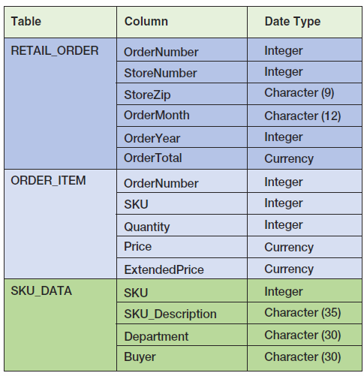
Extracted Retail Sales Data Format
2-<number>

Slide 18
Five tables in the Cape Code Sports database
  Order_item
  Sku_data
  Retail_order
  Inventory
  Warehouse
  Table names in Oracle system are Case-insensitive.
2-<number>

Slide 19
DBMS – ORACLE 11G
2-<number>

Slide 20
Create the DB
Create the Cape Codd Sports database in Oracle 11gR2
  Oracle-Cape-Codd-Drop-Create-Table.sql
Populate the database
  Oracle-Cape-Codd-Insert-Data.sql
2-<number>

Slide 21
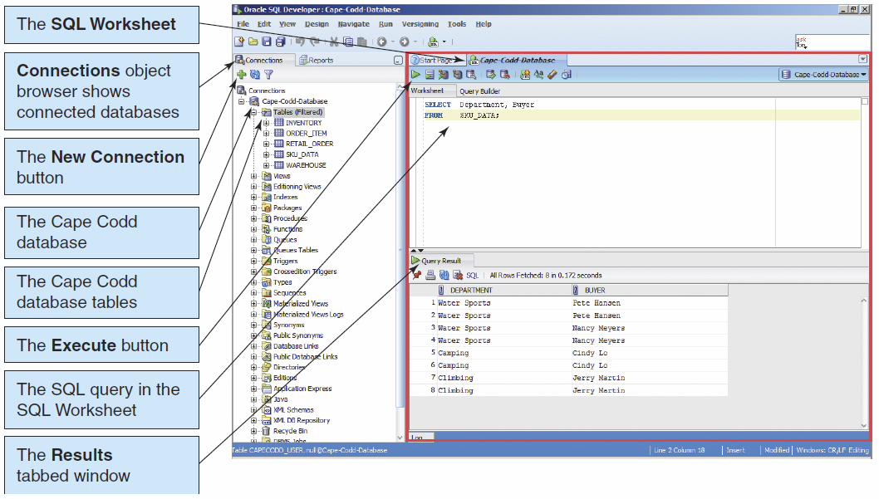
Using Oracle Database 11g
SQL Developer I
2-<number>

Slide 22
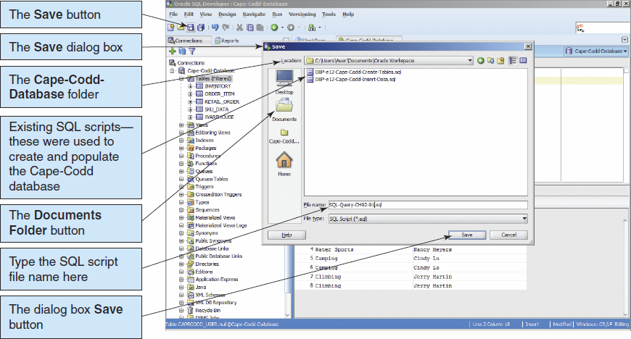
Using Oracle Database 11g
SQL Developer II
2-<number>

Slide 23
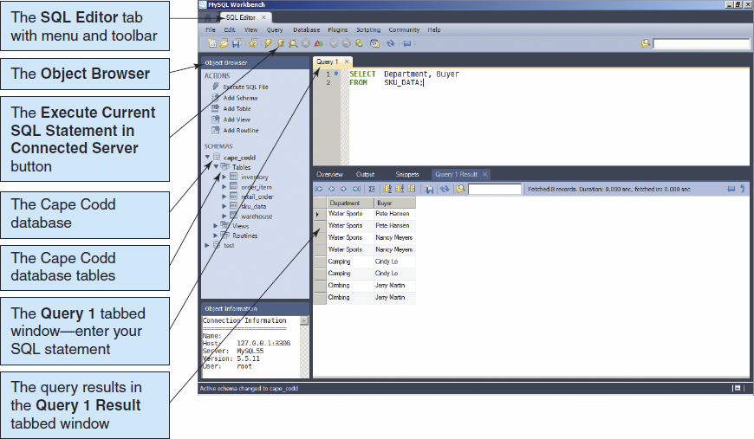
Using MySQL 5.5
MySQL Workbench I
2-<number>

Slide 24
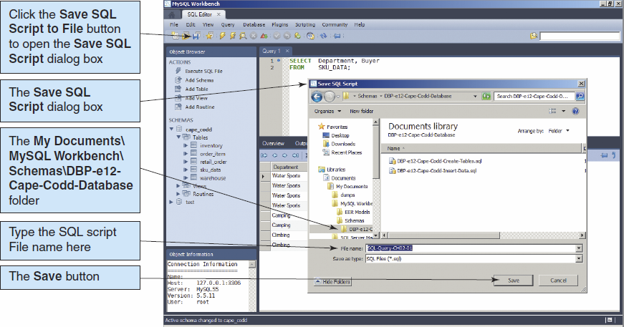
Using MySQL 5.5
MySQL Workbench II
2-<number>

Slide 25
SQL SELECT STATEMENT
Querying a Single Table:
2-<number>

Slide 26
The SQL SELECT Statement
The fundamental framework for an SQL query is the SQL SELECT statement.
  SELECT {ColumnName(s)}
  FROM {TableName(s)}
  WHERE {Condition(s)}
All SQL statements end with a semi-colon (;).
2-<number>

Slide 27
From
  which table to be queried
Where
  which rows to be included in the resulting table
Select
  which column(s) to be listed in the resulting table
Order by
  Which column(s) to be used for sorting rows
2-<number>

Slide 28
Illustrate how a DBMS executes a SELECT-FROM-WHERE statement in a single table.
  In the SKU_DATA table, list all of the departments and their buyers.
Do SQL Queries on Slides 29-57
2-<number>

Slide 29
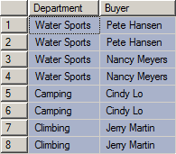
Specific Columns on One Table
SELECT Department, Buyer
FROM SKU_DATA;
2-<number>

Slide 30
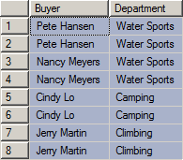
Specifying Column Order
SELECT Buyer, Department
FROM SKU_DATA;
2-<number>

Slide 31
Top N (MySQL)
SELECT department, buyer
FROM sku_data
LIMIT 5
;
2-<number>

Slide 32

The DISTINCT Keyword
/* eliminate duplicates */
SELECT DISTINCT Buyer, Department
FROM SKU_DATA;
2-<number>

Slide 33
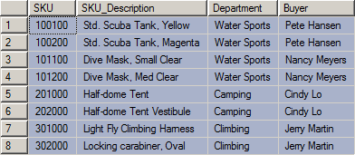
Selecting All Columns:
The Asterisk (*) Wildcard Character
SELECT *
FROM SKU_DATA;
2-<number>

Slide 34

Filter Rows from One Table
SELECT *
FROM SKU_DATA
WHERE Department = 'Water Sports';
NOTE: SQL wants a plain ASCII single quote: ' NOT ‘ !
MySQL string values are case-insensitive by default.
SELECT *
FROM SKU_DATA
WHERE binary Department = 'Water Sports';
2-<number>

Slide 35

Specific Columns and Rows from One Table
SELECT SKU_Description, Buyer
FROM SKU_DATA
WHERE Department = 'Climbing';
2-<number>

Slide 36
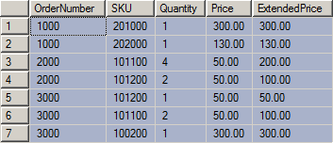
Sorting the rows - ORDER BY
SELECT *
FROM ORDER_ITEM
ORDER BY OrderNumber;
2-<number>

Slide 37
Sort Order
Ascending and Descending
SELECT *
FROM ORDER_ITEM
ORDER BY Price DESC;
SELECT *
FROM ORDER_ITEM
ORDER BY Price DESC, OrderNumber ASC;
NOTE: The default sort order is ASC—does not have to be specified.
2-<number>

Slide 38

WHERE Clause Options—AND
SELECT *
FROM SKU_DATA
WHERE Department = 'Water Sports'
AND Buyer = 'Nancy Meyers';
2-<number>

Slide 39

WHERE Clause Options—OR
SELECT *
FROM SKU_DATA
WHERE Department = 'Camping'
OR Department = 'Climbing';
2-<number>

Slide 40
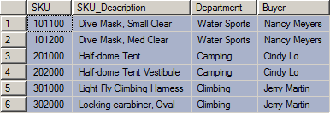
WHERE Clause Options—IN
SELECT *
FROM SKU_DATA
WHERE Buyer IN ('Nancy Meyers',
'Cindy Lo', 'Jerry Martin');
2-<number>

Slide 41

WHERE Clause Options—NOT IN
SELECT *
FROM SKU_DATA
WHERE Buyer NOT IN ('Nancy Meyers',
'Cindy Lo', 'Jerry Martin');
2-<number>

Slide 42

WHERE Clause Options—Ranges with BETWEEN
SELECT *
FROM ORDER_ITEM
WHERE ExtendedPrice
BETWEEN 100 AND 200;
2-<number>

Slide 43
WHERE Clause Options—Ranges with Math Symbols
SELECT *
FROM ORDER_ITEM
WHERE ExtendedPrice >= 100
AND ExtendedPrice <= 200;
2-<number>

Slide 44
WHERE Clause Options—
LIKE and Wildcards I
The SQL keyword LIKE can be combined with wildcard symbols:
  SQL 92 Standard (SQL Server, MySQL, etc.):
    _ = exactly one character
    % = any set of one or more characters
  Microsoft Access (based on MS DOS)
    ? = exactly one character
    * = any set of one or more characters
2-<number>

Slide 45
WHERE Clause Options—
LIKE and Wildcards II
SELECT *
FROM SKU_DATA
WHERE Buyer LIKE 'Pete%';
2-<number>

Slide 46

WHERE Clause Options—
LIKE and Wildcards III
Text page 61 typo: replace buyer with sku_description.
SELECT *
FROM SKU_DATA
WHERE sku_description LIKE '%Tent%';
2-<number>

Slide 47

WHERE Clause Options—
LIKE and Wildcards IV
SELECT *
FROM SKU_DATA
WHERE SKU LIKE '%2__';
2-<number>

Slide 48
SQL BUILT-IN FUNCTIONS
2-<number>

Slide 49
SQL Built-In Functions I
There are five SQL built-in functions:
  COUNT
  SUM
  AVG
  MIN
  MAX
2-<number>

Slide 50

SQL Built-In Functions II
SELECT SUM(ExtendedPrice)
AS Order3000Sum
FROM ORDER_ITEM
WHERE OrderNumber = 3000;
2-<number>

Slide 51

SQL Built-In Functions III
SELECT SUM(ExtendedPrice) AS OrderItemSum,
AVG(ExtendedPrice) AS OrderItemAvg,
MIN(ExtendedPrice) AS OrderItemMin,
MAX(ExtendedPrice) AS OrderItemMax
FROM ORDER_ITEM;
2-<number>

Slide 52

SQL Built-In Functions IV
SELECT COUNT(*) AS NumberOfRows
FROM ORDER_ITEM;
2-<number>

Slide 53

SQL Built-In Functions V
SELECT COUNT(DISTINCT Department)
AS DeptCount
FROM SKU_DATA;
2-<number>

Slide 54
OTHER OPERATIONS
2-<number>

Slide 55
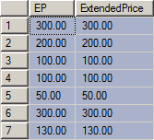
Arithmetic in SELECT Statements
SELECT Quantity * Price AS EP,
ExtendedPrice
FROM ORDER_ITEM;
2-<number>

Slide 56
Expressions in Select
Page 67: string concatenation
Oracle: ||
MS SQL server: +
MySQL: concat()
SELECT concat(Buyer,' in ',Department)
FROM SKU_DATA
2-<number>

Slide 57
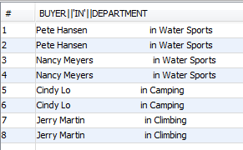
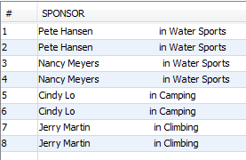
Only for Oracle
SELECT Buyer || ' in ' || Department FROM SKU_DATA;
SELECT Buyer || ' in ' || Department AS Sponsor
FROM SKU_DATA;
2-<number>

Slide 58
Length() function
Returns the length of the specified string.
Example:
  select length(buyer) from sku_data;
  Result: ?
2-<number>

Slide 59

String Functions in SELECT Statements
SELECT DISTINCT RTRIM(Buyer)
||' in '|| RTRIM(Department) AS Sponsor
FROM SKU_DATA;
NOTE: This SQL statement uses Oracle syntax—other DBMS products use different concatenation and character string operators.
2-<number>

Slide 60
Rtrim
The rtrim function removes all specified characters from the right-hand side of a string.
rtrim( string1, [ trim_string ] )
string1 is the string to trim the characters from the right-hand side.
trim_string is the string that will be removed from the right-hand side of string1. If this parameter is omitted, the rtrim function will remove all trailing spaces from string1.
2-<number>

