Slide 1
QUERYING TWO OR MORE TABLES
2-<number>

Slide 2
JOINs
In an SQL join operation, the SQL JOIN operator is used to combine parts or all of two or more tables.
  Explicit join ─ use the JOIN keyword for equijoin
  Implicit join ─ use a comma to connect the tables to be joined
When we join two tables, they must have common column, i.e., foreign key
2-<number>

Slide 3
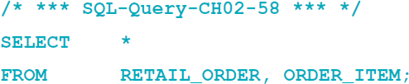
CROSS JOIN
In an SQL CROSS JOIN combines each row in one table with every row in another table.
This is known mathematically as a Cross product of the rows in the tables.
This is illogical in database work because we only need rows that somehow logically correspond in the two tables.
2-<number>

Slide 4
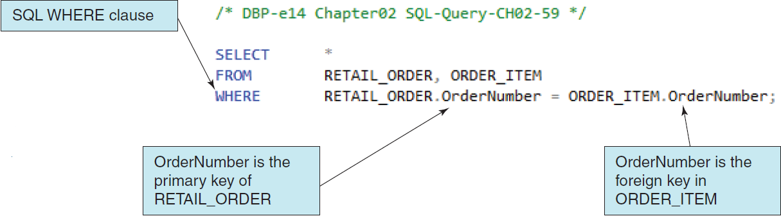
Implicit SQL INNER JOIN
Inner Join: selecting rows where the primary key values of one table match the foreign key values from a second table, which makes a join condition.
Because the SQL JOIN keyword does not appear in the SQL statement, this is an implicit join.
2-<number>

Slide 5
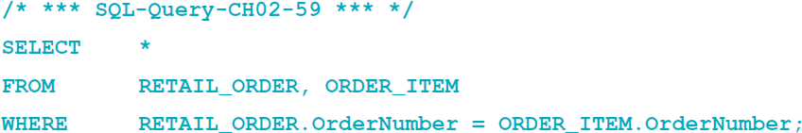
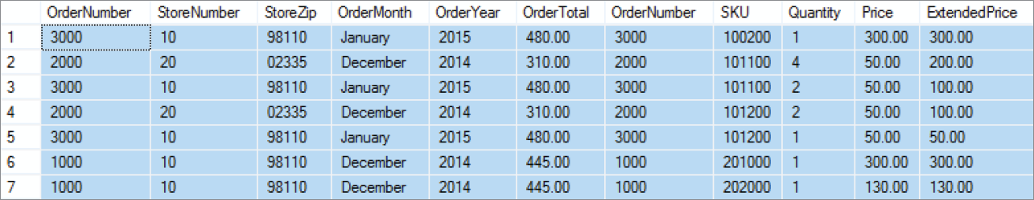
Implicit SQL INNER JOIN
2-<number>
Notes:
Retail_order: 3 * 6 = 18
Order_item: 7*5=35
7*11 = 77

Slide 6
Query
What is the total sales of the department ‘Water Sports’?
  Use implicit Join
Database model in Figure 2-34 on page 108
2-<number>
Notes:
Retail_order: ordertotal
retail:_order:ordernumber
Order_item->sku
SKU_DATA->department

Slide 7
Subquery
SELECT SUM(ExtendedPrice) AS SalesTotal
FROM ORDER_ITEM
WHERE SKU IN (
SELECT SKU
FROM SKU_DATA
WHERE Department = 'Water Sports‘
)
;
2-<number>

Slide 8

Implicit Join
Retrieve total sales for the department ‘Water Sports’
Retrieve total sales for the department ‘Climbing’
Retrieve total sales for the department ‘Camping’
Retrieve total sales for each department. (There are three departments.)
2-<number>

Slide 9


Explicit JOIN..ON..
SQL keyword join
SQL keyword on
2-<number>

Slide 10
EQUIJOIN
When tables are joined using an equal to condition as in the example above, the join is called an equijoin.
When people say “join”, 99.99999 percent of the time they mean equijoin.
Multiple joins can be used to process three or even more tables.
All parts if the SQL SELECT statement syntax can be applied to the table displaying the results of an SQL query using joins.
2-<number>

Slide 11
SQL JOIN ON Syntax
In SQL JOIN ON syntax:
  The SQL JOIN keyword is placed between the table names in the SQL FROM clause, where it replaces the comma that previously separated the two table names, and
  The SQL ON keyword now leads into an SQL ON clause, which includes the statement of matching key values that was previously in an SQL WHERE clause.
  The SQL WHERE clause is no longer used as part of the join, which makes it easier to read the actual restrictions on the rows in the query in the SQL WHERE clause itself.
The explicit SQL JOIN ON syntax is currently considered as the proper way to write SQL join operations, and the older implicit SQL syntax is considered an archaic, older syntax (but it still works).
2-<number>

Slide 12
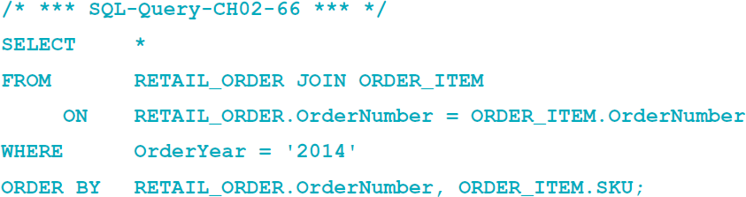
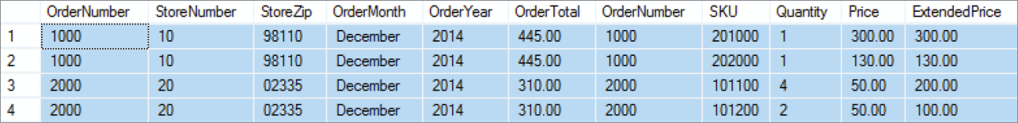
SQL JOIN ON Syntax
2-<number>

Slide 13
SQL Subqueries versus SQL Joins
SQL subqueries and SQL joins both process multiple tables.
An SQL subquery can only be used to retrieve data from the “top table”.
An SQL join can be used to obtain data from any participating tables.
2-<number>

Slide 14


Inner Join
Any department missing in the result?
2-<number>

Slide 15



Outer Join
2-<number>

Slide 16
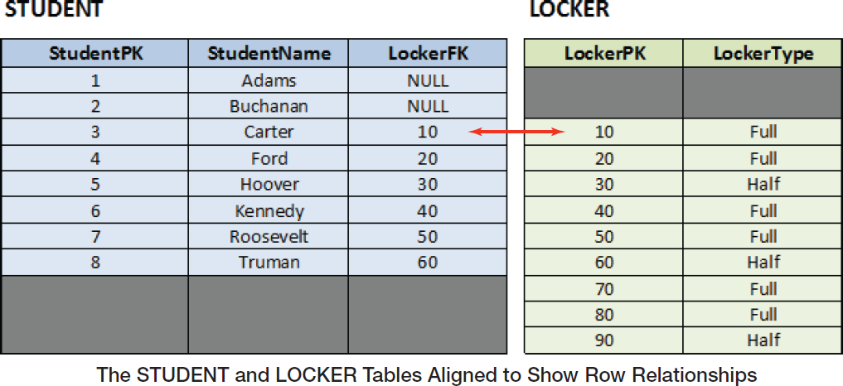
SQL Outer Joins
Example Tables
2-<number>

Slide 17
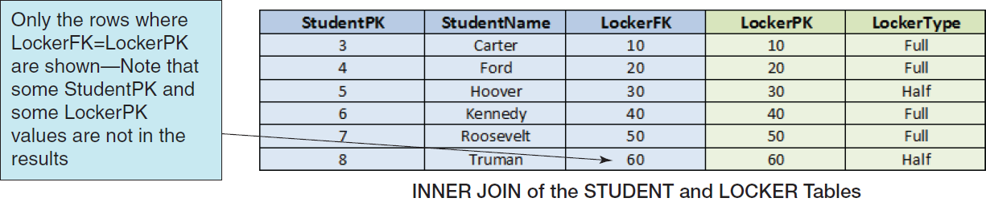
SQL INNER JOIN
2-<number>

Slide 18
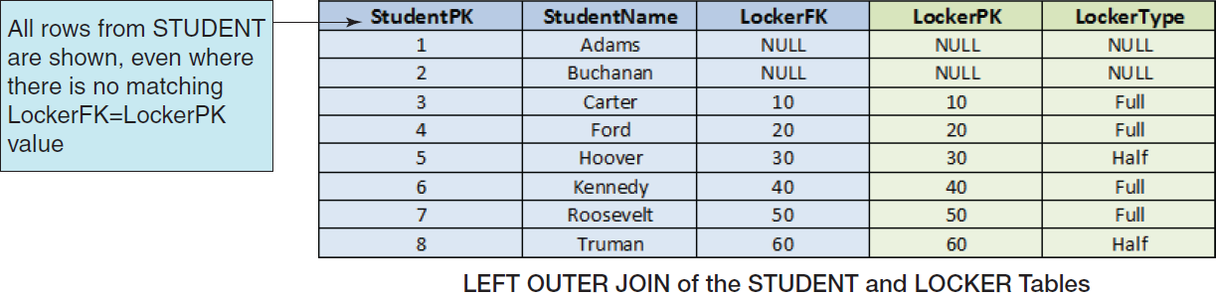
SQL LEFT OUTER JOIN
2-<number>

Slide 19
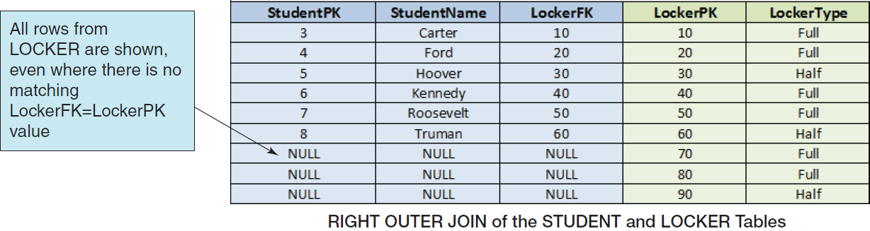
SQL RIGHT OUTER JOIN
2-<number>

Slide 20
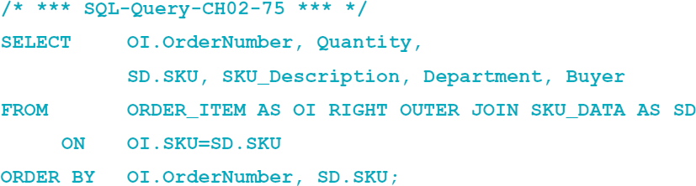
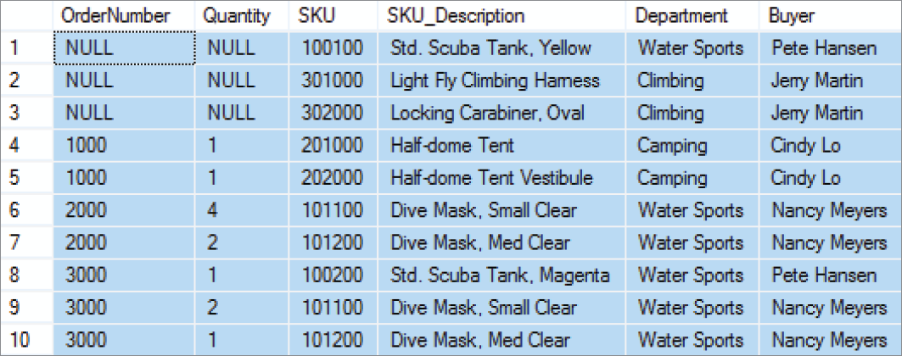
SQL OUTER JOIN Syntax
Note the use of the SQL syntax RIGHT OUTER JOIN … ON in the query, and note the NULL values in the query results:
2-<number>

