Slide 1
QUERYING TWO OR MORE TABLES
2-<number>

Slide 2
SQL SET OPERATORS
2-<number>

Slide 3
Querying Multiple Tables with SQL Set Operators
The Logic of Set Operators I – Mathematical Set Theory
Mathematicians use the term set theory to describe mathematical operations on sets, where a set is defined as a group of distinct items.
A relational database table meets the definition of a set, so it is little wonder that SQL includes a group of set operators for use with SQL queries.
2-<number>

Slide 4
Querying Multiple Tables with SQL Set Operators
The Logic of Set Operators II – Venn Diagrams
Venn diagrams are the standard method of visualizing sets and their relationships.
  A set is represented by a labeled circle.
  A subset is a portion of a set that is contained entirely within the set.
  The union of two sets represents a set that contains all values in both sets. This is equivalent to an OR logical operation
  (A OR B).
  The intersection of two sets represents the area common to both sets. This is equivalent to an AND logical operation
  (A AND B).
  The complement of set B in set A represents everything in set A that is not in set B. This is equivalent to a logical operation using NOT (A NOT B).
2-<number>

Slide 5
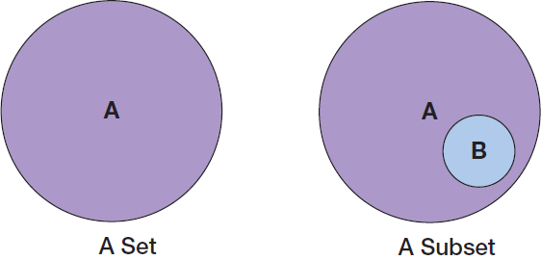
Querying Multiple Tables with SQL Set Operators
The Logic of Set Operators III – Venn Diagrams – Set and Subset
2-<number>

Slide 6
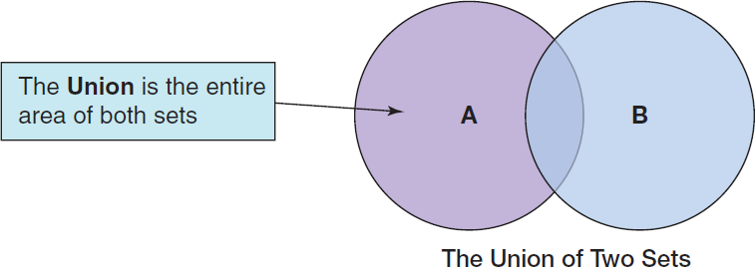
Querying Multiple Tables with SQL Set Operators
The Logic of Set Operators IV – Venn Diagrams – Union
2-<number>

Slide 7
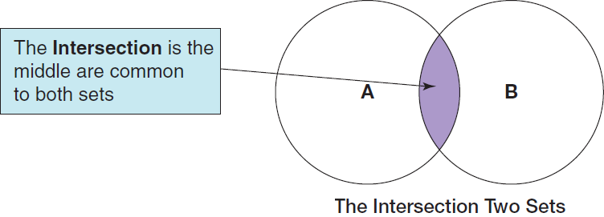
Querying Multiple Tables with SQL Set Operators
The Logic of Set Operators V – Venn Diagrams – Intersection
2-<number>

Slide 8
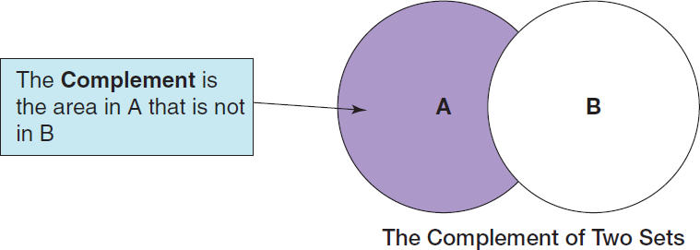
Querying Multiple Tables with SQL Set Operators
The Logic of Set Operators VI – Venn Diagrams – Complement
2-<number>

Slide 9
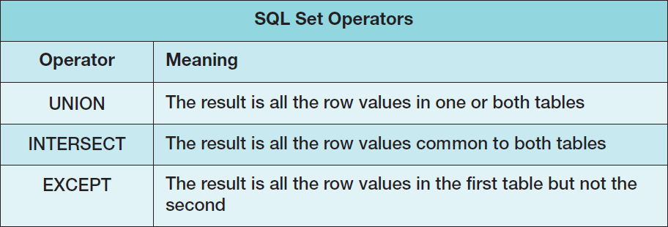
Querying Multiple Tables with SQL Set Operators
The Logic of Set Operators VII – SQL Set Operators
Note that in order to use SQL set operators, the table columns involved in the operations must be the same number in each SELECT component, and corresponding columns must have the same or compatible (e.g., CHAR and VARCHAR) data types!
2-<number>

Slide 10
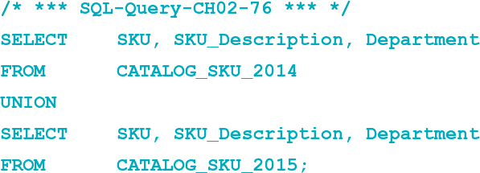
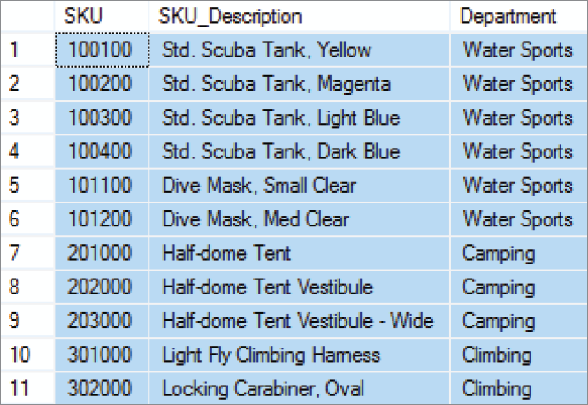
Querying Multiple Tables with SQL Set Operators
The Logic of Set Operators VIII – SQL UNION Operator
“What products were available for sale (by either catalog or Web site) in 2014 and 2015?”
2-<number>

Slide 11
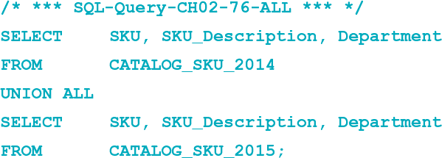
Querying Multiple Tables with SQL Set Operators
The Logic of Set Operators IX – SQL ALL Keyword
If we compare the output of SQL-Query-CH02-76 to the data in the CATALOG-SKU_2014 and CATALOG_SKU_2015 tables, we will note that there are no duplicate rows in the query output. For example, SKU 201000, the Half-Dome Tent, is in each table, but only appears once in the query output. If, for some reason, we want the duplicated rows to be displayed in the query output as well, we would simply add the SQL ALL keyword to the query:
2-<number>

Slide 12
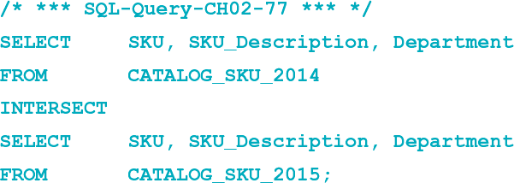
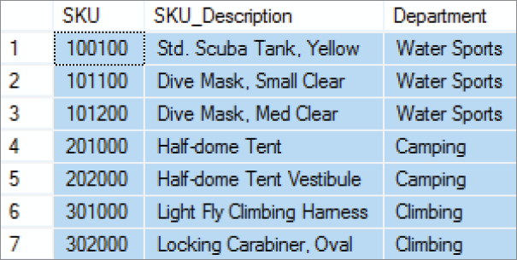
Querying Multiple Tables with SQL Set Operators
The Logic of Set Operators X – SQL INTERSECT Operator
“What products were available for sale (by either catalog or Web site) in both 2014 and 2015?” [MySQL 5.6 does not support the INTERSECT Operator]
2-<number>

Slide 13
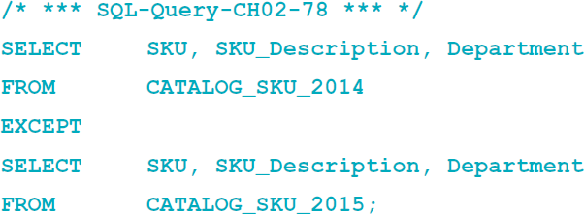
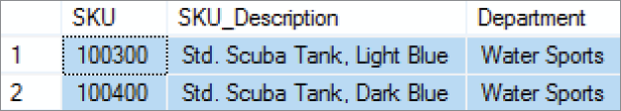
Querying Multiple Tables with SQL Set Operators
The Logic of Set Operators XI – SQL EXCEPT Operator
“What products were available for sale (by either catalog or Web site) in 2014 but not in 2015?” [Oracle Database calls this the SQL MINUS operator, and MySQL 5.6 does not support this operation]
2-<number>

