Slide 1
C442 Database Systems
Chapter Two:
Introduction to Structured Query Language
2-<number>

Slide 2
Chapter Objectives
To understand the use of extracted data sets in business intelligence (BI) systems
To understand the use of ad-hoc queries in business intelligence (BI) systems
To understand the history and significance of Structured Query Language (SQL)
To understand the SQL SELECT/FROM/WHERE framework as the basis for database queries
To create SQL queries to retrieve data from a single table
2-<number>

Slide 3
Chapter Objectives
To create SQL queries that use the SQL SELECT, FROM, WHERE, ORDER BY, GROUP BY, and HAVING clauses
To create SQL queries that use the SQL DISTINCT, AND, OR, NOT, BETWEEN, LIKE, and IN keywords
To create SQL queries that use the SQL built-in functions of SUM, COUNT, MIN, MAX, and AVG with and without the use of a GROUP BY clause
2-<number>

Slide 4
Chapter Objectives
To create SQL queries that retrieve data from a single table but restrict the data based upon data in another table (subquery)
To create SQL queries that retrieve data from multiple tables using an SQL join operation
2-<number>

Slide 5
Business Intelligence (BI) Systems
Business intelligence (BI) systems are information systems that assist managers and other professionals:
  Assessment
  Analysis
  Planning
  Control
2-<number>

Slide 6
Ad-Hoc Queries
Ad-hoc queries:
  Questions that can be answered using database data
  Example: “How many customers in Portland, Oregon, bought our green baseball cap?”
  Created by the user as needed, instead of programmed into an application
  Common in business
2-<number>

Slide 7
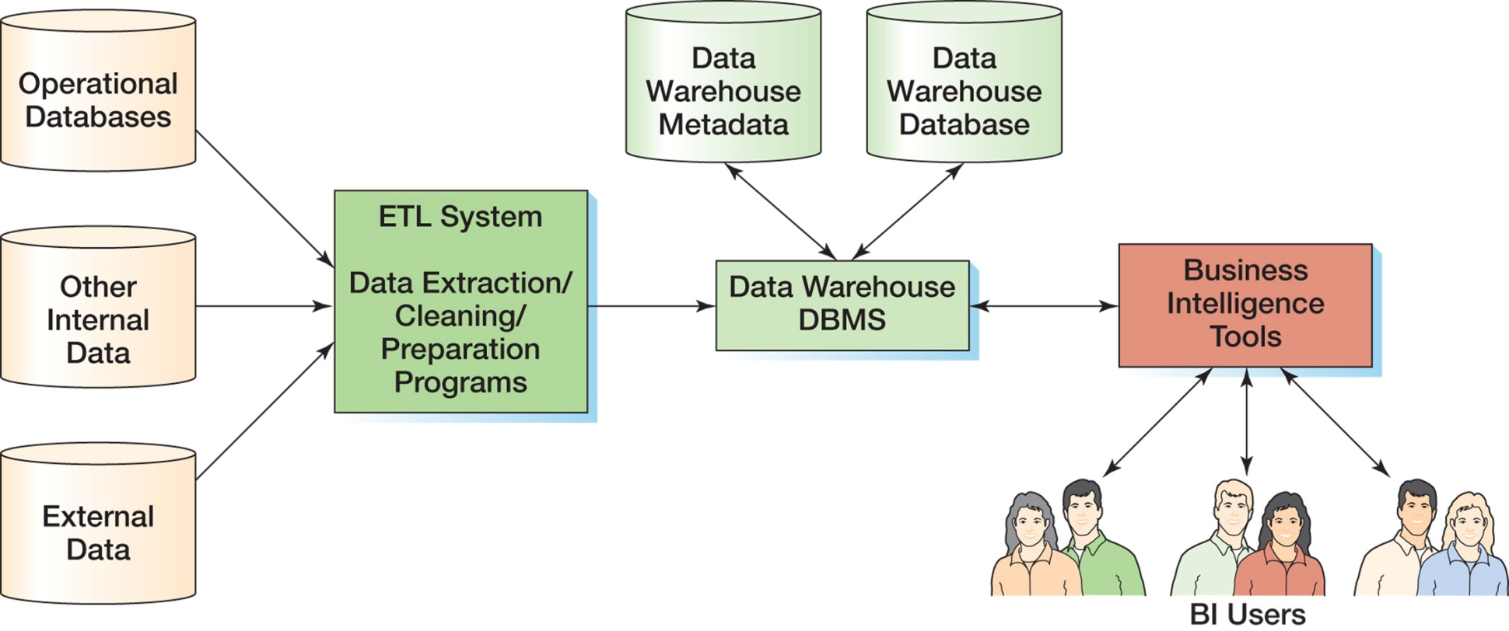
Components of a Data Warehouse
2-<number>

Slide 8
Structured Query Language
Structured Query Language (SQL) was developed by the IBM Corporation in the late 1970’s.
SQL was endorsed as a U.S. national standard by the American National Standards Institute (ANSI) in 1992 [SQL-92].
Newer versions exist, and they incorporate XML and some object-oriented concepts.
2-<number>

Slide 9
SQL As a Data Sublanguage
SQL is not a full featured programming language.
  C, C#, Java
SQL is a data sublanguage for creating and processing database data and metadata.
SQL is ubiquitous in enterprise-class DBMS products.
SQL programming is a critical skill.
2-<number>

Slide 10
SQL DDL, DML, and SQL/PSM
SQL statements can be divided into three categories:
  Data definition language (DDL) statements
    Used for creating tables, relationships, and other structures
    Covered in Chapter 7
  Data manipulation language (DML) statements
    Used for queries and data modification
    Covered in this chapter (Chapter 2)
2-<number>

Slide 11
SQL DDL, DML, and SQL/PSM
  SQL/Persistent Stored Modules (SQL/PSM) statements
    Add procedural programming capabilities
      Variables
      Control-of-flow statements
    Covered in Chapters:
      7 (general introduction)
      10 (SQL Server 2008 R2)
      10A (Oralce Database 11g)
      10B (MySQL 5.5)
2-<number>

Slide 12
CASE STUDY: CAPE CODE DATABASE
2-<number>

Slide 13
Cape Codd Outdoor Sports
Cape Codd Outdoor Sports is a fictitious company based on an actual outdoor retail equipment vendor.
Cape Codd Outdoor Sports:
  Has 15 retail stores in the United States and Canada.
  Has an online Internet store.
  Has a (postal) mail order department.
All retail sales are recorded in an Oracle database.
2-<number>

Slide 14
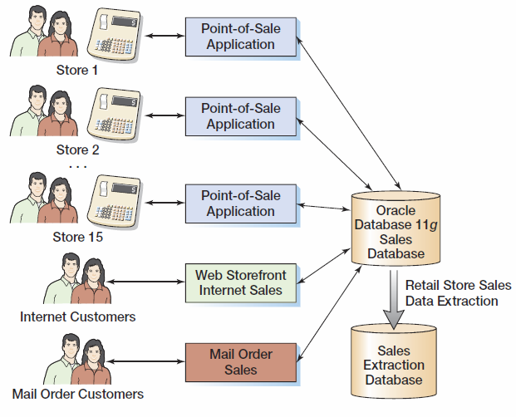
Cape Codd Retail Sales Structure
2-<number>

Slide 15
Cape Codd Retail Sales Data Extraction
The Cape Codd marketing department needs an analysis of in-store sales.
The entire database is not needed for this, only an extraction of retail sales data.
The data is extracted by the IS department from the operational database into a separate, off-line database for use by the marketing department.
2-<number>

Slide 16
Three tables are used:
  RETAIL_ORDER,
  ORDER_ITEM, and
  SKU_DATA
  SKU: Stock Keeping Unit
The extracted data is converted as necessary:
  Into a different DBMS—Microsoft SQL Server
  Into different columns—OrderDate becomes OrderMonth and OrderYear.
2-<number>

Slide 17
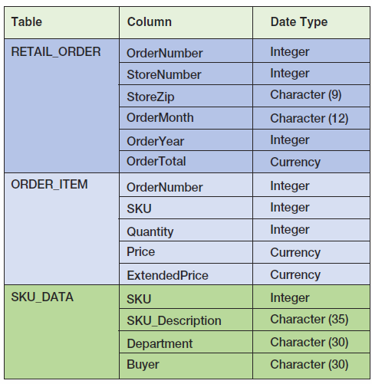
Extracted Retail Sales Data Format
2-<number>

Slide 18
Five tables in the Cape Code Sports database
  Order_item
  Sku_data
  Retail_order
  Inventory
  Warehouse
  Table names in Oracle system are Case-insensitive.
2-<number>

Slide 19
DBMS – ORACLE 11G
2-<number>

Slide 20
Create the DB
Create the Cape Codd Sports database in Oracle 11gR2
  Oracle-Cape-Codd-Drop-Create-Table.sql
Populate the database
  Oracle-Cape-Codd-Insert-Data.sql
2-<number>

Slide 21
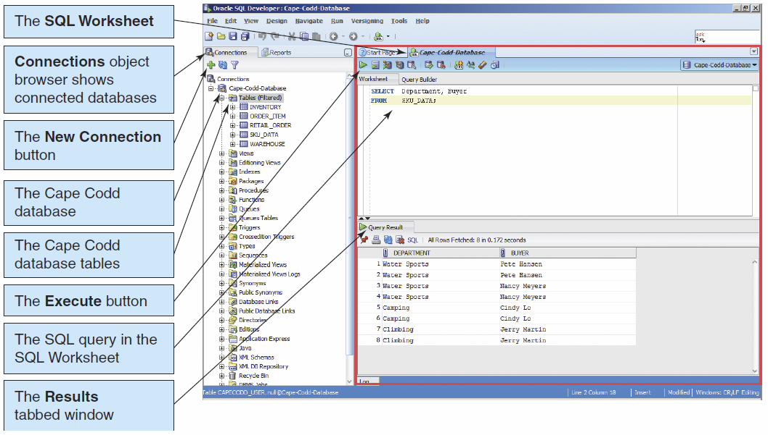
Using Oracle Database 11g
SQL Developer I
2-<number>

Slide 22
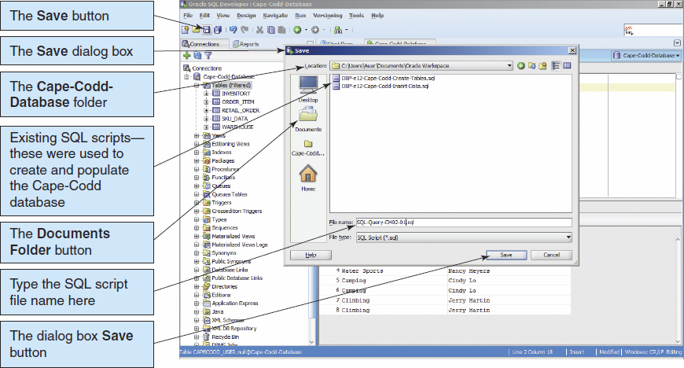
Using Oracle Database 11g
SQL Developer II
2-<number>

Slide 23
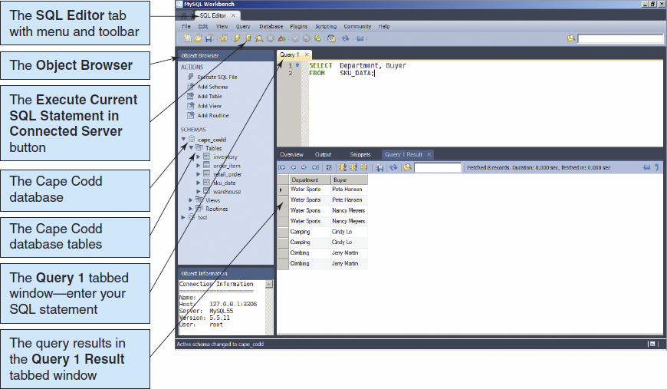
Using MySQL 5.5
MySQL Workbench I
2-<number>

Slide 24
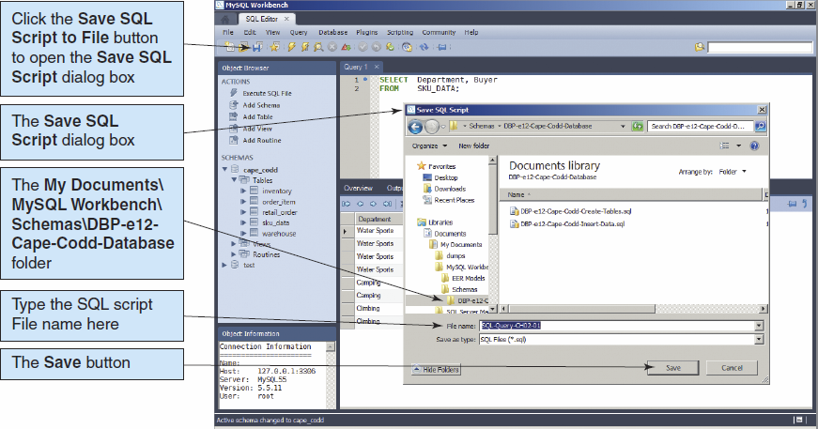
Using MySQL 5.5
MySQL Workbench II
2-<number>

Slide 25
SQL SELECT STATEMENT
Querying a Single Table:
2-<number>

Slide 26
The SQL SELECT Statement
The fundamental framework for an SQL query is the SQL SELECT statement.
  SELECT {ColumnName(s)}
  FROM {TableName(s)}
  WHERE {Condition(s)}
All SQL statements end with a semi-colon (;).
2-<number>

Slide 27
From
  which table to be queried
Where
  which rows to be included in the resulting table
Select
  which column(s) to be listed in the resulting table
Order by
  Which column(s) to be used for sorting rows
2-<number>

Slide 28
Illustrate how a DBMS executes a SELECT-FROM-WHERE statement in a single table.
  In the SKU_DATA table, list all of the departments and their buyers.
Do SQL Queries on Slides 29-57
2-<number>

Slide 29
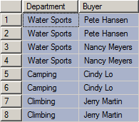
Specific Columns on One Table
SELECT Department, Buyer
FROM SKU_DATA;
2-<number>

Slide 30
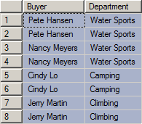
Specifying Column Order
SELECT Buyer, Department
FROM SKU_DATA;
2-<number>

Slide 31
Top N (MySQL)
SELECT department, buyer
FROM sku_data
LIMIT 5
;
2-<number>

Slide 32

The DISTINCT Keyword
/* eliminate duplicates */
SELECT DISTINCT Buyer, Department
FROM SKU_DATA;
2-<number>

Slide 33
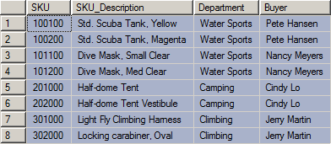
Selecting All Columns:
The Asterisk (*) Wildcard Character
SELECT *
FROM SKU_DATA;
2-<number>

Slide 34

Filter Rows from One Table
SELECT *
FROM SKU_DATA
WHERE Department = 'Water Sports';
NOTE: SQL wants a plain ASCII single quote: ' NOT ‘ !
MySQL string values are case-insensitive by default.
SELECT *
FROM SKU_DATA
WHERE binary Department = 'Water Sports';
2-<number>

Slide 35

Specific Columns and Rows from One Table
SELECT SKU_Description, Buyer
FROM SKU_DATA
WHERE Department = 'Climbing';
2-<number>

Slide 36
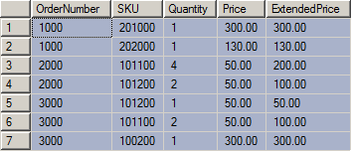
Sorting the rows - ORDER BY
SELECT *
FROM ORDER_ITEM
ORDER BY OrderNumber;
2-<number>

Slide 37
Sort Order
Ascending and Descending
SELECT *
FROM ORDER_ITEM
ORDER BY Price DESC;
SELECT *
FROM ORDER_ITEM
ORDER BY Price DESC, OrderNumber ASC;
NOTE: The default sort order is ASC—does not have to be specified.
2-<number>

Slide 38

WHERE Clause Options—AND
SELECT *
FROM SKU_DATA
WHERE Department = 'Water Sports'
AND Buyer = 'Nancy Meyers';
2-<number>

Slide 39

WHERE Clause Options—OR
SELECT *
FROM SKU_DATA
WHERE Department = 'Camping'
OR Department = 'Climbing';
2-<number>

Slide 40
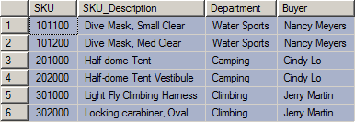
WHERE Clause Options—IN
SELECT *
FROM SKU_DATA
WHERE Buyer IN ('Nancy Meyers',
'Cindy Lo', 'Jerry Martin');
2-<number>

Slide 41

WHERE Clause Options—NOT IN
SELECT *
FROM SKU_DATA
WHERE Buyer NOT IN ('Nancy Meyers',
'Cindy Lo', 'Jerry Martin');
2-<number>

Slide 42

WHERE Clause Options—Ranges with BETWEEN
SELECT *
FROM ORDER_ITEM
WHERE ExtendedPrice
BETWEEN 100 AND 200;
2-<number>

Slide 43
WHERE Clause Options—Ranges with Math Symbols
SELECT *
FROM ORDER_ITEM
WHERE ExtendedPrice >= 100
AND ExtendedPrice <= 200;
2-<number>

Slide 44
WHERE Clause Options—
LIKE and Wildcards I
The SQL keyword LIKE can be combined with wildcard symbols:
  SQL 92 Standard (SQL Server, MySQL, etc.):
    _ = exactly one character
    % = any set of one or more characters
  Microsoft Access (based on MS DOS)
    ? = exactly one character
    * = any set of one or more characters
2-<number>

Slide 45
WHERE Clause Options—
LIKE and Wildcards II
SELECT *
FROM SKU_DATA
WHERE Buyer LIKE 'Pete%';
2-<number>

Slide 46

WHERE Clause Options—
LIKE and Wildcards III
Text page 61 typo: replace buyer with sku_description.
SELECT *
FROM SKU_DATA
WHERE sku_description LIKE '%Tent%';
2-<number>

Slide 47

WHERE Clause Options—
LIKE and Wildcards IV
SELECT *
FROM SKU_DATA
WHERE SKU LIKE '%2__';
2-<number>

Slide 48
SQL BUILT-IN FUNCTIONS
2-<number>

Slide 49
SQL Built-In Functions I
There are five SQL built-in functions:
  COUNT
  SUM
  AVG
  MIN
  MAX
2-<number>

Slide 50

SQL Built-In Functions II
SELECT SUM(ExtendedPrice)
AS Order3000Sum
FROM ORDER_ITEM
WHERE OrderNumber = 3000;
2-<number>

Slide 51

SQL Built-In Functions III
SELECT SUM(ExtendedPrice) AS OrderItemSum,
AVG(ExtendedPrice) AS OrderItemAvg,
MIN(ExtendedPrice) AS OrderItemMin,
MAX(ExtendedPrice) AS OrderItemMax
FROM ORDER_ITEM;
2-<number>

Slide 52

SQL Built-In Functions IV
SELECT COUNT(*) AS NumberOfRows
FROM ORDER_ITEM;
2-<number>

Slide 53

SQL Built-In Functions V
SELECT COUNT(DISTINCT Department)
AS DeptCount
FROM SKU_DATA;
2-<number>

Slide 54
OTHER OPERATIONS
2-<number>

Slide 55
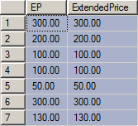
Arithmetic in SELECT Statements
SELECT Quantity * Price AS EP,
ExtendedPrice
FROM ORDER_ITEM;
2-<number>

Slide 56
Expressions in Select
Page 67: string concatenation
Oracle: ||
MS SQL server: +
MySQL: concat()
SELECT concat(Buyer,' in ',Department)
FROM SKU_DATA
2-<number>

Slide 57
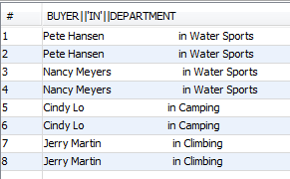
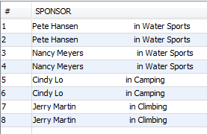
Only for Oracle
SELECT Buyer || ' in ' || Department FROM SKU_DATA;
SELECT Buyer || ' in ' || Department AS Sponsor
FROM SKU_DATA;
2-<number>

Slide 58
Length() function
Returns the length of the specified string.
Example:
  select length(buyer) from sku_data;
  Result: ?
2-<number>

Slide 59

String Functions in SELECT Statements
SELECT DISTINCT RTRIM(Buyer)
||' in '|| RTRIM(Department) AS Sponsor
FROM SKU_DATA;
NOTE: This SQL statement uses Oracle syntax—other DBMS products use different concatenation and character string operators.
2-<number>

Slide 60
Rtrim
The rtrim function removes all specified characters from the right-hand side of a string.
rtrim( string1, [ trim_string ] )
string1 is the string to trim the characters from the right-hand side.
trim_string is the string that will be removed from the right-hand side of string1. If this parameter is omitted, the rtrim function will remove all trailing spaces from string1.
2-<number>

Slide 61
GROUP BY
SQL Clause
2-<number>

Slide 62
Run Queries
SELECT department FROM sku_data GROUP BY department;
SELECT department, sku FROM sku_data GROUP BY department;
SELECT department, count(sku) FROM sku_data GROUP BY department;
SELECT department, buyer FROM sku_data GROUP BY department, buyer;
SELECT department, buyer, sku FROM sku_data GROUP BY department, buyer;
SELECT department, buyer, count(sku) FROM sku_data GROUP BY department, buyer;
SELECT department, buyer, count(*) FROM sku_data GROUP BY department, buyer;
2-<number>

Slide 63

GROUP BY I
SELECT Department, Buyer,
COUNT(*) AS
Dept_Buyer_SKU_Count
FROM SKU_DATA
GROUP BY Department, Buyer
;
2-<number>

Slide 64
Do It Yourself
Write a SELECT statement for each of the following queries.
Counts the total SKUs in each department.
Counts the total SKUs in each warehouse.
Counts the total SKUs in each order.
2-<number>

Slide 65
Query
How many SKUs is each buyer responsible for?
List buyers who is responsible for at least two SKUs. Sort buyers by their department names in ascending order.
2-<number>

Slide 66
Example
SELECT Department, Buyer,
COUNT(*) AS
Dept_Buyer_SKU_Count
FROM SKU_DATA
GROUP BY Department, Buyer
HAVING count(*)>=2
Order by department desc;
2-<number>

Slide 67
Query
List departments and the total SKUs in each department, excluding SKU 302000 from the total.
2-<number>

Slide 68

The SQL Keyword GROUP BY III
/* CH02-52 */
SELECT Department, COUNT(*) AS
Dept_SKU_Count
FROM SKU_DATA
WHERE SKU <> 302000
GROUP BY Department
ORDER BY Dept_SKU_Count;
2-<number>

Slide 69
Query
List the departments that has more than one SKU which is not 302000.
2-<number>

Slide 70

The SQL Keyword GROUP BY IV
SELECT Department, COUNT(*) AS
Dept_SKU_Count
FROM SKU_DATA
WHERE SKU <> 302000
GROUP BY Department
HAVING COUNT (*) > 1
ORDER BY Dept_SKU_Count;
2-<number>

Slide 71
Grouping Rows in SQL Queries
The SQL WHERE clause specifies which rows will be used to determine the groups.
The SQL HAVING clause specifies which groups will be used in the final result.
In general, place WHERE before GROUP BY. Some DBMS products do not require that placement; but to be safe, always put WHERE before GROUP BY.
There is an ambiguity in statements that include both WHERE and HAVING clauses. The results can vary, so to eliminate this ambiguity SQL always applies WHERE before HAVING.
2-<number>

Slide 72
Text Page 112 - 2.38
/* Display the WarehouseID and the sum of QuantityOnHand grouped by WarehouseID.
  Omit all SKUs that have 3 or more items on hand from the sum of the associated warehouse,
  Name the sum TotalItemsOnHandLT3.
  Show Warehouse ID only for warehouses having fewer than two(2) SKUs in their TotalItemsOnHandLT3
  Display the results in descending order of TotalItemsOnHandLT3.
*/
2-<number>
Notes:
The table structure of the query result: A table of two columns: select warehouseID, sum(quantityonhand)
Show a single column with a group function together, it implies that we must apply GROUP BY clause to partition all rows by their warehouseID.
Which table(s) should be queried? from INVENTORY
Intermediate query:
select warehouseID, sum(quantityonhand)
from inventory
group by warehouseID
;
In each warehouse, only include the sku items having less than 3 on hand: where quantityonhand < 3
Assign an alias to sum(quantityonhand): AS TotalItemsOnHandLT3
Filter groups by the condition: sum(quantityonhand) < 2
Sort by the sum in descending order: order by TotalItemsOnHandLT3 desc
select warehouseid, sum(quantityonhand) as TotalItemsOnHandLT3
from inventory
where quantityonhand < 3
group by warehouseid
having sum(quantityonhand) < 2
order by TotalItemsOnHandLT3 desc
;

Slide 73
QUERYING TWO OR MORE TABLES
2-<number>

Slide 74
Subquery
Join
2-<number>

Slide 75
What will this query return?
SELECT ordernumber
from order_item
group by ordernumber
having sum(extendedprice) IN (
SELECT max(sum(extendedprice))
from order_item
group by ordernumber )
;
2-<number>

Slide 76
SUBQUERY
A query within a query
A nested queries that use IN and NOT IN operators.
Child SELECT is placed inside parentheses.
Only the columns of the top level query can be displayed in the query results!
2-<number>

Slide 77
Query
What is the total sales of the department ‘water sports’?
Database model in Figure 2-34 on page 108
2-<number>
Notes:
Retail_order: ordertotal
retail:_order:ordernumber
Order_item->sku
SKU_DATA->department

Slide 78
SELECT SUM(ExtendedPrice) AS SalesTotal
FROM ORDER_ITEM
WHERE SKU IN (
SELECT SKU
FROM SKU_DATA
WHERE Department = 'Water Sports‘
)
;
2-<number>

Slide 79
Query
List name of buyers who manage at lease one product purchased in January 2015
Database model in Figure 2-34 on page 108
2-<number>

Slide 80
Querying Multiple Tables: Subqueries II
SELECT Buyer, Department
FROM SKU_DATA
WHERE SKU IN
(SELECT SKU
FROM ORDER_ITEM
WHERE OrderNumber IN
(SELECT OrderNumber
FROM RETAIL_ORDER
WHERE OrderMonth = 'January'
AND OrderYear = 2015)
)
;
2-<number>

Slide 81
Querying Multiple Tables with SQL Joins
The Logic of Joins I
In an SQL join operation, the SQL JOIN operator is used to combine parts or all of two or more tables.
  Explicit join ─ the JOIN operator for equijoin
  Implicit join ─ the comma sign
2-<number>

Slide 82
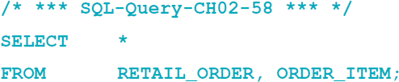
Querying Multiple Tables with SQL Joins
The Logic of Joins II – SQL CROSS JOIN
In an SQL CROSS JOIN combines each row in one table with every row in another table.
This is known mathematically as a Cartesian product of the rows in the tables.
This is illogical in database work because we only need rows that somehow logically correspond in the two tables.
2-<number>

Slide 83
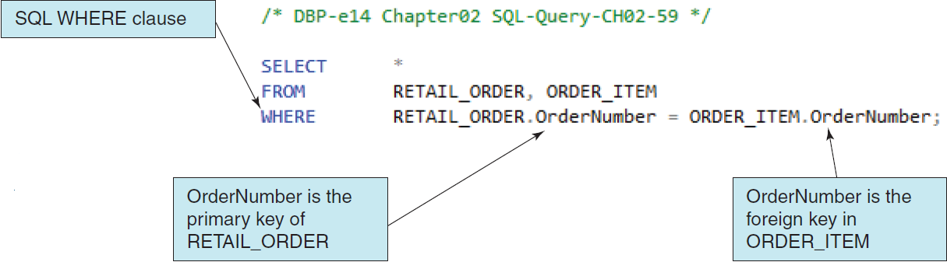
Querying Multiple Tables with SQL Joins
The Logic of Joins III – Implicit SQL INNER JOIN
By selecting rows by matching by the primary key values of one table with the foreign key values of a second table, we produce an SQL INNER JOIN.
Because the SQL JOIN keyword does not appear in the SQL statement, this is an implicit join.
2-<number>

Slide 84
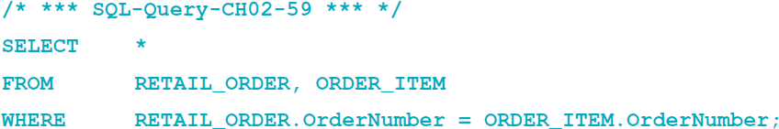
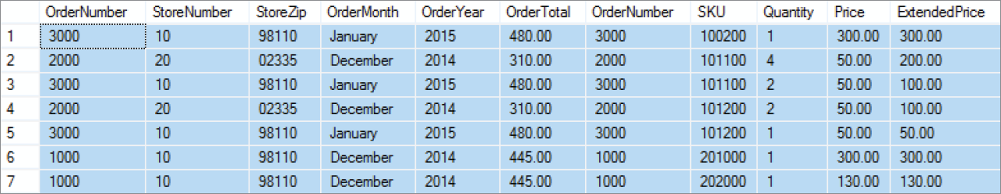
Querying Multiple Tables with SQL Joins
The Logic of Joins IV – Implicit SQL INNER JOIN
2-<number>

Slide 85
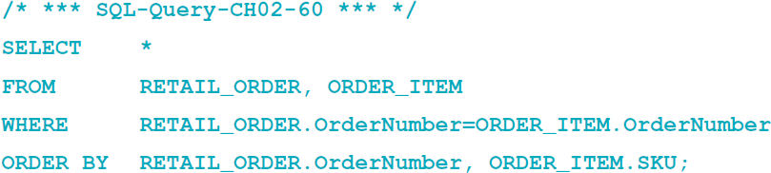
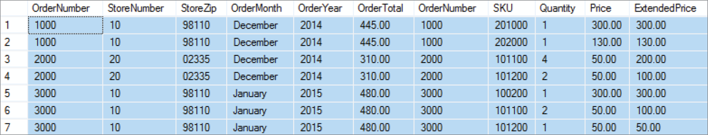
Querying Multiple Tables with SQL Joins
The Logic of Joins V – Implicit SQL INNER JOIN
With an SQL ORDER BY clause for easier reading by OrderNumber:
2-<number>

Slide 86
Query
What is the total sales of the department ‘water sports’?
Database model in Figure 2-34 on page 108
2-<number>
Notes:
Retail_order: ordertotal
retail:_order:ordernumber
Order_item->sku
SKU_DATA->department

Slide 87
Subquery
SELECT SUM(ExtendedPrice) AS SalesTotal
FROM ORDER_ITEM
WHERE SKU IN (
SELECT SKU
FROM SKU_DATA
WHERE Department = 'Water Sports‘
)
;
2-<number>

Slide 88
Join
SELECT department, sum(extendedprice)
FROM sku_data s LEFT JOIN order_item o
ON s.sku = o.sku
GROUP BY department
;
2-<number>

Slide 89
Querying Multiple Tables with SQL Joins
The Logic of Joins VI – EQUIJOIN
The process of using an SQL JOIN operation to join two tables is called joining the two tables.
When tables are joined using an equal to condition as in the example above, the join is called an equijoin.
When people say “join”, 99.99999 percent of the time they mean equijoin.
Multiple joins can be used to process three or even more tables.
All parts if the SQL SELECT statement syntax can be applied to the table displaying the results of an SQL query using joins.
2-<number>

Slide 90
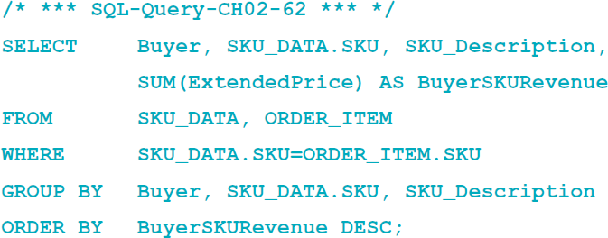
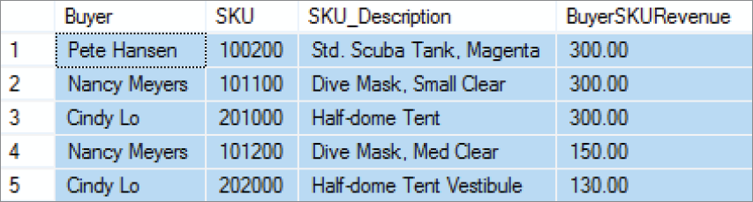
Querying Multiple Tables with SQL Joins
The Logic of Joins VII
2-<number>

Slide 91
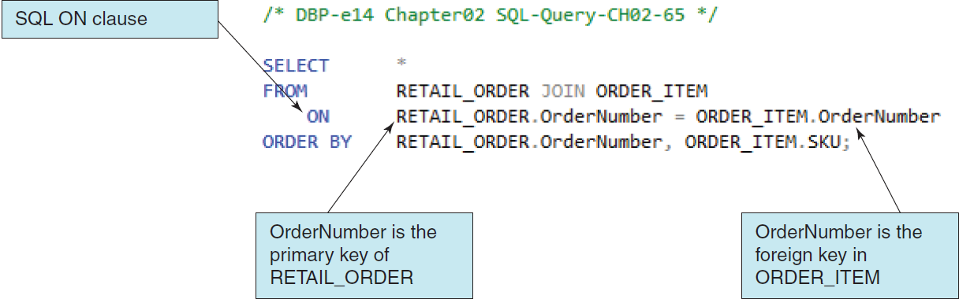
Querying Multiple Tables with SQL Joins
The Logic of Joins VIII – Explicit SQL INNER JOIN
By selecting rows by matching by the primary key values of one table with the foreign key values of a second table, we produce an SQL INNER JOIN.
Because the SQL JOIN keyword does appear in the SQL statement, this is an explicit join.
2-<number>

Slide 92
Querying Multiple Tables with SQL Joins
The Logic of Joins IX – SQL JOIN ON Syntax
In SQL JOIN ON syntax:
  The SQL JOIN keyword is placed between the table names in the SQL FROM clause, where it replaces the comma that previously separated the two table names, and
  The SQL ON keyword now leads into an SQL ON clause, which includes the statement of matching key values that was previously in an SQL WHERE clause.
  The SQL WHERE clause is no longer used as part of the join, which makes it easier to read the actual restrictions on the rows in the query in the SQL WHERE clause itself.
The explicit SQL JOIN ON syntax is currently considered as the proper way to write SQL join operations, and the older implicit SQL syntax is considered an archaic, older syntax (but it still works).
2-<number>

Slide 93
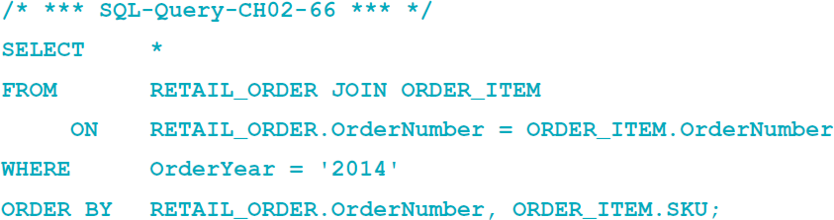
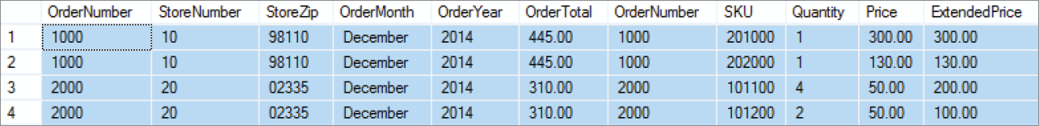
Querying Multiple Tables with SQL Joins
The Logic of Joins X – SQL JOIN ON Syntax
2-<number>

Slide 94
SQL Subqueries versus SQL Joins
SQL subqueries and SQL joins both process multiple tables.
An SQL subquery can only be used to retrieve data from the “top table”.
An SQL join can be used to obtain data from any number of tables, including the “top table” of the subquery.
In Chapter 8, we will study the correlated subquery. That kind of subquery can do work that is not possible with joins.
2-<number>

Slide 95
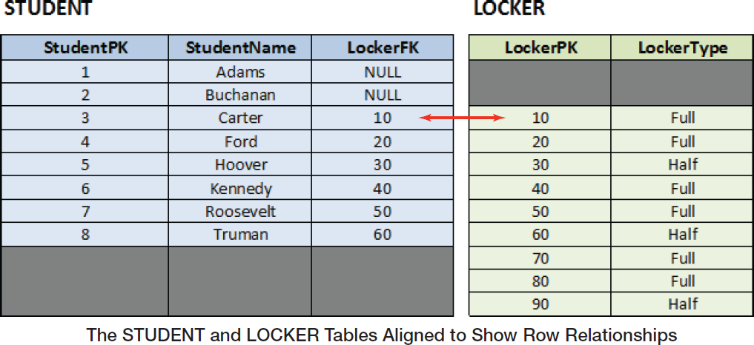
Querying Multiple Tables with SQL Outer Joins
The Logic of Outer Joins I – Example Tables
2-<number>

Slide 96
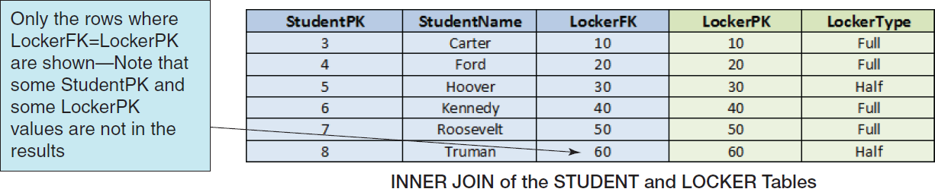
Querying Multiple Tables with SQL Outer Joins
The Logic of Outer Joins II – SQL INNER JOIN
2-<number>

Slide 97
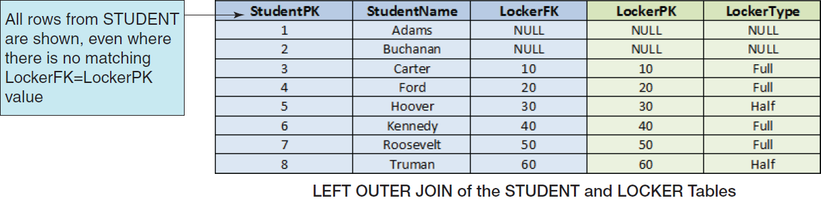
Querying Multiple Tables with SQL Outer Joins
The Logic of Outer Joins III – SQL LEFT OUTER JOIN
2-<number>

Slide 98
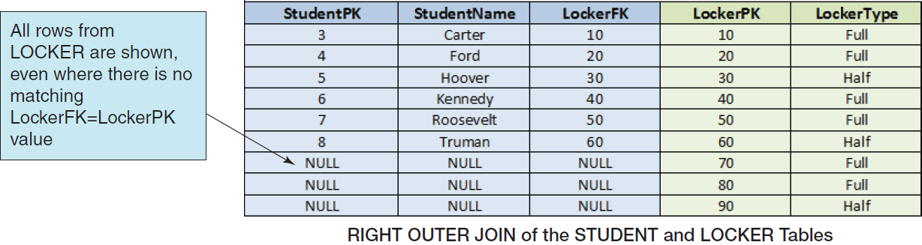
Querying Multiple Tables with SQL Outer Joins
The Logic of Outer Joins IV – SQL RIGHT OUTER JOIN
2-<number>

Slide 99
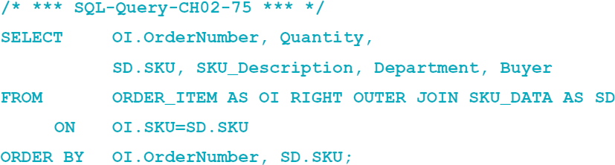
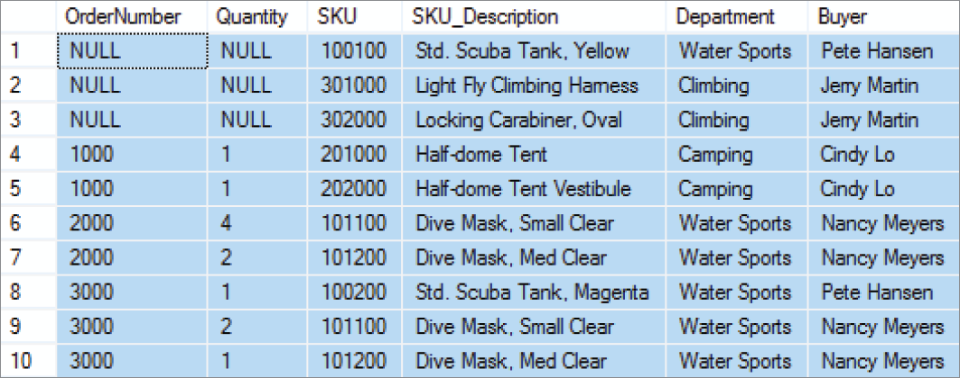
Querying Multiple Tables with SQL Outer Joins
The Logic of Outer Joins V – SQL OUTER JOIN Syntax
Note the use of the SQL syntax RIGHT OUTER JOIN … ON in the query, and note the NULL values in the query results:
2-<number>

Slide 100
Querying Multiple Tables with SQL Set Operators
The Logic of Set Operators I – Mathematical Set Theory
Mathematicians use the term set theory to describe mathematical operations on sets, where a set is defined as a group of distinct items.
A relational database table meets the definition of a set, so it is little wonder that SQL includes a group of set operators for use with SQL queries.
2-<number>

Slide 101
Querying Multiple Tables with SQL Set Operators
The Logic of Set Operators II – Venn Diagrams
Venn diagrams are the standard method of visualizing sets and their relationships.
  A set is represented by a labeled circle.
  A subset is a portion of a set that is contained entirely within the set.
  The union of two sets represents a set that contains all values in both sets. This is equivalent to an OR logical operation
  (A OR B).
  The intersection of two sets represents the area common to both sets. This is equivalent to an AND logical operation
  (A AND B).
  The complement of set B in set A represents everything in set A that is not in set B. This is equivalent to a logical operation using NOT (A NOT B).
2-<number>

Slide 102
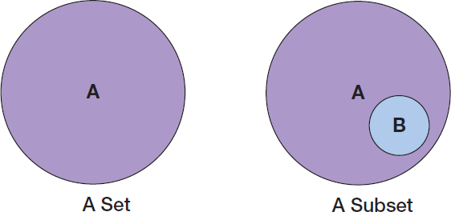
Querying Multiple Tables with SQL Set Operators
The Logic of Set Operators III – Venn Diagrams – Set and Subset
2-<number>

Slide 103
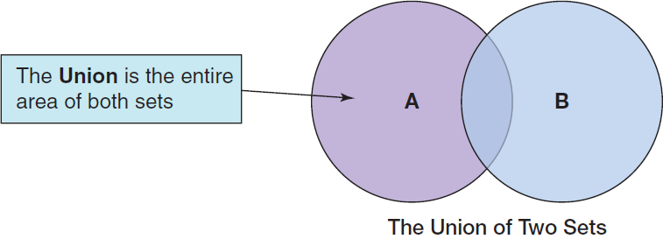
Querying Multiple Tables with SQL Set Operators
The Logic of Set Operators IV – Venn Diagrams – Union
2-<number>

Slide 104
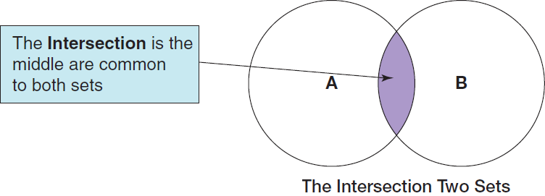
Querying Multiple Tables with SQL Set Operators
The Logic of Set Operators V – Venn Diagrams – Intersection
2-<number>

Slide 105
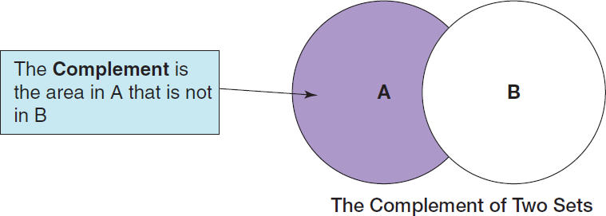
Querying Multiple Tables with SQL Set Operators
The Logic of Set Operators VI – Venn Diagrams – Complement
2-<number>

Slide 106
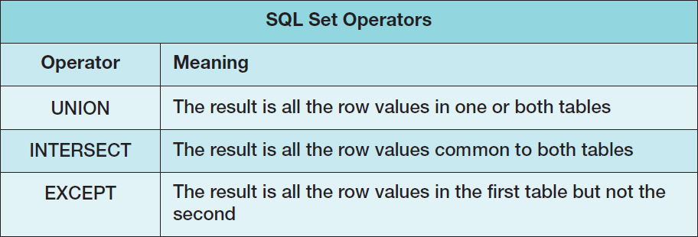
Querying Multiple Tables with SQL Set Operators
The Logic of Set Operators VII – SQL Set Operators
Note that in order to use SQL set operators, the table columns involved in the operations must be the same number in each SELECT component, and corresponding columns must have the same or compatible (e.g., CHAR and VARCHAR) data types!
2-<number>

Slide 107
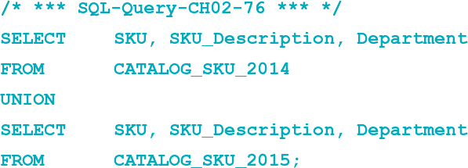
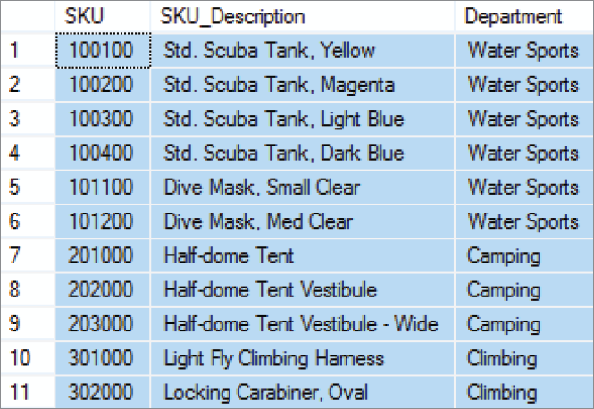
Querying Multiple Tables with SQL Set Operators
The Logic of Set Operators VIII – SQL UNION Operator
“What products were available for sale (by either catalog or Web site) in 2014 and 2015?”
2-<number>

Slide 108
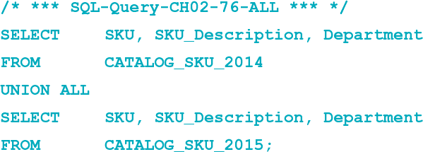
Querying Multiple Tables with SQL Set Operators
The Logic of Set Operators IX – SQL ALL Keyword
If we compare the output of SQL-Query-CH02-76 to the data in the CATALOG-SKU_2014 and CATALOG_SKU_2015 tables, we will note that there are no duplicate rows in the query output. For example, SKU 201000, the Half-Dome Tent, is in each table, but only appears once in the query output. If, for some reason, we want the duplicated rows to be displayed in the query output as well, we would simply add the SQL ALL keyword to the query:
2-<number>

Slide 109
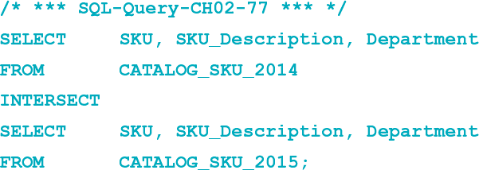
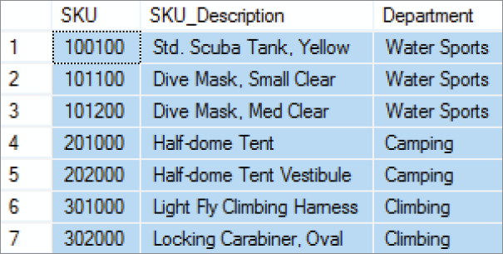
Querying Multiple Tables with SQL Set Operators
The Logic of Set Operators X – SQL INTERSECT Operator
“What products were available for sale (by either catalog or Web site) in both 2014 and 2015?” [MySQL 5.6 does not support the INTERSECT Operator]
2-<number>

Slide 110
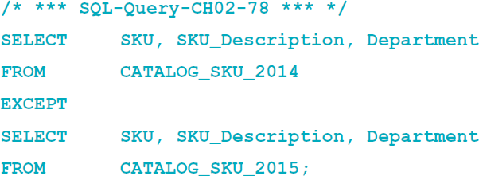
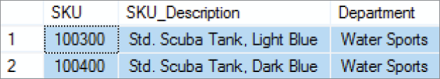
Querying Multiple Tables with SQL Set Operators
The Logic of Set Operators XI – SQL EXCEPT Operator
“What products were available for sale (by either catalog or Web site) in 2014 but not in 2015?” [Oracle Database calls this the SQL MINUS operator, and MySQL 5.6 does not support this operation]
2-<number>

