Slide 1
SDTM Simulator
You want to demonstrate software capabilities to a client whom you've never worked with before
You need some SDTM data for a SUG paper and you can't use client data
You've got tight timelines and can't wait for "real" SDTM datasets before you start your ADaM work

Slide 2
Current capabilities
Demographics (DM)
Events (AE)
Subject Visits (SV)
Findings (EG, LB, VS)

Slide 3
Dependencies
DM
SV
AE
Findings

Slide 4
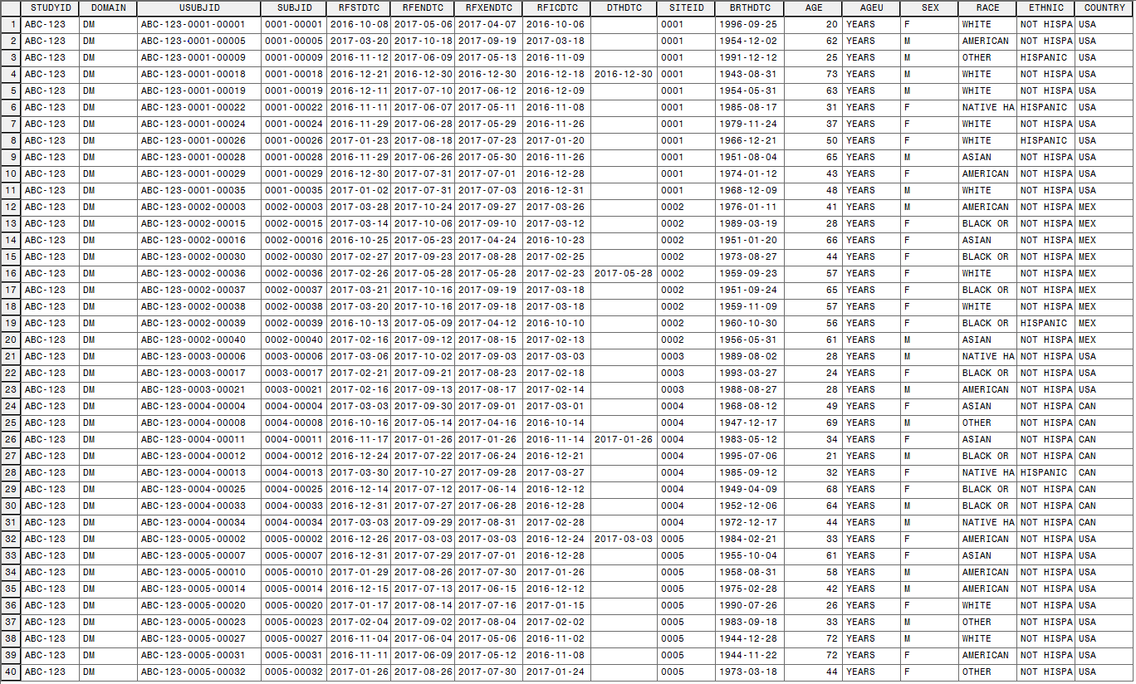
Program Flow: DM
%dm_create
(out=dm10
,subjid_n=40
,siteid_n=5
,country_list=(USA,CAN,MEX)
,country_table=(.6,.2,.2)
,fpfvdt=01oct2016
,lpfvdt=01apr2017
,screendur=3
,treatmentdur=182
,followupdur=28
,deathprob=0.05
,sex_table=(.6,.4)
);

Slide 5
Example DM dataset

Slide 6
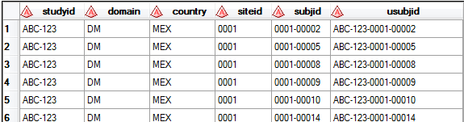
Program Flow: DM
%dm_create
(out=dm10
,subjid_n=40
,siteid_n=5
,country_list=(USA,CAN,MEX)
,country_table=(.6,.2,.2)
…
Create subjects along with their sites and countries

Slide 7
Example DM dataset

Slide 8
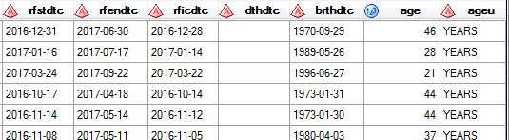
Program Flow: DM
%dm_create
(…
,fpfvdt=01oct2016
,lpfvdt=01apr2017
,screendur=3
,treatdur=182
,followupdur=28
,deathprob=0.05
…
Start date, end date, date of birth, etc.

Slide 9
Example DM dataset

Slide 10
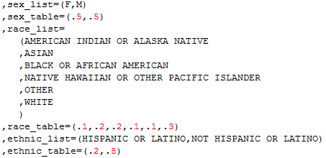
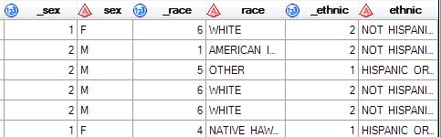
Program Flow: DM
%dm_create
(…
,sex_table=(.6,.4)
);
Sex, race, ethnicity

Slide 11
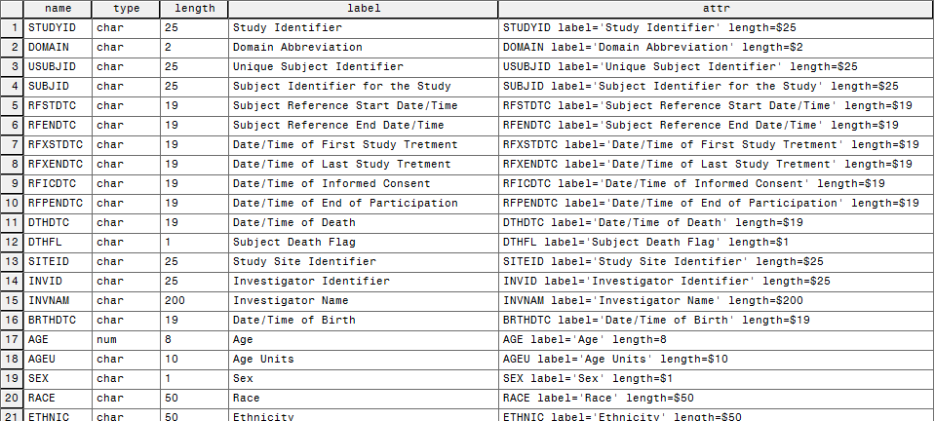
DM metadata
dm_meta.sas creates metadata for all allowable DM variables

Slide 12
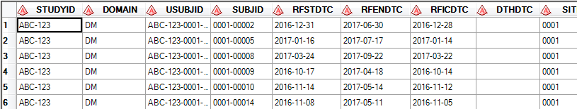
Program Flow: DM
%sdtm_attrs
(data=dm10
,out=sdtm.dm
,domain=dm
);
Apply metadata from dm_meta

Slide 13
Program Flow: DM
%dm_create
(out=dm10
,subjid_n=40
,siteid_n=5
,country_list=(USA,CAN,MEX)
,country_table=(.6,.2,.2)
,fpfvdt=01oct2016
,lpfvdt=01apr2017
,screendur=3
,treatmentdur=182
,followupdur=28
,deathprob=0.05
,sex_table=(.6,.4)
);
%sdtm_attrs
(data=dm10
,out=sdtm.dm
,domain=dm
);

Slide 14
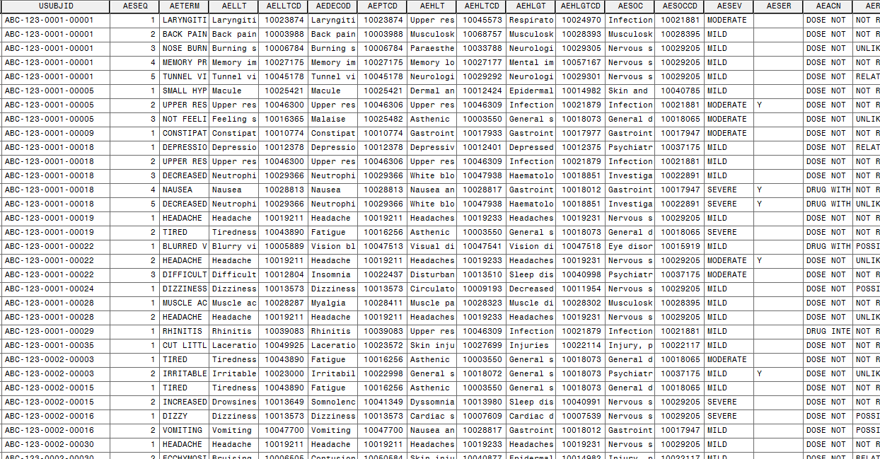
Example AE dataset

Slide 15
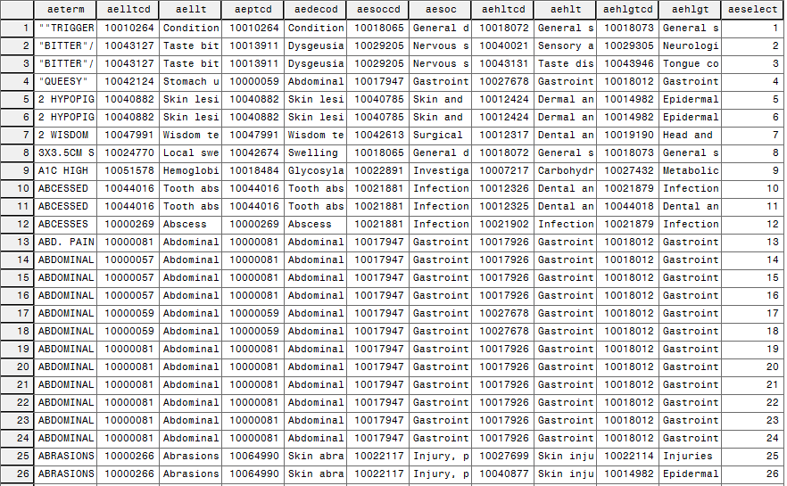
META.AESELECT

Slide 16
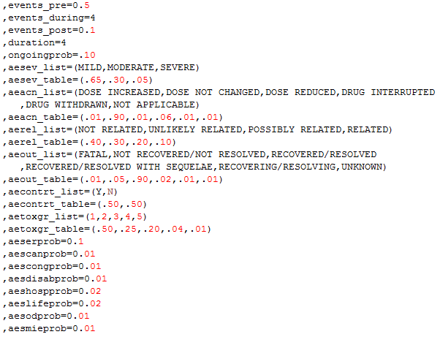
AE customization

Slide 17
Program Flow: AE
%events_create
(dm=sdtm.dm
,domain=ae
,meddra=meta.aeselect
,out=ae10
,events_pre=0.2
,events_during=2
,events_post=0.1
,duration=4
,aesev_table=(.65,.20,.15)
,aeserprob=.10
,aeshospprob=.05
);
Followed by a call to %sdtm_attrs().
Inputs
Output
Number of events in each period (Poisson)
Other customizations

Slide 18
Example AE dataset

Slide 19
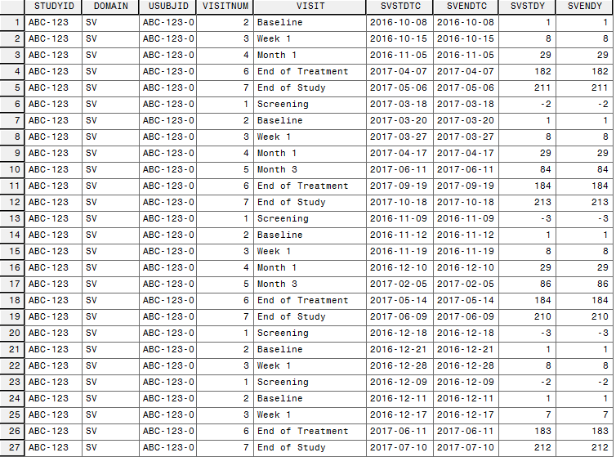
Example SV dataset

Slide 20
Program Flow: SV
%sv_create
(dm=sdtm.dm
,out=sv10
,visitnum_list=
(1
,2
,3
,4
,5
,6
,7
)
,visit_list=
(Screening
,Baseline
,Week 1
,Month 1
,Month 3
,End of Treatment
,End of Study
)
,reference_list=
(rficdtc
,rfstdtc
,rfstdtc
,rfstdtc
,rfstdtc
,rfxendtc
,rfendtc
)
,target_list=
(0
,0
,7
,28
,84
,0
,0
)
,delta_list=
(0
,0
,1
,2
,3
,3
,0
)
,duration_list=
(1
,1
,1
,1
,1
,1
,1
)
,missingprob=0.05
);

Slide 21
Example SV dataset

Slide 22
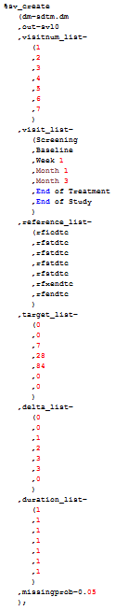
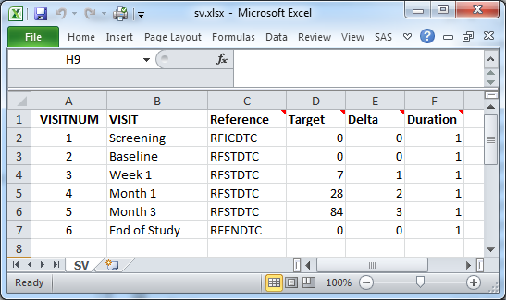
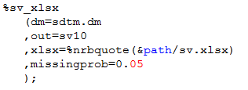
SV via XLSX

Slide 23
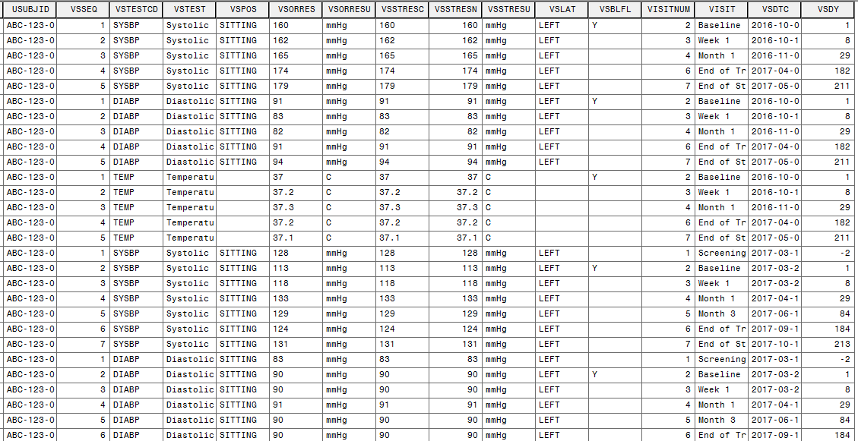
Example VS dataset

Slide 24
Program Flow: VS
%findings_create
(sv=sdtm.sv
,domain=vs
,out=vs10
,testcd_list=
(SYSBP
,DIABP
,TEMP
)
,test_list=
(Systolic Blood Pressure
,Diastolic Blood Pressure
,Temperature
)
,stresu_list=
(mmHg
,mmHg
,C
)
,mean_list=
(140
,90
,37
)
,stddev_list=
(15
,10
,0.2
)
,precision_list=
(1
,1
,0.1
)
,pos_list=
(SITTING
,SITTING
,missing
)
,lat_list=
(LEFT
,LEFT
,missing
)
,blvisitnum=2
,missingprob=0.01
);

Slide 25
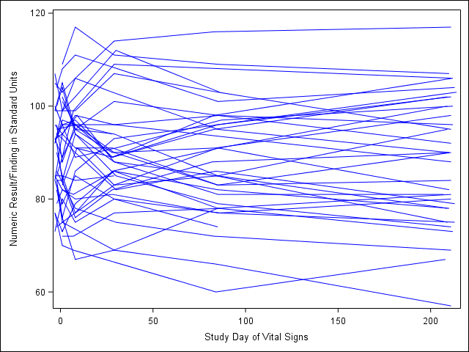
Correlated numeric values

Slide 26
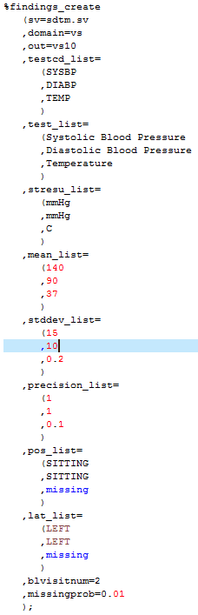
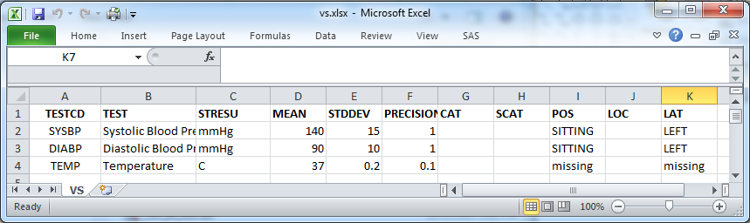
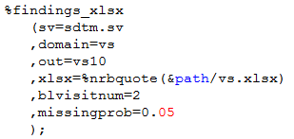
VS via XLSX

Slide 27
But wait, there's more…
%findings_create(…, domain=lb, …)
%findings_xlsx(…, domain=lb, …)
%findings_create(…, domain=eg, …)
%findings_xlsx(…, domain=eg, …)
Only have metadata to support EG, LB, VS at present
But more metadata could easily be added
Adding more macro parameters would be the bigger issue.
cat_list, scat_list, method_list
Not too difficult, but more difficult than adding metadata

Slide 28
Limitations
No Trial domains
No other findings metadata
No other common datasets
MH, CM, EX, etc.
Assumes you have screening and follow-up
Assumes parallel groups
Assumes dozens of other things

Slide 29
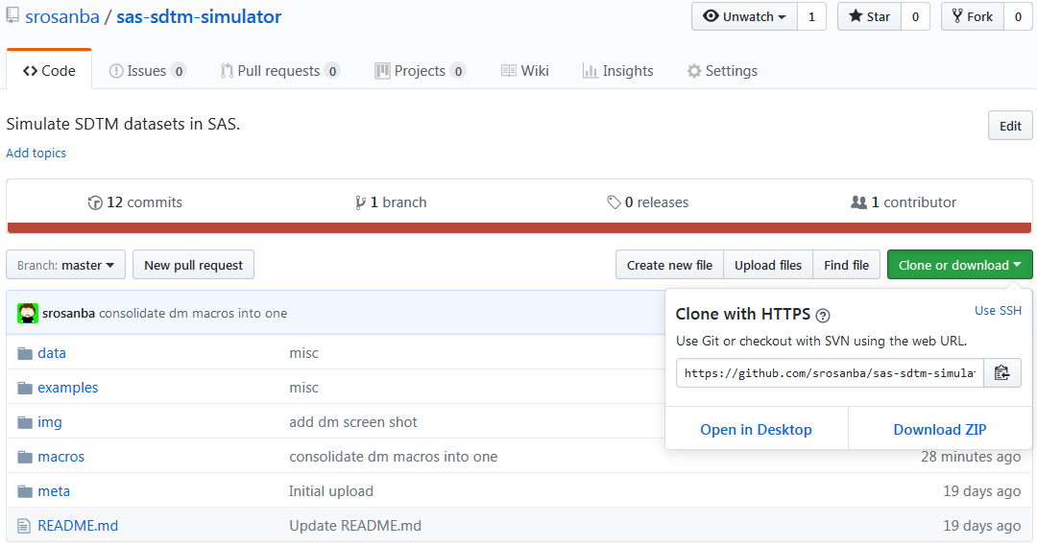
GitHub
https://github.com/srosanba/sas-sdtm-simulator

