Slide 1
Introduction to the SDTM Simulator
by Shane Rosanbalm

Slide 2
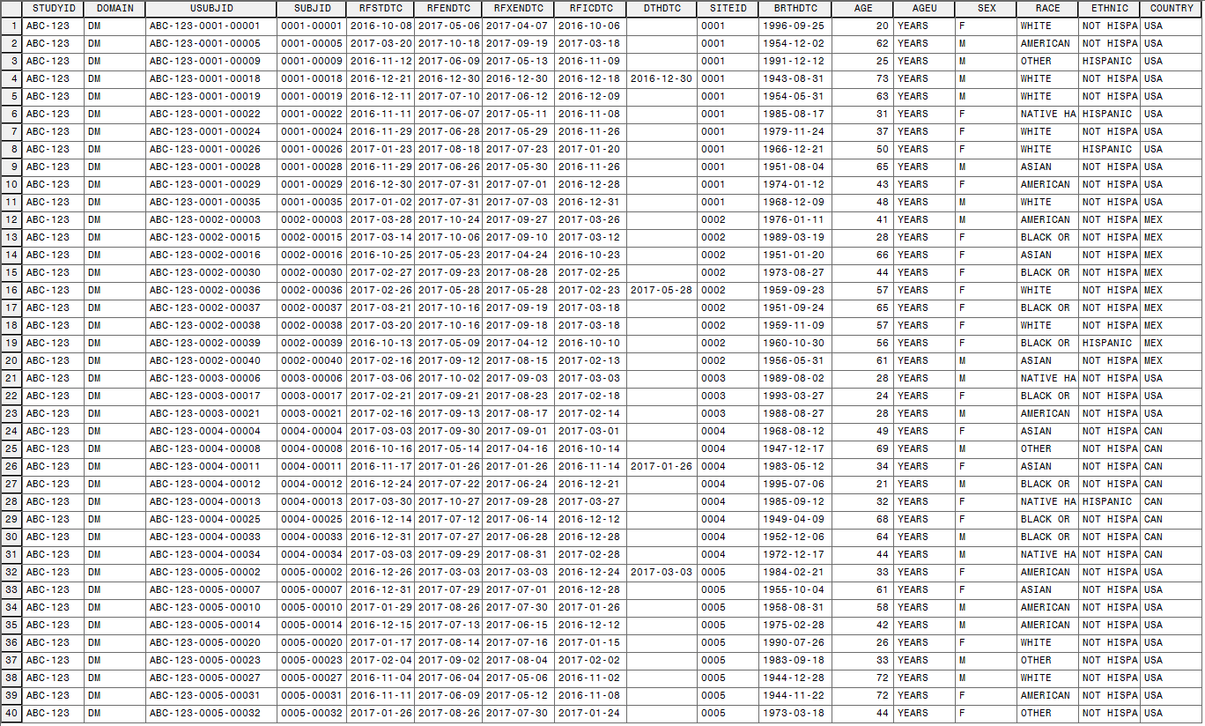
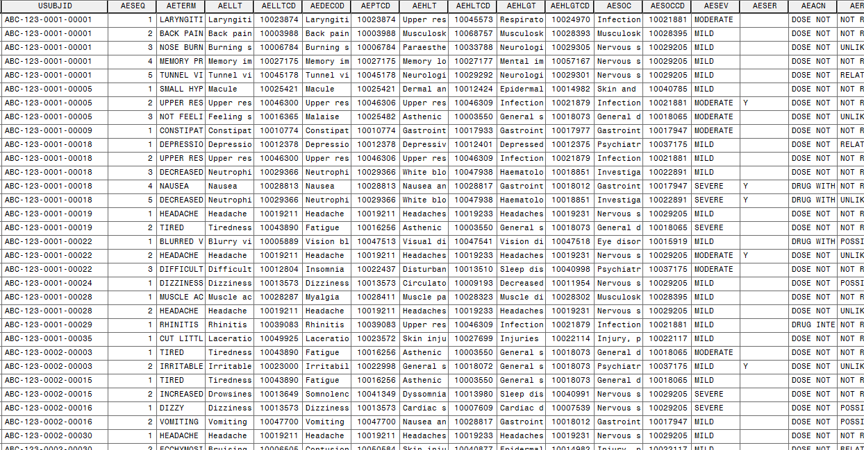
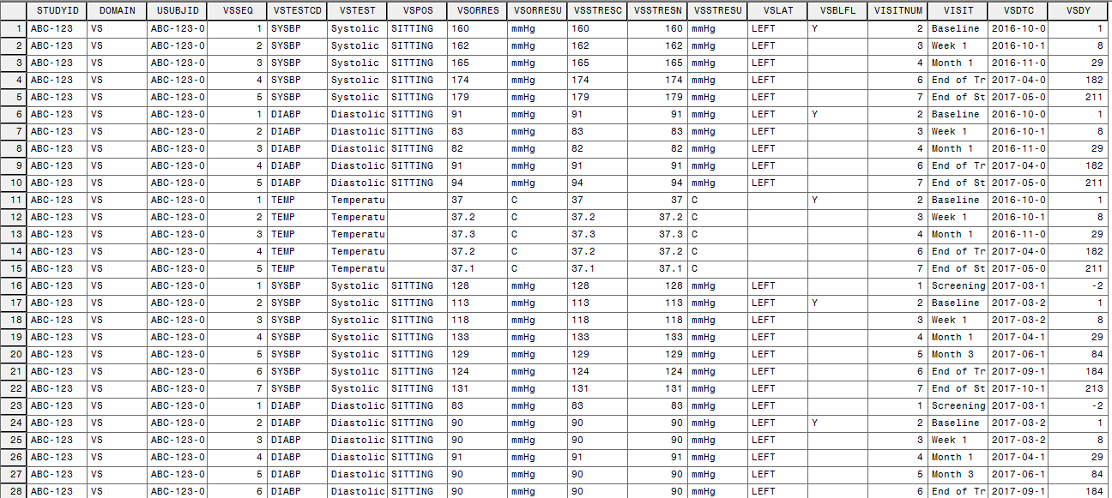
What does it do?

Slide 3
Why does it exist?
You may have heard that we had some clinical data stolen last year.
We were using real (deidentified) clinical data on a cloud hosting service to test a new tool (ChartFoundry) because ... well, because that was the only decent option available.
After that painful experience, we decided to invest in a set of more robust tools for data simulation.

Slide 4
When might you use it?
Graphics
You want to demonstrate software capabilities to a client whom you've never worked with before
Stat Prog
You need some SDTM data for a SUG paper
You've got tight timelines and can't wait for "real" SDTM datasets before you start your ADaM work
You need to create a mock figure

Slide 5
Current capabilities
Demographics (DM)
Events (AE)
Subject Visits (SV)
Findings (EG, LB, VS)
DM
SV
AE
Findings

Slide 6
Program Flow: DM
%dm_create
(out=dm10
,subjid_n=40
,siteid_n=5
,country_list=(USA,CAN,MEX)
,country_table=(.6,.2,.2)
,fpfvdt=01oct2016
,lpfvdt=01apr2017
,screendur=3
,treatmentdur=182
,followupdur=28
,deathprob=0.05
,sex_table=(.6,.4)
);

Slide 7
Example DM dataset

Slide 8
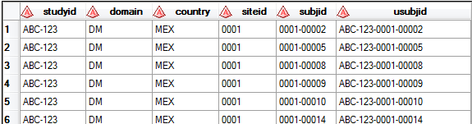
Program Flow: DM
%dm_create
(out=dm10
,subjid_n=40
,siteid_n=5
,country_list=(USA,CAN,MEX)
,country_table=(.6,.2,.2)
…
Create subjects along with their sites and countries

Slide 9
Example DM dataset

Slide 10
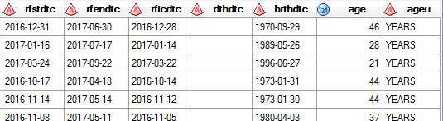
Program Flow: DM
%dm_create
(…
,fpfvdt=01oct2016
,lpfvdt=01apr2017
,screendur=3
,treatdur=182
,followupdur=28
,deathprob=0.05
…
Start date, end date, date of birth, etc.

Slide 11
Example DM dataset

Slide 12
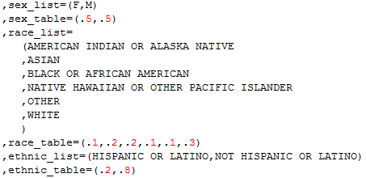
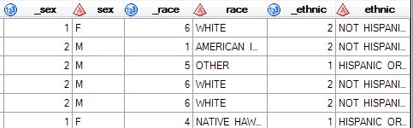
Program Flow: DM
%dm_create
(…
,sex_table=(.6,.4)
);
Sex, race, ethnicity

Slide 13
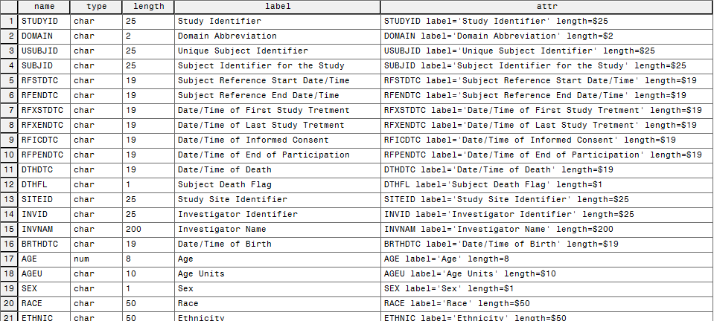
DM metadata
dm_meta.sas creates metadata for all allowable DM variables

Slide 14
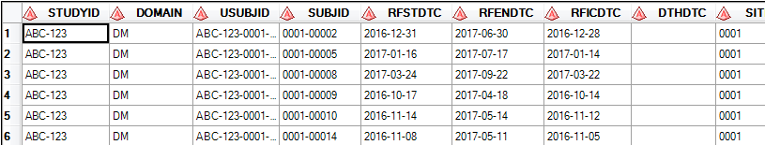
Program Flow: DM
%sdtm_attrs
(data=dm10
,out=sdtm.dm
,domain=dm
);
Apply metadata from dm_meta

Slide 15
Program Flow: DM
%dm_create
(out=dm10
,subjid_n=40
,siteid_n=5
,country_list=(USA,CAN,MEX)
,country_table=(.6,.2,.2)
,fpfvdt=01oct2016
,lpfvdt=01apr2017
,screendur=3
,treatmentdur=182
,followupdur=28
,deathprob=0.05
,sex_table=(.6,.4)
);
%sdtm_attrs
(data=dm10
,out=sdtm.dm
,domain=dm
);

Slide 16
Example AE dataset

Slide 17
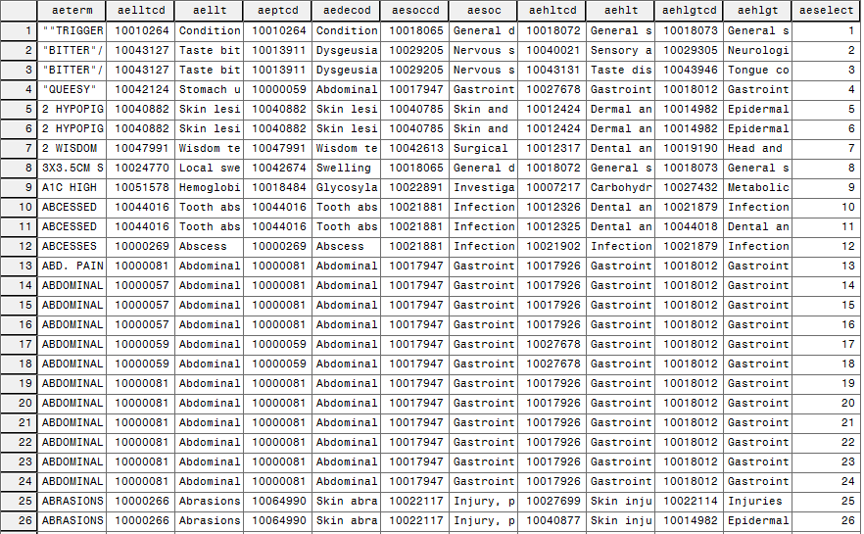
META.AESELECT

Slide 18
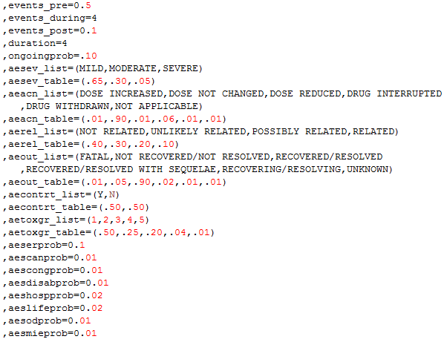
AE customization

Slide 19
Program Flow: AE
%events_create
(dm=sdtm.dm
,domain=ae
,meddra=meta.aeselect
,out=ae10
,events_pre=0.2
,events_during=2
,events_post=0.1
,duration=4
,aesev_table=(.65,.20,.15)
,aeserprob=.10
,aeshospprob=.05
);
Followed by a call to %sdtm_attrs().
Inputs
Output
Number of events in each period (Poisson)
Other customizations

Slide 20
Example AE dataset

Slide 21
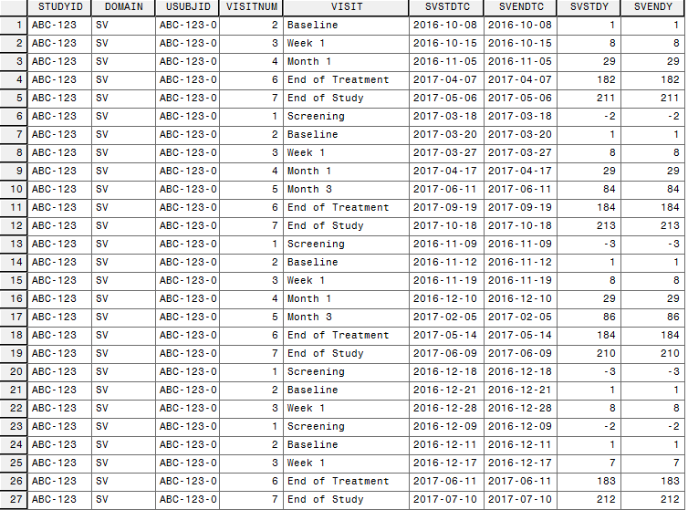
Example SV dataset

Slide 22
Program Flow: SV
%sv_create
(dm=sdtm.dm
,out=sv10
,visitnum_list=
(1
,2
,3
,4
,5
,6
,7
)
,visit_list=
(Screening
,Baseline
,Week 1
,Month 1
,Month 3
,End of Treatment
,End of Study
)
,reference_list=
(rficdtc
,rfstdtc
,rfstdtc
,rfstdtc
,rfstdtc
,rfxendtc
,rfendtc
)
,target_list=
(0
,0
,7
,28
,84
,0
,0
)
,delta_list=
(0
,0
,1
,2
,3
,3
,0
)
,duration_list=
(1
,1
,1
,1
,1
,1
,1
)
,missingprob=0.05
);

Slide 23
Example SV dataset

Slide 24
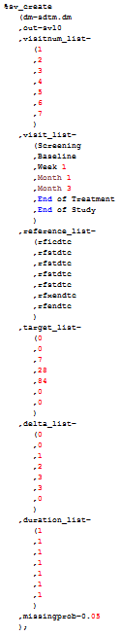
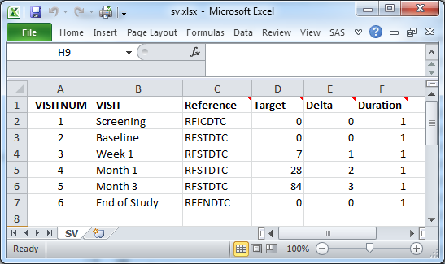
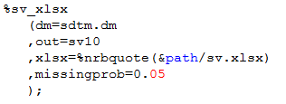
SV via XLSX

Slide 25
Example VS dataset

Slide 26
Program Flow: VS
%findings_create
(sv=sdtm.sv
,domain=vs
,out=vs10
,testcd_list=
(SYSBP
,DIABP
,TEMP
)
,test_list=
(Systolic Blood Pressure
,Diastolic Blood Pressure
,Temperature
)
,stresu_list=
(mmHg
,mmHg
,C
)
,mean_list=
(140
,90
,37
)
,stddev_list=
(15
,10
,0.2
)
,precision_list=
(1
,1
,0.1
)
,pos_list=
(SITTING
,SITTING
,missing
)
,lat_list=
(LEFT
,LEFT
,missing
)
,blvisitnum=2
,missingprob=0.01
);

Slide 27
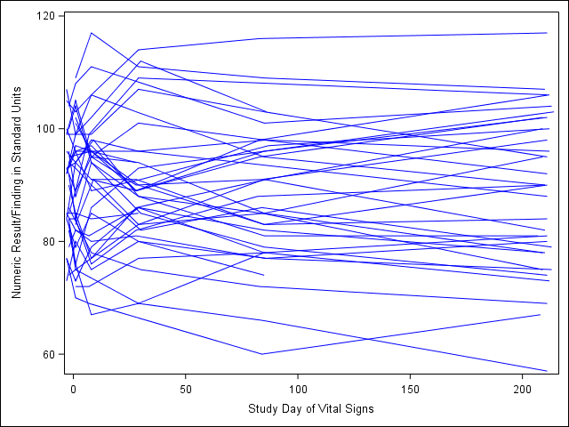
Correlated numeric values

Slide 28
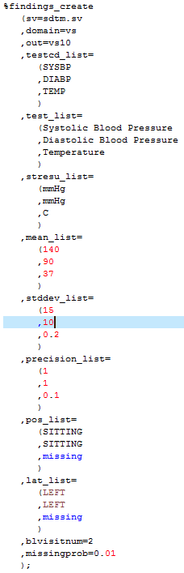
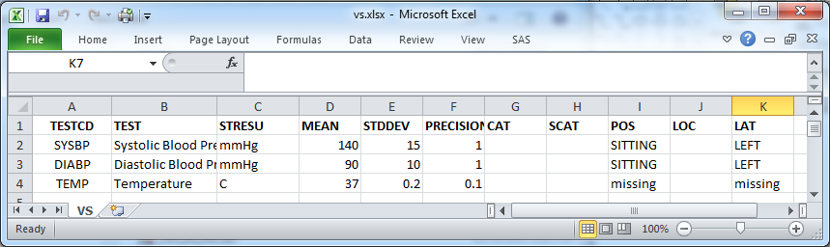
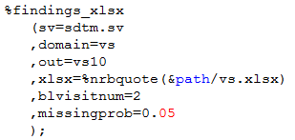
VS via XLSX

Slide 29
But wait, there's more…
%findings_create(…, domain=lb, …)
%findings_xlsx(…, domain=lb, …)
%findings_create(…, domain=eg, …)
%findings_xlsx(…, domain=eg, …)
Only have metadata to support EG, LB, VS at present
But more metadata could easily be added
Adding more macro parameters would be the bigger issue.
cat_list, scat_list, method_list
Not too difficult, but more difficult than adding metadata

Slide 30
Limitations
No Trial domains
No other findings metadata
No other common datasets
MH, CM, EX, etc.
Assumes you have screening and follow-up
Assumes parallel groups
Assumes dozens of other things

Slide 31
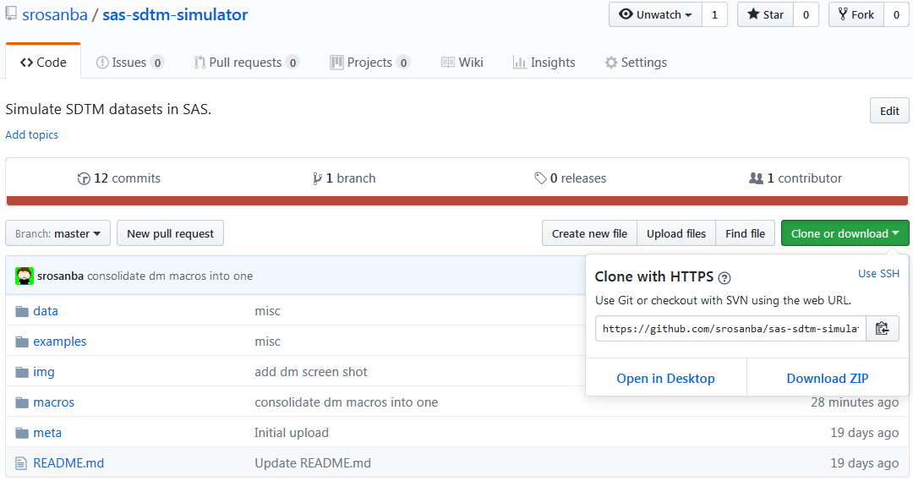
GitHub
https://github.com/srosanba/sas-sdtm-simulator

Slide 32
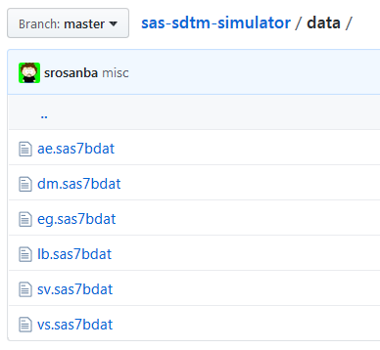
Unboxing

Slide 33
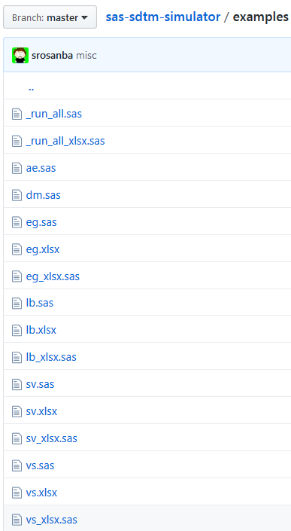
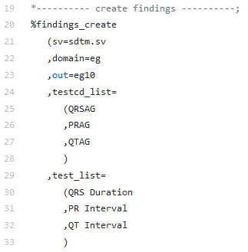
Unboxing

Slide 34
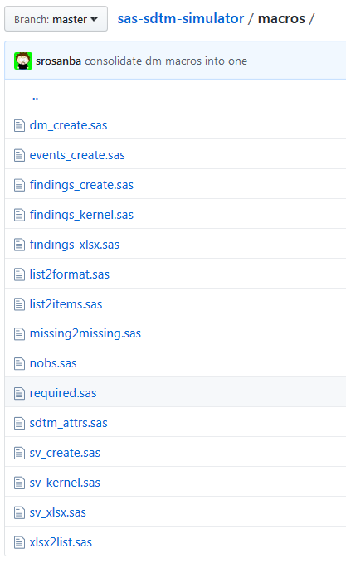
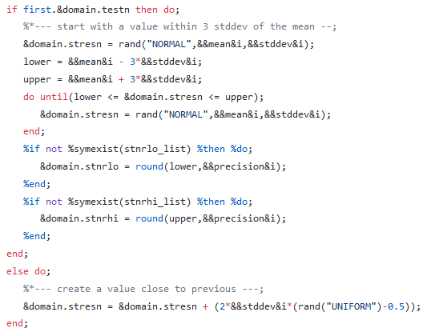
Unboxing

Slide 35
Questions?

