Slide 1
Introduction to Statistical Investigations
Second Edition
Tintle, Chance, Cobb, Rossman, Roy, Swanson, VanderStoep
Chapter 2.1
Generalization: How Broadly Do the Results Apply?
Sampling from a Finite Population: Proportions
This slide deck contains animations. Please disable animations if they cause issues with your device.
Copyright ©2021 John Wiley & Sons, Inc.

Slide 2
Warm-Up #1
For the hot-dog-is-a-sandwich study, discuss with your neighbor:
What are the observational units?
What is the variable(s)?

Slide 3
Statistic and Parameter
So far in our study of tests of significance we’ve focused on process probabilities.
Is the probability that Buzz will push the correct button more than 0.5?
Is the probability that scissors will be thrown less than
Is it likely that less than 50% of the class will think a hot dog is a sandwich?

Slide 4
Statistic and Parameter
With Buzz, the statistic was the proportion of times Buzz pushed the correct button in the trials we looked at and the parameter was Buzz’s probability (long-run proportion) of pushing the correct button.
We used this sample statistic to tell us something about the parameter.

Slide 5
Generalization
Now we want to focus more on finite populations instead of an infinite process.
Typically the entire population is not measured for what we are interested in and it is difficult to do so (this would be taking a census).
We, therefore, take samples (some subgroup of the population) to give us information we want about a population.
We want to generalize the information from the sample to the population.
In this section, we will look at how to collect a sample that we feel is representative of the larger population.

Slide 6
Example 2.1: Voter Turnout
In 2018, the General Social Survey (GSS) asked if the respondent voted in the 2016 U.S. Presidential Election.
Of the 2,181 eligible voters surveyed, 1,523 (69.8%) of them said yes.
But the United States Election Project said there were 230,931,921 citizens eligible to vote in that election and only 136,753,936 (59.2%) of them voted.
Why aren’t these two percentages that represent voter turnout the same?

Slide 7
Example 2.1: Population and Sample
Perhaps the respondents to the GSS (the sample) were not representative of all eligible voters (the population).
The population is the entire collection of observational units we are interested in, and the sample is a subset of the population on which we record data.
What would convince you that GSS respondents are representative of the larger population?

Slide 8
Example 2.1: Population and Sample
Perhaps the respondents to the GSS (the sample) were not representative of all eligible voters (the population).
The population is the entire collection of observational units we are interested in, and the sample is a subset of the population on which we record data.
What would convince you that GSS respondents are representative of the larger population?
They need to come from all over the country.
Everyone in the voting-eligible population could potentially be selected for the survey.

Slide 9
Example 2.1: Nonrandom Samples
We wouldn’t want to do a call-in survey, where only the proudest Americans replied.
Or just sample from some convenient areas of the country.
A convenience sample is a nonrandom sample of a population. Voluntary response, like a phone-in or mail-in survey, is a common type of convenience sample.
Convenience samples often over sample certain segments of the population that can result in over or under-estimating the true population parameter.

Slide 10
Example 2.1: Biased Sampling Method
A sampling method is biased if statistics from samples consistently over or under-estimate the population parameter.
Bias is a property of a sampling method, not the sample.
A method must consistently produce non-representative results to be considered biased.

Slide 11
Example 2.1: Simple Random Sample
To prevent bias, we select a random sample, such as a simple random sample (SRS). How is this a better way of selecting a representative sample?
A simple random sample ensures that every sample of size n is equally likely to be the sample selected.
This also means that each observational unit in the population has an equal chance of being selected.

Slide 12
Example 2.1: Sampling Frame
A random sample is very different than “randomly asking your friends.”
To create a simple random sample, you need a sampling frame (a list of all individuals in the population).
Then have a computer randomly select names from the sampling frame.

Slide 13
Example 2.1: General Social Survey
Does the General Social Survey use a simple random sample?
It is unlikely that the GSS has a complete sampling frame, such as a list of all adults in the United States.
However, the GSS uses a method that tries to ensure that each U.S. adults has the same probability of being chosen as every other U.S. adult and thus makes the sample representative of the population.
Why are the GSS results so different from the actual results? Was it just by random chance?

Slide 14
Example 2.1: Sampling Students (1 of 13)
To explore a whether the difference between a sample proportion and a population proportion is due to random chance, we need to explore distributions of sample proportions where we have access to the entire population.
We will look at data collected from the registrar’s office from a small college in the Midwest.
Of the 2,919 students in this population, we know that 77.6% of them lived on campus.

Slide 15
Example 2.1: Sampling Students (2 of 13)
We usually don’t have information on an entire population like we do here.
We usually need to make inferences about a population based on a sample.
Suppose a researcher asks the first 30 students he finds on campus one morning whether they live on campus. This would be a quick and convenient way to get a sample.
We suspect that this will lead to an overestimate of the proportion of students who live on campus. Why?

Slide 16
Example 2.1: Sampling Students (3 of 13)
To get a representative sample, we could take a simple random sample of 30 students from the college.
Represent each student by ID numbers 1 to 2919
Have the computer randomly select 30 numbers between 1 and 2,919
The table on the next slide shows one such sample.

Slide 17
Example 2.1: Sampling Students (4 of 13)
I D s of the 30 people selected, along with their residential status
ID | On campus? | ID | On campus? | ID | On campus?
827 | Y | 844 | N | 825 | Y
1355 | Y | 90 | Y | 2339 | N
1455 | Y | 1611 | Y | 2064 | Y
2391 | Y | 2550 | Y | 2604 | Y
575 | Y | 2632 | Y | 2147 | Y
2049 | N | 2325 | Y | 2590 | Y
895 | N | 2563 | Y | 1718 | Y
1732 | Y | 1819 | N | 168 | Y
2790 | Y | 968 | Y | 1777 | Y
2237 | Y | 566 | N | 2077 | Y

Slide 18
Example 2.1: Sampling Students (5 of 13)
What proportion live on campus?
is the sample proportion
The symbol that corresponds to
but describes the population
proportion, not the sample proportion, is π

Slide 19
Example 2.1: Sampling Students (6 of 13)
is close to the population value?
A different sample of 30 students would probably have had a different value
How are these statistics useful in estimating the population parameter values?
Let’s take more simple random samples of 30 students to examine the null distribution of the statistics from other samples.
How do we know if

Slide 20
Example 2.1: Sampling Students (7 of 13)
We took 5 different SRS s of 30 students
Each sample gives different statistics
This is called sampling variability
The statistics from each sample don’t change much:
Sample proportions from 0.63 to 0.83

Slide 21
Example 2.1: Sampling Students (8 of 13)

Slide 22
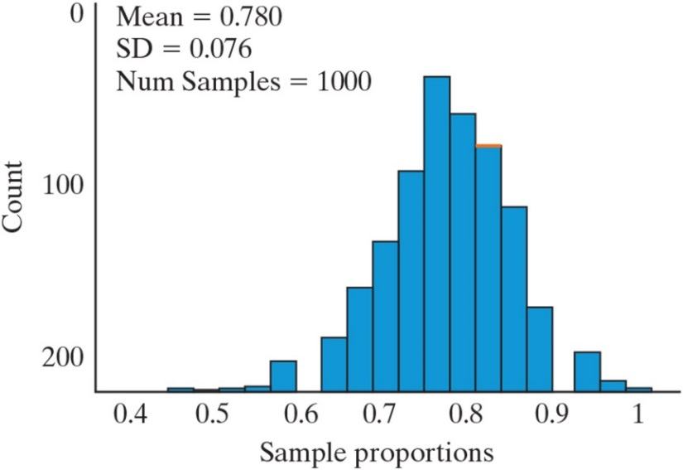
Example 2.1: Sampling Students (9 of 13)
We took 1,000 simple random samples and the graph below is of the 1,000 sample proportions (for living on campus).
The mean of the distribution falls near the population parameter

Slide 23
Example 2.1: Sampling Students (10 of 13)
What would happen if we took all possible random samples of 30 students from this population?
The average of the sample proportions would match the population proportion exactly
Statistics computed from simple random samples cluster around the parameter
There is no tendency to over or underestimate the parameter
Simple random sampling is an unbiased method of sampling for a sample proportion

Slide 24
Example 2.1: Sampling Students (11 of 13)
We can generalize when we use simple random sampling because it creates:
A sample that is representative of the population
A sample statistic that is close to the parameter

Slide 25
Example 2.1: Sampling Students (12 of 13)
But what about the standard deviation?
When the population size is large, we can predict the sample-to-sample variation in sample proportions:
For this example, we get:

Slide 26
Example 2.1: Sampling Students (13 of 13)
When sampling from a large population, the standard deviation of sample proportions is estimated by the
formula,
where π is the proportion of
success in the population and n is the sample size.
The population is considered large enough when it is more than 20 times the sample size.

Slide 27
Example 2.1: The Central Limit Theorem
The Central Limit Theorem for sampling from a large finite population says that the distribution of sample proportions from repeated random samples will be approximately normal if there are at least 10 successes and at least 10 failures in each sample.

Slide 28
Example 2.1: Back to Voter Turnout
, with a sample size of n = 2,181.
We would like to make inferences about the parameter of interest, π, the proportion of all eligible voters in 2016 who voted in the presidential election.
Is it plausible that we would observe a sample proportion of 0.698 if the population proportion is equal to 0.592?
The observed sample proportion was

Slide 29
Example 2.1: Using the Central Limit Theorem
We can assume the distribution of sample proportions is approximately normal. (Why?)
With of mean of 0.592
And SD of
This means the sample proportion from the GSS has a standardized statistic of:

Slide 30
Example 2.1: Strong Evidence
With a standardized statistic of 10.10, we have very strong evidence that this difference did not arise from random chance alone.
What could be another explanation for this difference between sample proportion of voters and population proportion of voters?

Slide 31
Example 2.1: Nonsampling Concerns (1 of 2)
When a question is posed to someone in a poll that has a socially desirable response (like you voted), individuals will sometimes overestimate or incorrectly recall their past behavior.
In this case, we have reason to believe that the difference between 0.698 and 0.592 is not due to a badly collected sample (a “sampling concern”) or due to random chance, but rather due to individuals not being honest in their responses.
This is a type of nonsampling concern.

Slide 32
Example 2.1: Nonsampling Concerns (2 of 2)
In addition to carefully selecting the sample, you need to guard against other possible sources of bias as well.
For example, when talking to people, their memories and truthfulness can impact their answers.
Other examples of nonsampling concerns include:
The effects that the wording of a question can have on responses
The effects that interviewers can have by virtue of their demeanor, sex, race and other characteristics
Using an uncalibrated scale, etc.

Slide 33

Cool-Down #1
1.5.1: Which long-run proportion of success, $π$, gives the largest standard deviation of the null distribution when the sample size is 10?
A. 0.05 B. 0.25 C. 0.50 D. 0.90

Slide 34
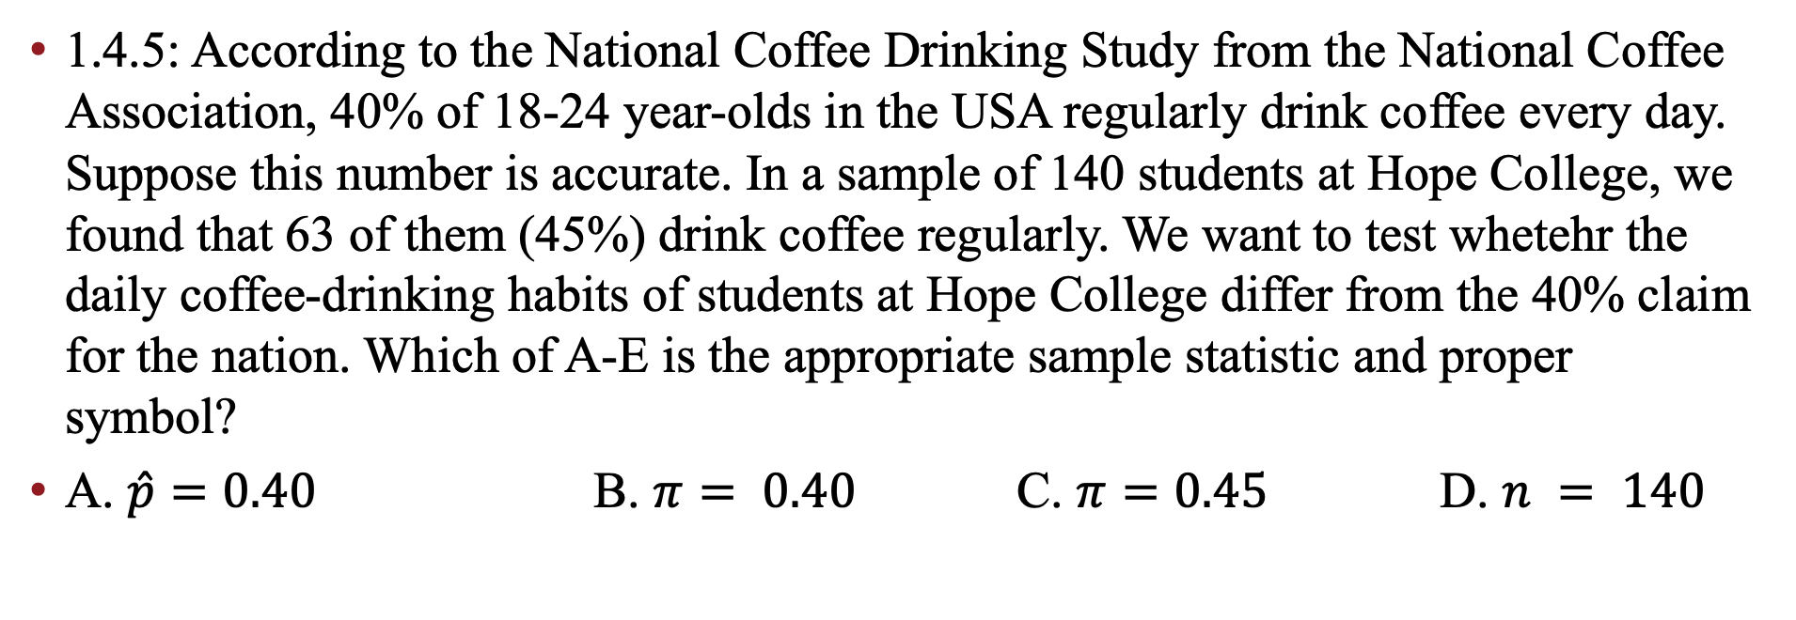
Cool-Down #2
1.4.5: According to the National Coffee Drinking Study from the National Coffee Association, 40% of 18-24 year-olds in the USA regularly drink coffee every day. Suppose this number is accurate. In a sample of 140 students at Hope College, we found that 63 of them (45%) drink coffee regularly. We want to test whetehr the daily coffee-drinking habits of students at Hope College differ from the 40% claim for the nation. Which of A-E is the appropriate sample statistic and proper symbol?
A. $\hat{p}=0.40$ B. $π= 0.40$ C. $π=0.45$ D. $n = 140$

Slide 35
Cool-Down #3
2.1.8: The administration at a local high school is considering building a new gym. In order to find out how the student body feels about this, a student organization decides to conduct a survey of the students. Which of the sampling methods in A-D is a simple random sample from all the students at the school?
A. Survey random students who are leaving after school sports practices.
B. Randomly select 40 students in each grade level and survey the selected students.
C. Randomly select two homeroom classes from the 50 homeroom classes at the school and survey all students from those two classes.
D. Obtain a list of all students attending the high school, randomly select students from the list, and survey the students selected.

