Slide 1
Introduction to Statistical Investigations
Second Edition
Tintle, Chance, Cobb, Rossman, Roy, Swanson, VanderStoep
Chapter 1.4
Significance: How Strong is the Evidence?
1.4: What Impacts Strength of Evidence?
This slide deck contains animations. Please disable animations if they cause issues with your device.
Copyright ©2021 John Wiley & Sons, Inc.

Slide 2
Quizzes
Study your quiz and figure out what the correct answers/processes are
You can correct your quiz, from now until March 5th
You can attempt up to two times
You get to see your previous attempts, and a calculator.
You'll have at most 25 minutes to do complete it.

Slide 3
Example 1.4: Predicting Elections
Do voters make judgments about candidates based on facial appearances?
More specifically, can you predict an election by choosing the candidate whose face is more competent-looking?
Participants were shown two candidates and asked who has the more competent-looking face.

Slide 4
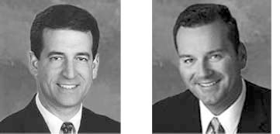
Who Has the More Competent Looking Face?
2004 Senate Candidates from Wisconsin

Slide 5
Who Has the More Competent Looking Face?
2004 Senate Candidates from Wisconsin
Winner
Loser

Slide 6
Example 1.4: Predicting Elections (1 of 4)
They determined which face was the more competent for the 32 Senate races in 2004.
What are the observational units?
What is the variable measured?

Slide 7
Example 1.4: Predicting Elections (1 of 4)
They determined which face was the more competent for the 32 Senate races in 2004.
What are the observational units?
The 32 Senate races
What is the variable measured?
Whether the method predicted the winner correctly

Slide 8
Example 1.4: Predicting Elections (2 of 4)
Null hypothesis: The probability this method predicts the winner equals 0.50. (H₀ : π = 0.50)
Alternative hypothesis: The probability this method predicts the winner is greater than 0.50. (H₀ : π > 0.50)
This method correctly predicted 23 of 32 races, hence

Slide 9
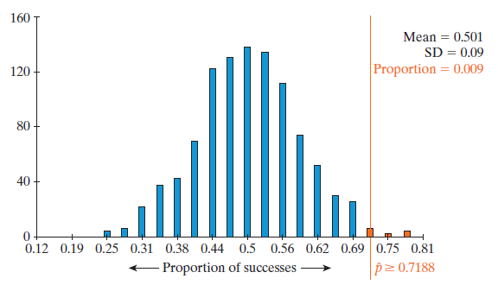
Example 1.4: Predicting Elections (3 of 4)
1,000 simulated sets of 32 races using the One Proportion applet.

Slide 10
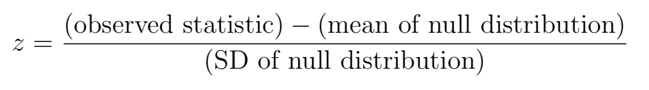
What is the p-value? What is the z-score?

Slide 11
Is it good? – p-value
p-value | Evidence Against Null
above 0.10 | not much
between 0.5 and 0.10 | moderate
between 0.01 and 0.05 | strong
below 0.01 | very strong

Slide 12
Is it good? – standardized statistic
Standardized Statistic | Evidence Against Null
between −1.5 and 1.5 | not much
below −1.5 or above 1.5 | moderate
below −2 or above 2 | strong
below −3 or above 3 | very strong
very
strong
weak
weak
very
strong
strong
strong
-3
-2
-1
0
1
2
3
Strength of evidence against H₀ for various values of z

Slide 13
Example 1.4: Predicting Elections (4 of 4)
With a p-value of 0.009 we have strong evidence against the null hypothesis.
When we calculate the standardized statistic, we again show strong evidence against the null.

Slide 14
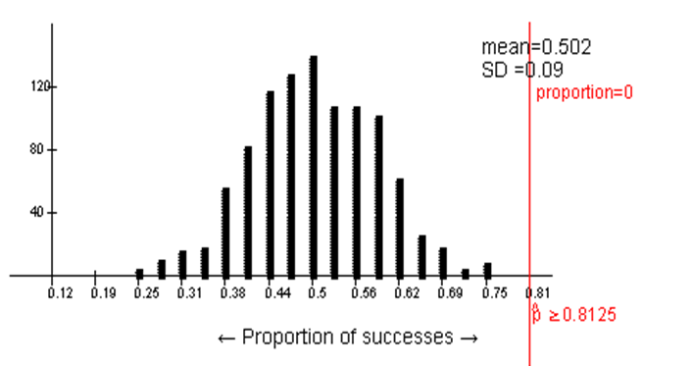
Example 1.4: Difference Between Observed Statistic and the Null Parameter (1 of 2)
What if researchers correctly predicted 26 elections instead of 23?
never occurs just by chance
hence the p-value is 0.

Slide 15
Example 1.4: Difference Between Observed Statistic and the Null Parameter (2 of 2)
The farther away the observed statistic is from the average value of the null distribution (or π₀), the more evidence there is against the null hypothesis.

Slide 16
Example 1.4: What Affects the Strength of Evidence?
The difference between the observed statistic
and null hypothesis parameter
Sample size.
Whether we do a one or two-sided test.

Slide 17
Example 1.4: Sample Size (1 of 4)
Suppose the sample proportion stays the same, do you think increasing sample size will increase, decrease, or have no impact on the strength of evidence against the null hypothesis?

Slide 18
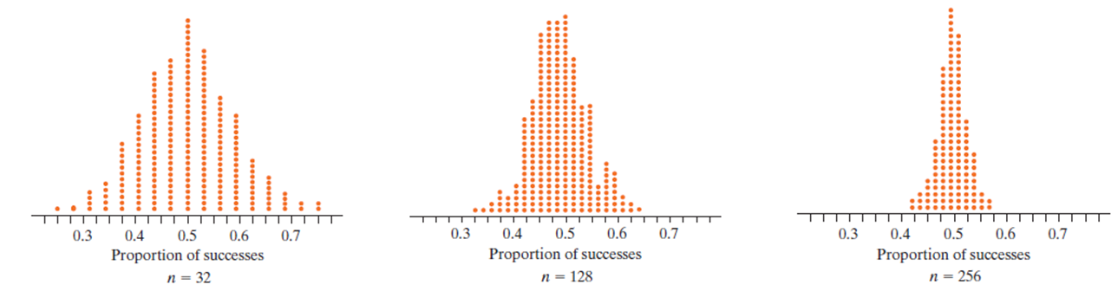
Example 1.4: Sample Size (2 of 4)
The null distribution changes as we increase the sample size from 32 senate races to 128 races to 256 races.
As the sample sizes increases, the variability (standard deviation) in the simulated statistics (sample proportions) decreases.

Slide 19
Example 1.4: Sample Size (3 of 4)
What does decreasing variability mean for statistical significance (with same sample proportion)?
32 elections
p-value = 0.009 and z = 2.43
128 elections
p-value = 0 and z =5.07
256 elections
Even stronger evidence
p-value = 0 and z = 9.52

Slide 20
Reminder
p-value | Evidence Against Null
above 0.10 | not much
between 0.5 and 0.10 | moderate
between 0.01 and 0.05 | strong
below 0.01 | very strong
Standardized Statistic | Evidence Against Null
between −1.5 and 1.5 | not much
below −1.5 or above 1.5 | moderate
below −2 or above 2 | strong
below −3 or above 3 | very strong

Slide 21
Example 1.4: Sample Size (4 of 4)
As the sample size increases, the variability in simulated sample proportions (the null distribution SD) decreases.
Therefore, as the sample size increases, the evidence against the null hypothesis increases (as long as the sample proportion stays the same and is in the direction of the alternative hypothesis).

Slide 22
Example 1.4: Two-Sided Tests (1 of 5)
What if researchers were wrong; instead of the person with the more competent face being elected more frequently, it was actually less frequently?
With our original alternative, if we get a sample proportion less than 0.50, we would get a very large p-value.
This is a one-sided test.
Often one-sided is too restrictive.
In fact most research uses two-sided tests.

Slide 23
Example 1.4: Two-Sided Tests (2 of 5)
In a two-sided test we have evidence in favor of the alternative hypothesis if the observed sample proportion is in either tail of the null distribution.
Null hypothesis: The probability this method predicts the winner equals 0.50.
Alternative hypothesis: The probability this method predicts the winner is not 0.50.

Slide 24
Example 1.4: Two-Sided Tests (3 of 5)
This change to the alternative hypothesis also affects how we compute the p-value.
Remember that the p-value is the probability (assuming the null hypothesis is true) of obtaining a proportion that is equal to or more extreme than the observed statistic
In a two-sided test, more extreme goes in both directions.

Slide 25
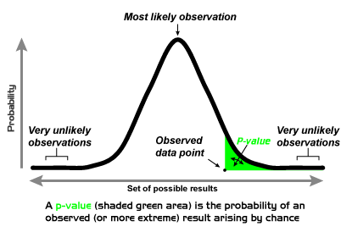
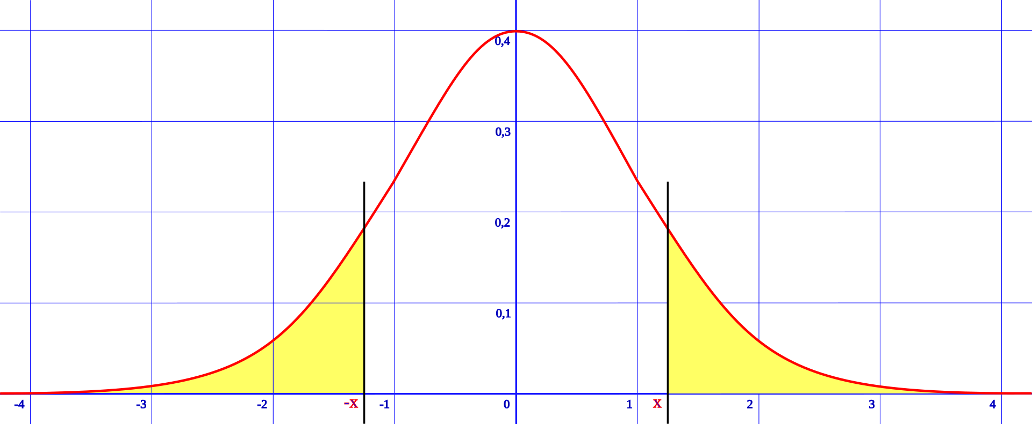
From Wikipedia

Slide 26
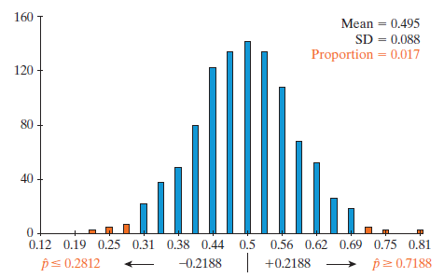
Example 1.4: Two-Sided Tests (4 of 5)
Because our sample proportion was 0.7188 and 0.7188 is 0.2188 above 0.5, we also need to look at 0.2188 below 0.50. (This gets a bit more complicated when the distribution is not symmetric, but the applet will do all the work for you.)
The p-value will include all simulated proportions 0.7188 and above as well as those 0.2812 and below.

Slide 27
Example 1.4: Two-Sided Tests (5 of 5)
0.7188 or greater was obtained 9 times
0.2812 or less was obtained 8 times
The p-value is
Two-sided tests increase the p-value (it about doubles) and hence decrease the strength of evidence.
Two-sided tests are said to be more conservative. More evidence is needed to conclude alternative.

Slide 28
Example 1.4: Predicting House Elections (1 of 4)
Researchers also predicted the 279 races for the House of Representatives in 2004.
They correctly predicted the winner in
of the races.
The House’s sample percentage (67.7%) is bit smaller than the Senate’s (71.9%), but the House’s sample size is larger (279) than for the senate races (32).
Do you expect the strength of evidence to be stronger, weaker, or essentially the same for the House compared to the Senate?

Slide 29
Example 1.4: Predicting House Elections (2 of 4)
Distance of the observed statistic to the null hypothesis value
The observed statistic in the House is 0.677 compared to 0.719 in the Senate
Slight decrease in the strength of evidence
Sample size
The sample size is almost 10 times as large (279 vs. 32) in the House compared to the Senate
This will increase the strength of evidence

Slide 30
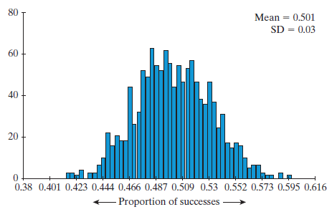
Example 1.4: Predicting House Elections (3 of 4)
Null distribution of 279 sample House races
Simulated statistics ≥ 0.677 didn’t occur hence the p-value is approximately 0

Slide 31
Example 1.4: Predicting House Elections (4 of 4)
What about the standardized statistics?
For the Senate it was 2.43
For the House it is 5.90.
The larger sample size for the House trumped its smaller proportion, so we have stronger evidence against the null using the data from the House.

