Slide 1
Introduction to Statistical Investigations
Second Edition
Tintle, Chance, Cobb, Rossman, Roy, Swanson, VanderStoep
Chapter 1.5
Significance: How Strong is the Evidence?
Inference for a Single Proportion: Theory-Based Approach
This slide deck contains animations. Please disable animations if they cause issues with your device.
Copyright ©2021 John Wiley & Sons, Inc.

Slide 2
Simulation-Based vs. Theory-Based
We will now look at the more traditional method of determining a p-value through theory-based techniques.
When we used simulation-based methods, we all got slightly different p-values. The more repetitions we would do, the closer our p-values were to each other.
In theory-based methods, we will use a theoretical distribution to model our null distribution and we will all get the same p-value.

Slide 3
Theory-Based Techniques
Hopefully, you’ve noticed the shape of most of our simulated null distributions were quite predictable.
We can predict this shape using normal distributions.
When we do a test of significance using theory-based methods, only how our p-values are found will change. Everything else will stay the same.

Slide 4
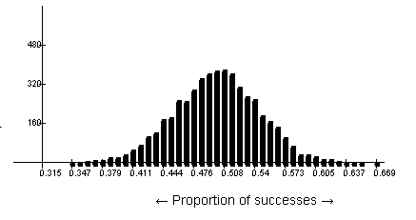
The Null Distributions
Our null distributions:
Were typically bell-shaped
Centered at the proportion under the null
Width was dependent mostly on the sample size.

Slide 5
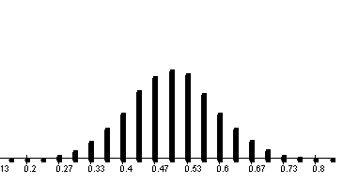
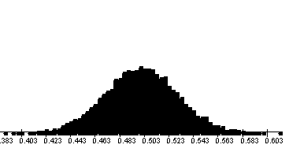
The Normal Distribution
Both of these are centered at 0.50.
The one on the left represents samples of size 30.
The one on the right represents samples of size 300.
Both could be predicted using normal distributions.

Slide 6
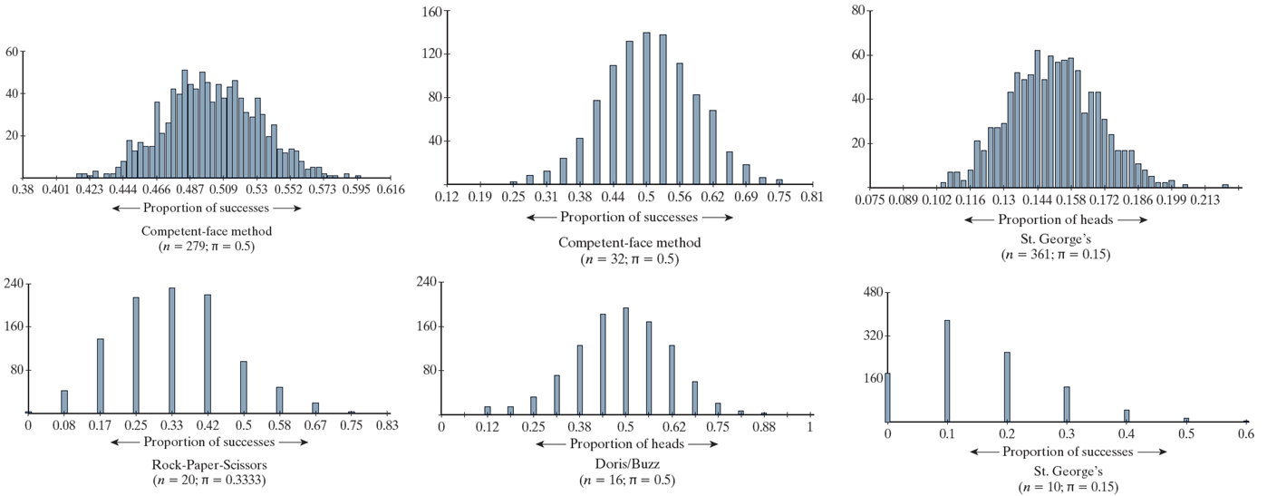
Examples from this Chapter
Which ones will normal distributions fit?
2
3
1
4
5
6

Slide 7
Advantages and Disadvantages of Theory-Based Tests
Advantages of theory-based tests
No need to set up some simulation method
Fast and easy
Can be done with a wide variety of software
We all get the same p-value.
Determining confidence intervals (we will do this in Chapter 3) is much easier.
Disadvantages of theory-based tests
They will all come with some validity conditions (like the number of successes and failures we have for a single proportion test).

Slide 8
When Can I Use a Theory-Based Test that Uses the Normal Distribution?
You should have at least 10 successes and 10 failures in your sample to be fairly confident that a normal distribution will fit the simulated null distribution nicely.

Slide 9
Senate Elections
279 races
189 successes (predicted correctly)
279-189 = 90 failures (predicted incorrectly)
Meets the validity condition?

Slide 10
Example 1.5: Predicting Standard Deviation
where π is the proportion under the null (hypothesis), and n is
the sample size.

Slide 11
Example 1.5: Central Limit Theorem
The Central Limit Theorem.
If the sample size is large enough:
The distribution of sample proportions will be bell-shaped (or normal)
Centered at the long-run proportion (π)
With a standard deviation of
This means we can predict the shape, center, and variability of a null distribution and don’t need to simulate under certain conditions (at least 10 successes and failures in our sample).

Slide 12
Do I need to simulate? Or can I use the CLT?
Rock Paper Scissors:
20 games
6 games, someone uses scissors
20-6=14 games someone does not use scissors
Harley
10 tries
9 times he goes to the correct cup
1 time he doesn't go to the correct cup
Halloween Candy:
283 kids observed
148 (52.3%) chose candy
135 (47.7%) chose toys

Slide 13
Do I need to simulate? Or can I use the CLT?
When validity conditions are not met, use simulation-based methods.

Slide 14
Example if time

Slide 15
Example 1.5: Halloween Treats (1 of 4)
Researchers investigated whether children show a preference for toys or candy
Test households in five Connecticut neighborhoods offered children two plates:
One with candy
One with small, inexpensive toys
The researchers observed the selections of 283 trick-or-treaters between ages 3 and 14.

Slide 16
Example 1.5: Halloween Treats (2 of 4)
Null: The long run proportion of trick-or-treaters who choose candy is 0.50.
Alternative: The long run proportion of trick-or-treaters who choose candy is not 0.50.
Notice we are focusing on candy but could have easily done this focusing on the toy.

Slide 17
Example 1.5: Halloween Treats (3 of 4)
283 children were observed
148 (52.3%) chose candy
135 (47.7%) chose toys
Run the applet:
What is the p-value (two-sided)?
What is the standard deviation?

Slide 18
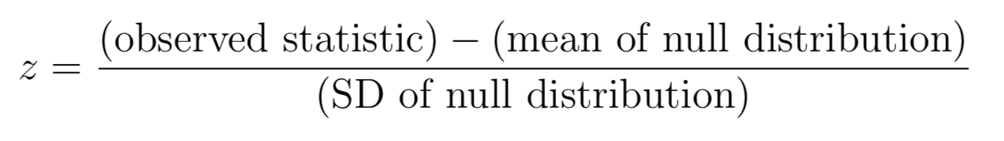
What is the standard deviation using the Central Limit Theorem?
What is the z-statistic, using that computation?

Slide 19
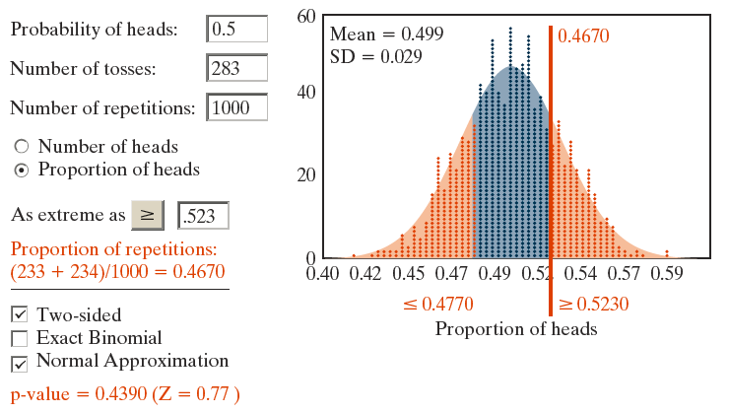
Example 1.5: Simulation- and Theory-Based Results from the One Proportion Applet

Slide 20
Example 1.5: Halloween Treats (4 of 4)
The theory-based p-value is 0.4390 so if half of the population of trick-or-treaters preferred candy, then there’s a 43.90% chance that a random sample of 283 trick-or-treaters would have 148 or more, or 135 or fewer, choose the candy.
Because it’s not a small p-value, we don’t have strong (or even moderate) evidence that trick-or-treaters prefer one type of treat over the other.

