Slide 1
Introduction to Statistical Investigations
Second Edition
Tintle, Chance, Cobb, Rossman, Roy, Swanson, VanderStoep
Chapter 4
Causation: Can We Say What Caused the Effect?
This slide deck contains animations. Please disable animations if they cause issues with your device.
Copyright ©2021 John Wiley & Sons, Inc.

Slide 2
Is this on the midterm exam?
No
It will be on the next quiz/final, though

Slide 3
Big Idea of Chapter 4 (1 of 2)
Previous research questions focused on one proportion
What proportion of the time did Buzz push the correct button?
What proportion of the time did Marine choose the correct bag?
Or one mean
How many hours, on average, do college students sleep per night?
We will now start to focus research questions on comparing two groups
Are smokers more likely than non-smokers to have lung cancer?
Are children who used night lights as infants more likely to need glasses than children who didn’t use night lights?

Slide 4
Big Idea of Chapter 4 (2 of 2)
In comparing two groups, there will be two variables
Example: smoking, lung cancer.
So with these comparisons, we will:
Determine when there is an association between our two variables.
Determine when we can conclude the outcome of one variable causes an outcome of the other.

Slide 5
Types of Variables
When two variables are involved in a study, they are often classified as explanatory and response
Explanatory variable (Independent, Predictor)
The variable we think is “explaining” the change in the response variable. (Many times, this is the variable the researchers are manipulating.)
Response variable (Dependent)
The variable we think is being impacted or changed by the explanatory variable.

Slide 6
Explanatory vs. Response
Cause
(Explanatory)
Effect
(Response)

Slide 7
Roles of Variables
Turn and talk:
Choose the explanatory (cause) and response (effect) variable:
Smoking and lung cancer
Heart disease and Diet
Time spent on social media and GPA
Hair color and eye color
Cold call: share answers & nuance
Sometimes there is a clear distinction between explanatory and response variables and sometimes there isn’t.
It also depends on what our research question is.

Slide 8
Observational Studies (1 of 2)
In observational studies researchers observe individuals and measure variables of interest
Examples:
A significantly higher proportion of individuals who smoke get lung cancer compared to same-age individuals who don’t smoke
College students who spend more time on Facebook tend to have lower GPAs
Most studies we've examined so far have been this.

Slide 9
Observational Studies (2 of 2)
Do these studies prove that smoking causes lung cancer or Facebook causes lower GPAs?
Many people who see these types of studies think so…
It depends on the study design

Slide 10
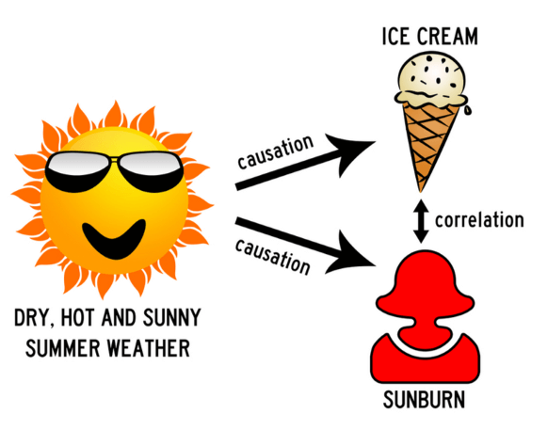
Variable Association
Two variables are associated if the values of one variable provide information (help you predict) the values of the other variable.
But association ≠ causation!

Slide 11
Confounding variable
Sometimes we're forgetting what's right in front of us.
There could be a confounding variable that explains things better.
A confounding variable is associated with both the explanatory variable and the response variable.
its effects on the response cannot be separated from those of the explanatory variable.
Because of this, we can’t draw cause and effect conclusions when confounding variables are present.

Slide 12
Example 4.1: Night Lights and Nearsightedness (1 of 5)
Near-sightedness often develops in childhood
Recent studies looked to see if there is an association between near-sightedness and nightlight use with infants
Researchers interviewed parents of 479 children who were outpatients in a pediatric ophthalmology clinic
Asked parents whether the child slept with the room light on, with a night light on, or in darkness before age 2
Children were also separated into two groups: near-sighted or not near-sighted based on the child’s recent eye examination

Slide 13
Example 4.1: Night Lights and Nearsightedness (2 of 5)
 | Darkness | Night Light | Room Light | Total
Near-sighted | 18 | 78 | 41 | 137
Not near-sighted | 154 | 154 | 34 | 342
Total | 172 | 232 | 75 | 479
The largest count of near-sighted children is from the group who slept in a room with a night light as infants.
Is there a better way to look at the data?
Conditional proportions
18/172 ≈ 0.105 78/232 ≈ 0.336 41/75 ≈ 0.547
(we'll talk more about conditional proportions later!)

Slide 14
Example 4.1: Night Lights and Nearsightedness (3 of 5)
 | Darkness | Night Light | Room Light | Total
Near-sighted | 10.5% 18/172 | 33.6% 78/232 | 54.7% 41/75 | 137
Not near-sighted | 154 | 154 | 34 | 342
Total | 172 | 232 | 75 | 479
Notice that as the light level increases, the percentage of near-sighted children also increases.
We say there is an association between near-sightedness and nightlights.
Two variables are associated if the values of one variable provide information (help you predict) the values of the other variable.

Slide 15
Example 4.1: Night Lights and Nearsightedness (4 of 5)
While there is an association between the lighting condition nearsightedness, can we claim that nightlights and room lights caused the increase in near-sightedness?
Might there be other reasons for this association?

Slide 16
Example 4.1: Night Lights and Nearsightedness (5 of 5)
Could parent’s eyesight be another explanation?
Maybe parents with poor eyesight tend to use more light to make it easier to navigate the room at night and parents with poor eyesight also tend to have children with poor eyesight.
Now we have a third variable of parents’ eyesight
Parents’ eyesight is considered a confounding variable.

Slide 17
Example 4.1: Confounding Variables (1 of 2)
A confounding variable is associated with both the explanatory variable and the response variable.
We say a variable is confounding because its effects on the response cannot be separated from those of the explanatory variable.
Because of this, we can’t draw cause and effect conclusions when confounding variables are present.

Slide 18
Example 4.1: Confounding Variables (2 of 2)
Since confounding variables can be present in observational studies, we can’t conclude causation from these kinds of studies.
This doesn’t mean the explanatory variable isn’t influencing the response variable. Association may not imply causation, but association can be a pretty big hint.

Slide 19
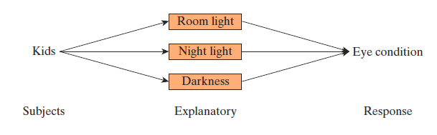
Example 4.1: Diagramming this Study (1 of 2)
Here is the design of the study
The children are sorted into groups according to the explanatory variable
Then the response is measured

Slide 20
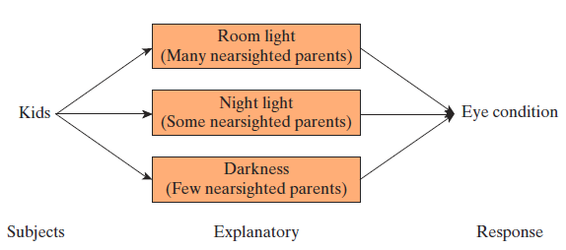
Example 4.1: Diagramming this Study (2 of 2)
Here’s another look with potential confounding effect of the parents’ own vision
The three groups of children differ on the amount of room light, but they may also differ on the quality of their parents’ eyesight

Slide 21
4.2: Observational Studies vs. Experiments

Slide 22
4.2: Observational Studies vs Experiments (1 of 2)
In an observational study, the groups you compare are “just there.” They are defined by what you see rather than by what you do.
For example, the researchers didn’t control which children slept with a nightlight on, or a room light on, or with no light on.
Observational studies may have confounding variables present that prevent us from determining a cause and effect.

Slide 23
Observational Studies vs Experiments (2 of 2)
In an experiment, you actively create the groups and then assign the conditions to be compared.
These conditions may be one or more treatment or a control.
Well-designed experiments can control for confounding variables by making the treatment groups very similar except for what the experimenter manipulates.
Observational units → "experimental" units

Slide 24
Example 4.2: Lying on the Internet (1 of 8)
Step 1. Ask a research question.
Does the Internet encourage lying?
More specifically, the researchers compared two groups of students playing in a competitive game.
Business grad students
Playing a bargaining game

Slide 25
Example 4.2: Lying on the Internet
Each student was randomly assigned to one of two groups.
One group used email as their method of communication. The other used pencil and paper.
Researchers thought that those using email would lie more often about the size of the pot in the game they were playing compared to those using paper and pencil.

Slide 26
Example 4.2: Lying on the Internet
What is the experimental unit?
What is the explanatory variable? Is it categorical or quant.?
What is the response variable? Is it categorical or quant.?

Slide 27
Example 4.2: Lying on the Internet (2 of 8)
Step 2. Design a study and collect data.
The explanatory variable is the communication method (email or paper and pencil) and the response is whether or not the subject lies.
How should the subjects be assigned to the two communication treatments?
What if you had all the males use email and all the females use paper and pencil?
Suppose a larger proportion of those using email lied. If you made the assignment to the groups this way, you wouldn’t know if more lying occurred because of using email or because they are male.

Slide 28
Example 4.2: Lying on the Internet (3 of 8)
Step 2. Design a study and collect data.
When you don’t have a balance of males and a balance of females in each group, a person’s sex could be a confounding variable.
To overcome this, you could assign half the females and half the males to each group.
This study would then be balanced with respect to the possible confounding variable of a person’s sex.

Slide 29
Example 4.2: Lying on the Internet (4 of 8)
Step 2. Design a study and collect data.
Randomly assigning experimental units to groups tends to balance out all the other variables.
Any variable that could have an effect on the response should be equalized between the two groups and therefore should not be confounding.

Slide 30
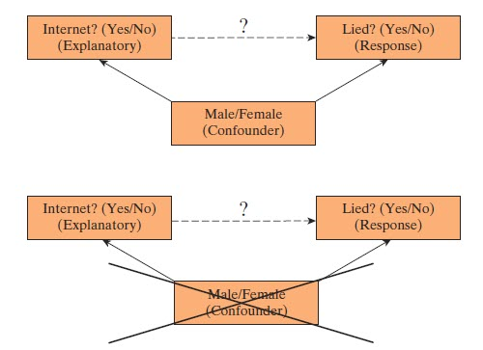
Example 4.2: Lying on the Internet (5 of 8)
Randomization creates approximate balance and tends to eliminate confounding effects.

Slide 31
Example 4.2: Lying on the Internet (6 of 8)
Step 3. Explore the data.
The researchers found that 24 of 26 (92%) who used email were guilty of lying compared to 14 of 22 (64%) who used paper and pencil.
These are called conditional proportions and we will take a closer look at them in Chapter 5.

Slide 32
Example 4.2: Lying on the Internet (7 of 8)
Step 4. Draw inferences beyond the data.
There are two possible explanations for getting a difference in proportions as large as the 64% and 92% that we saw from the data.
1. People felt more comfortable and tend to lie more when using email. In other words the format of the game influenced how people responded.
2. Perhaps the format does not influence the response and it was just luck of the draw that put more “liars” into the email group.
We will see in the next chapter that it’s highly unlikely (p-value ≈ 0.015) that we would get a difference in proportions as large as we did if the second explanation is true.

Slide 33
Example 4.2: Lying on the Internet (8 of 8)
Step 5. Formulate conclusions.
Since the results are statistically significant, we can say we have strong evidence that a larger proportion tend to lie when using email as their method of communication in this game and that the method caused this difference.
We can conclude this causation because random assignment should have balanced out any confounding variables that might be present.
Since the subjects in the study were all business school graduate students, we should be careful on how far we can generalize these results.

Slide 34
Example 4.2: The Big Idea
Confounding variables are controlled in experiments due to the random assignment of subjects to treatment groups.
Randomly assigning people to groups tends to balance out all other variables between the groups.
So variables that could have an effect on the response should be equalized between the two groups and therefore should not be confounding.
Thus, cause and effect conclusions are possible in experiments through random assignment. (It must be a well-run experiment.)

Slide 35
Example 4.2: Random vs Random
With observational studies, random sampling is often used. This possibly allows us to make inferences from the sample to the population from which the sample was drawn.
With experiments, random assignment is often used. This allows us to possibly conclude causation.

Slide 36
Example 4.2: Blocking and Random Assignment
The goal in random assignment is to make two groups as similar as possible.
Sometimes there are characteristics (or variables) of subjects that you can see, and you can block on these variables.
Make each group have the same characteristics of your subjects.

Slide 37
Example 4.2: Blocking and Random Assignment
For example, if our subjects consist of 60% females and 40% males, we can force each group to consist of 60% female and 40% male.
So block when you can, but when you can’t (which is most of the time) randomly assign subjects to groups to make them as similar as possible.

