Slide 1
Introduction to Statistical Investigations
Second Edition
Tintle, Chance, Cobb, Rossman, Roy, Swanson, VanderStoep
Chapter 2.2, 2.3
Generalization: How Broadly Do the Results Apply?
Quantitative Data / Inference for a Single Quantitative Variable
This slide deck contains animations. Please disable animations if they cause issues with your device.
Copyright ©2021 John Wiley & Sons, Inc.

Slide 2
Warm Up
Let's say you want to find out how many hours SMC students sleep. You want to find out if the average number of hours all students sleep is less than 8.
A. How would you obtain a sample?
B. What variable would you measure on each student? Is it quantitative, or categorical?
C. Give an example of convenience sampling in this scenario.
D. Give an example of simple random sampling in this scenario.

Slide 3
Example 2.2
Sampling Students
Last time we looked at the categorical variable “whether or not the student lives on campus” for all students living in a small midwestern college.
We will now look at the quantitative variable “cumulative GPA” for all students enrolled that particular semester.
✅/❎ vs. 📈

Slide 4
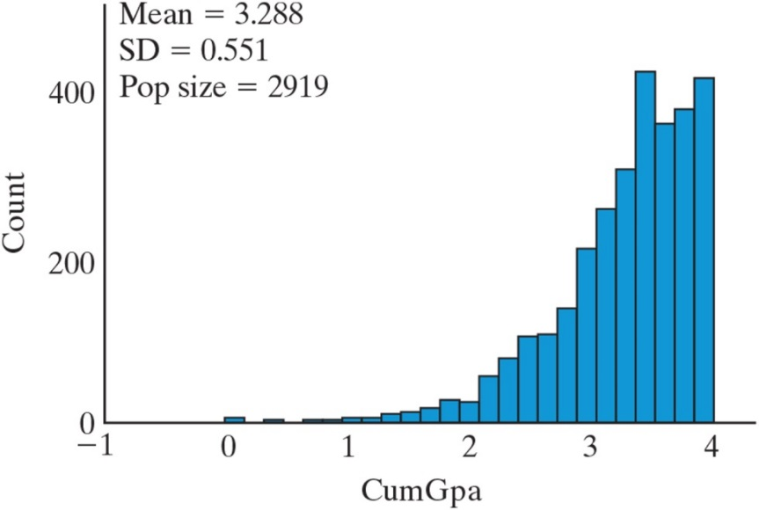
Example 2.2: Sampling Students (1 of 2)
The registrar gave us all 2,919 students' cumulative GPAs.
Here's the distribution:

Slide 5
Example 2.2: Skewed
A distribution of data is skewed if it is not symmetric
Bulk of the values tend to fall on one side of the distribution with the “longer tail”
Right-skewed distributions have their longer tail on the right.
Left-skewed distributions have their longer tail on the left.
The distribution of cumulative GPAs is highly skewed to the left.
Skew = the long tail

Slide 6
Example 2.2: Median
Sort the data from smallest to largest → Grab the middle value
Middle value is known as the median.
The median of the GPA data is 3.41 (the 1460th observation) in the sorted GPAs.
So half the students have a GPA of 3.41 or higher.
The mean of the distribution is lower at 3.288.
The mean gets pulled in the direction of the skewness compared to the median.

Slide 7
Example 2.2: Standard Deviation
Remember that often we think of standard deviation as the “typical” distance from the mean.
But we should be cautious in doing this with a skewed distribution like we have.
The mean isn't where it is on the normal distribution!

Slide 8
Example 2.2: Symbols
Population mean: μ (“mu”)
Mean is just "average" – easy to compute wherever we are.
Population standard deviation: σ (“sigma”)
The population mean GPA is μ =3.288
The population standard deviation GPA is σ = 0.551.
These numbers come from the applet

Slide 9
Example 2.2: Sample of 30 Students (1 of 2)
Let’s pretend we didn’t have access to the population, but only this random sample of 30 student GPAs.
ID | Cum GPA | ID | Cum GPA | ID | Cum GPA
827 | 3.44 | 844 | 3.59 | 825 | 3.94
1355 | 2.15 | 90 | 3.30 | 2339 | 3.07
1455 | 3.08 | 1611 | 3.08 | 2064 | 3.48
2391 | 2.91 | 2550 | 3.41 | 2604 | 3.10
575 | 3.94 | 2632 | 2.61 | 2147 | 2.84
2049 | 3.64 | 2325 | 3.36 | 2590 | 3.39
895 | 2.29 | 2563 | 3.02 | 1718 | 3.01
1732 | 3.17 | 1819 | 3.55 | 168 | 3.04
2790 | 2.88 | 968 | 3.86 | 1777 | 3.83
2237 | 3.25 | 566 | 3.60 | 2077 | 3.46

Slide 10
Example 2.2: Symbols for Samples
Sample mean: (“x-bar”)
Sample standard deviation: s (“s”)

Slide 11
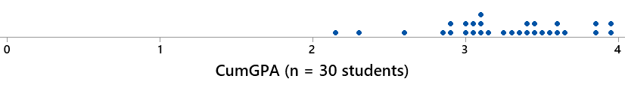
Example 2.2: Sample of 30 Students (2 of 2)
Because we have a random sample, our sample shares some characteristics of the population. (which we know because the registrar gave us the graph)
The sample distribution is also skewed left (see graph below).
The sample mean is
and the sample SD is s = 0.438.
We'll worry about how we got the SD later.

Slide 12
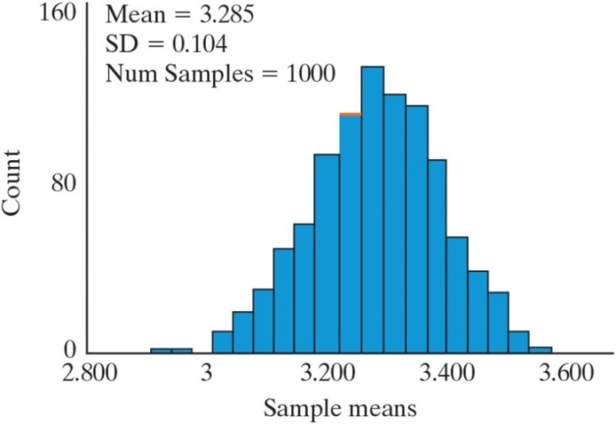
Example 2.2: Sampling Students (2 of 2)
We know if we took a different sample of 30 students we would probably get a different mean.
We want to know how these sample means might differ
We took 1,000 random samples of 30 students and the graph shows the 1,000 mean GPAs from these samples.

Slide 13
Example 2.2: Central Limit Theorem (1 of 2)
The shape of the distribution of sample means is approximately normal even though the population was quite skewed.
The Central Limit Theorem for sample means implies that the distribution of sample means is approximately normal when the sample size is large.
It appears as though a sample size of 30 is large enough.
If the population distribution is not highly skewed, the distribution of sample means will be approximately normal if the sample size is at least 20.

Slide 14
Example 2.2: Mean of the GPAs
The mean of our 1,000 GPAs was 3.285.
This is quite similar to the population mean of 3.288.
If we had an actual sampling distribution, instead of just 1,000 samples, these means would match exactly.

Slide 15
Example 2.2: Standard Deviation of GPAs
The standard deviation of our 1,000 samples was 0.104.
Much smaller than the population SD of 0.551.
This too, can be predicted. The SD of the sample means is predicted to be
in our case.

Slide 16
Example 2.2: Central Limit Theorem (2 of 2)
When taking random samples from a large population (more than 20 times the size of the sample), the distribution of sample means will:
Center around the population mean (μ)
Have a standard deviation smaller than the population,
Central Limit Theorem: The distribution of sample means will be approximately normal when the sample size is large (or if the population distribution is normally distributed)

Slide 17
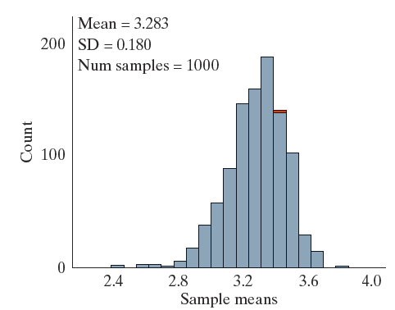
Example 2.2: What if the sample size was small?
We took 1,000 samples of size 10 from the population.
We do not get a symmetric distribution of sample means.
This distribution is slightly skewed to the left

Slide 18
Section 2.2: Summary
With quantitative variables, sometimes the distribution is skewed, and has a tail.
Skewed left = the tail is on the left
Skewed right = the tail is on the right.
If we sort all the values we obtained, we can choose the middle value to get the median.
If we sample, we can computer the population mean and the standard deviation.
If our sample is large enough, >20, we can assume the variable will be approximately normal, then use the Central Limit Theorem.

Slide 19
Section 2.3
Inference for a Single Quantitative Variable
We will explore how to use the information from the previous section to carry out a theory-based test for a population mean.

Slide 20
Example 2.3: Estimating Elapsed Time
How long do you think a song is?
Students in a stats class (for their final project) collected data on students’ perception of time
Subjects were told that they’d listen to music and then be asked questions when it was over.
The researchers played 10 seconds of the Jackson 5’s “A B C” and asked how long they thought it lasted
Can students accurately estimate the length?

Slide 21
Example 2.3: Hypotheses
Null Hypothesis: People will accurately estimate the length of a 10 second-song snippet, on average.
Alternative Hypothesis: People will not accurately estimate the length of a 10 second-song snippet, on average.

Slide 22
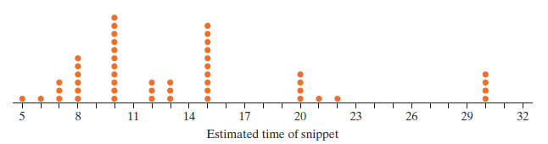
Example 2.3: Displaying Data
A sample was recorded of 48 students on campus, each answering how long they estimated the song length to be.
What does a single dot represent?
What are the observational units? Variable?

Slide 23
Example 2.3: Skewed, mean, median
The distribution obtained is not symmetric but is right skewed.
Remember that when data are skewed right, the mean gets pulled out to the right while the median is more resistant to this.
Also notice there are spikes at 10 and 15 seconds.

Slide 24
Example 2.3: Mean vs Median
The mean is 13.71 and the median is 12.
How would these numbers change if one of the people that gave an answer of 30 seconds actually said 300 seconds?
The standard deviation is 6.5 sec. Is it resistant to outliers?

Slide 25
Example 2.3: Inference (1 of 3)
Can we generalize the results of this study to all college students in the population?
Would all college students, on average, overestimate the actual length of the snippet (10 seconds)?
Was the sample randomly drawn from a population of all college students? No.
Is there an obvious reason to believe that these 48 students would estimate the length that much differently than the rest of the population? Probably not.
So we will proceed as though we do have a representative sample.

Slide 26
Example 2.3: Inference (2 of 3)
Our problem now is, how do we develop a null distribution? (The second S in our 3S strategy.)
Flipping coins and spinning spinners will not work to model what would happen under a true null hypothesis.
Let’s look at two ways to do this (the first way is really just a way to think about how this can be done).

Slide 27
Example 2.3: Inference (3 of 3)
We don’t have population data.
More specifically, we don’t have population data that reflects our null hypothesis where μ = 10 seconds.
All we have is our sample of 48.

Slide 28
Example 2.3: Simulation-Based Inference (1 of 6)
We need to create a population based on what we know about our sample and what we want the mean to be.
We need to come up with a large data set that we think our population of time estimates might look like under a true null.
We might assume the population is skewed (like our sample) and has a standard deviation similar to what we found in our sample but has a mean of 10 seconds.

Slide 29
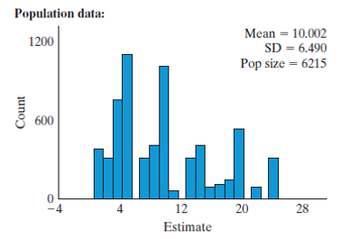
Example 2.3: Simulation-Based Inference (2 of 6)
Invent a population of values with a mean of 10.
Repeatedly, take random samples from that population to simulate what samples could look like when the null hypothesis is true.
Here’s simulated population data like what we need.
It has a similar shape and SD to that of the sample.
Notice, however, the mean of this distribution matches the value in the null hypothesis. (Which is what we want to develop a null distribution.)

Slide 30
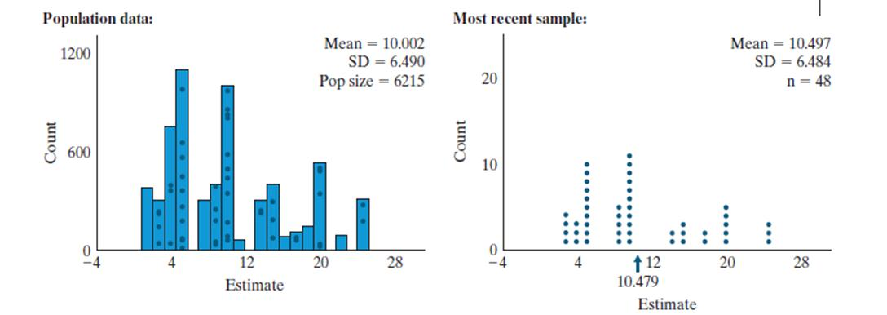
Example 2.3: Simulation-Based Inference (3 of 6)
To develop a distribution of statistics (sample means) that could have happened if the null was true, we start to take samples of size 48 from our made-up population.

Slide 31
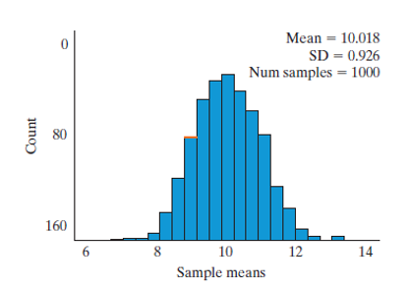
Example 2.3: Simulation-Based Inference (4 of 6)
Then repeat this so we develop a distribution of 1,000 sample means that could have happened if the null was true.

Slide 32
Example 2.3: Simulation-Based Inference (5 of 6)
Notice that this distribution of sample means is bell-shaped, centered on the value of the null, has a standard deviation much smaller than that of the population standard deviation.
Also notice that the sample mean of 13.71 seconds never occurred, so we have a p-value of about 0.
What’s the standardized statistic?
What’s our conclusion?

Slide 33
Example 2.3: Simulation-Based Inference (6 of 6)
Doing this simulation-based test for a single mean requires that we make a guess as to what the population distribution looks like.
We did that to develop a distribution of simulated statistics.
But can we predict what this distribution of simulated statistics is going to look like without developing a population distribution?
Do we know what shape it will have? What its mean should be? What its standard deviation should be?

Slide 34
Example 2.3: Theory-Based Test (1 of 3)
The answer is yes to all these.
In fact, creating a population each time we want to run a test of significance is extremely time consuming and cumbersome. (So this will be the only time we will do it.)
In practice we will test a single mean using a theory-based test.

Slide 35
Example 2.3: Theory-Based Test (2 of 3)
As long as the sample size is large enough, we will see that we can predict the shape, center, and variability of a distribution of sample statistics given we just have a sample and not a population.
The distribution of sample statistics:
Should be centered at the value under the null
If the sample size is large enough, it will be bell-shaped.
We have seen that the standard deviation should be
or
in our case.

Slide 36
Example 2.3: Theory-Based Test (3 of 3)
Since we don’t know the population standard deviation, our best guess as to its value is the sample standard deviation.
So we will predict our distribution of statistics that could have happened if the null was true will have a standard deviation of (s is the sample standard deviation)
Because of this extra unknown (the population standard deviation) we will not use a normal distribution to approximate the distribution of sample statistics but will use a t-distribution.

Slide 37
Example 2.3: t-distribution
The shape of a t-distribution is very similar to a normal distribution.
The t-distribution has slightly “heavier” tails than a normal distribution.
The t-statistic is the standardized statistic we use with a single quantitative variable and can be found using the formula:
(standard deviation of our sample divided by the square root of the sample size) is called the standard error and is an estimate for the standard deviation of the null distribution. (Notice that this formula has the same form as the one we used to determine the standardized statistic for a single proportion.)
The

Slide 38
Example 2.3: t-statistic
The t-statistic for our example is:
With a standardized statistic of 3.95, we have strong evidence against the null.
We can still use the rule that a standardized statistic more than 2 or less than negative 2 provides strong evidence against the null.

Slide 39
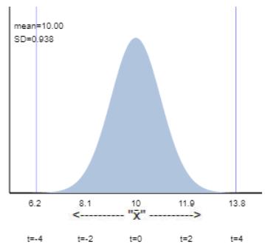
Example 2.3: t-distribution and t-statistic
Here is a theoretical t-distribution for our example.
Notice that our statistic of 13.71 seconds is way out in the tail of the distribution.
Also notice the mean and SD of this distribution. How were these determined?

Slide 40
Example 2.3: Validity Conditions
The theory-based test for a single mean requires: That you have a symmetric sample distribution, or a sample size of at least 20 and the sample distribution is not strongly skewed.
In practice we can use the theory-based applet to run this test. We can either enter the raw data or the sample size, sample mean, and sample standard deviation.
(See results on the following slide.)

Slide 41
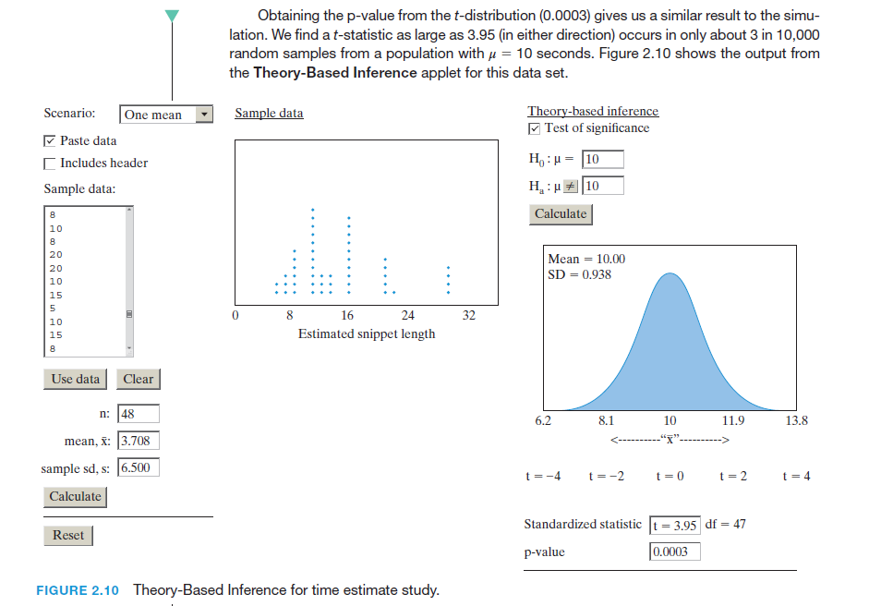
Example 2.3: Theory-based Applet: One Mean Scenario

Slide 42
Example 2.3: Estimating Time Conclusions
Formulate Conclusions.
Based on our small p-value, we can conclude that people don’t accurately estimate the length of a 10-second song snippet and in fact they overestimate it.
To what larger population can we make our inference?

Slide 43
Example 2.3: Summary
When we test a single quantitative variable, our hypotheses have the following form:
We will get our data (or mean, sample size, and S D for our data) and use the Theory-Based Inference applet to determine the p-value.
The p-value we get with this test has the same general meaning as those from a test for a single proportion.

Slide 44
Example 2.3: Decision Errors (1 of 3)
When we make a conclusion based on a test of significance, hopefully we made the correct decision.
However, perhaps we didn’t.
In other words, we made a decision that is in error.
We usually don’t know if we made a decision error, but let’s look closer at the two types of decision errors we could have made.

Slide 45
Example 2.3: Decision Errors (2 of 3)
We rejected the null hypothesis in this study, does that mean that we’ve proven that the population mean is not equal to 10 seconds?
If the null was true and μ = 10 seconds, (and we assume we had a random sample), we still could have been very unlikely and obtained a sample with too many over-estimators.
This means we would have found strong evidence that people can’t estimate the song snippet correctly, on average, when in fact they can.
This is a decision error we could have made.

Slide 46
Example 2.3: Decision Errors (3 of 3)
What about the opposite case?
What if we tested H₀: μ = 13 seconds (and with our statistic of 13.71 seconds) our p-value had been large so that we did not reject the null hypothesis?
Would we have proven students, on average, estimate the song snippet as being 13 seconds long?
We would not have strong evidence against the null, but suppose the null was not true.
This is another type of decision error that we could have made.

Slide 47
Cool-Down
Poll the class for how many hours of sleep they get.
A representative of each row should report individual data points for their entire row.
We'll plug this data into the applet next time to explore.

