Slide 1
Introduction to Statistical Investigations
Second Edition
Tintle, Chance, Cobb, Rossman, Roy, Swanson, VanderStoep
Chapter 00
Preliminaries
This slide deck contains animations. Please disable animations if they cause issues with your device.
Copyright ©2021 John Wiley & Sons, Inc.

Slide 2
Consider these statements.
“I will never start jogging because my friend’s dad jogged his whole life, but he died at age 46 from a heart attack.”
“Don’t get your child vaccinated. I had my child vaccinated and now he is autistic.”
Turn and talk: Are these scientific conclusions?
They make broad conclusions…
…But use anecdotal evidence to do so.
  Personal observations
  Striking examples

Slide 3
Statistics
We need scientific conclusions.
Scientific conclusions cannot be based on anecdotal evidence.
We need evidence from a well-collected data set.

Slide 4
Statistics
Statistics is the science of:
  producing useful data to address a research question,
  analyzing the resulting data, and
  drawing appropriate conclusions from the data.
We boil this process down into 6 steps, called the "Statistical Investigation Method".

Slide 5
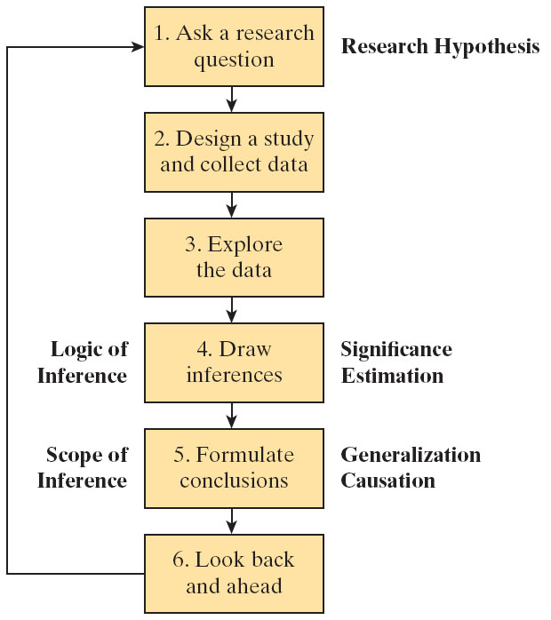
Six-Step Statistical Investigation Method

Slide 6
Opt-in vs. Opt-out
Suppose we are putting together a "SMC Statistics Directory", so everyone in Stats classes can contact each other.
Turn and talk: What is the difference between opting in to be in this directory, versus opting out of it?
Opt-in: You must make a choice to be included.
Opt-out: You must make a choice to be excluded.
Do you think the method chosen affects how many people will sign up?

Slide 7
Example P.1: Organ Donations
A majority of people approve of organ donation.
But depending on the location, people may not sign up.
The method used to recruit donors (opt-in vs. opt-out) varies depending on where you live.
Do these different methods result in different sign-up rates?
Let's look at a 2003 study to answer this question.

Slide 8
Example P.1: Recruiting Organ Donors (1 of 7)
Step 1: Ask a Research Question
In general:
Is there a method that will increase the likelihood that a person agrees to become an organ donor?
More specifically:
Does the default option presented to driver’s license applicants influence the likelihood of someone becoming an organ donor?

Slide 9
Example P.1: Recruiting Organ Donors (2 of 7)
Step 2: Design a study and collect data
The researchers decided to recruit various participants and ask them to pretend to apply for a new driver’s license.
Participants did not know what the focus of the study was.
The researchers gave different options for the donor question, but the participants did not know this.

Slide 10
Example P.1: Recruiting Organ Donors (3 of 7)
Step 2: Design a study and collect data
Participants were provided one of three recruitment options:
Neutral: No choice was pre-selected. Participants were forced to make a choice, become a donor or not.
Opt-in: Participants were told that the default option was not to be a donor. They could choose to become a donor if they wished.
Opt-out: Participants were told that the default option was to be a donor. They could choose not to become a donor if they wished.
The participants completed the survey.

Slide 11
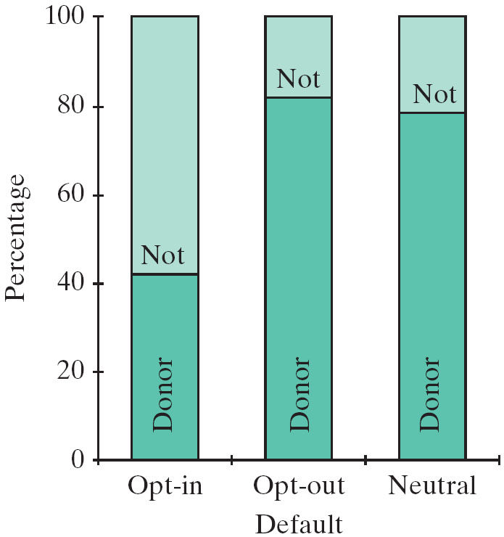
Example P.1: Recruiting Organ Donors (4 of 7)
Step 3: Explore the data.
23 of 55 (41.8%) participants in the opt-in group agreed to become organ donors
41 of 50 (82.0%) participants in the opt-out group agreed to become organ donors
44 of the 56 (78.6%) participants in the neutral group agreed to become organ donors

Slide 12
Example P.1: Recruiting Organ Donors (5 of 7)
Step 4: Draw inferences beyond the data.
The researchers analyzed whether the observed differences between the groups was large enough to indicate that the default option had a genuine effect.
They reported strong evidence that the neutral and opt-out versions do lead to a higher chance of agreeing to become a donor.
They could be quite confident that the neutral version increases the chances that a person agrees to become a donor by between 20 and 54 percentage points.
This difference is large enough to save thousands of lives per year in the United States.

Slide 13
Example P.1: Recruiting Organ Donors (6 of 7)
Step 5: Formulate conclusions.
Based on the analysis of the data and the design of the study, the researchers concluded that…
The neutral version causes an increase in the proportion who agree to become donors over the opt-in.
But the participants in the study were volunteers recruited from bulletin boards on the internet.
Generalizing conclusions beyond these participants is only legitimate if they are representative of a larger group of people.
(The authors believed their sample included a “broad range of demographics.”)

Slide 14
Example P.1: Recruiting Organ Donors (7 of 7)
Step 6: Look back and ahead.
Limitation: Participants were asked to imagine how they would respond. May not mirror what they'd do in real life.
If we could do it over again:
Look at people’s actual responses to questions about organ donation or could monitor donor rates for states that adopt a new policy.
Examine whether presenting educational material on organ donation might increase people’s willingness to donate.
Include participants from wider demographic groups than these volunteers.

Slide 15
Terminology
Data: Values measured or categories recorded.
Observational units: The individual entities on which data are recorded.
  (who or what do we observe, to get this data?)
Variables: The recorded characteristics of the observational units.
Variables can be:
  Quantitative
    You can add, subtract, etc. with the values.
    Height, weight, distance, time…
  Categorical
    Labels for which arithmetic does not make sense.
    Sex, ethnicity, eye color…

Slide 16
What are the observational units and variables in the Organ Donation Study?
Observational units: The participants.
Variables:
  The version of the question they received. [Categorical]
  Whether or not they became an organ donor. [Categorical]

Slide 17
More Terminology
The distribution of a variable describes the pattern of value/category outcomes.
For the organ donation study the bar chart shown displays the distribution of responses.

Slide 18
Learning objectives for P.1
Describe how the six steps of a statistical investigation apply to a particular statistical study.
Think of and write research questions that could be investigated with a statistical study.
Identify the observational units and variables in a statistical study.
Classify variables as categorical or quantitative.

Slide 19
Time for an Exploration!

